Slide 1
EBI web resources I: databases and tools
Yanbin Yin
Fall 2014

Slide 2
Outline
Intro to EBI
Databases and web tools
UniProt
Gene Ontology
Hands on Practice
MOST MATERIALS ARE FROM: http://www.ebi.ac.uk/training/online/course-list

Slide 3
Three international nucleotide sequence databases

Slide 4
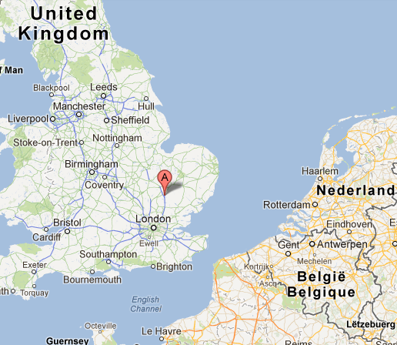
The European Bioinformatics Institute (EBI)
Created in 1992 as part of European Molecular Biology Laboratory (EMBL)
EMBL was created in 1974 and is a molecular biology research institution supported by 20 European countries and Australia
Wellcome Trust Genome Campus, Hinxton,Cambridge, UK
Neighbor of Wellcome Trust Sanger Institute

Slide 5
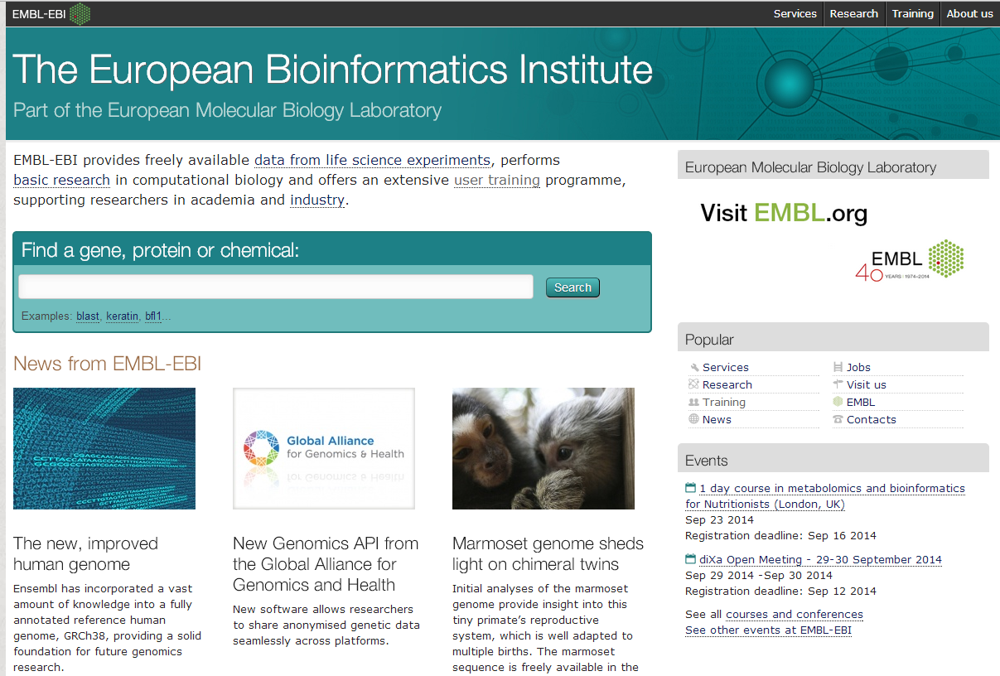
http://www.ebi.ac.uk/

Slide 6
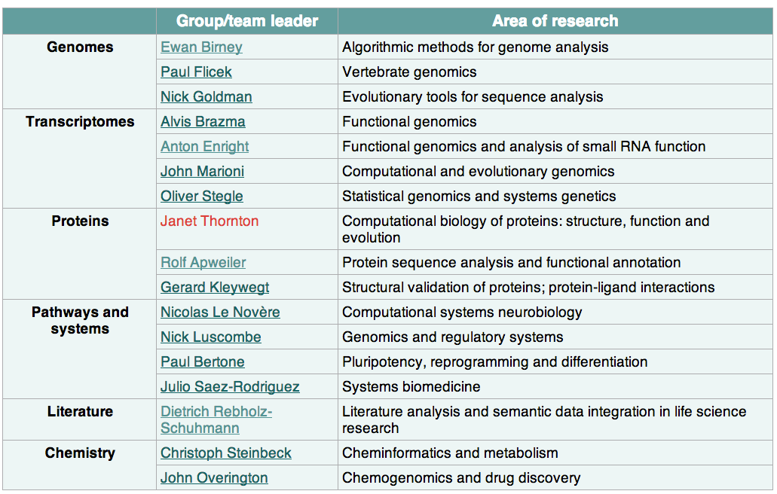
Research groups in EBI
InterPro
miRBase
UniProt

Slide 7
Major databases in EBI
GenBank
Genome MapView
GEO
GenPept (nr)
CDD
MMDB
EMBL-Bank (DNA and RNA sequences)
Ensembl (genomes)
ArrayExpress(microarray-based gene-expression data)
UniProt (protein sequences)
InterPro(protein families, domains and motifs)
PDBe (macromolecular structures)
Others, such as
IntAct (protein–protein interactions)
Reactome (pathways)
ChEBI (small molecules)
IntEnz (enzyme classification)
GO (gene ontology)
Swiss Institute of Bioinformatics
Sanger Institute

Slide 8
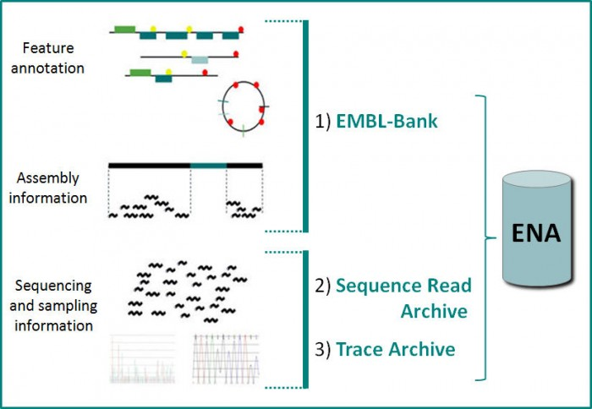
http://www.ebi.ac.uk/training/online/course/nucleotide-sequence-data-resources-ebi
chromatograms

Slide 9
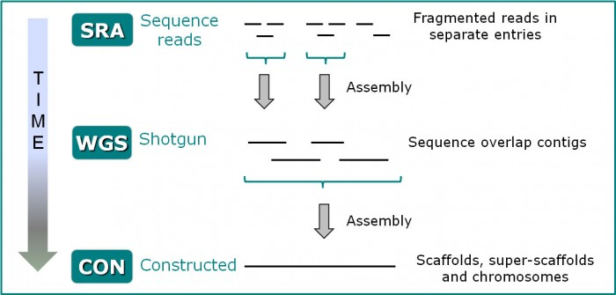
Sequence might first enter ENA as SRA (Sequence Read Archive) fragmented sequence reads; it might be re-submitted as assembled WGS (Whole Genome Shotgun) sequence overlap contigs; it might be re-submitted again with further assembly as CON (Constructed) sequence entries, with the older WGS entries being consigned to the Sequence Version Archive

Slide 10
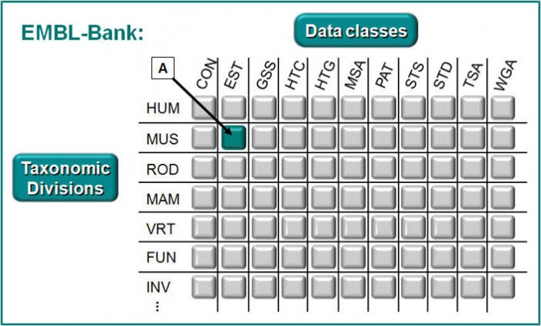
Data is first split into classes, then it is split into intersecting slices by taxonomy

Slide 11
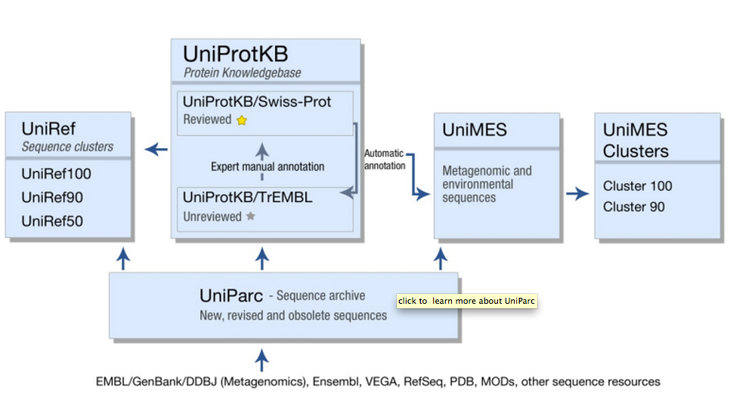
UniProt

Slide 12
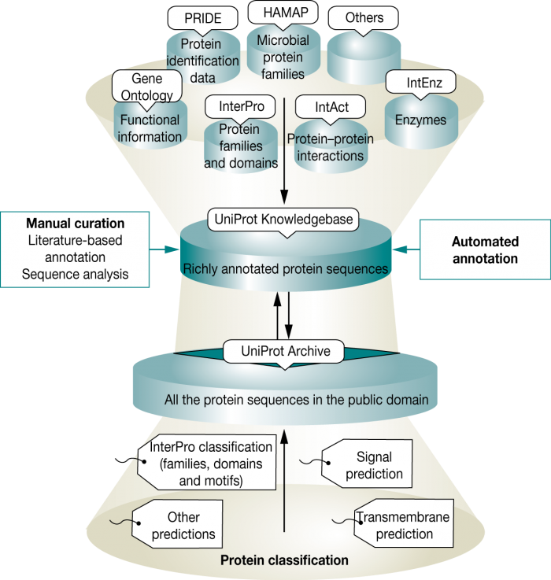
Sources of annotation for the UniProt Knowledgebase

Slide 13
Curation generation
http://cys.bios.niu.edu/yyin/teach/PBB/Bioinformatics%20Curation%20generation.pdf
Life as a Scientific Curator
http://www.ebi.ac.uk/about/jobs/career-profiles/scientific-curator
Scientific Database Curator job : Cambridge, United Kingdom
http://www.nature.com/naturejobs/science/jobs/444213-scientific-database-curator

Slide 14
Hands on practice 1: UniProt

Slide 15
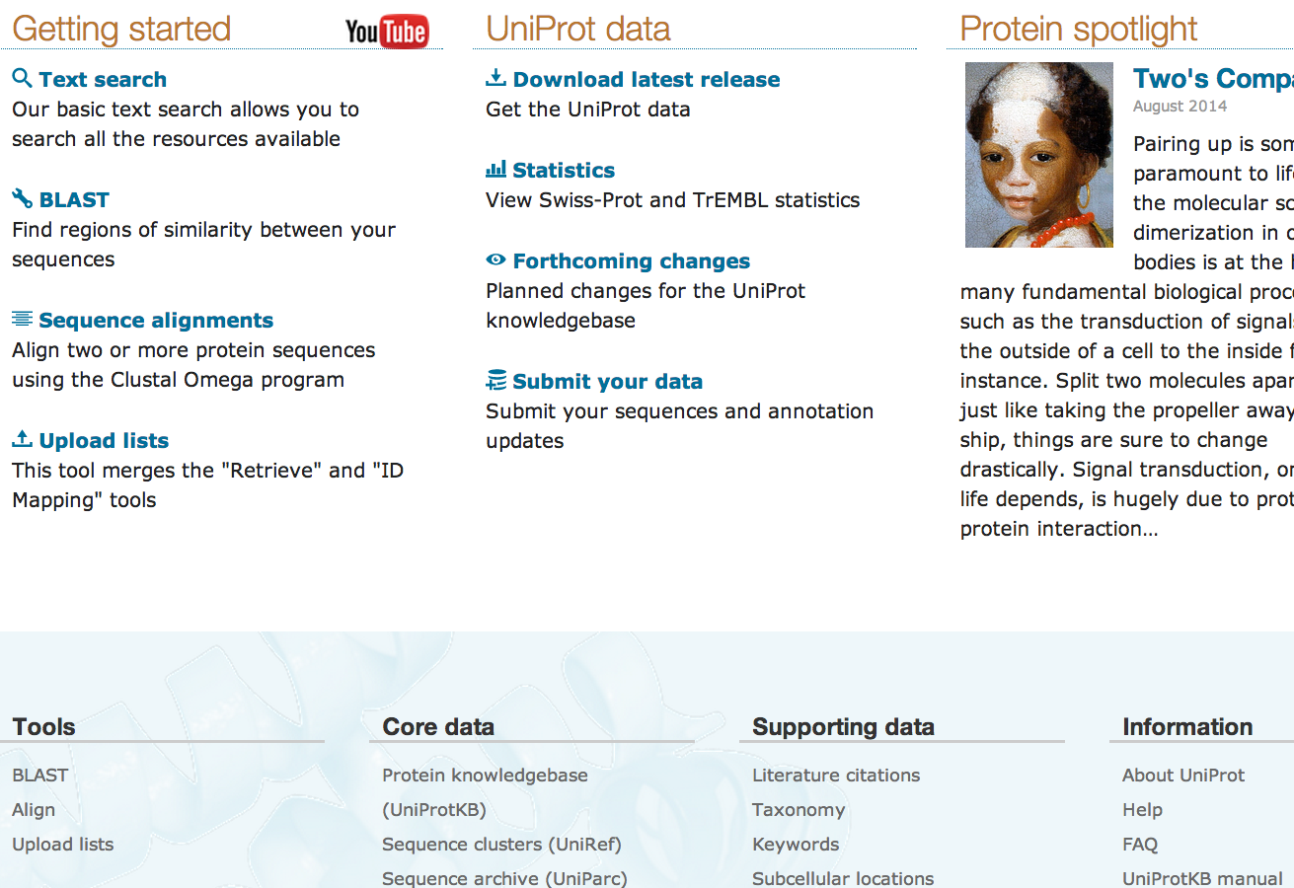
www.uniprot.org
http://www.uniprot.org/help/about
http://www.uniprot.org/docs/uniprot_flyer.pdf

Slide 16
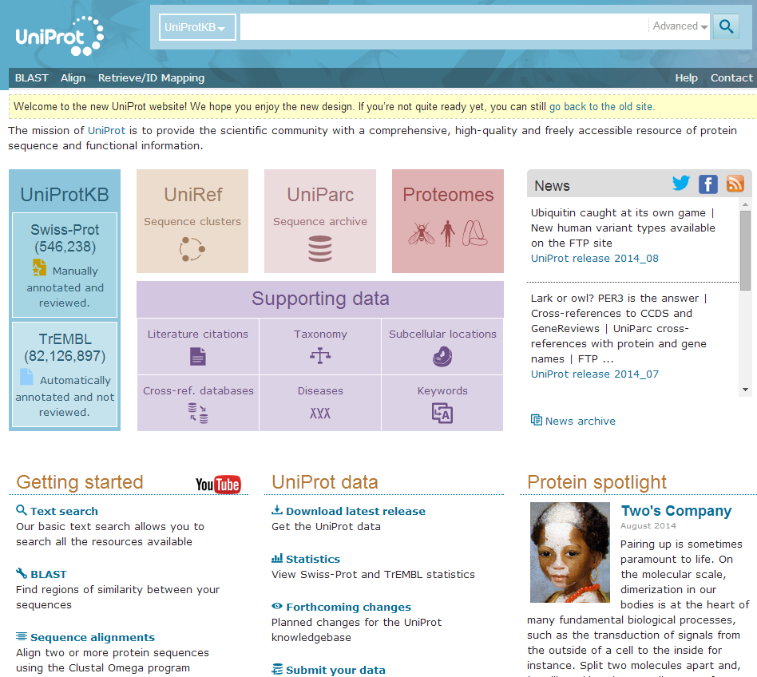
We are going to do ID mapping

Slide 17
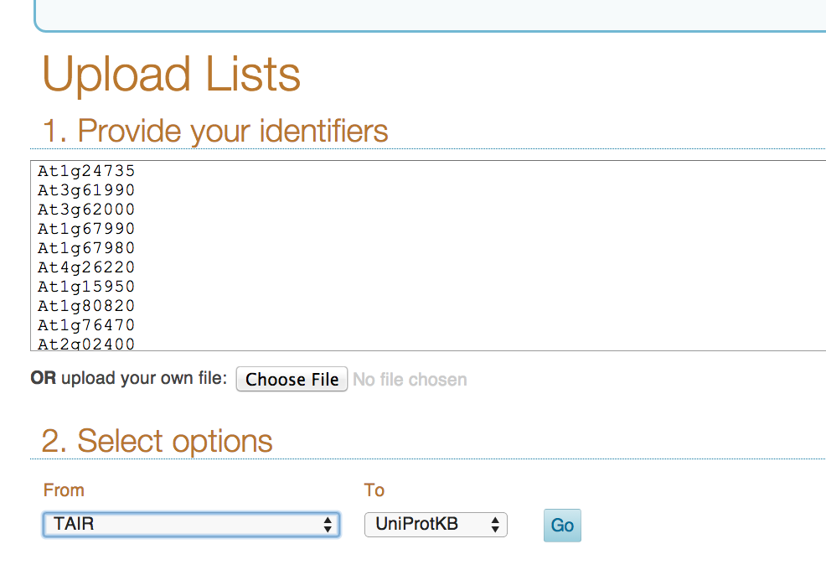
http://cys.bios.niu.edu/yyin/teach/PBB/at-id.txt
Choose TAIR here and UniProtKB here

Slide 18
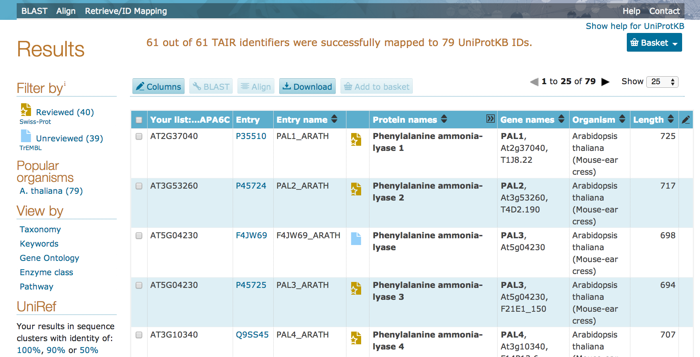
These are UniProt IDs

Slide 19
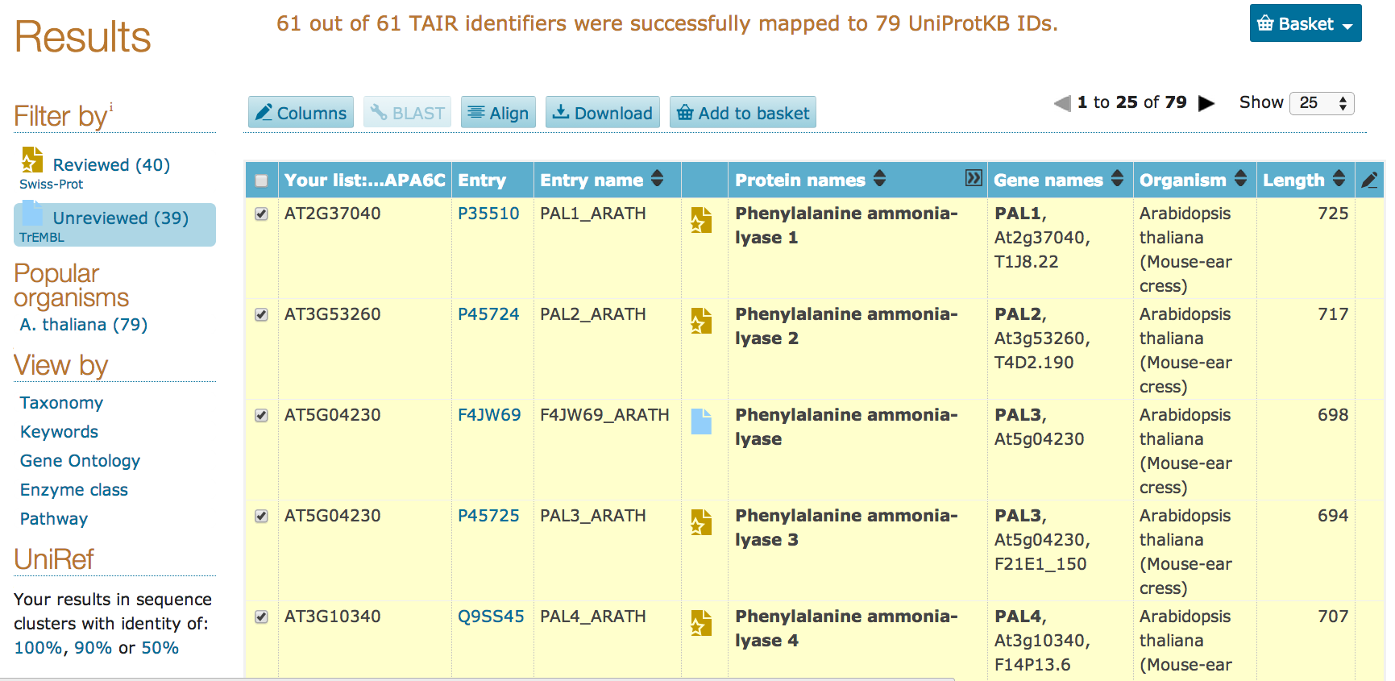
Select the PAL proteins and align them
Clustal omega program will be called to alignment the selected protein seqs
May take 1 min to finish

Slide 20
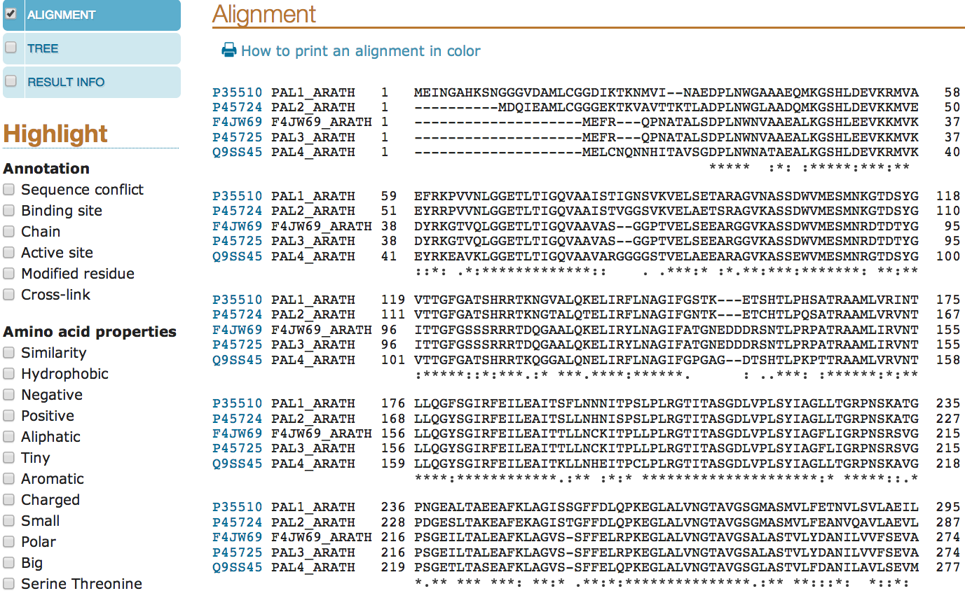
This is the MSA result page
Toggle these options on will add colors in the alignment

Slide 21
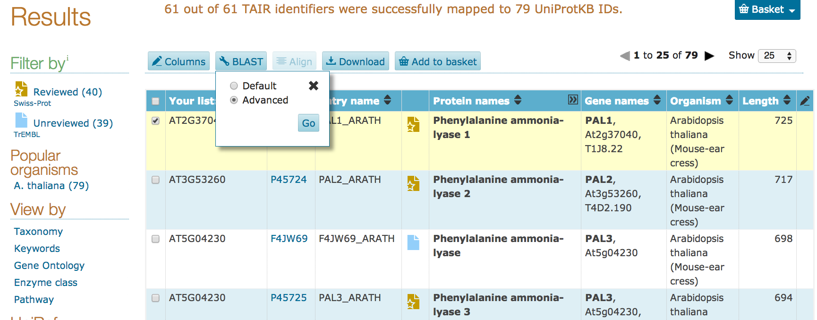
Go back to the protein list page
Selecting one protein will enable the BLAST button
Choose advanced will allow to change BLAST parameters

Slide 22
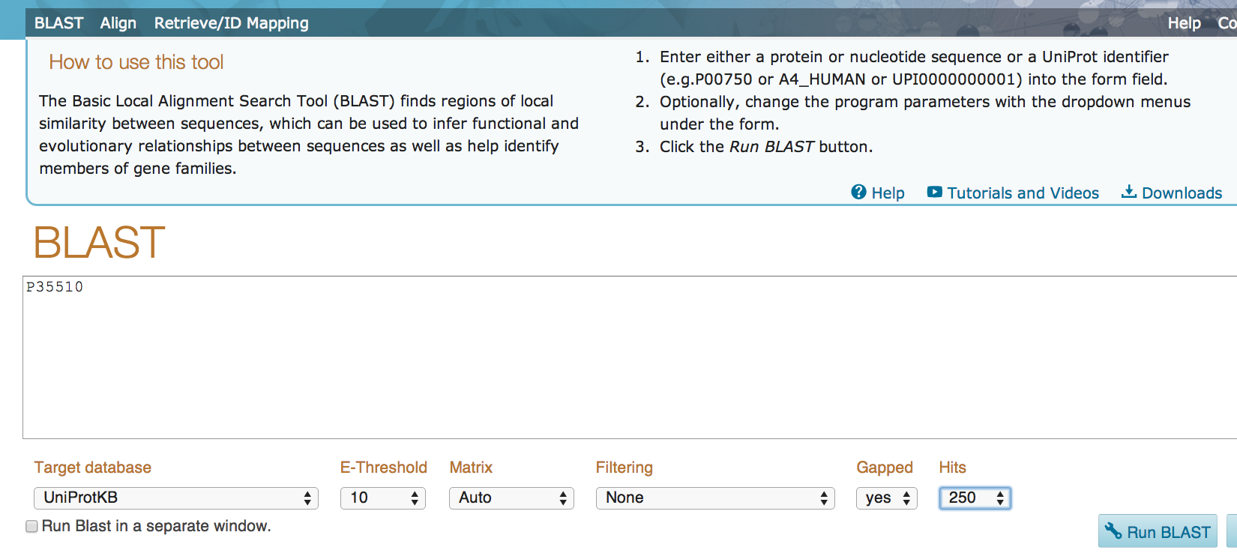
Here you can make changes

Slide 23
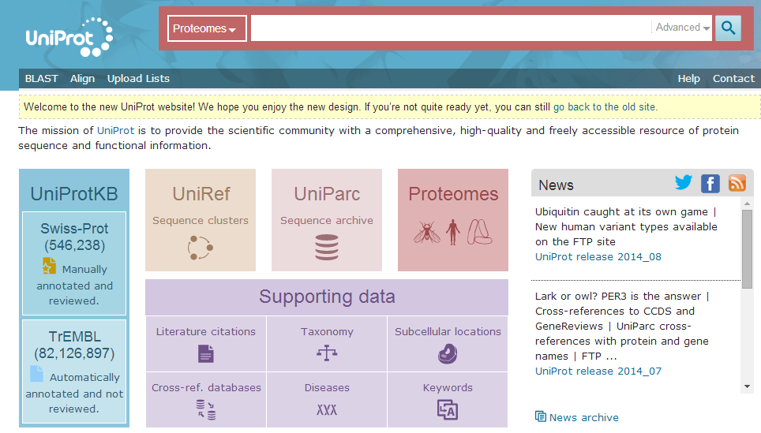
We are going to search UniProt proteomes for human protein set
Click on Advanced you will see a pop-out window
Here you can specify search terms

Slide 24
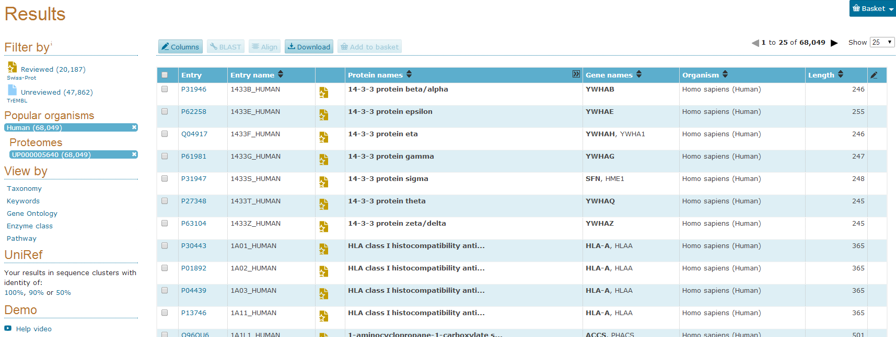
Click here to get help
Click here to open a new page

Slide 25
Gene Ontology
http://geneontology.org/page/documentation
The Gene Ontology (GO) project is a collaborative effort to address the need for consistent descriptions of gene products in different databases
The project began as a collaboration between three model organism databases, FlyBase (Drosophila), the Saccharomyces Genome Database (SGD) and the Mouse Genome Database (MGD), in 1998
Three structured controlled vocabularies (ontologies) that describe gene products in terms of their associated biological processes, cellular components and molecular functions in a species-independent manner.
There are three separate aspects to this effort:
1, the development and maintenance of the ontologies themselves;
2, the annotation of gene products, which entails making associations between the ontologies and the genes and gene products in the collaborating databases; and
3, development of tools that facilitate the creation, maintenance and use of ontologies.

Slide 26
The scope of GO
Gene Ontology covers three domains:
cellular component, the parts of a cell or its extracellular environment;
molecular function, the elemental activities of a gene product at the molecular level, such as binding or catalysis;
biological process, operations or sets of molecular events with a defined beginning and end, pertinent to the functioning of integrated living units: cells, tissues, organs, and organisms
GO is not a database of gene sequences, nor a catalog of gene products. Rather, GO describes how gene products behave in a cellular context.
GO is not a dictated standard, mandating nomenclature across databases. Groups participate because of self-interest, and cooperate to arrive at a consensus.
GO is not a way to unify biological databases (i.e. GO is not a 'federated solution'). Sharing vocabulary is a step towards unification, but is not, in itself, sufficient.

Slide 27
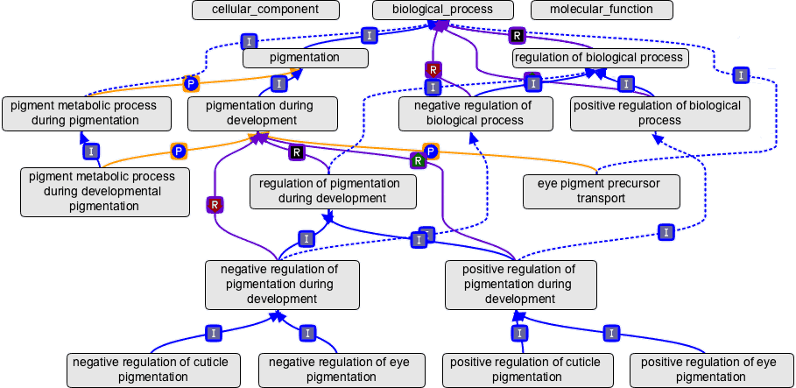
The structure of GO can be described in terms of a graph, where each GO term is a node, and the relationships between the terms are edges between the nodes. GO is loosely hierarchical, with 'child' terms being more specialized than their 'parent' terms, but unlike a strict hierarchy, a term may have more than one parent term
http://geneontology.org/page/ontology-structure

Slide 28
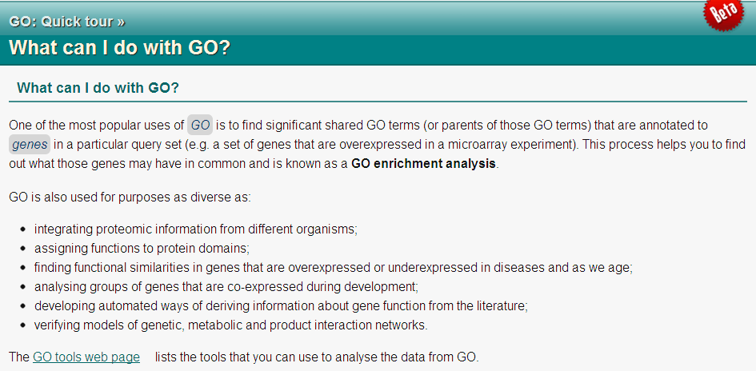
id: GO:0000016
name: lactase activity namespace: molecular_function
def: "Catalysis of the reaction: lactose + H2O = D-glucose + D-galactose." [EC:3.2.1.108]
synonym: "lactase-phlorizin hydrolase activity" BROAD [EC:3.2.1.108]
synonym: "lactose galactohydrolase activity" EXACT [EC:3.2.1.108]
xref: EC:3.2.1.108
xref: MetaCyc:LACTASE-RXN
xref: Reactome:20536
is_a: GO:0004553 ! hydrolase activity, hydrolyzing O-glycosyl compounds
http://www.ebi.ac.uk/training/online/course/go-quick-tour/what-can-i-do-go

Slide 29
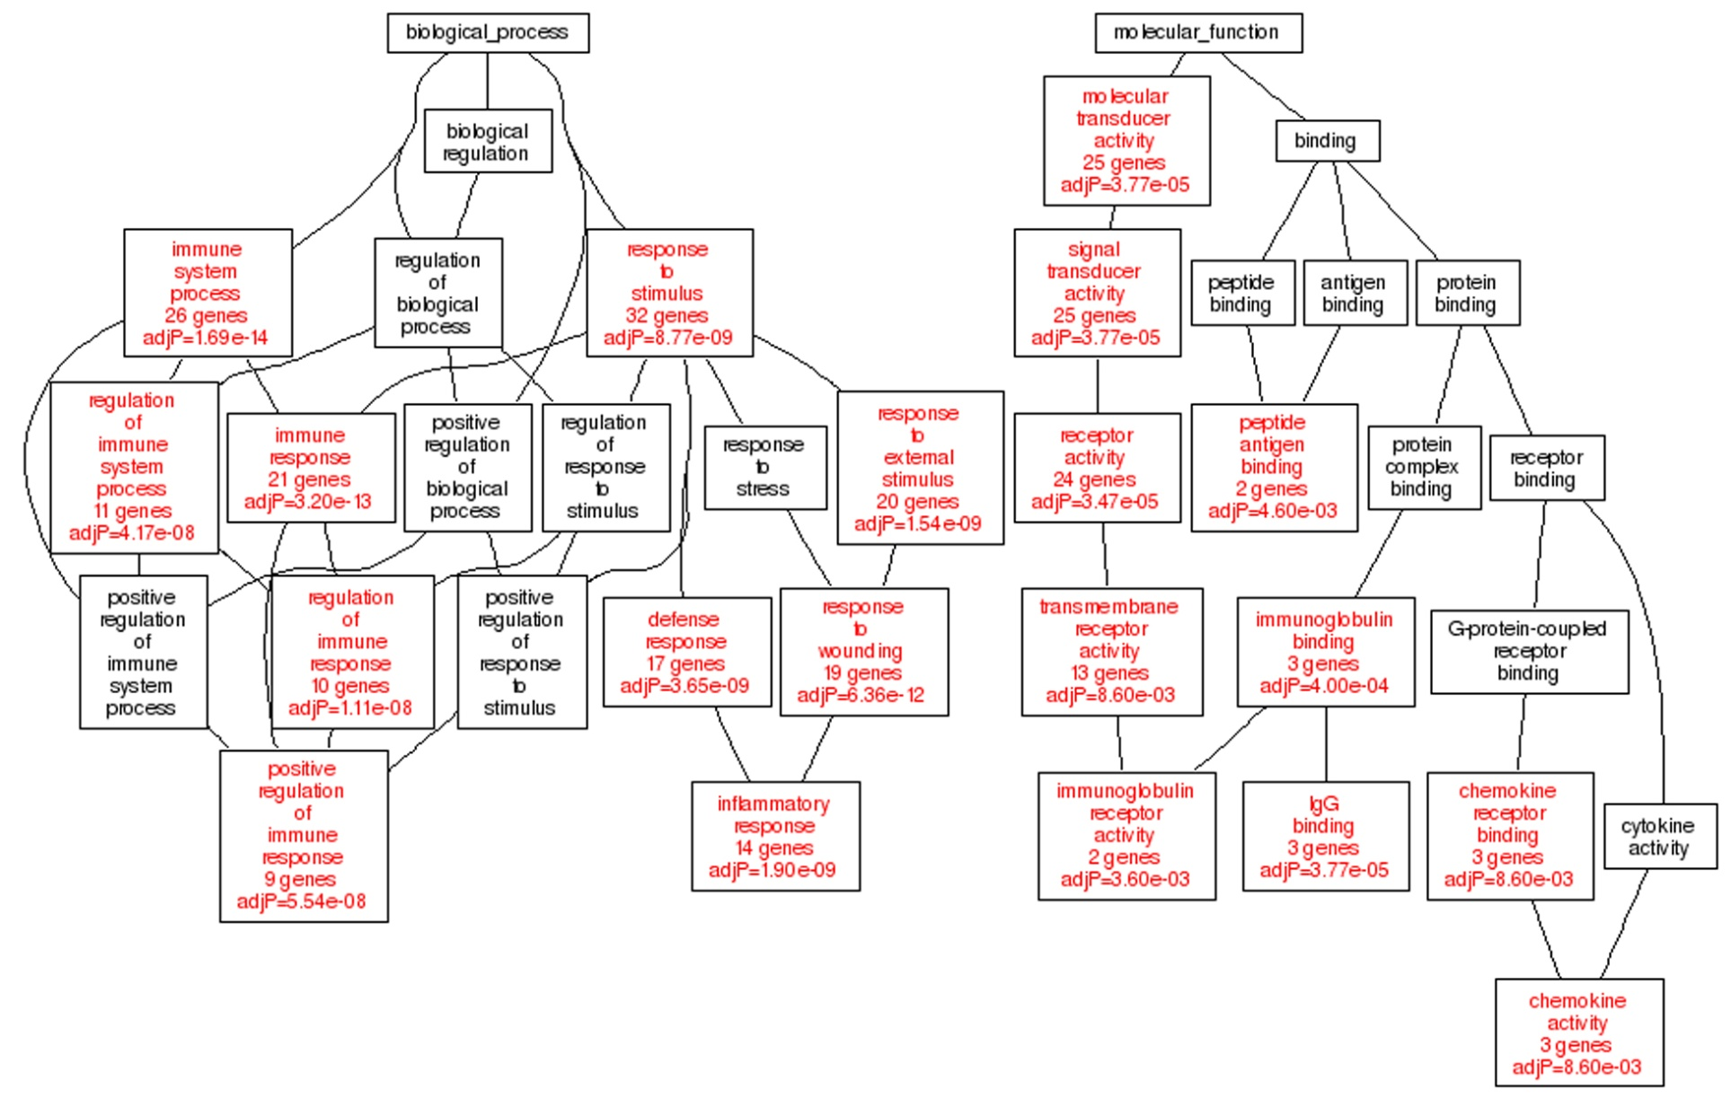
Enrichment analysis: use statistical test e.g. Fisher exact test
Example: in human genome background (20,000 gene total), 40 genes are involved in p53 signaling pathway. A given gene list has found that 3 out of 300 belong to p53 signaling pathway. Then we ask the question if 3/300 is more than random chance comparing to the human background of 40/20000
http://david.abcc.ncifcrf.gov/helps/functional_annotation.html#E4

Slide 30
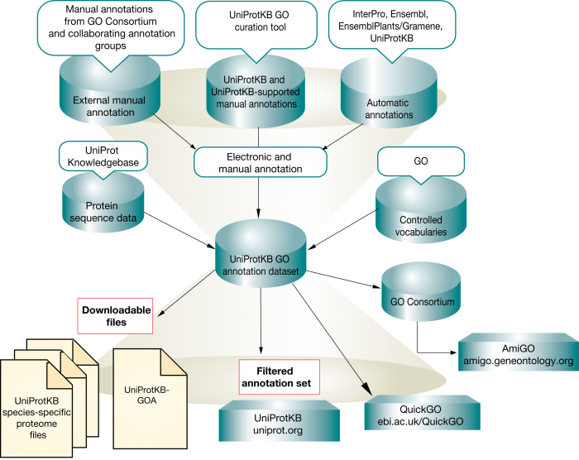
UniProt-GO annotation (GOA)
http://www.ebi.ac.uk/training/online/course/uniprot-goa-quick-tour/what-uniprot-goa

Slide 31
UniProt-GOA format
The reference used to make the annotation (e.g. a journal article)
An evidence code denoting the type of evidence upon which the annotation is based
The date and the creator of the annotation
Gene product: Actin, alpha cardiac muscle 1, UniProtKB:P68032
GO term: heart contraction ; GO:0060047 (biological process)
Evidence code: Inferred from Mutant Phenotype (IMP) Reference: PMID 17611253
Assigned by: UniProtKB, June 6, 2008

Slide 32
The idea of GO annotation for new sequences
If you have a new genome/transcriptome sequenced, how do you
perform a GO annotation for it?
Find a closet model organism which has been annotated by GO
BLAST your data against this closest organism
Transfer the GO annotation of the best match to your query sequences
For instance, if we want to annotate fern transcriptome with GO function descriptions ….
Find Arabidopsis UniProt protein dataset
Find the Arabidopsis GOA association file
BLASTx fern reads (or assembled UniGenes) against the UniProt set
Analyze BLAST result to link fern reads GO terms

Slide 33
Hands on practice 2: GO annotation

Slide 34
http://geneontology.org/

Slide 35
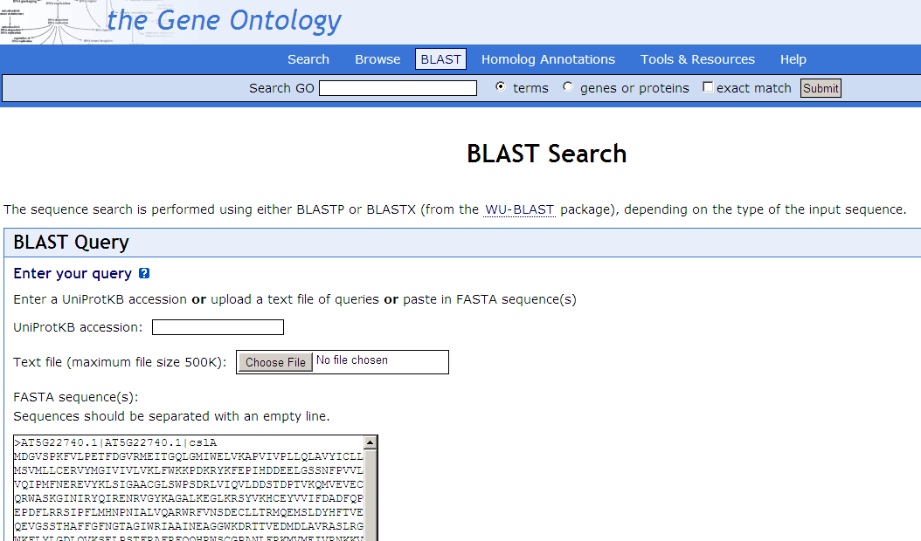
http://amigo1.geneontology.org/cgi-bin/amigo/blast.cgi
Get an example protein sequence file from http://cys.bios.niu.edu/yyin/teach/PBB/csl-pr.fa

Slide 36
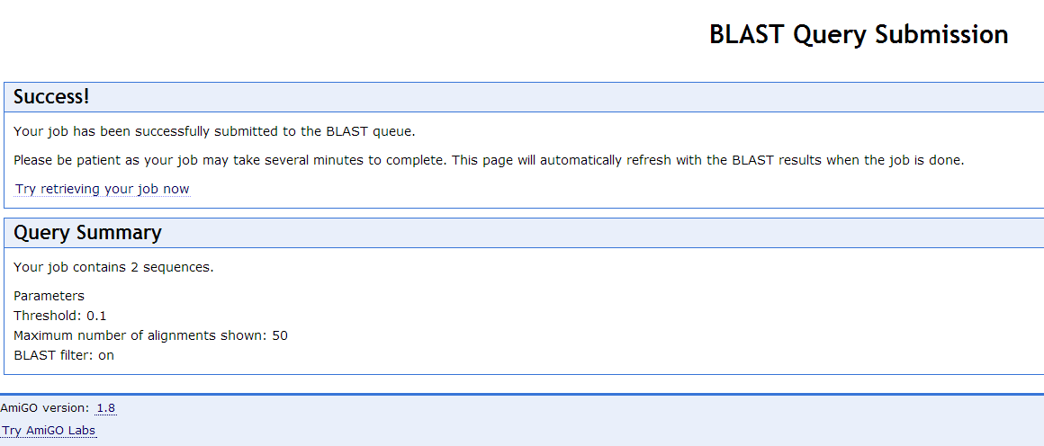
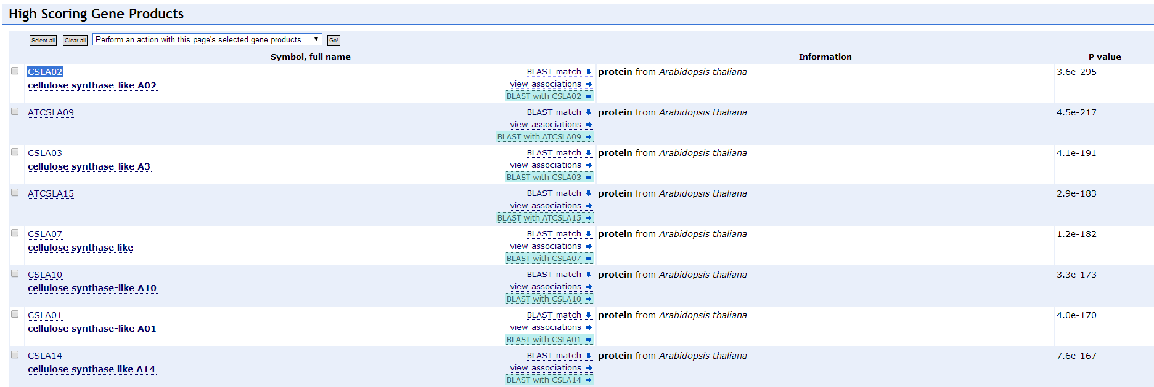

Slide 37
This is easy. Now let’s try to get a list of differentially expressed genes and then find what’s common in this list of genes in terms of functions.
We’re gonna use NCBI GEO website to get the gene list and then feed the gene list to GO enrichment analysis tools

Slide 38
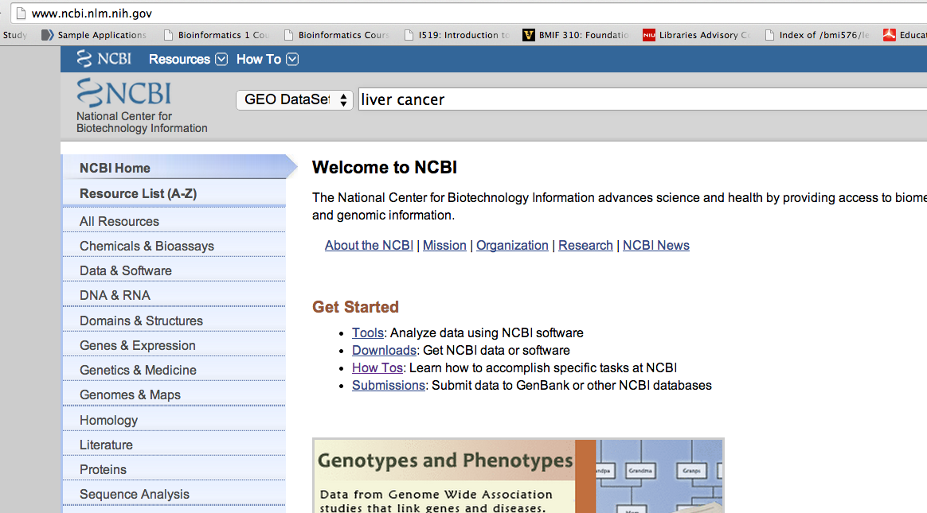
Go to NCBI home page, search GEO DataSets with keyword “liver cancer”, and hit search

Slide 39
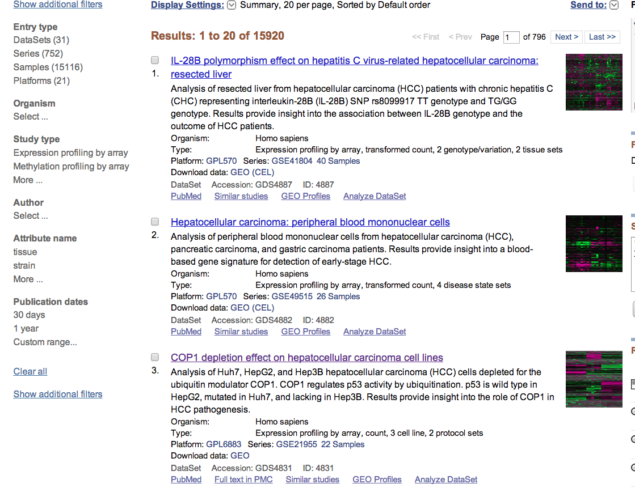
Top hits are always GEO DataSets, let’s choose the 3rd one, hit Analyze DataSet

Slide 40
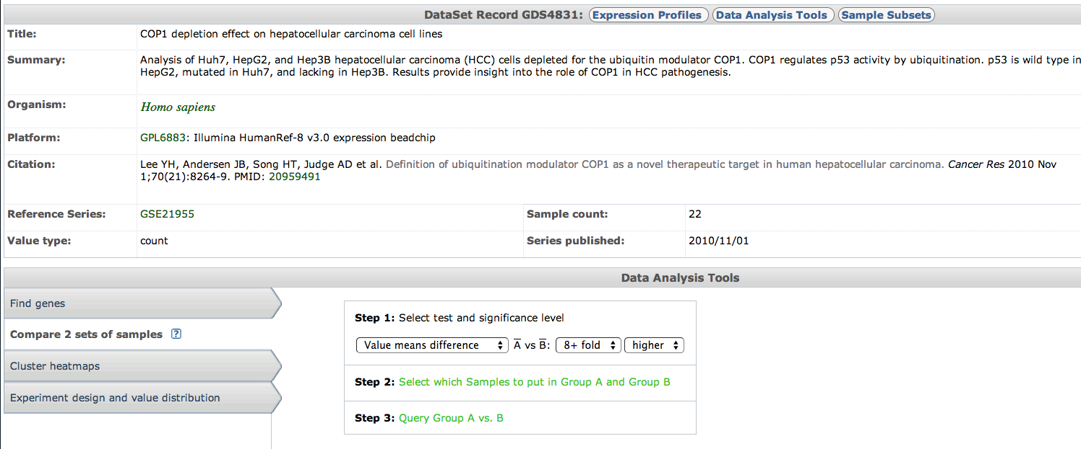
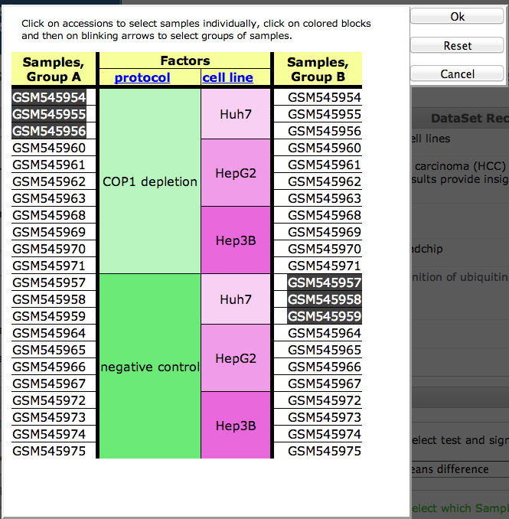
Choose “Compare 2 sets of samples”
Choose “Value means difference”
Choose “8+ fold”
Choose “higher”
Then go to Step 2
Select to choose group A: three samples for COP 1 depletion and Huh7 cell line
Group B: three samples for negative control and Huh7 cell line
Hit ok, and go to Step 3

Slide 41
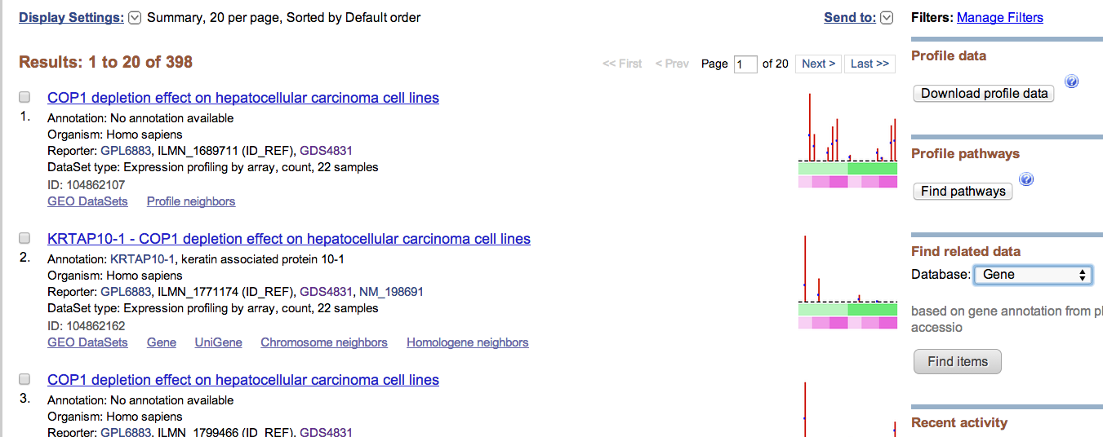
Total 398 gene profiles are found with 8+ fold higher expression in COP 1 depletion than in negative control in Huh7 cell line
To get the list of genes, choose Gene database and hit Find items

Slide 42
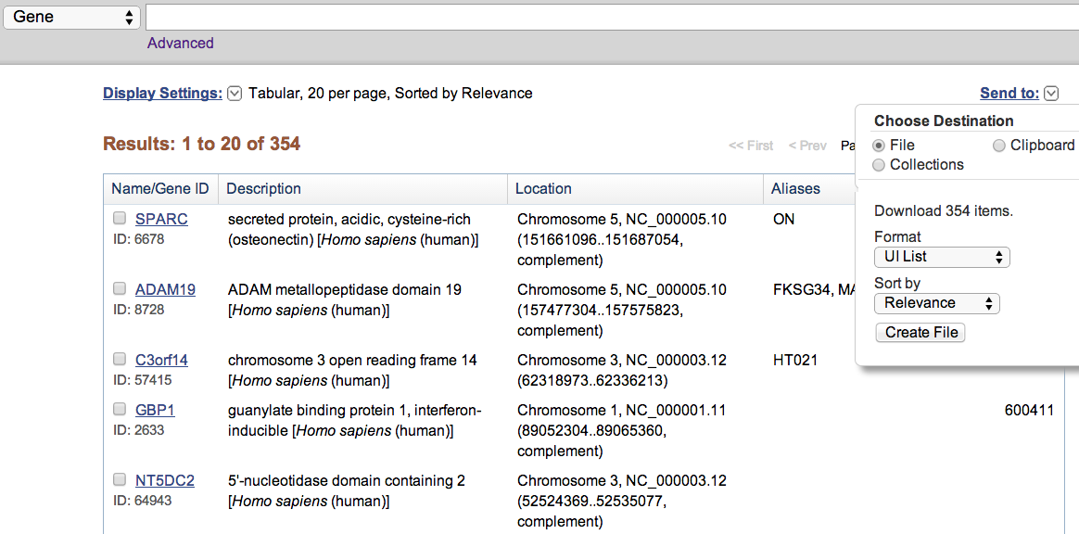
Total 354 genes correspond to 398 gene profiles
To download the list of Gene IDs, hit Send to, choose UI list as format and hit Create file
A file named “gene_result.txt” will be automatically downloaded to your local computer
Find out where it is downloaded to, open it using notepad++

Slide 43
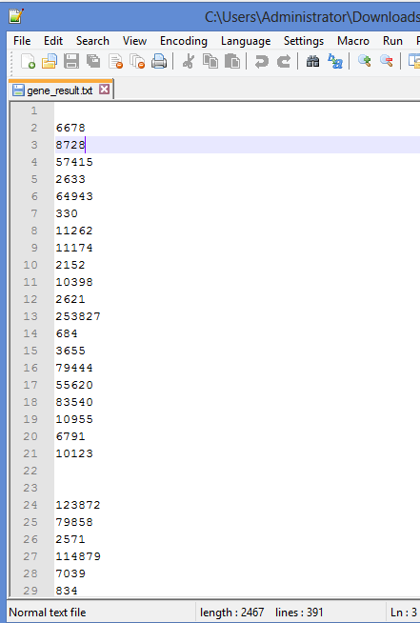
View the file using notepad++
Next we will use DAVID to perform function enrichment analysis

Slide 44
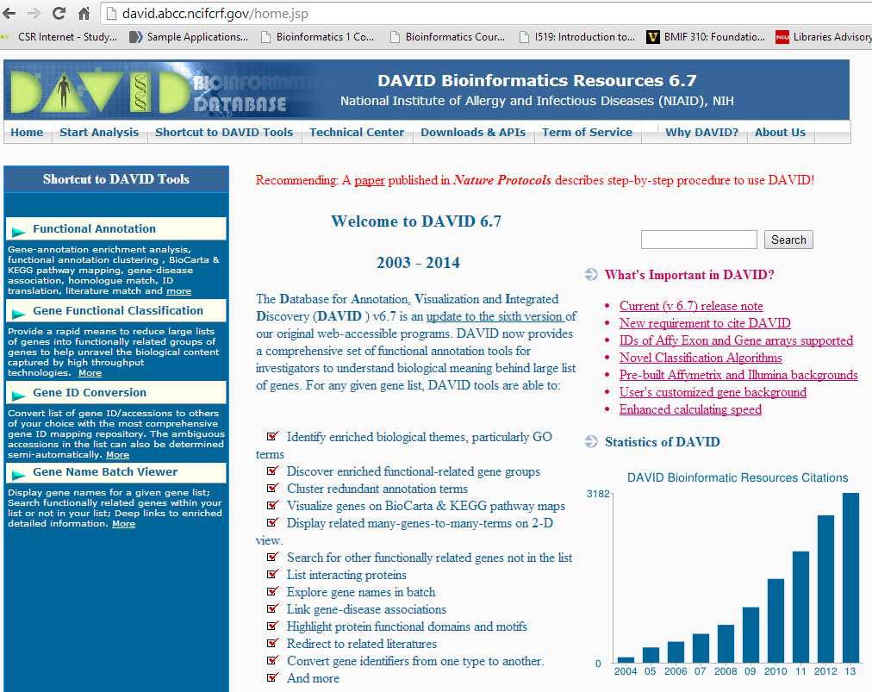
The Database for Annotation, Visualization and IntegratedDiscovery (DAVID )
Hit start analysis

Slide 45
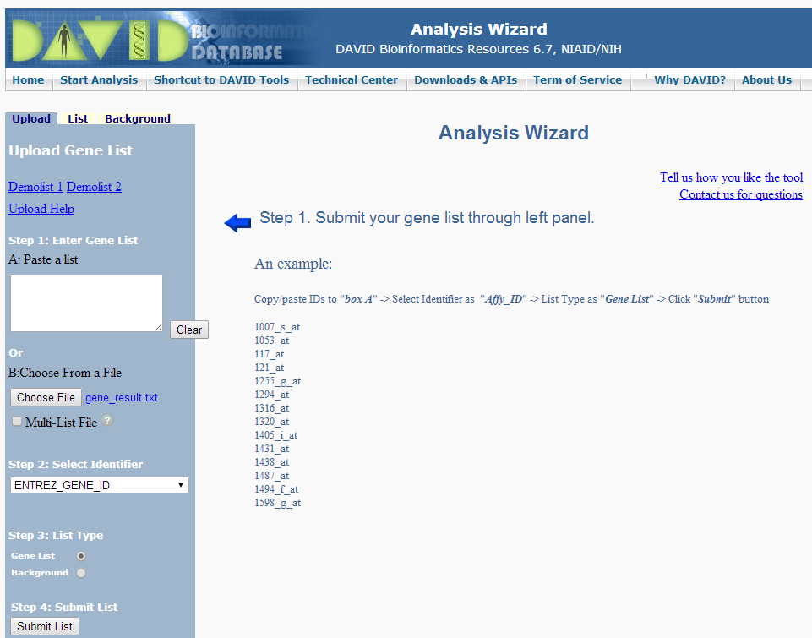
Upload the list of Gene IDs
Select ENTREZ_GENE_ID
Click on Gene list

Slide 46
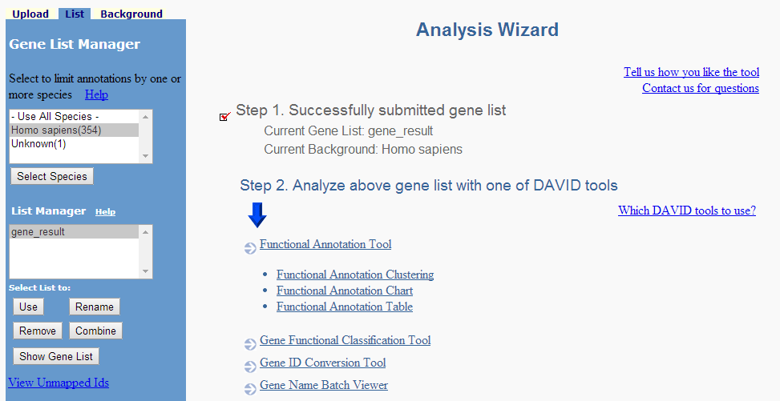
This allows you to view functional annotation from various resources including GO
Check the submitted gene list

Slide 47
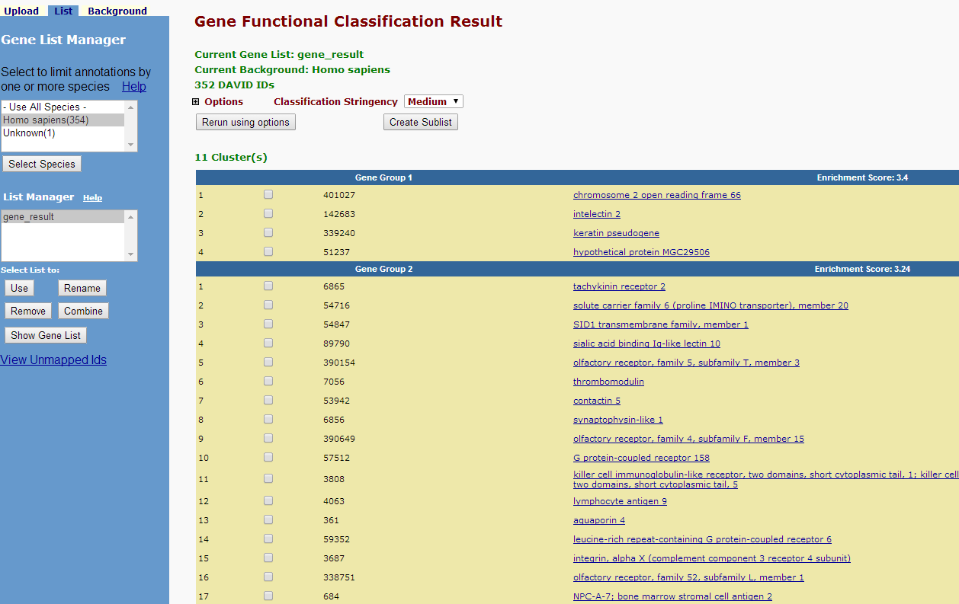
This classifies the input genes into groups according to their functional relatedness

Slide 48
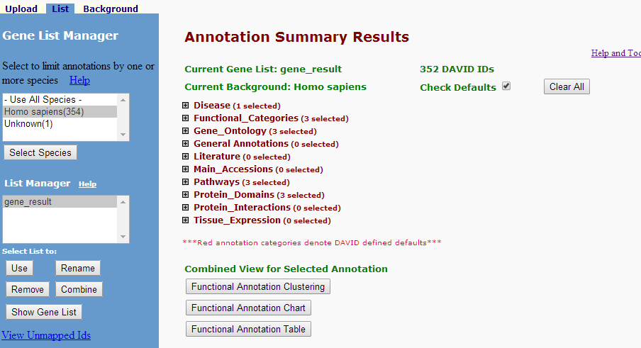
If you have clicked on Functional Annotation tool, you are at this page
All these can be changed by users (to show not to show and show what)
Click here will open a new window to show the clusters of functional annotations (terms)

Slide 49
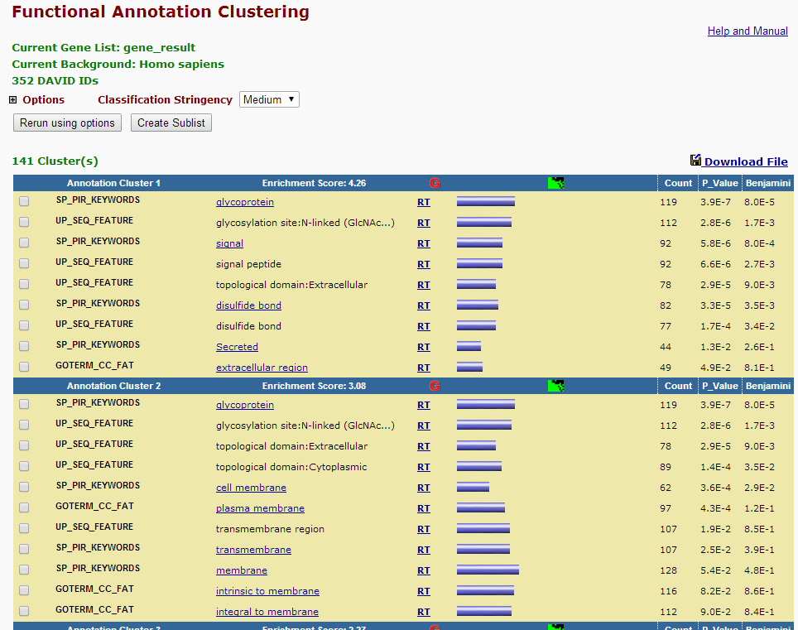
These are clusters of functional terms, not genes
(remember redundancy created by different databases?)

Slide 50
Next lecture: EBI web resources II (ENSEMBL and InterPro)

