Slide 1
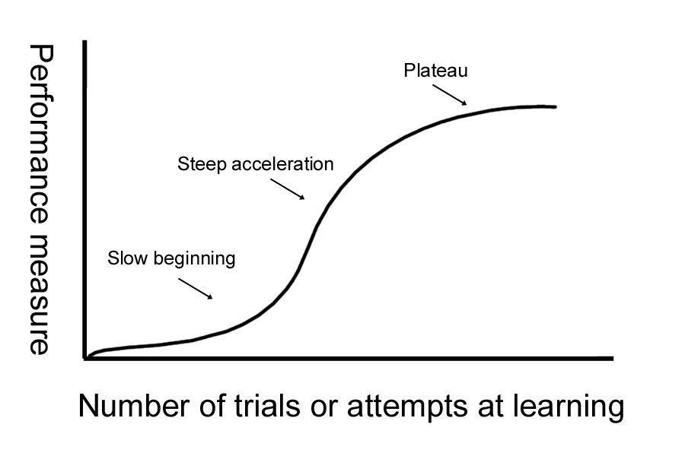
Install external command line softwares
Yanbin Yin
Fall 2014

Slide 2
Homework #8
Create a folder under your home called hw8
Change directory to hw8
Copy the faa file and ptt file you’ve downloaded from NCBI ftp site in hw7 to hw8 folder
Create unix one-liner (piping different commands) to count how many proteins are there in the faa file and save the protein gi numbers (just the gi) in a file
Create unix one-liner (piping different commands) to process the ptt file and count how many genes are located in the positive strand and how many in the negative strand
Write a report (in word or ppt) to include all the operations/commands and screen shots.
Due on Nov 24 (send by email)
Office hour:
Tue, Thu and Fri 2-4pm, MO325A
Or email: yyin@niu.edu

Slide 3
Programs/tools we often use
BLAST
FASTA
HMMER
EMBOSS
lftp
bioperl
R
Clustalw
MAFFT
MUSCLE
SRA toolkit
weblogo
PhyML
FastTree
RaxML
USEARCH
...
http://gacrc.uga.edu/

Slide 4
On WINDOWS, you download some softwares usually in exe format. You double click on some icon and windows installer will do the rest for you. Usually you will be asked: where you want to have this program installed to (C:\WINDOWS\Programs\)
On Linux, it’s very different. You download the software package, usually in compressed format (.gz or .zip). You have to type in a series of commands to install it, often write it to a system folder (e.g. /usr/bin), which you don’t have access unless you are the root user

Slide 5
Linux-based program types
Source codes in C, C++, Java, Fortran etc.
Need to be compiled before execute the command
Precompiled executables or binary codes
Source codes in scripting languages (perl, python, R etc.)
Can execute directly
Many programs need dependencies (if order to install program A, you need install B first …)

Slide 6
On your own ubuntu machine …
Not on Ser
You are the root (administrator) and using the sudo command you can install anything you want into the system directory (/usr/bin/, /bin/, /lib/ etc.)
apt-get (Advanced Packaging Tool) can do many installations for you from source or binary codes
https://help.ubuntu.com/12.04/serverguide/apt-get.html
On Ser, you are not the root and you can only install things under your home using the “hard” way
Download->unpack->install->edit PATH environmental variable
Make sure you create folders for each tools, e.g. yourhome/tools/fasta

Slide 7
Install BLAST on your own machine
Not on Ser
[test if installed]
sudo apt-get install blast2
[test if installed]
blastall
[where it installed]
which blastall
[if you want to uninstall]
sudo apt-get remove blast2
[test if it’s gone]
blastall
[new version of blast]
sudo apt-get install ncbi-blast+

Slide 8
Use apt-get to install
lftp, emboss, hmmer, bioperl, clustaw, muscle, R
sudo apt-get install xxx
[to test if installed, type in the command]

Slide 9
On your own MAC
http://www.digimantra.com/howto/apple-aptget-command-mac/
http://superuser.com/questions/173088/apt-get-on-mac-os-x
http://www.macobserver.com/tmo/article/install_the_command_line_c_compilers_in_os_x_lion
Install Xcode, then C compiler, then you can install Mac port
http://www.macports.org/install.php
With mac port, you can install
wget: sudo port install wget
lftp: sudo port install lftp
hmmer: sudo port install hmmer
emboss: sudo port install emboss
R: sudo port install R
blast: http://www.blaststation.com/freestuff/en/howtoNCBIBlastMac.html

Slide 10
Install programs using the hard way (your are NOT the root)
Usually when a bioinformatics tool is released, the tool package also includes a readme/install/manual file in addition to the program itself.
In most cases, there are more than one files in the program folder.
Some times you will see files in multiple different languages.
The readme or install file will tell you how to install the tool.
Basic steps: download the package -> unpack (untar, unzip) -> read the readme -> install

Slide 11
Install BLAST using the hard way
We will download executables of BLAST
BLAST is written C and C program needs to be compiled to get executable program
lftp ftp.ncbi.nih.gov:/blast/executables/LATEST
get ncbi-blast-2.2.30+-x64-linux.tar.gz
bye
Now you returned to Ser
ls -l
mkdir tools
cd tools
mkdir blast
mv ../ncbi-blast-2.2.30+-x64-linux.tar.gz blast
cd blast
Unpack the tar ball
tar -zxf ncbi-blast-2.2.30+-x64-linux.tar.gz
ls -l
cd ncbi-blast-2.2.30+/bin
ls -l
./blastp -h
pwd

Slide 12
Now return to your home
cd
blastp -h
You will be told that command is not found. The reason is that blastp is not in your current path. You have to give the full path to run it in your home
/home/yyin/tools/blast/ncbi-blast-2.2.30+/bin/blastp
What if you don’t want to type this long path? You can add it to a hidden file in your home called .bashrc where Shell auto execute every time you log in: Shell will be notified that when you call blastp, go to that folder to find it.
You are at your home
nano .bashrc
Add the following in the beginning of the file
export PATH="$PATH:$HOME/tools/blast/ncbi-blast-2.2.30+/bin"
Now exit from nano and do the following
. .bashrc
blastp -h

Slide 13
Environment variable
An environment variable is a named object that contains data used by one or more applications. The value of an environmental variable can for example be the location of all executable files in the file system, the default editor that should be used, or the system locale settings. Users new to Linux may often find this way of managing settings a bit unmanageable. However, environment variables provides a simple way to share configuration settings between multiple applications and processes in Linux.
env to list all built-in environment variable
PATH is a very important environment variable. This sets the path that the shell would be looking at when it has to execute any program. It would search in all the directories that are defined in the variable. Remember that entries are separated by a ' : ' . You can add any number of directories to this list.
PATH=/usr/local/sbin:/usr/local/bin:/usr/sbin:/usr/bin:/sbin:/bin:/usr/games

