Slide 1
NCBI web resources I: databases and Entrez
Yanbin Yin
Fall 2014
Most materials are downloaded from ftp://ftp.ncbi.nih.gov/pub/education/

Slide 2
Homework assignment 1
Extract the gene IDs reported in table 1 of http://www.ncbi.nlm.nih.gov/pmc/articles/PMC523881/
Using NCBI batch Entrez to download all refseq protein fasta sequences from Arabidopsis thaliana
Search “oncogenes” using Entrez and report in human how many oncogenes correspond to how many total proteins and how many refseq proteins
Write a report to explain all the operations and include screen shots
Due on 9/16 (send by email or bring printed hard copy to class)

Slide 3
References
NCBI mcbios workshop
ftp://ftp.ncbi.nih.gov/pub/education/mcbios2012/
NCBI web resource tutorials
ftp://ftp.ncbi.nih.gov/pub/education/tutorials/
NCBI discovery workshops
ftp://ftp.ncbi.nih.gov/pub/education/discovery_workshops/NLM/2012/Sept2012/
NCBI Help Manual
http://www.ncbi.nlm.nih.gov/books/NBK3831/

Slide 4
Youtube
http://www.youtube.com/ncbinlm
Go to www.youtube.com
Search “NCBI tutorial general”

Slide 5
Topics
Intro. to NCBI
Selected NCBI Databases
The Entrez system
Hands on practice

Slide 6
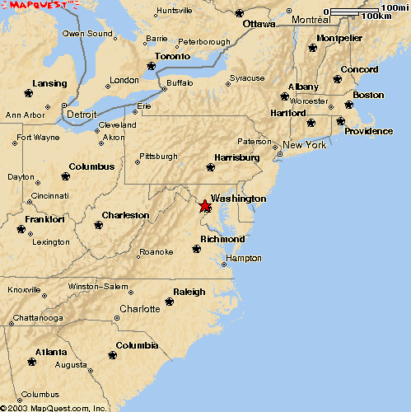
The National Center for Biotechnology Information
Bethesda,MD
Created in 1988 as a part of the
National Library of Medicine at NIH
Establish public databases
Research in computational biology
Develop software tools for sequence analysis
Disseminate biomedical information

Slide 7
GenBank history
ftp://ftp.ncbi.nih.gov/genbank/

Slide 8
Molecular Data
Sequences
Expression
Genome Maps
3D Structures
Protein Domains
Homologous Genes, Proteins, Structures
Pathways
Genetic Variation

Slide 9
Selected NCBI Databases
Biomedical literature
PubMed free Medline
PubMed Central full text online access
NCBI Bookshelf online biomedical textbooks
Biomolecular Databases
Nucleotide
GenBank submitted sequence records
RefSeq curated NCBI reference sequences
Protein GenBank and RefSeq translations, outside protein
dbSNP small scale genetic variations
Structure biomolecular 3-D structures
MMDB NCBI’s 3D structure database
GEO microarray expression data
SRA next-generation sequence data

Slide 10
Information Hubs: Aggregators
Taxonomy access to NCBI data through source organism classification
BioProjects molecular data and literature related to large scale molecular projects (genomes, transcriptomes, metagenomes)
Genome specialized displays for complete genomes and access to microbial genome analysis tools
Gene molecular data and literature related to genes
BioSystems biochemical pathways and processes linked to NCBI genes, gene products, small molecules, and structures

Slide 11
Information Hubs: Analyses
Analysis Results
HomoloGene homologous genes from selected eukaryotes
Protein Clusters homologs (proteins) from microbial genomes
UniGene sequence-based gene catalog (eukaryotes)
GEO Datasets microarray experiments and analyses

Slide 12
Sequence Databases at NCBI
Primary
GenBank: NCBI’s primary sequence database
Trace Archive: reads from capillary sequencers
Sequence Read Archive: next generation data
Derivative
GenPept (GenBank translations)
Outside Protein (UniProt—Swiss-Prot, PDB)
NCBI Reference Sequences (RefSeq)

Slide 13
GenBank types of entries

Slide 14
Three international nucleotide sequence databases

Slide 15
RefSeq: NCBI’s Derivative Sequence Database
Experimentally verified / curated transcripts and proteins
NM_, NP_ accession numbers
Model transcripts and proteins
XM_, XP_ accession numbers
Assembled Genomic Regions (contigs)
NT_, NW_ accession numbers
Chromosome records
NC_, AC_ accession numbers
RefSeqGene Records
NG_ accession numbers (NG_ also used pseudo genes and other fixed genomic sequences)
Draft whole genome shotgun assemblies (microbial)
NZ_ accession numbers
Microbial proteins
NP_, YP_, ZP_ accessions
ftp://ftp.ncbi.nih.gov/refseq/release/
Notes:
Goal= nonredundant set of genes/proteins for each organism represented
Model= comes from analysis of genomic content from organism assembly
Reannotation of microbial genomes, for example.

Slide 16
GenBank & RefSeq

Slide 17
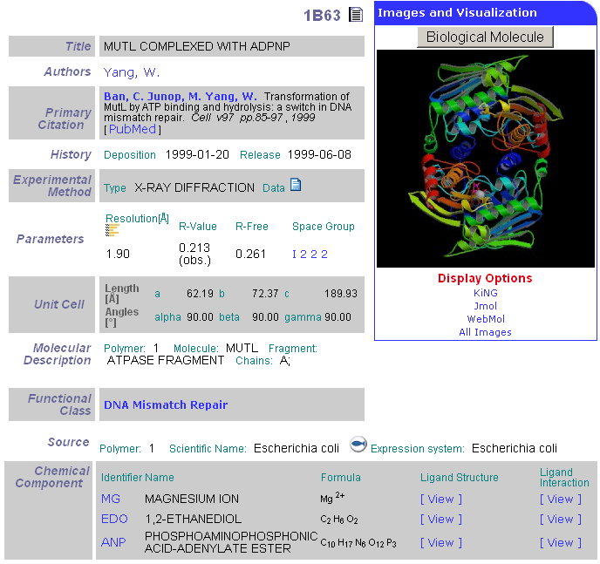
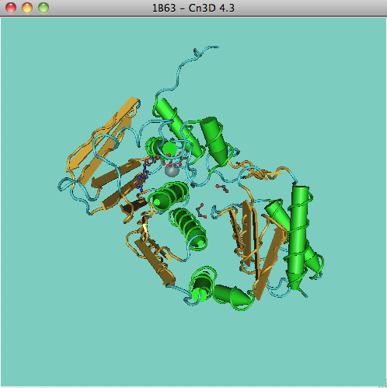
Protein Sequences from Structures
>gi|5542073|pdb|1B63|A Chain A, Mutl Complexed With Adpnp
SHMPIQVLPPQLANQIAAGEVVERPASVVKELVENSLDAGATRIDIDIERGGAKLIRIRDNGCGIKKDEL
ALALARHATSKIASLDDLEAIISLGFRGEALASISSVSRLTLTSRTAEQQEAWQAYAEGRDMNVTVKPAA
HPVGTTLEVLDLFYNTPARRKFLRTEKTEFNHIDEIIRRIALARFDVTINLSHNGKIVRQYRAVPEGGQK
ERRLGAICGTAFLEQALAIEWQHGDLTLRGWVADPNHTTPALAEIQYCYVNGRMMRDRLINHAIRQACED
KLGADQQPAFVLYLEIDPHQVDVNVHPAKHEVRFHQSRLVHDFIYQGVLSVLQ

Slide 18
MMDB: Molecular Modeling Data Base
Derived from experimentally determined PDB records
Value added to PDB records including:
Addition of explicit chemical graph information
Validation (secondary structure elements)
Inclusion of Taxonomy, Citation
Conversion to ASN.1 data description language
Structure neighbors determined by
Vector Alignment Search Tool (VAST)
Notes:
PDB at Rutgers.
Import structure records that are experimentally determined.
Check coordinates of secondary structure coordinates. Validation to make them compatible with Entrez system.

Slide 19
Protein Domains
Structural Domain
Discrete independently folding unit of a protein
Conserved Domain (sequence-based)
Protein region with recognizable position-specific pattern of sequence conservation
Sequence-based domains often roughly correspond to structural domains
Domains often have distinct, identifiable functions

Slide 20
NCBI’s Conserved Domain Database
Searchable with RPS-BLAST
Sources
SMART
PFAM
COGs
NCBI curated domains
structure-informed alignments

Slide 21
NCBI Search Services and Tools
Entrez integrated literature and molecular databases
BLink protein similarities
Graphical Sequence Viewer incipient genome browser
BLAST highest volume sequence search service
VAST structure similarity searches
Map Viewer graphical genome map display (assembled eukaryotic genomes only)
Cn3D 3D structure viewer
Genome Workbench standalone sequence analysis annotation platform

Slide 22
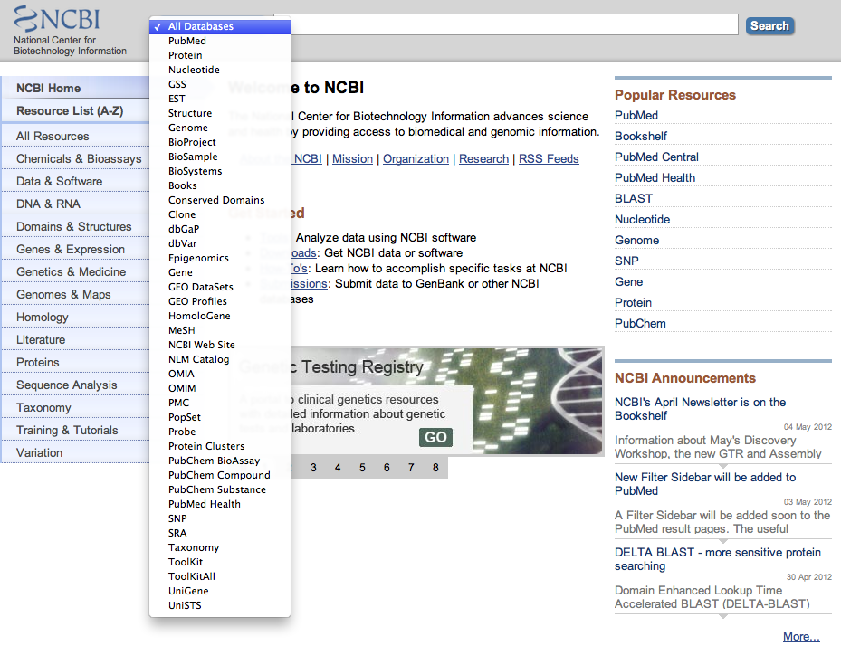
Entrez: Integrated Molecular and Sequence Databases
http://www.ncbi.nlm.nih.gov/

Slide 23
Entrez: A Discovery System
Word weight
PubMed abstracts
3-D Structure
Taxonomy
3 -D Structure
VAST
Phylogeny
Gene
Neighbors
Related Structures
BLAST
Nucleotide sequences
Protein sequences
BLAST
Neighbors
Related Sequences
Neighbors
Related Sequences
BLink
Domains
Hard Link

Slide 24
Hands-on exercise 1
Cancer related genes

Slide 25
Notes:
Google NCBI or type the url in the address box of firefox. In the pull down manual, you can choose from dozens of databases. But here let’s go with the all databases. Click on Search.

Slide 26
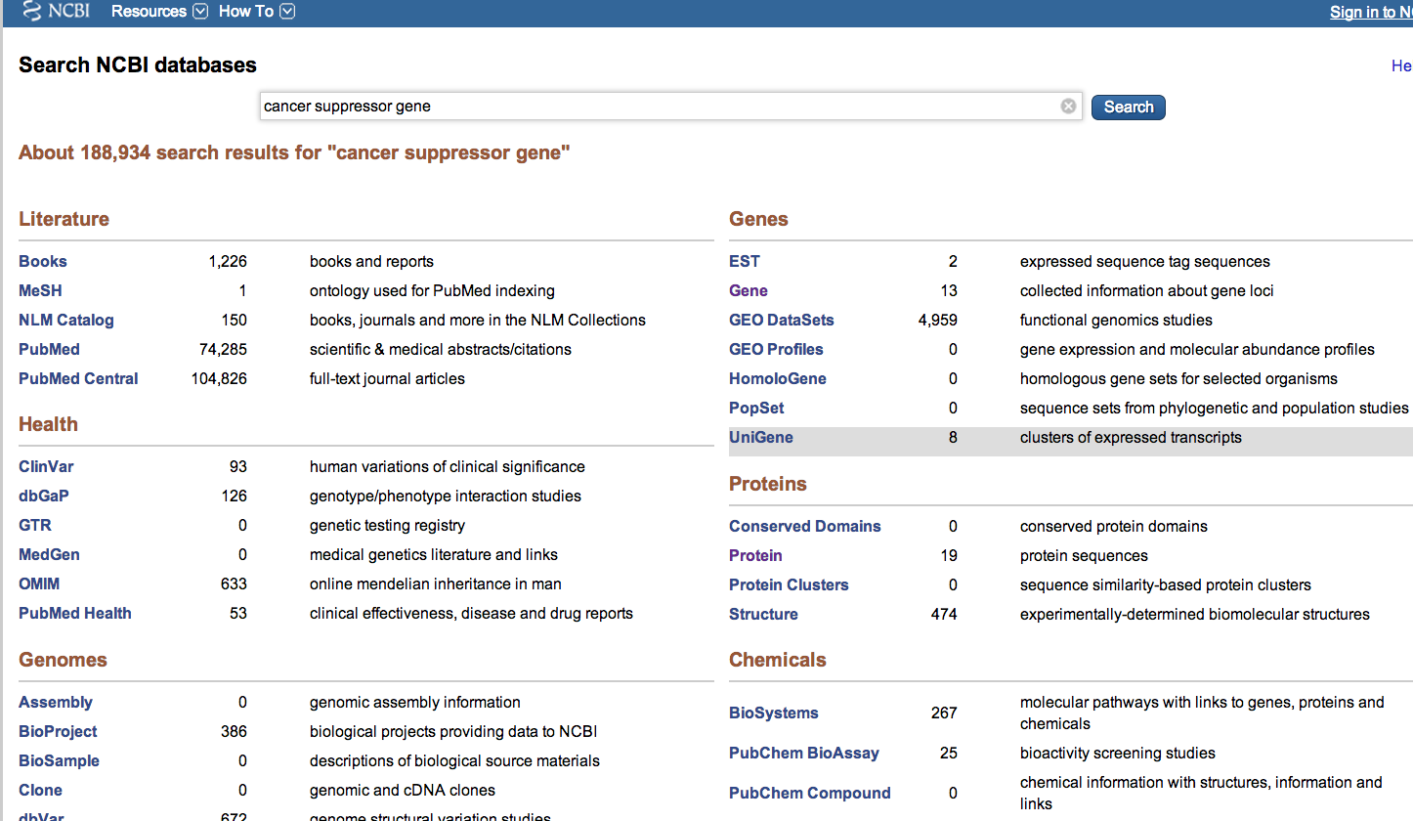
Notes:
We will see the match info in all entrez databases. Let’s try Proteins.

Slide 27
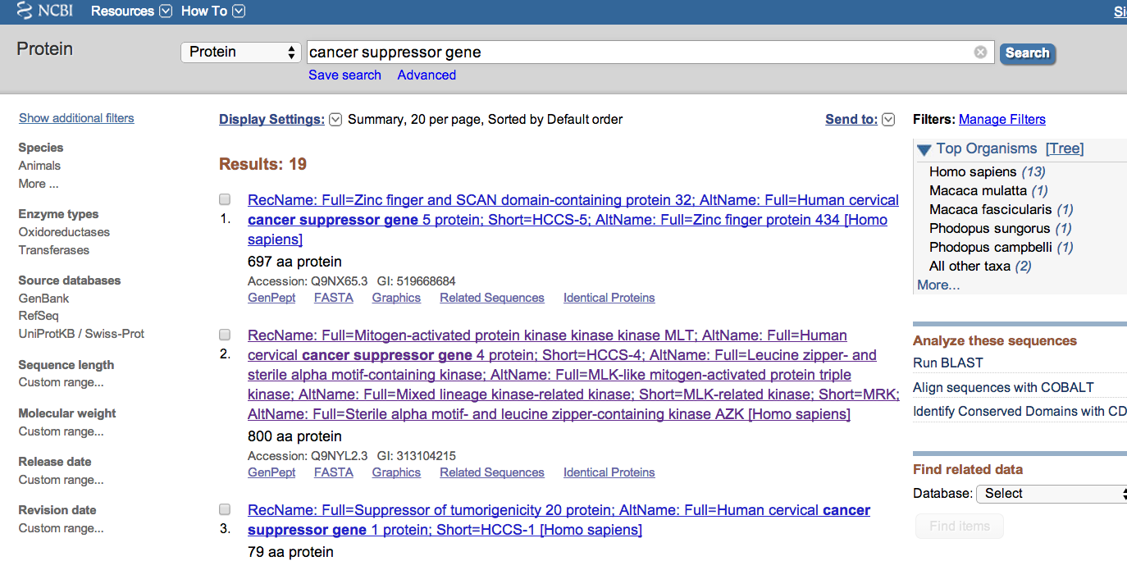
Notes:
We are now able to see there are 23 protein entries related to our query. On the right, we see a organism tree box. Let’s narrow our search to Human.

Slide 28
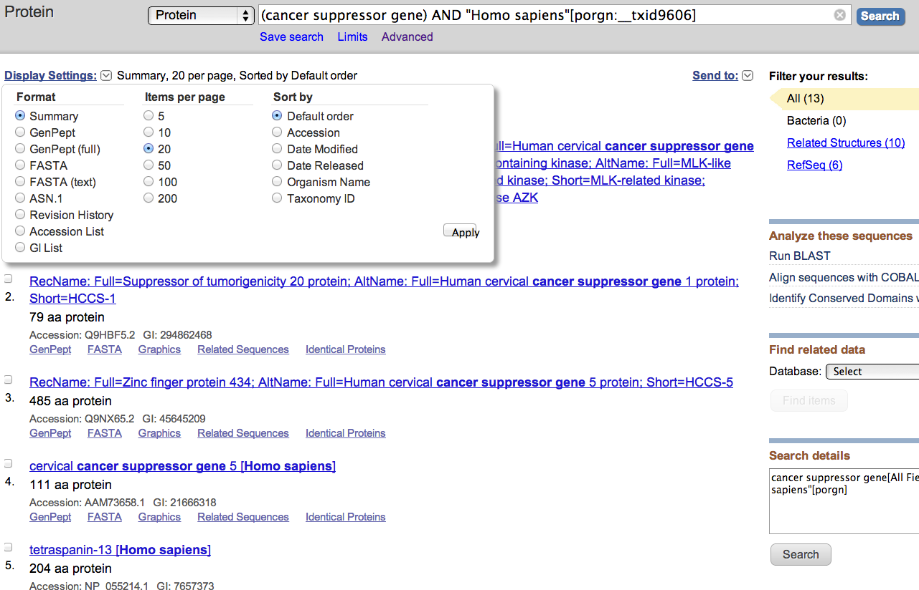
Notes:
Now we see there are only 13 proteins left all from human. On the left upper corner, click on display settings, we can choose to show the fasta format or genpept format of all these entries. Let’s choose fasta.

Slide 29
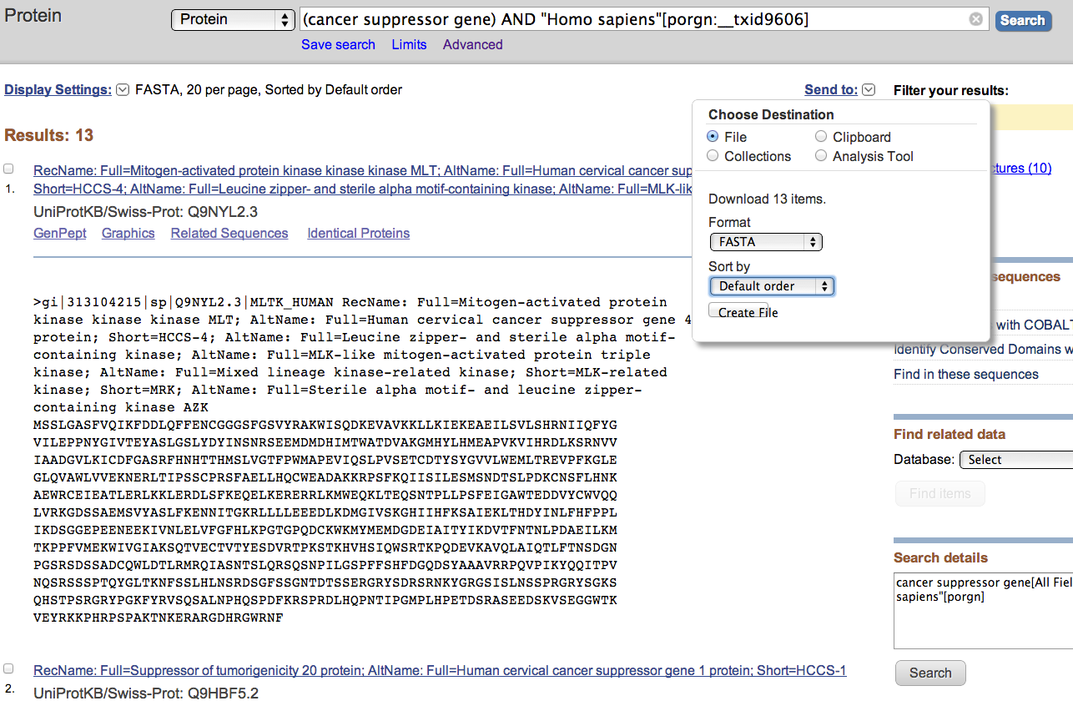
Notes:
Click on send to will allow you to download all the fasta sequences of these proteins. If you click on create file, a text file will be created on your local computer to store the sequences. There are other options that are very useful. Now lets click on the first protein entry which is a kinase protein.

Slide 30
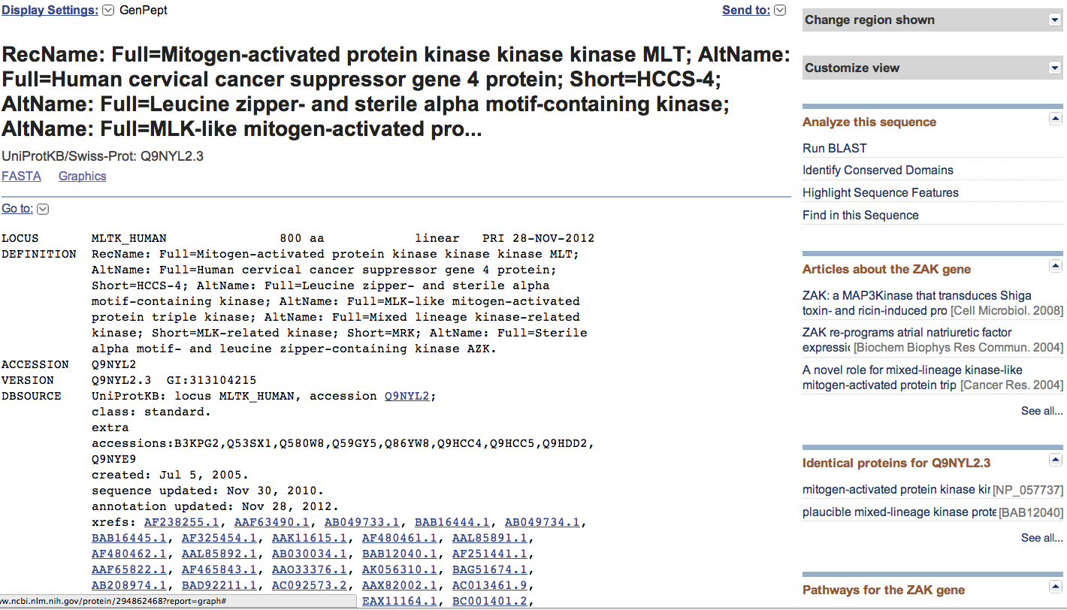
Notes:
This is the genpept or genbank format of this protein, with a lot of information. However, o the far right of the window, there is a list of tabs that can be expanded or collapsed. These tabs allow you to explore this protein in a number of different ways. Let’s try identify conserved domains.

Slide 31
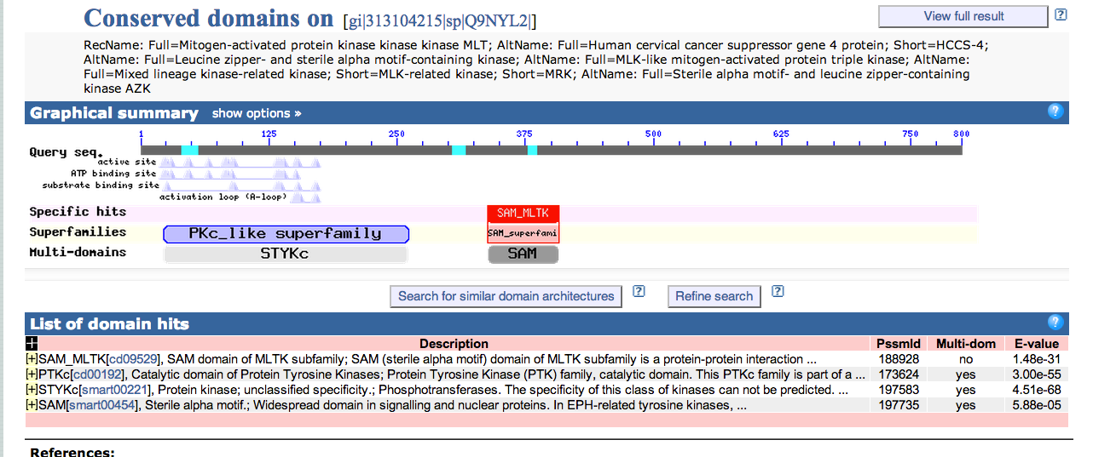
Notes:
This shows the conserved domains the query protein has. This is precomputed by rps-blast search against ncbi’s CDD database.

Slide 32
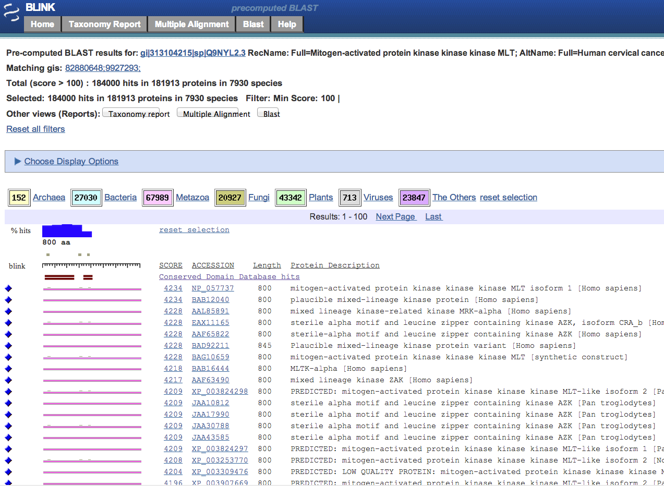
Notes:
If we go back to select blink, that will give us precomputed blast result of this query protein. You can check the alignment of the query protein and link to homologs and a lot of different things from this page.

Slide 33
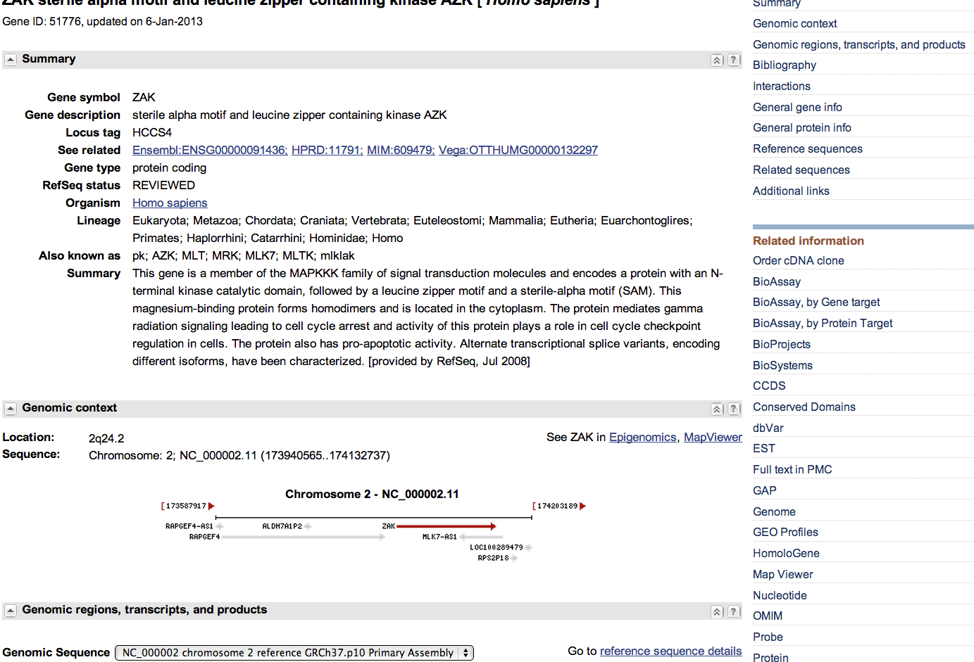
Notes:
Let’s go back to select gene. This page shows the Gene encoding that protein. So it has much richer information in this page. The ncbi gene database is actually a central database that connects to all other different databases. For example, the genomic context shows you the neighboring genes. Let’s try UniGene, GEO, HomoloGene, MapViewer, SNP, Epegenomics etc.

Slide 34
Hands-on exercise 2
Given a list of sequence IDs, get their sequences from NCBI

Slide 35
Suppose
You read a paper which reported a list of genes (with a table e.g. to show all the IDs)
Or
You have a collaborator sending you a file with all the IDs
You want to quickly get the sequences of these genes

Slide 36
Download the example id file at http://cys.bios.niu.edu/yyin/teach/PBB/gt8-id.txt
Plain text file!

Slide 38
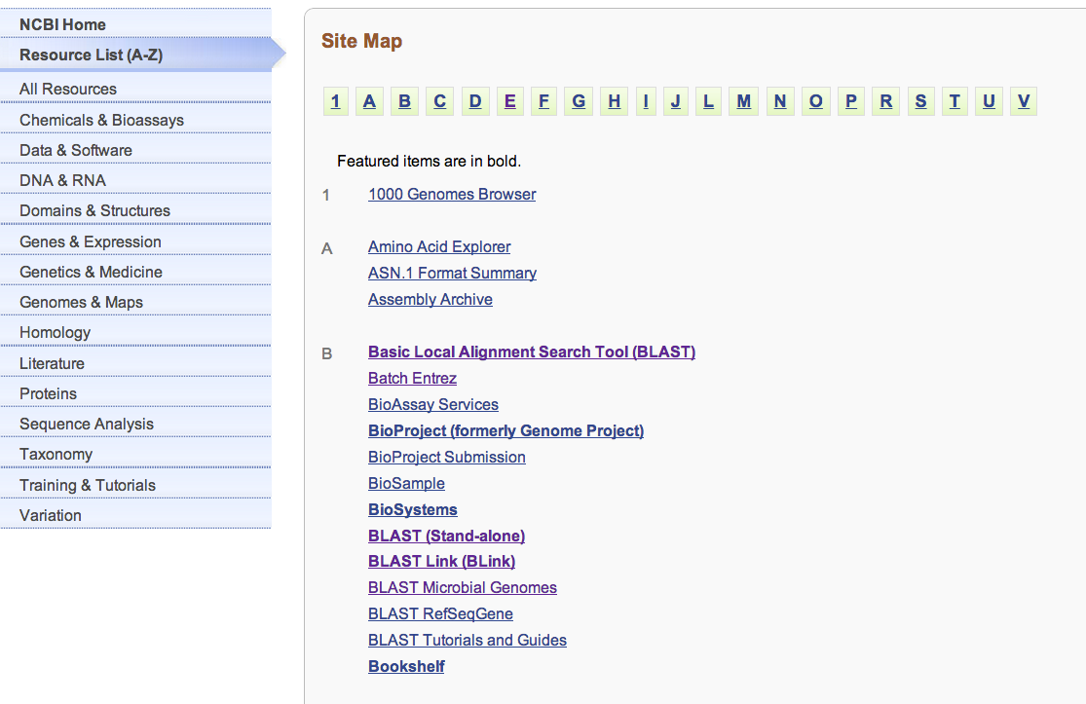

Slide 39
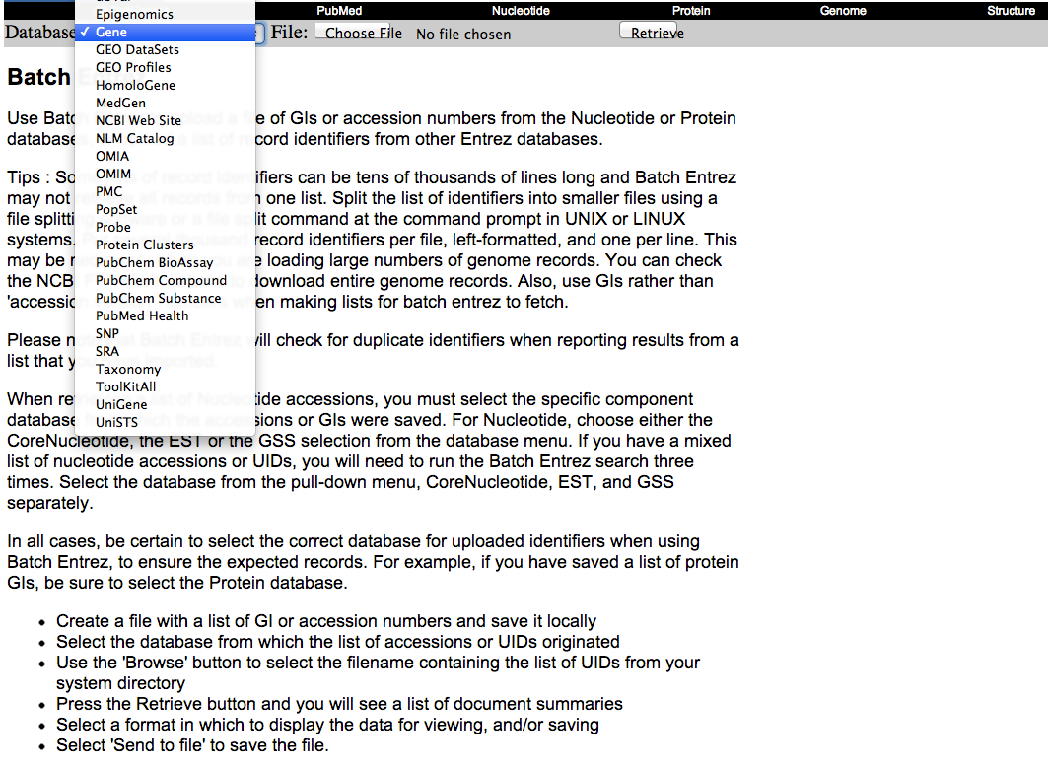

Slide 40
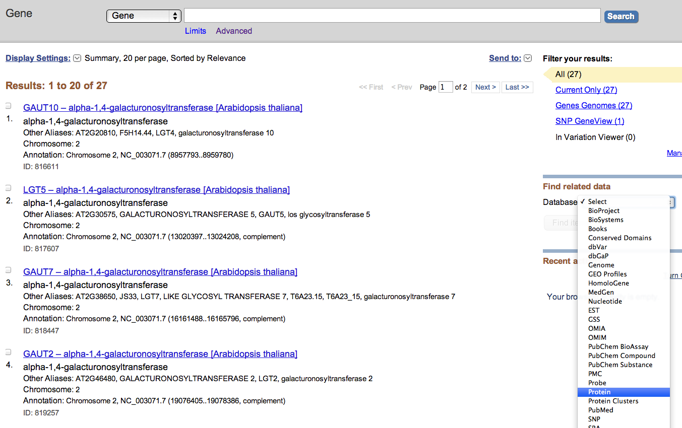

Slide 41
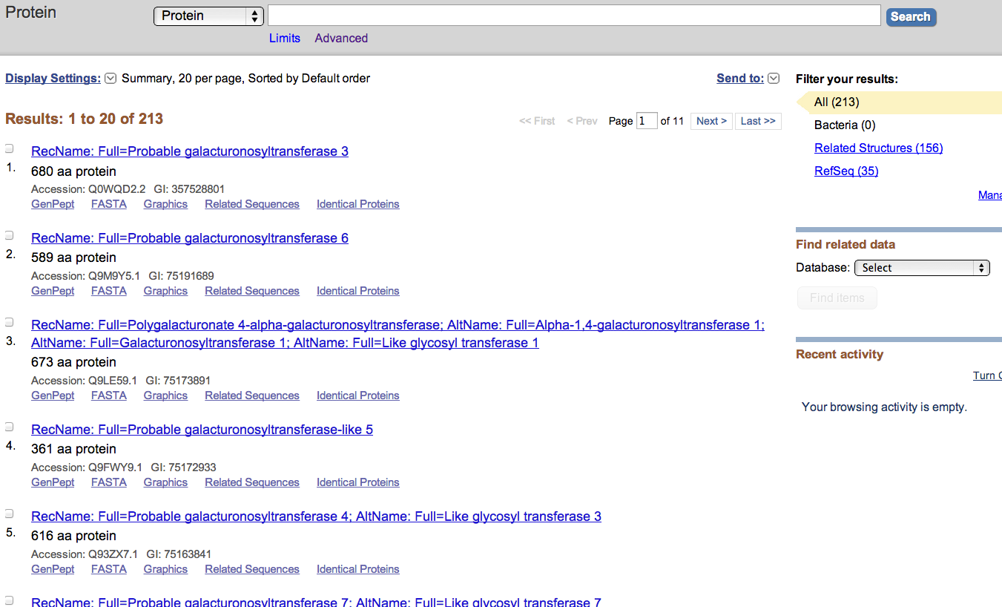

Slide 42
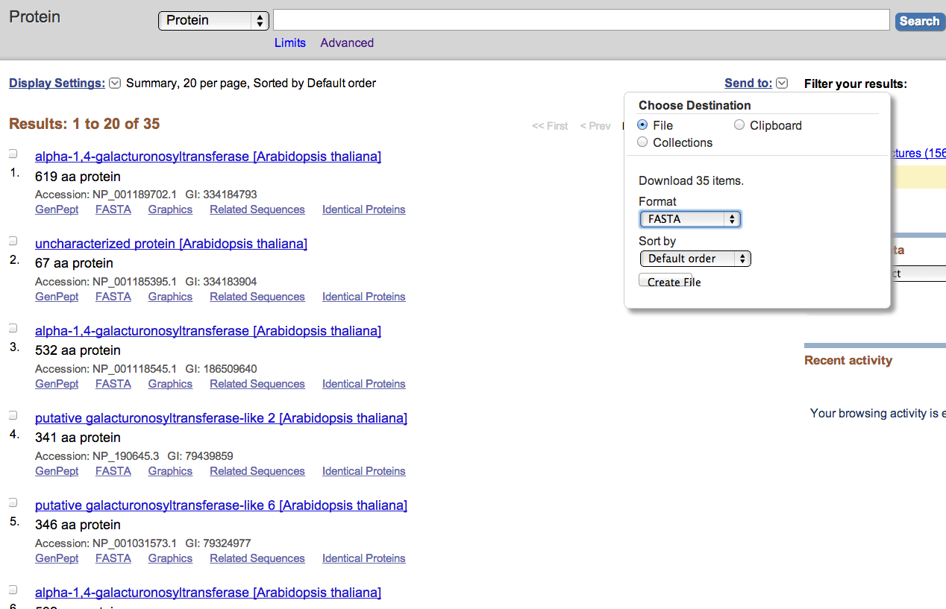

Slide 43
Hands-on exercise 3
Find sequences through taxonomy database

Slide 44
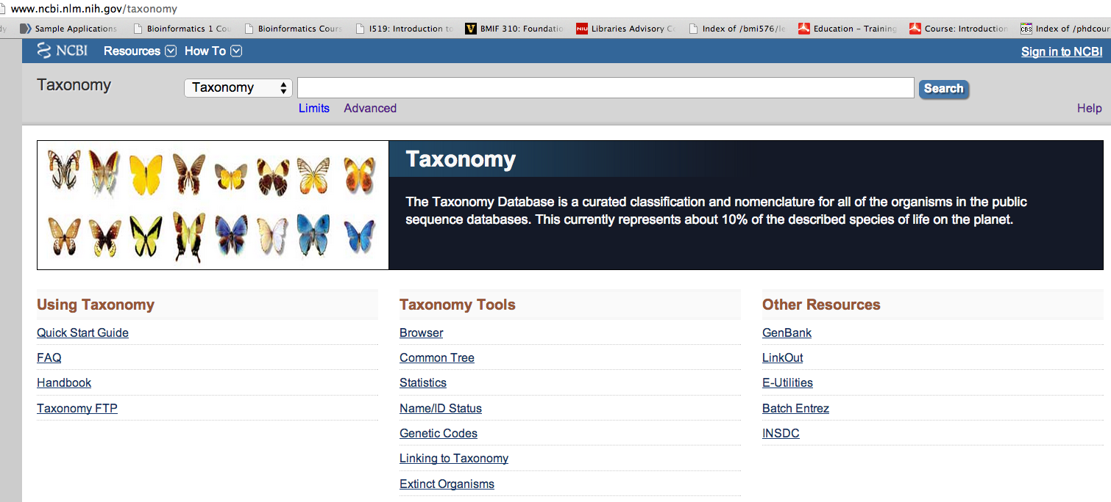
http://www.ncbi.nlm.nih.gov/taxonomy
http://nar.oxfordjournals.org/content/early/2011/12/01/nar.gkr1178.full-text-lowres.pdf

Slide 45
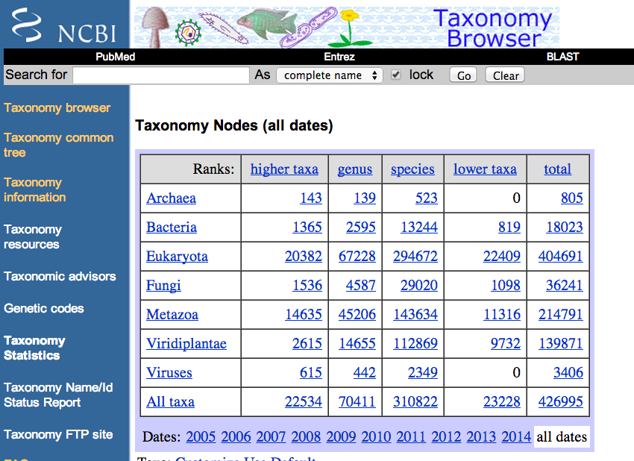

Slide 46
If you have a list of species names and you want to find out how they are related according to NCBI taxonomy database

Slide 47
Download a list of plant species from:
http://cys.bios.niu.edu/yyin/teach/PBB/plant-genome.txt
Choose file -> Add from file

Slide 48
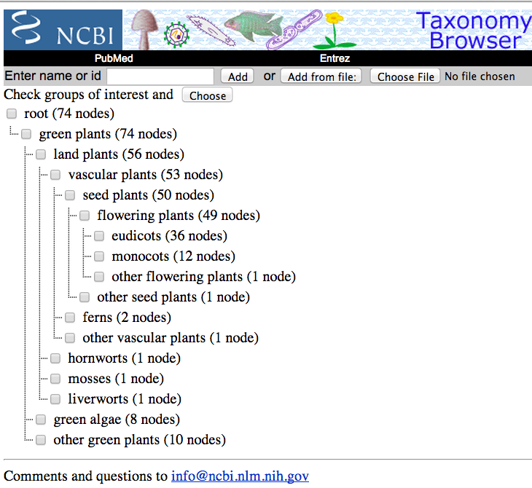
Here is how these plants are distributed in the taxonomic classification

Slide 49
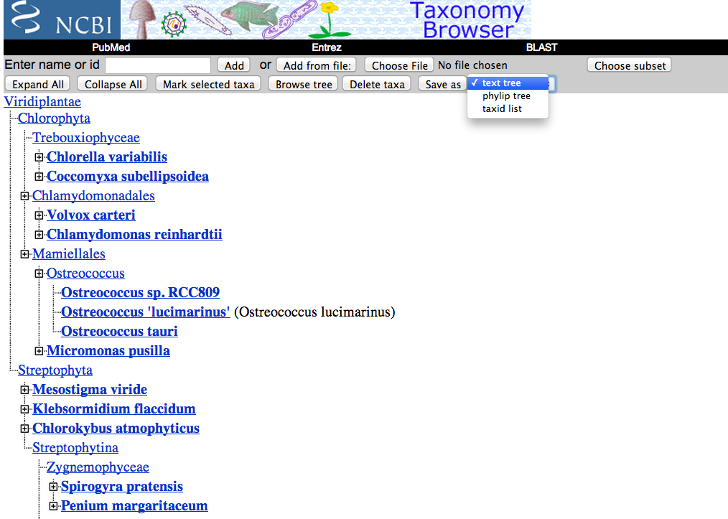
You may save this as a phylip format file, which could be presented as a phylogeny graph using tree viewer softwares

Slide 50
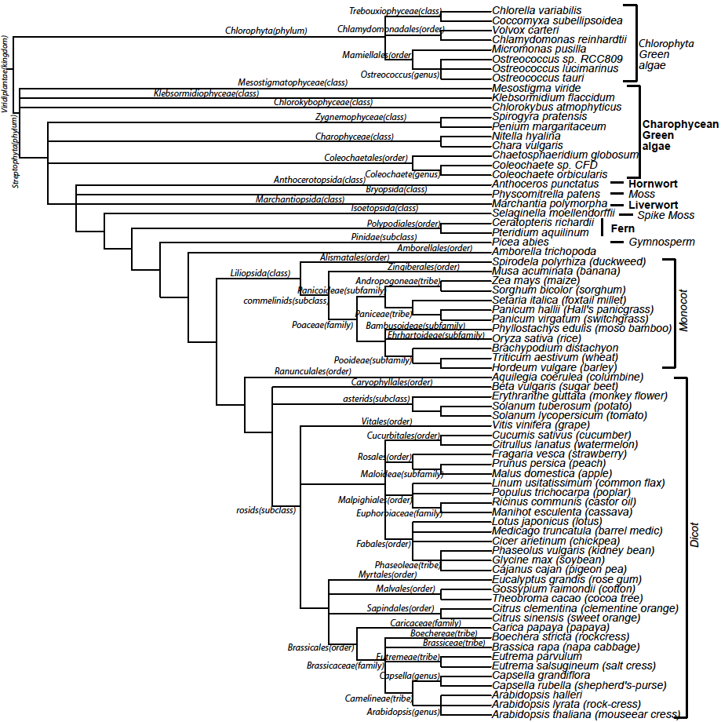

Slide 53
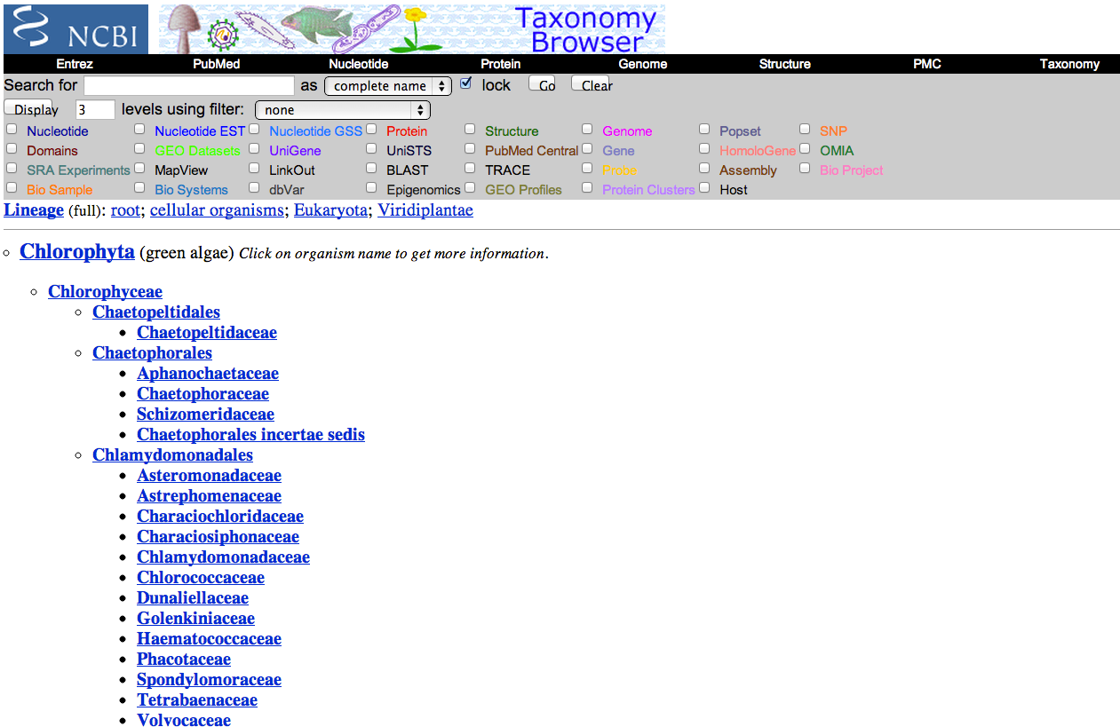

Slide 54
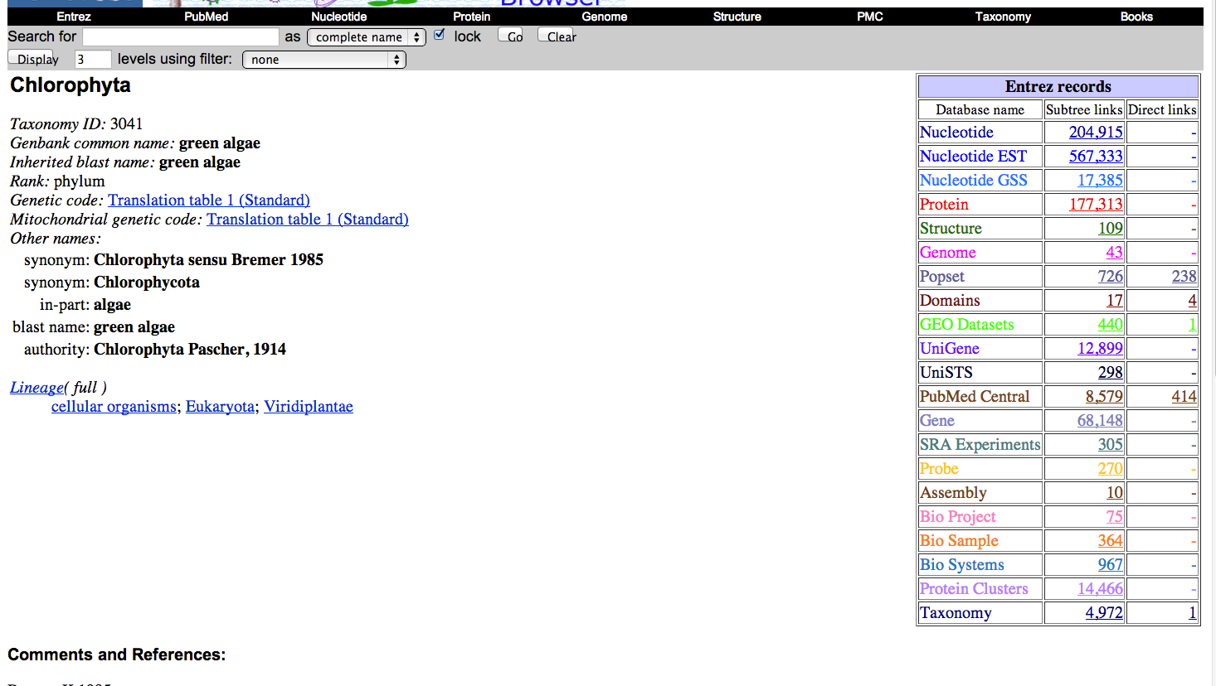

Slide 55
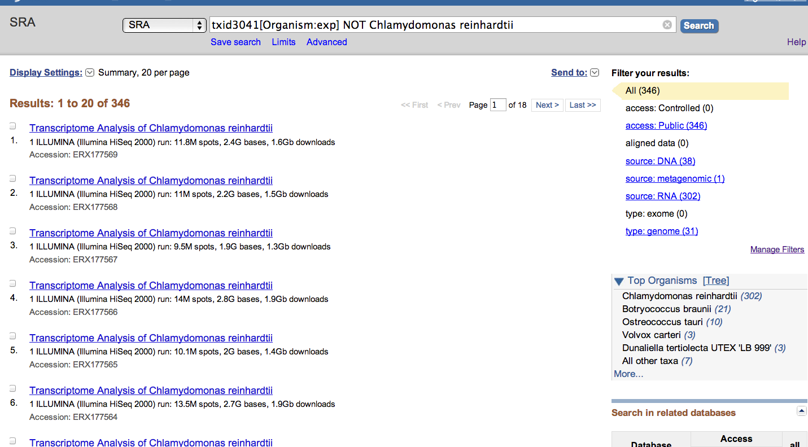

Slide 56
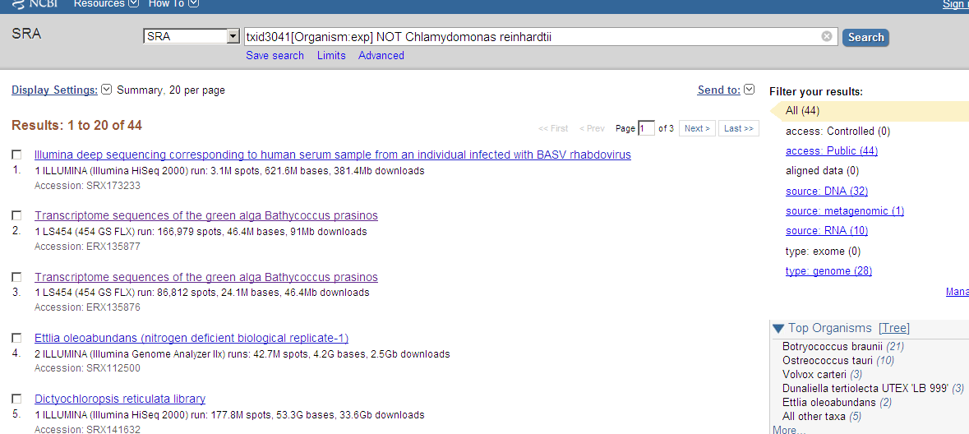

Slide 57
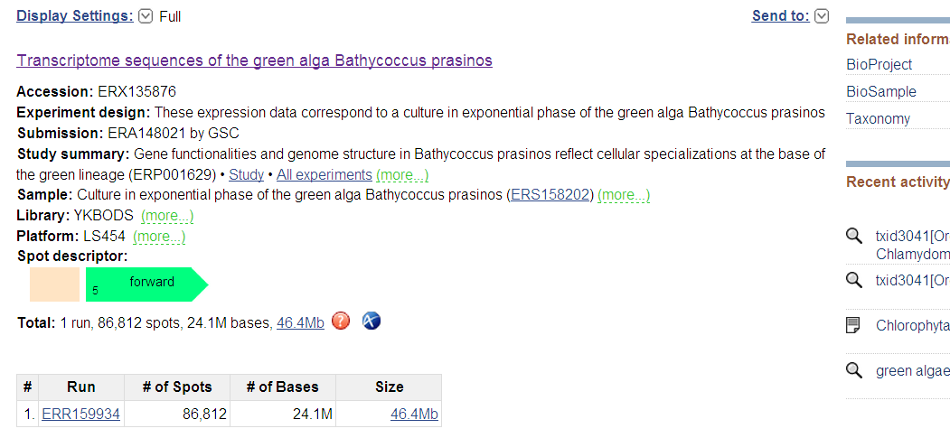

Slide 58
Next lecture
NCBI resources II: tools and ftp resources

