Slide 1
NCBI resources III: GEO and expression data analysis
Yanbin Yin
Fall 2014

Slide 2
Homework assignment 2
Given the publication http://www.ncbi.nlm.nih.gov/pubmed/19723656, find GEO datasets that are associated with the paper.
Choose the first data series and perform a GEO2R analysis
Find the top two differentially expressed genes and search their gene symbol at Gene database and explain what they are
Write a report (in word or ppt) to include all the operations and screen shots
Due on 9/23 (send by email or bring printed hard copy to class)
Office hour:
Tue, Thu and Fri 2-4pm, MO325A
Or email: yyin@niu.edu

Slide 3
Gene Expression Omnibus (GEO)
http://www.ncbi.nlm.nih.gov/geo/
GEO is an international public repository that archives and freely distributes microarray, next-generation sequencing, and other forms of high-throughput functional genomics data submitted by the research community.
The three main goals of GEO are to:
Provide a robust, versatile database in which to efficiently store high-throughput functional genomic data
Offer simple submission procedures and formats that support complete and well-annotated data deposits from the research community
Provide user-friendly mechanisms that allow users to query, locate, review and download studies and gene expression profiles of interest (Query and analysis)

Slide 4
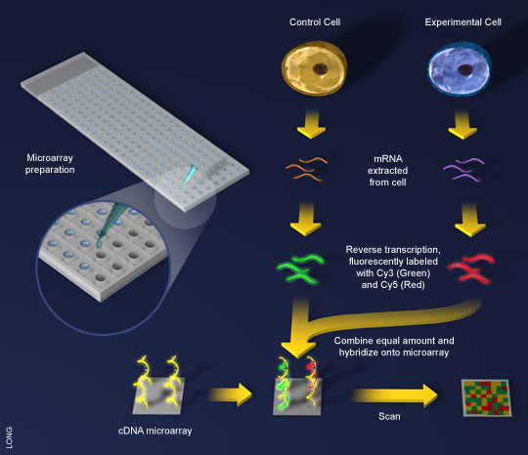
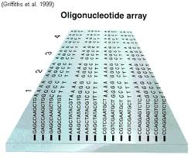
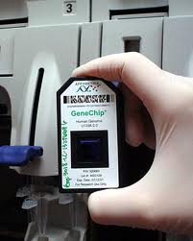
Basic intro to microarray
Cyanine

Slide 5
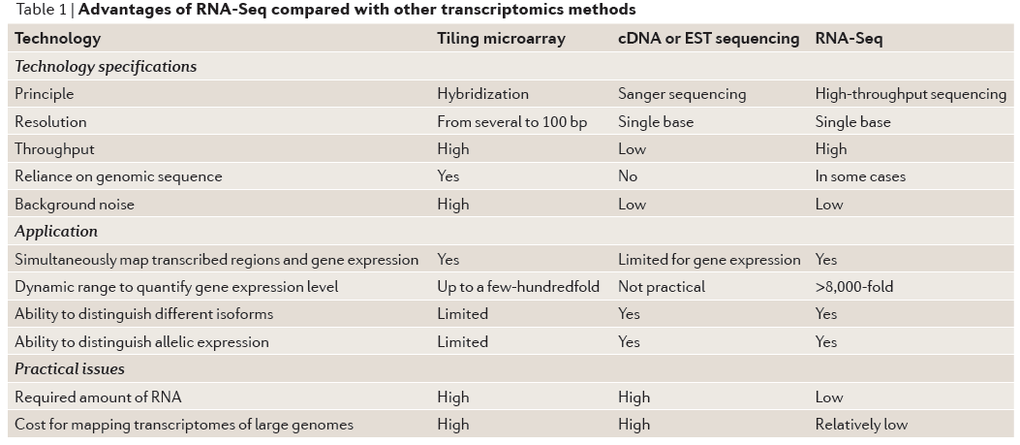
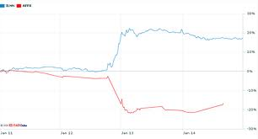
People are moving from microarray to high throughput sequencing

Slide 6
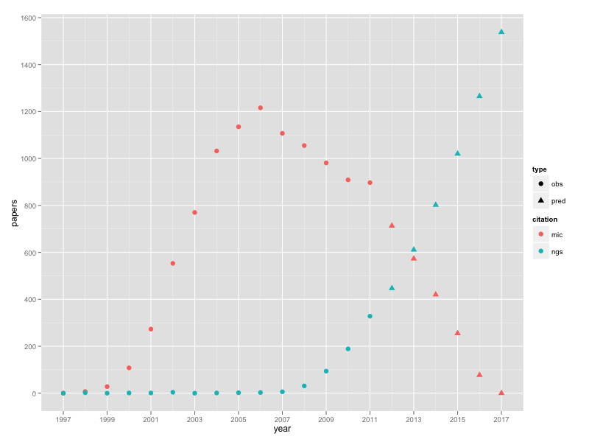
When can we expect the last microarray paper?
http://jermdemo.blogspot.com/2012/01/when-can-we-expect-last-damn-microarray.html

Slide 7
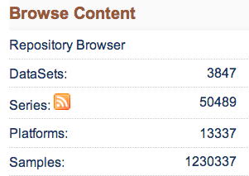
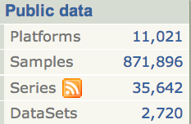
What data does GEO have?
http://www.ncbi.nlm.nih.gov/geo/
Submitter supplied: Platform, Sample, Series
NCBI curated: DataSets and Profiles
Tools: GEO BLAST and GEO2R
Omics data:
Genomics
Transcriptomics
Epigenomics
Proteomics
…

Slide 8
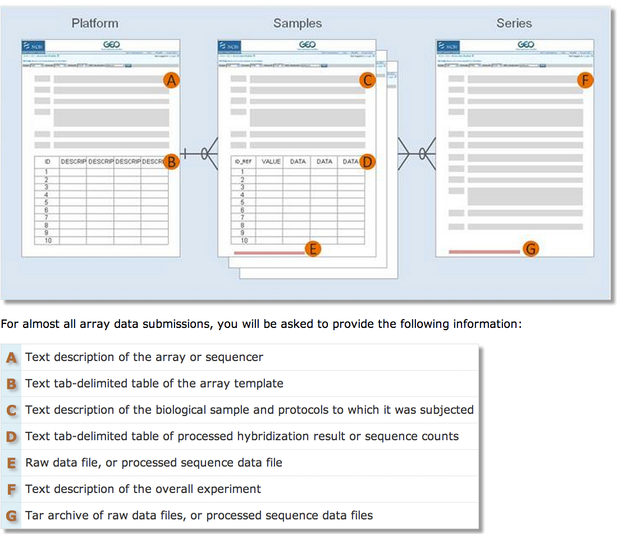
GEO accession number (GPLxxx)
GSExxx
GSMxxx

Slide 9
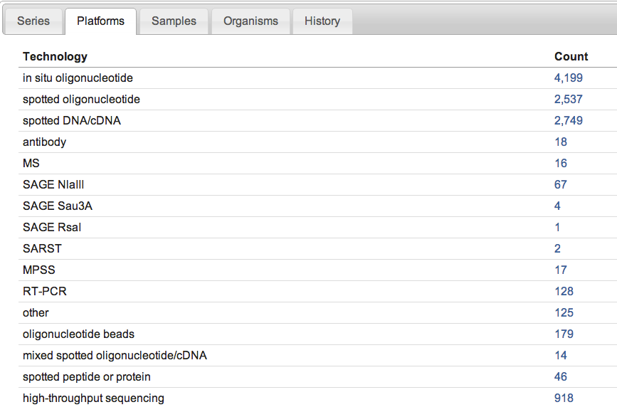
Microarray
NGS

Slide 10
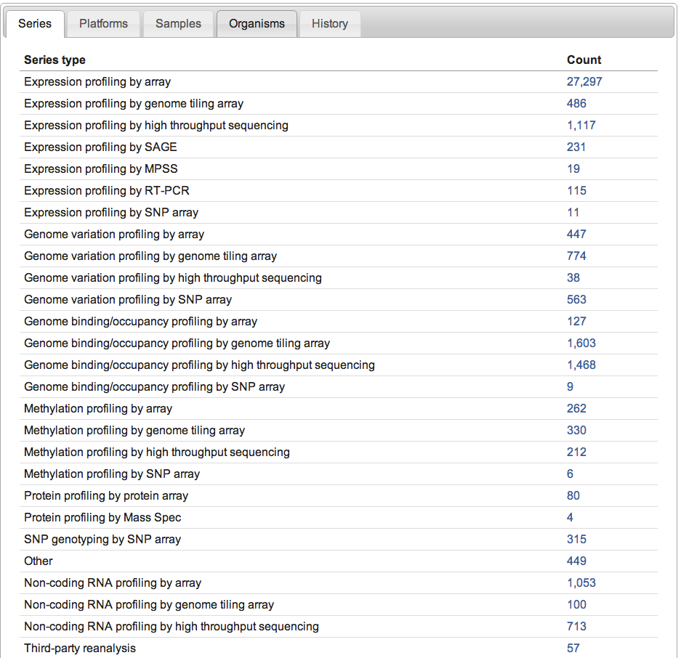
Expression
Genome variation
DNA-binding
Methylation/
Epigenomics
Protein array
ncRNAs

Slide 11
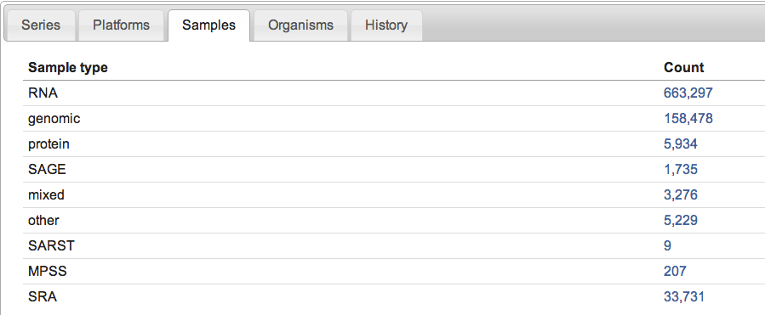

Slide 12
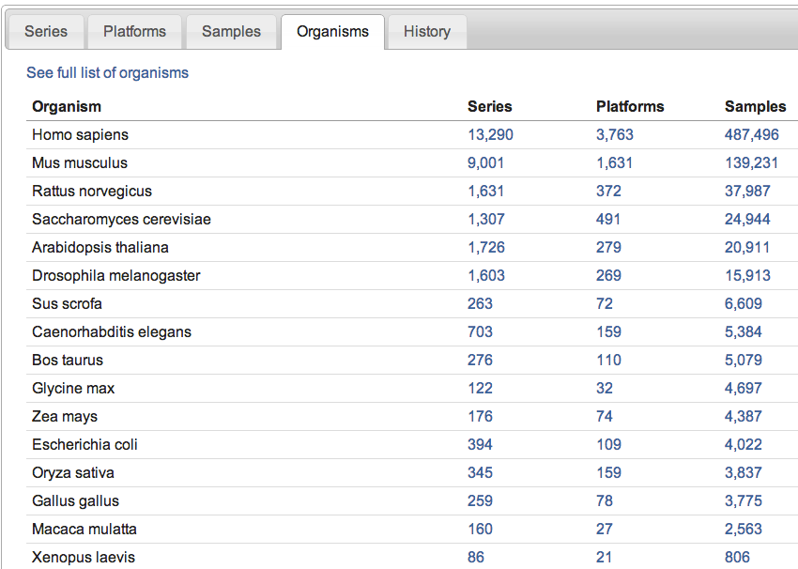

Slide 13
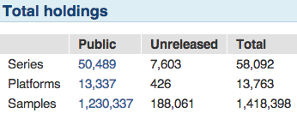
http://www.ncbi.nlm.nih.gov/geo/info/overview.html
Platform, Sample, Series
Experiment centric
Gene centric
Data of a GEO Series are reassembled by GEO staff into GEO Dataset records (GDSxxx).
A DataSet represents a curated collection of biologically and statistically comparable GEO Samples and forms the basis of GEO's suite of data display and analysis tools.
Profiles are derived from DataSets
A Profile consists of the expression measurements for an individual gene across all Samples in a DataSet.
Not all submitted data are suitable for DataSet assembly, so not all Series have corresponding DataSet record(s).

Slide 14
Hands on exercise 1
GEO browse and query

Slide 15
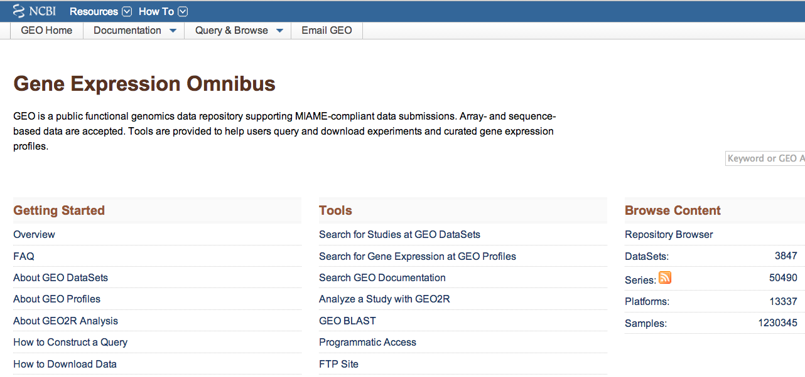
http://www.ncbi.nlm.nih.gov/geo/

Slide 16
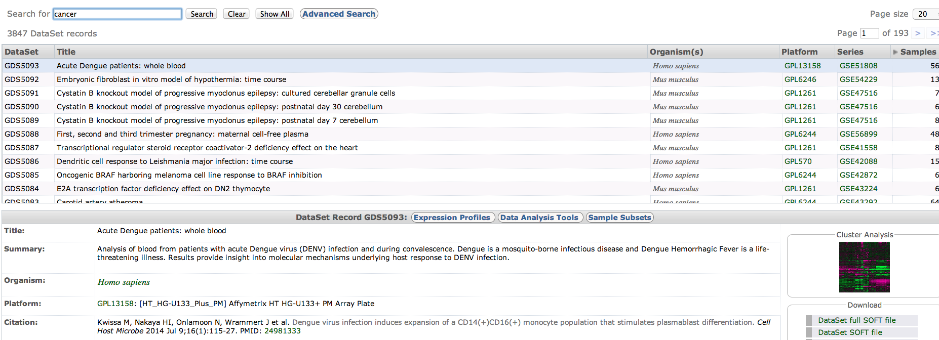
Try:
cancer
colon cancer
arabidopsis
ecoli
These are only DataSets
Type the keyword in the search box and click search

Slide 17
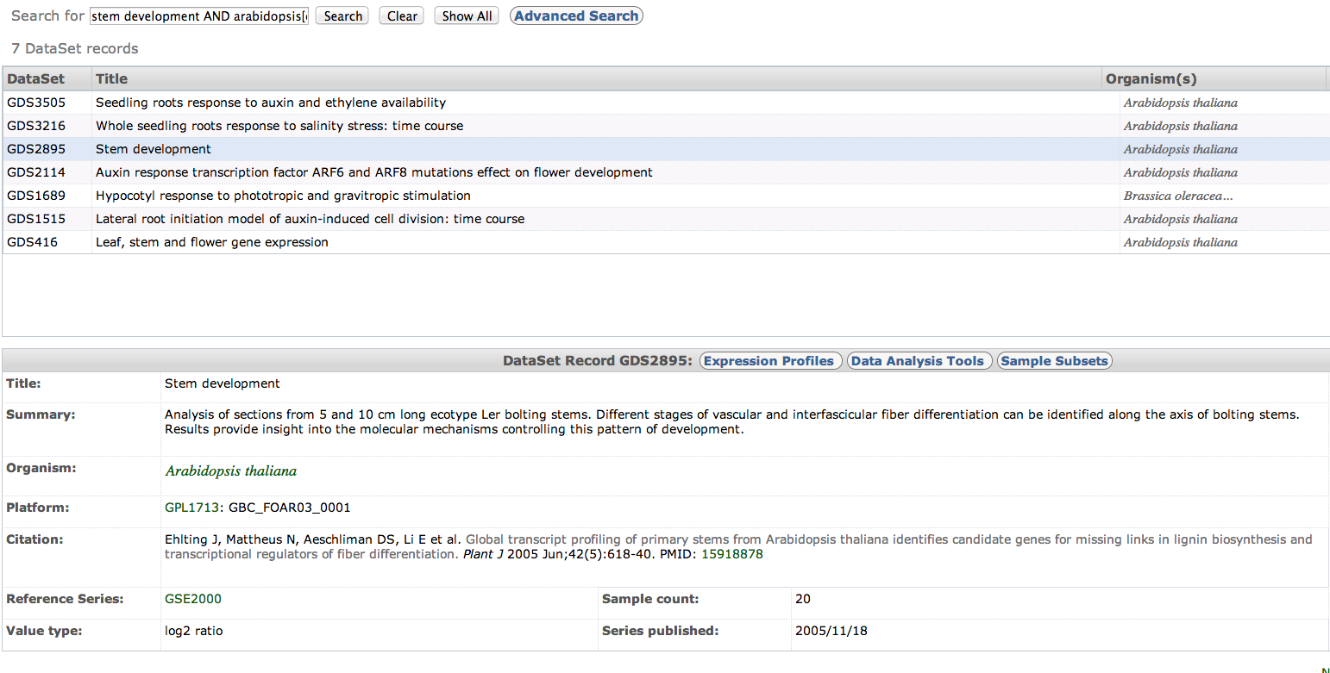
Construct queries to narrow down the results
term [field] OPERATOR term [field]
stem development AND arabidopsis[organism]

Slide 18
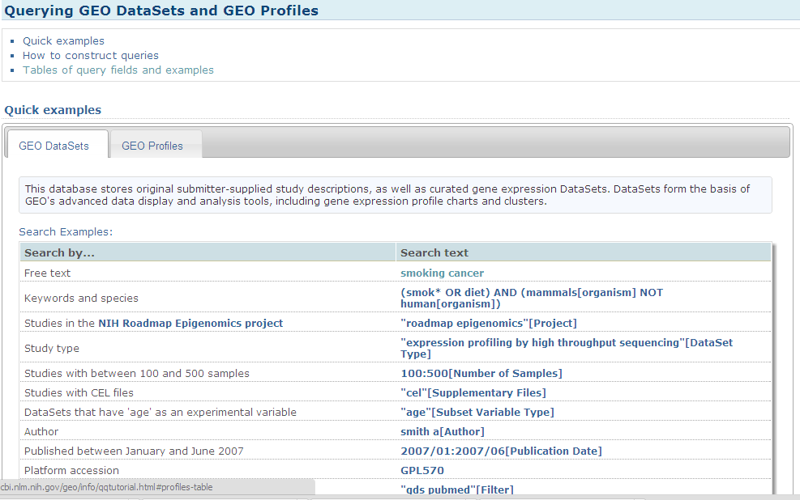
http://www.ncbi.nlm.nih.gov/geo/info/qqtutorial.html
term [field] OPERATOR term [field]

Slide 20
Hands on exercise 2
GEO gene profiles

Slide 21
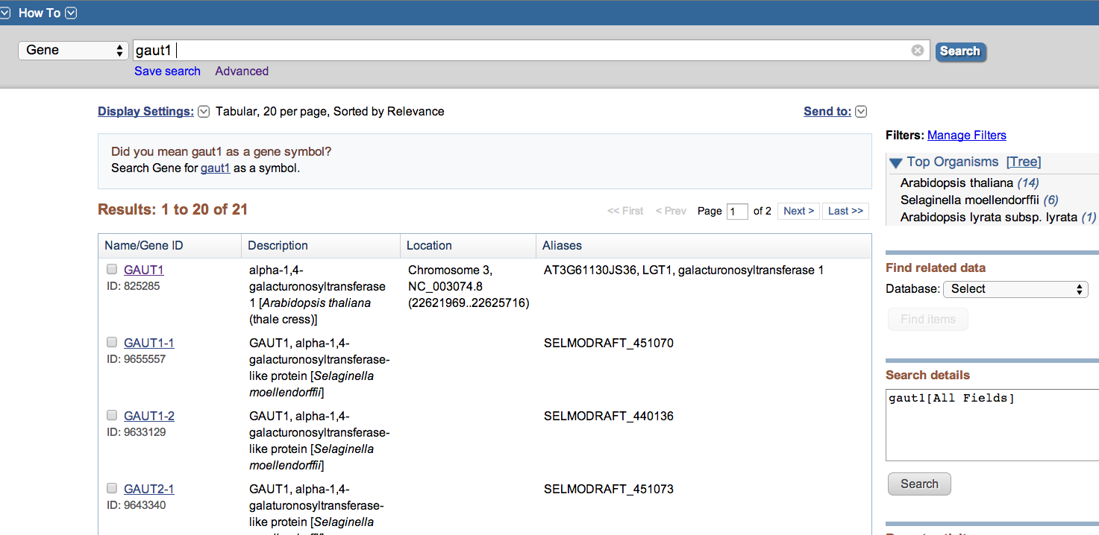
Search for a gene: GAUT1

Slide 22
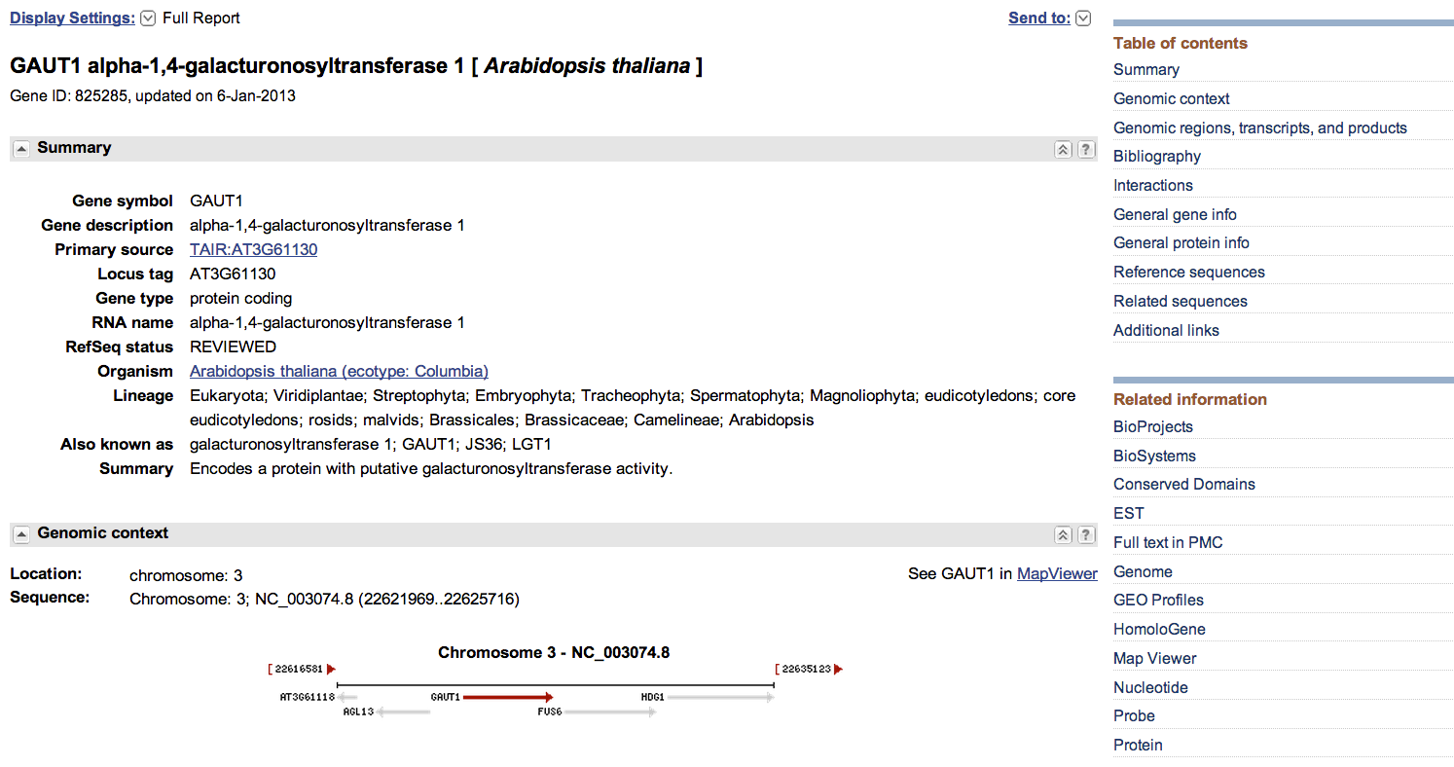

Slide 23
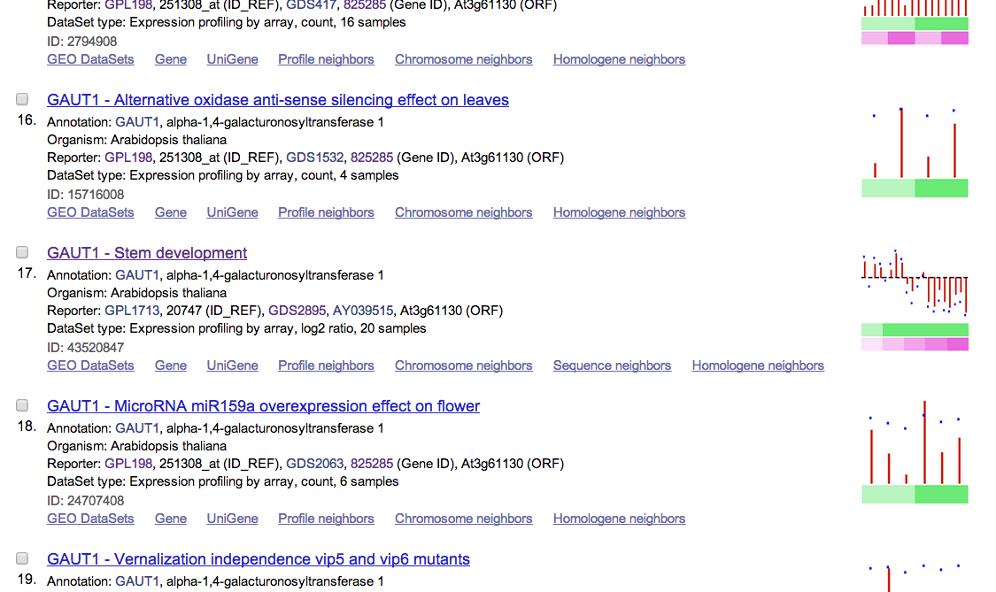
Scroll down to find record 17
Click here

Slide 24
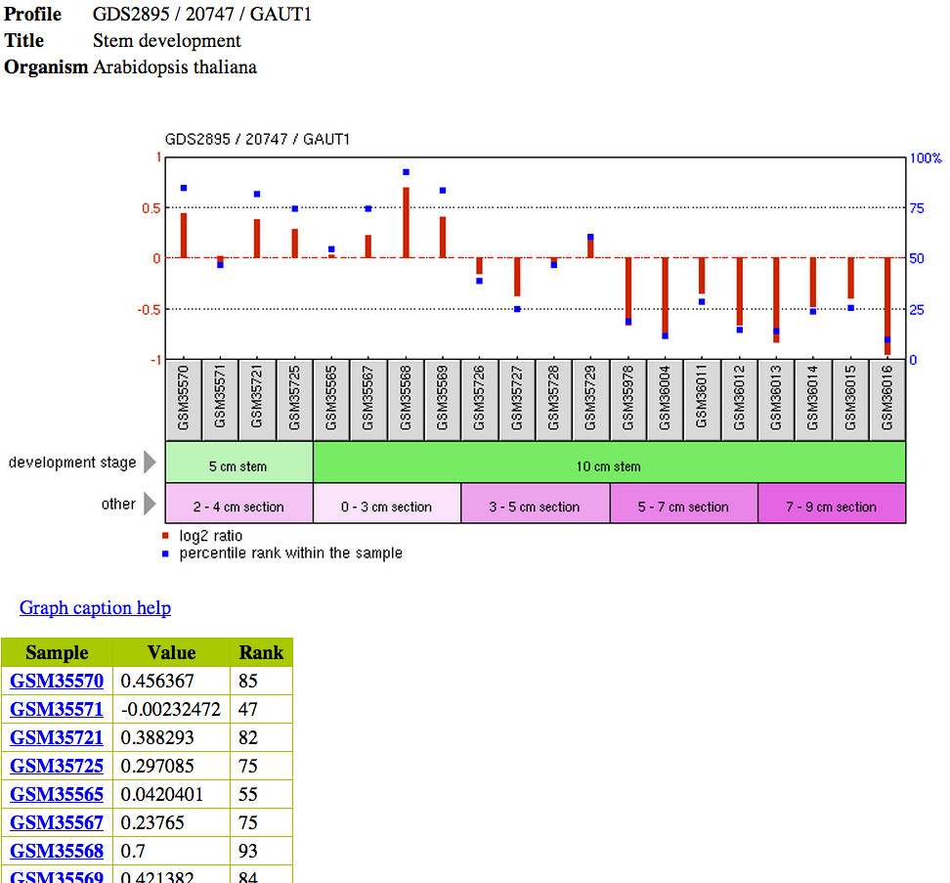

Slide 25
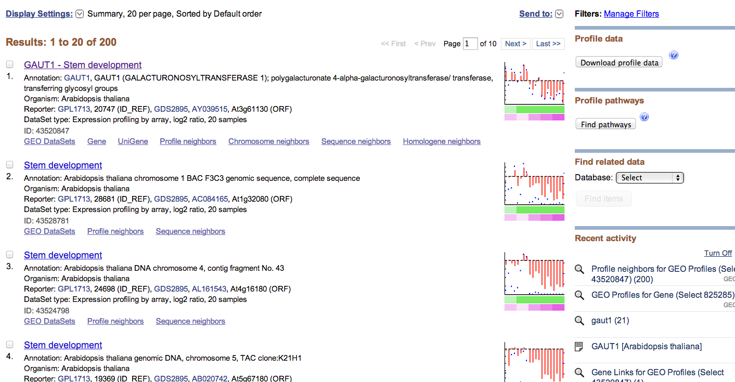
Profile neighbors: what are the co-expressed genes sharing similar expression profiles?
Go back to result page

Slide 26
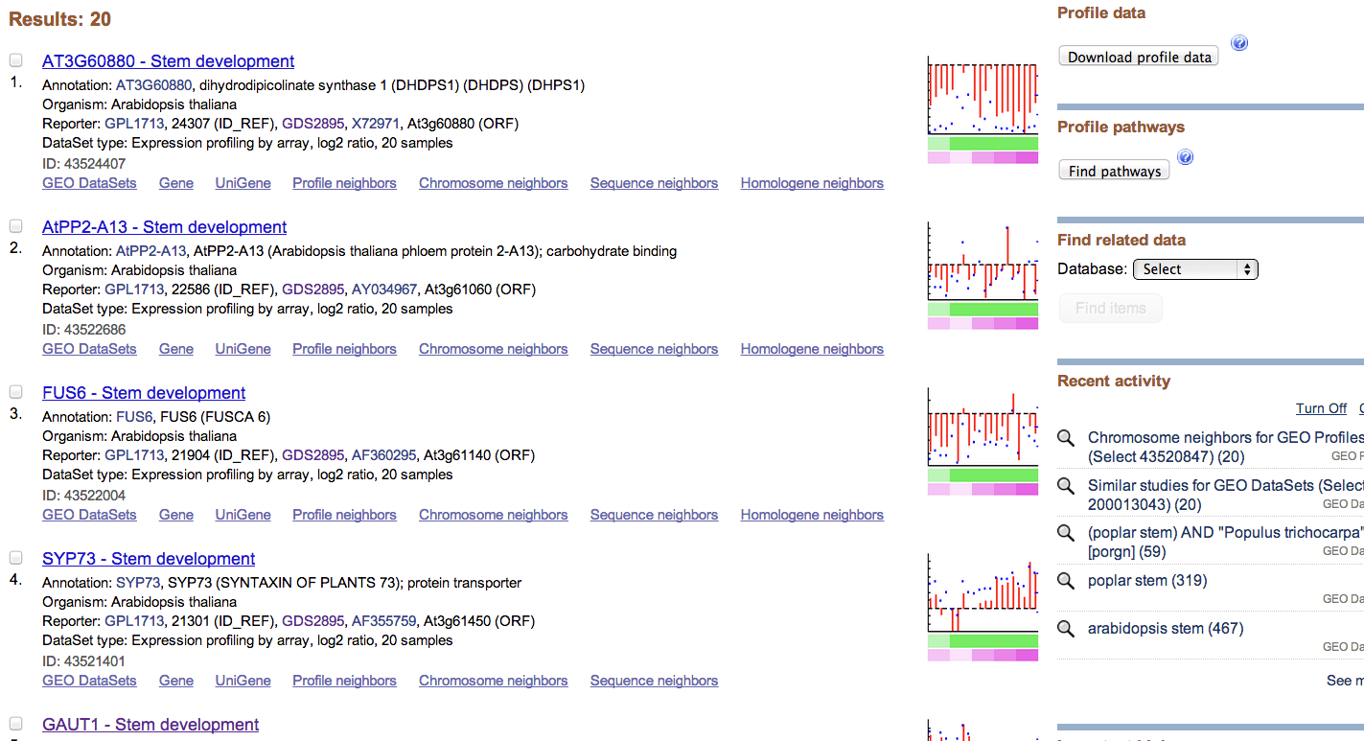
Chromosome neighbors: are neighboring genes co-expressed?

Slide 27
Hands on exercise 3
GEO DataSets analysis tool

Slide 28
stem development AND arabidopsis[organism]
Click on 893

Slide 29
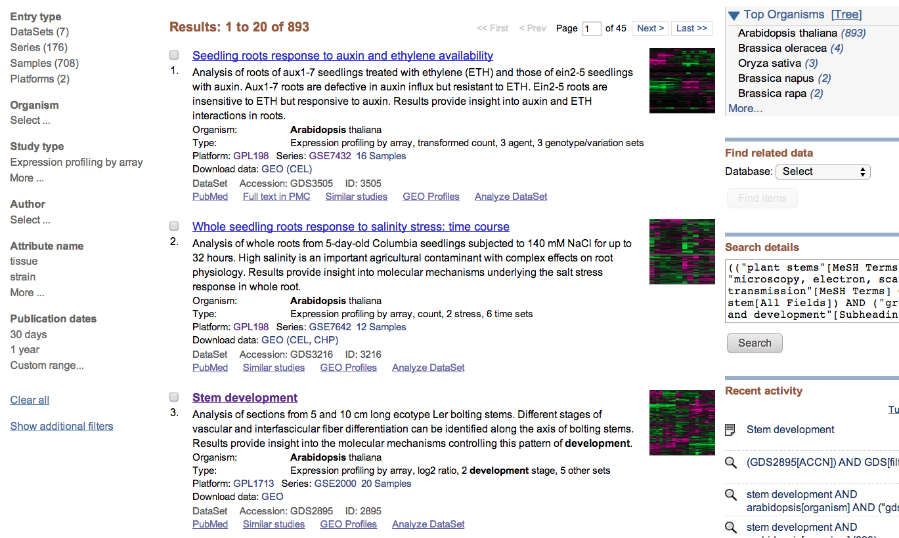

Slide 30
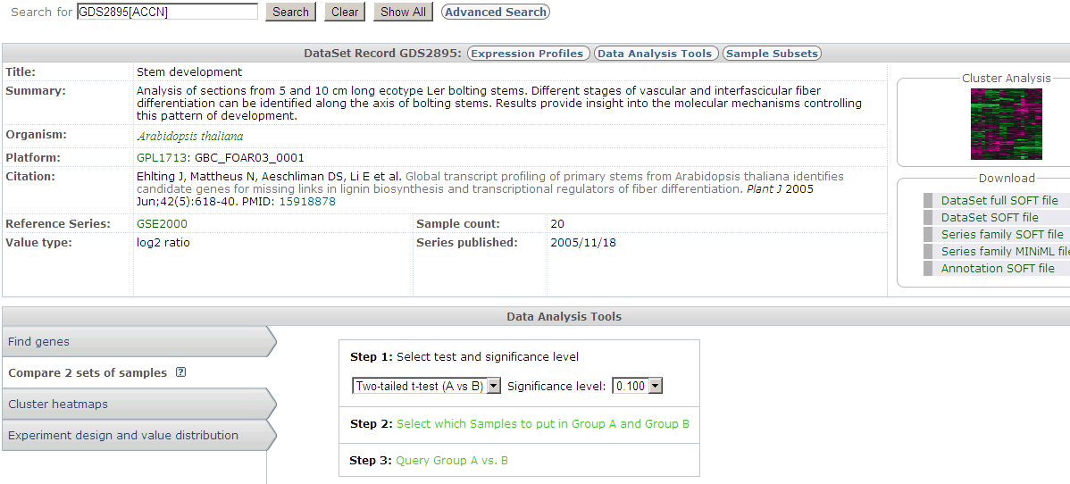
We want to use this DataSet to identify differentially expressed genes in stem development
How: define two groups of samples and run two sample t test
Click on step 2 to define two groups of samples

Slide 31
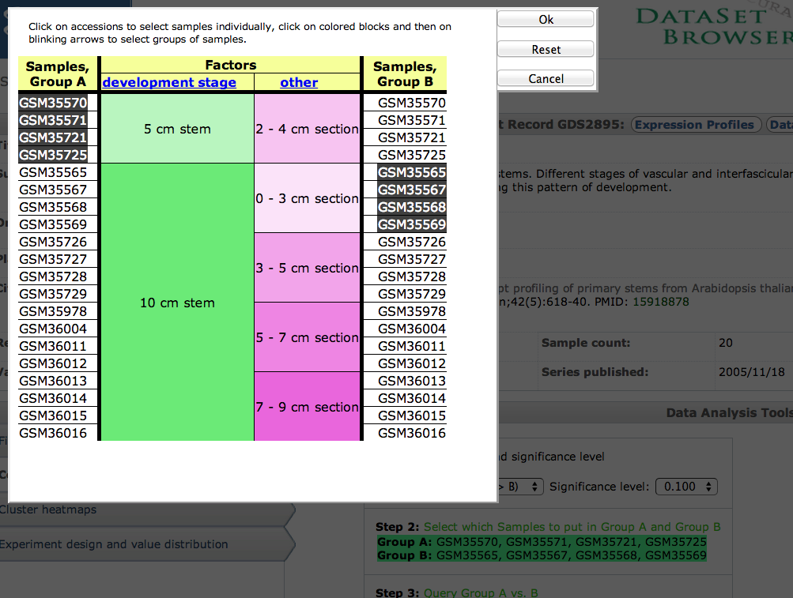
Click samples to select

Slide 32
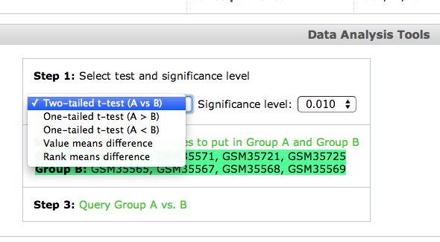
Step 1: you can choose different statistical methods for analysis
Step 3 to perform analysis

Slide 33
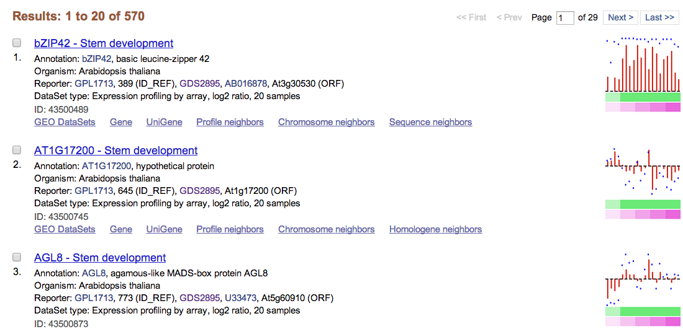
Result page is a list of genes with significantly different expression between two groups of samples
Group 2
Group 1

Slide 34
“Analyze DataSet” is for GEO DataSets
“GEO2R” is for GEO Series
GEO2R: differentially expressed genes
http://www.youtube.com/watch?v=EUPmGWS8ik0

Slide 35
stem development AND arabidopsis[organism]
Click on 893

Slide 36
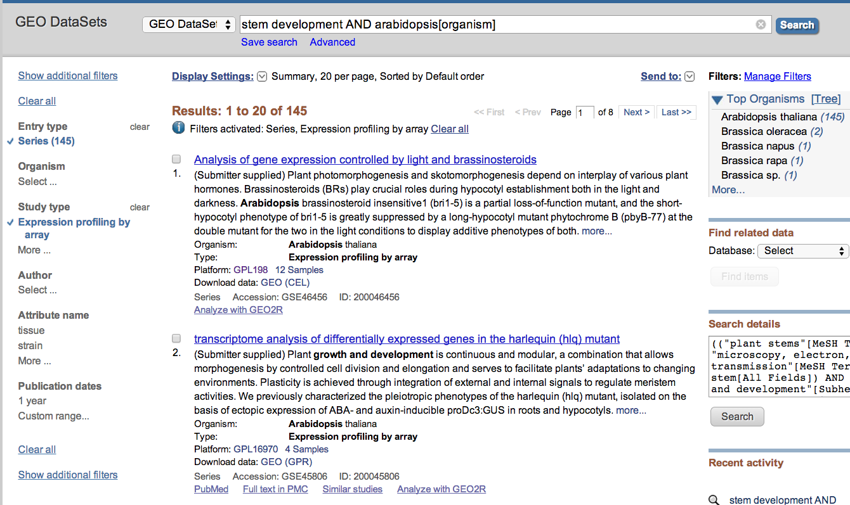

Slide 37
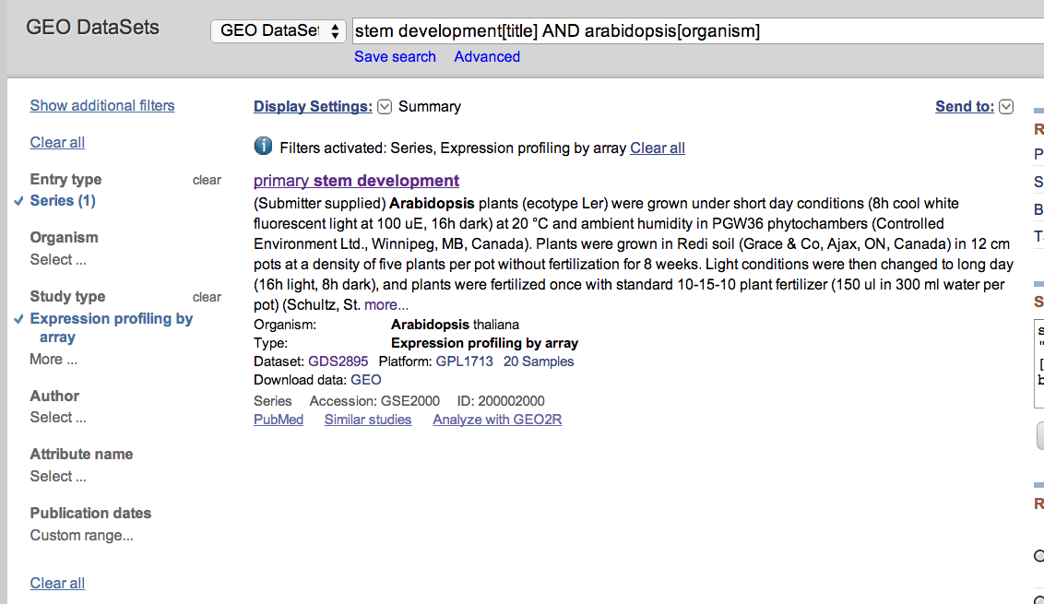
Hard to choose? Let’s modify the query text to narrow down
stem development[title] AND arabidopsis[organism]
Click on the title to get detailed info about this data series

Slide 38
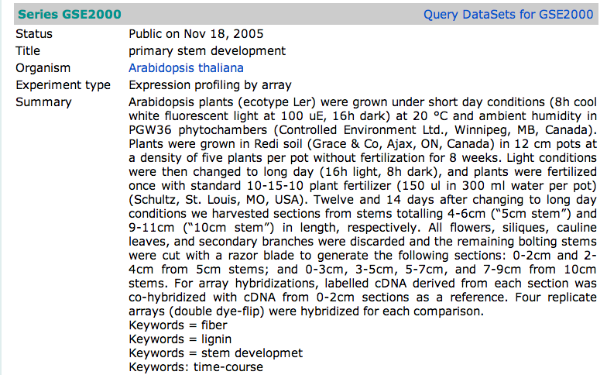
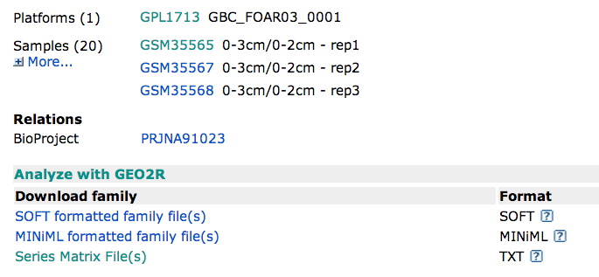
Description of experiments
Platform and sample data

Slide 39
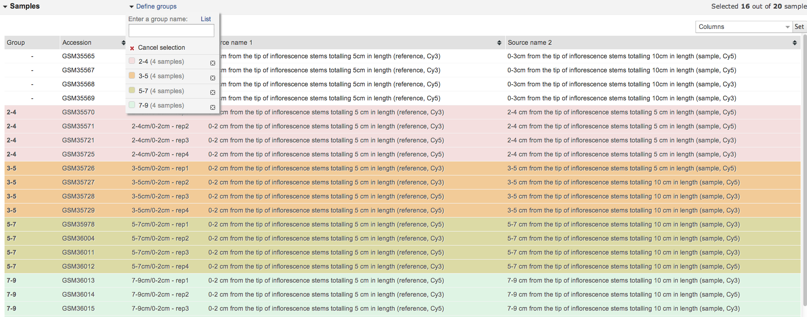
Click on Define groups and type in group names
Select samples from the table and click on the defined group to assign to the group
Click on Top 250 in the bottom of the page to run the job

Slide 40
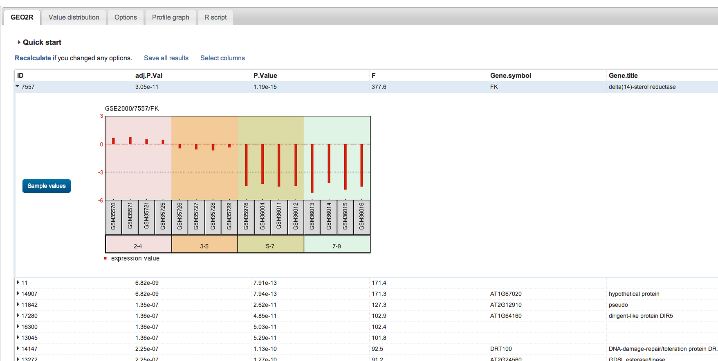
The result page, click on the ID will give the graph
The 4 groups have different profiles for each gene

Slide 41
ftp
FTP stands for File Transfer Protocol.
HTTP stands for Hyper Text Transfer Protocol.
When ftp appears in a URL it means that the user is connecting to a file server and not a Web server and that some form of file transfer is going to take place.
When http appears in a URL it means that the user is connecting to a Web server and not a file server. The files are transferred but not downloaded, therefore not copied into the memory of the receiving device.
http://wiki.answers.com/Q/What_is_the_difference_between_FTP_and_HTTP

Slide 42
ftp server of NCBI

Slide 43
ftp resources
Refseq genomes, proteins, mRNAs
Microbial genomes
Plant genomes
Fungal genomes
Blast database folder
Sra reads
Geo datasets

Slide 44
Next lecture: EBI resources I

