Slide 1
EBI web resources II: Ensembl and InterPro
Yanbin Yin
Fall 2014
http://www.ebi.ac.uk/training/online/course/

Slide 2
Homework 3
Go to http://www.ebi.ac.uk/interpro/training.html and finish the second online training course “Introduction to protein classification at the EBI” and then answer the following questions:
What is the difference between a protein family and a protein domain?
Can a protein belong to multiple families or contain multiple domains?
What are protein sequence features? Examples?
What is a protein signature? What is it used for?
What are the major signature types?
Is PROSITE a sequence pattern database or a profile database? What about Pfam?
What is the definition of “annotation”?
In your report, answer these questions and also include the screen shot of the page(s) that support your answer.
Due on 10/7 (send by email)
Office hour:
Tue, Thu and Fri 2-4pm, MO325A
Or email: yyin@niu.edu

Slide 3
Outline
Intro to genome annotation
Protein family/domain databases
InterPro, Pfam, Superfamily etc.
Genome browser
Ensembl
Hands on Practice

Slide 4
Genome annotation
Predict genes (where are the genes?)
protein coding
RNA coding
Function annotation (What are these genes?)
Search against UniProt or NCBI-nr (GenPept)
Search against protein family/domain databases
Search against Pathway databases
Function vocabularies
defined in
Gene Ontology
Proteins can be classified into groups according to sequence or structural similarity. These groups often contain well characterized proteins whose function is known. Thus, when a novel protein is identified, its functional properties can be proposed based on the group to which it is predicted to belong.

Slide 5
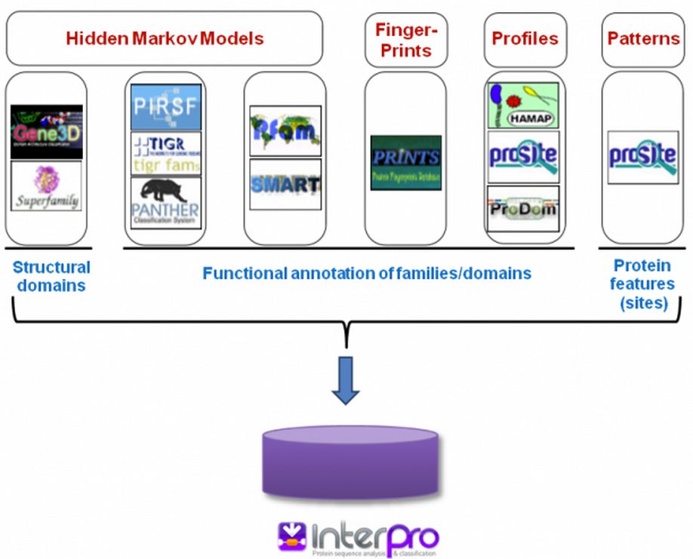
Superfamily
Gene3D
SCOP
CATH
PDB

Slide 6
InterPro components
CATH/Gene3D University College, London, UK
PANTHER University of Southern California, CA, USA
PIRSF Protein Information Resource, Georgetown University, USA
Pfam Wellcome Trust Sanger Institute, Hinxton, UK
PRINTS University of Manchester, UK
ProDom PRABI Villeurbanne, France
PROSITE Swiss Institute of Bioinformatics (SIB), Geneva, Switzerland
SMART EMBL, Heidelberg, Germany
SUPERFAMILY University of Bristol, UK
TIGRFAMs J. Craig Venter Institute, Rockville, MD, US
HAMAP Swiss Institute of Bioinformatics (SIB), Geneva, Switzerland
Pfam, SMART, TIGRFAM,
COG, KOG, PRK, CD, LOAD
CDD components

Slide 7
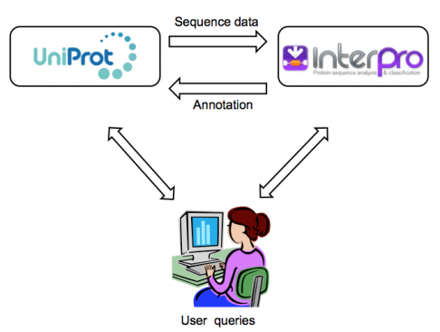
Most UniProt proteins are annotated with at least one InterPro signature

Slide 8
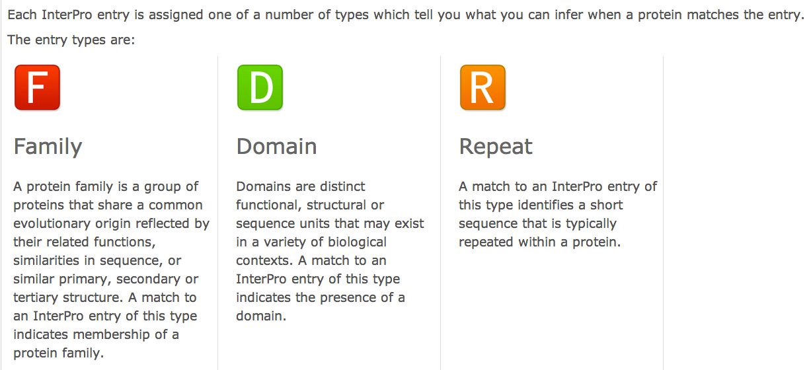
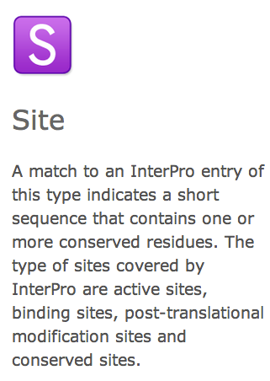

Slide 9
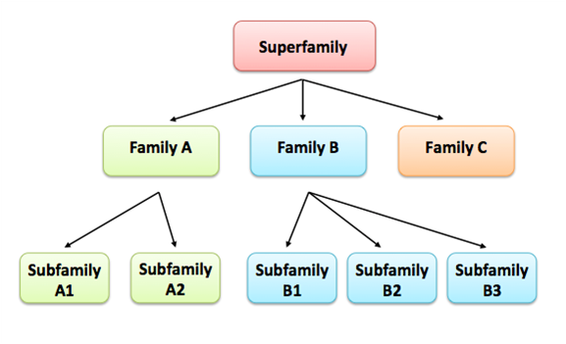
Protein families are often arranged into hierarchies, with proteins that share a common ancestor subdivided into smaller, more closely related groups. The terms superfamily (describing a large group of distantly related proteins) and subfamily (describing a small group of closely related proteins) are sometimes used in this context

Slide 10
Protein Classification
Nearly all proteins have structural similarities with other proteins and, in some of these cases, share a common evolutionary origin. Proteins are classified to reflect both structural and evolutionary relatedness. Many levels exist in the hierarchy, but the principal levels are family, superfamily and fold, described below.
Family: Clear evolutionarily relationship
Proteins clustered together into families are clearly evolutionarily related. Generally, this means that pairwise residue identities between the proteins are 30% and greater.
Superfamily: Probable common evolutionary origin
Proteins that have low sequence identities, but whose structural and functional features suggest that a common evolutionary origin is probable are placed together in superfamilies.
Fold: Major structural similarity
Proteins are defined as having a common fold if they have the same major secondary structures in the same arrangement and with the same topological connections. Different proteins with the same fold often have peripheral elements of secondary structure and turn regions that differ in size and conformation. Proteins placed together in the same fold category may not have a common evolutionary origin: the structural similarities could arise just from the physics and chemistry of proteins favoring certain packing arrangements and chain topologies.
http://scop.mrc-lmb.cam.ac.uk/scop/intro.html

Slide 11
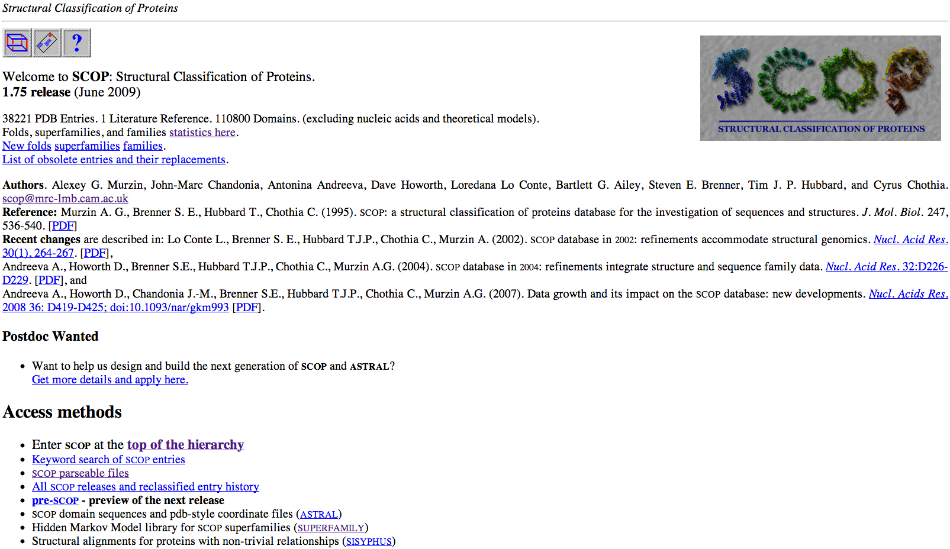
Structure
PDB
SCOP
CATH
Superfamily
Gene3D
Protein
Sequence
UniProt
GenPept
Pfam
SMART
ProSite
Function
(literature)
Evolution

Slide 12
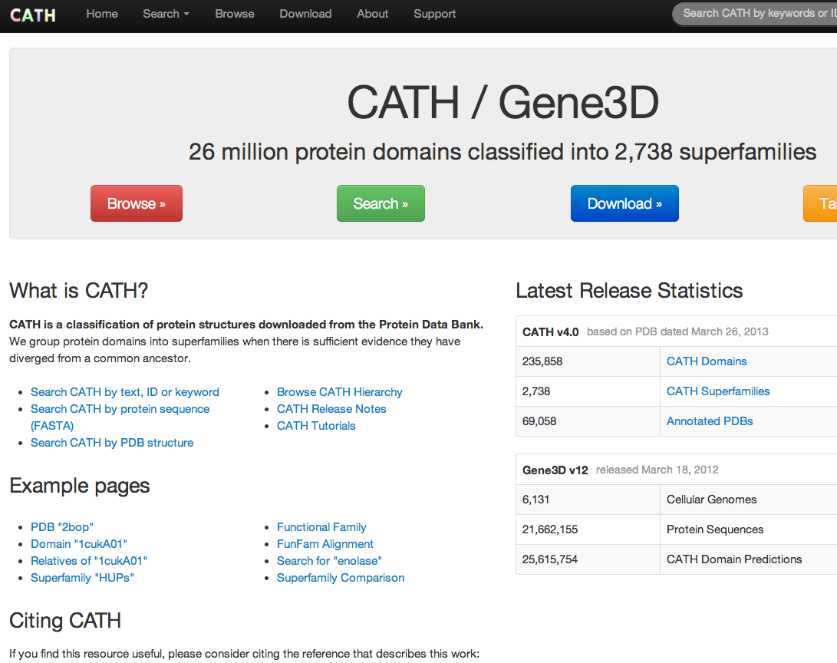
http://www.cathdb.info/

Slide 13
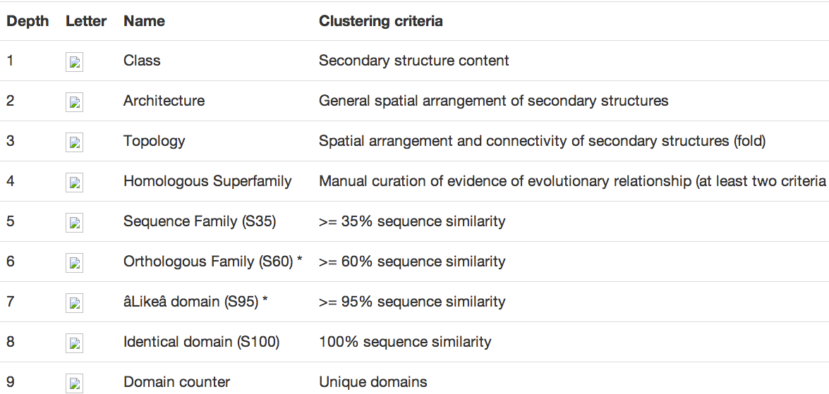
fold ~ class – superfamily ~ clan – family – subfamily – domain sequence

Slide 14
Family- and domain-based classifications are not always straightforward and can overlap, since proteins are sometimes assigned to families by virtue of the domain(s) they contain. An example of this kind of complexity is outlined below
Domain composition of phospholipase D1, which is an enzyme that breaks down phosphatidylcholine. The protein contains a PX (phox) domain that is involved in binding phosphatidylinositol, a PH (pleckstrin homology) domain that has a role in targeting the enzyme to particular locations within the cell, and two PLD (phospholipase D) domains responsible for the protein’s catalytic activity

Slide 15
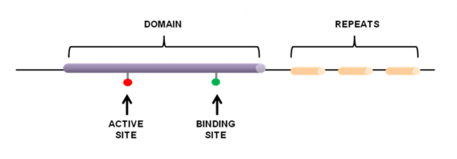
Sequence features differ from domains in that they are usually quite small (often only a few amino acids long), whereas domains represent entire structural or functional units of the protein (see Figure). Sequence features are often nested within domains – a protein kinase domain, for example, usually contains a protein kinase active site
Sequences features are groups of amino acids that confer certain characteristics upon a protein, and may be important for its overall function. Such features include:
active sites, which contain amino acids involved in catalytic activity.
binding sites, containing amino acids that are directly involved in binding molecules or ions.
post-translational modification (PTM) sites, which contain residues known to be chemically modified (phosphorylated, palmitoylated, acetylated, etc) after the process of protein translation.
repeats, which are typically short amino acid sequences that are repeated within a protein, and may confer binding or structural properties upon it.

Slide 16
Hands on exercise 1: search against protein family databases

Slide 17
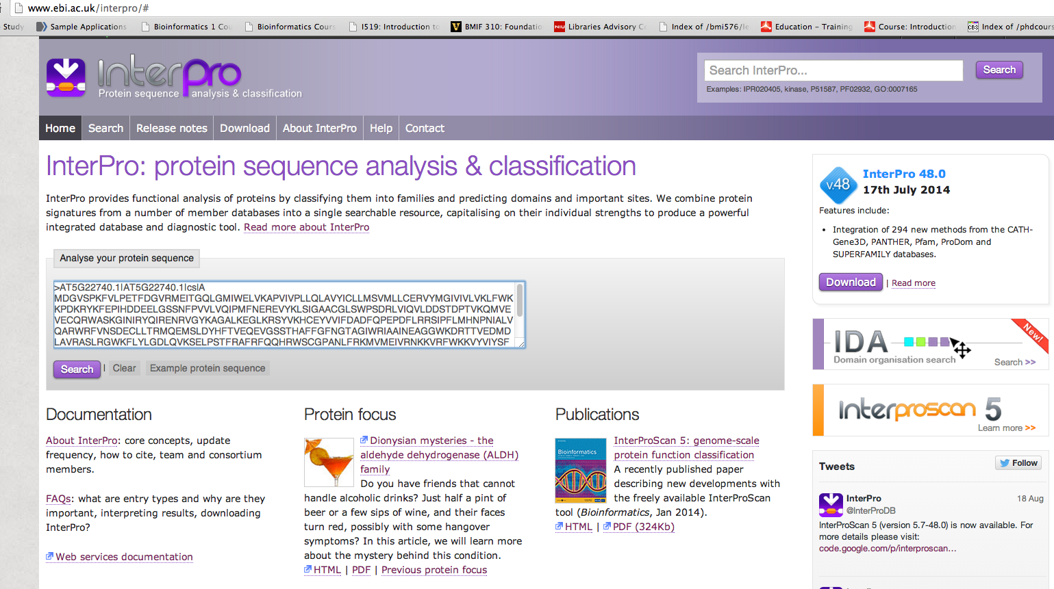
http://www.ebi.ac.uk/interpro/
http://cys.bios.niu.edu/yyin/teach/PBB/csl-pr.fa, put the first sequence in the search box
Hit Search; take about 1 min
Read more about InterPro

Slide 18
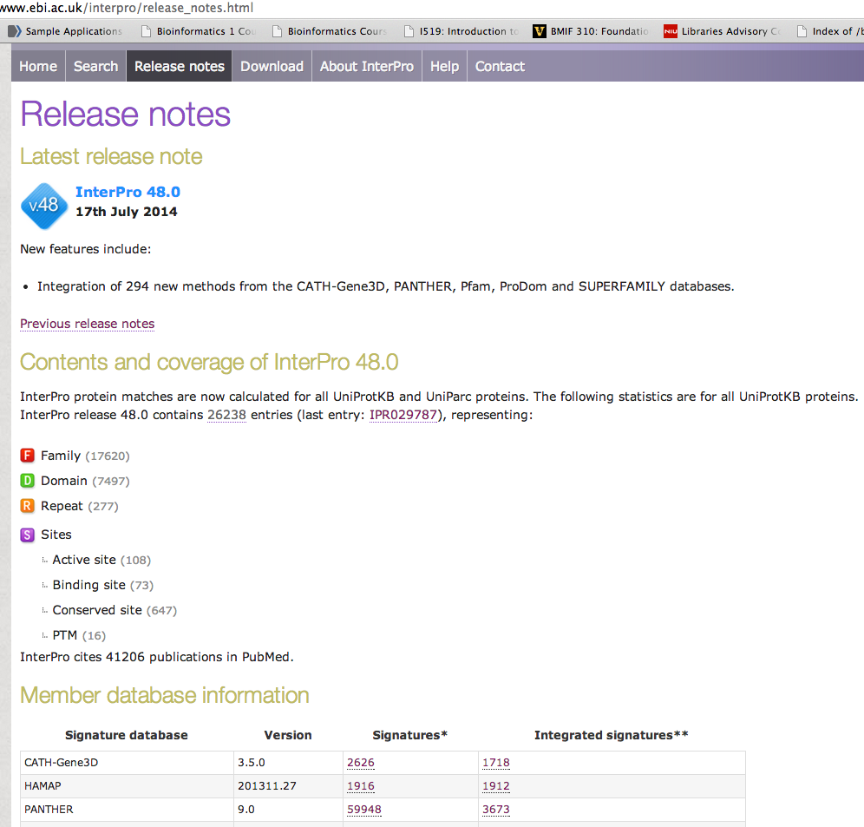
http://www.ebi.ac.uk/interpro/release_notes.html

Slide 19
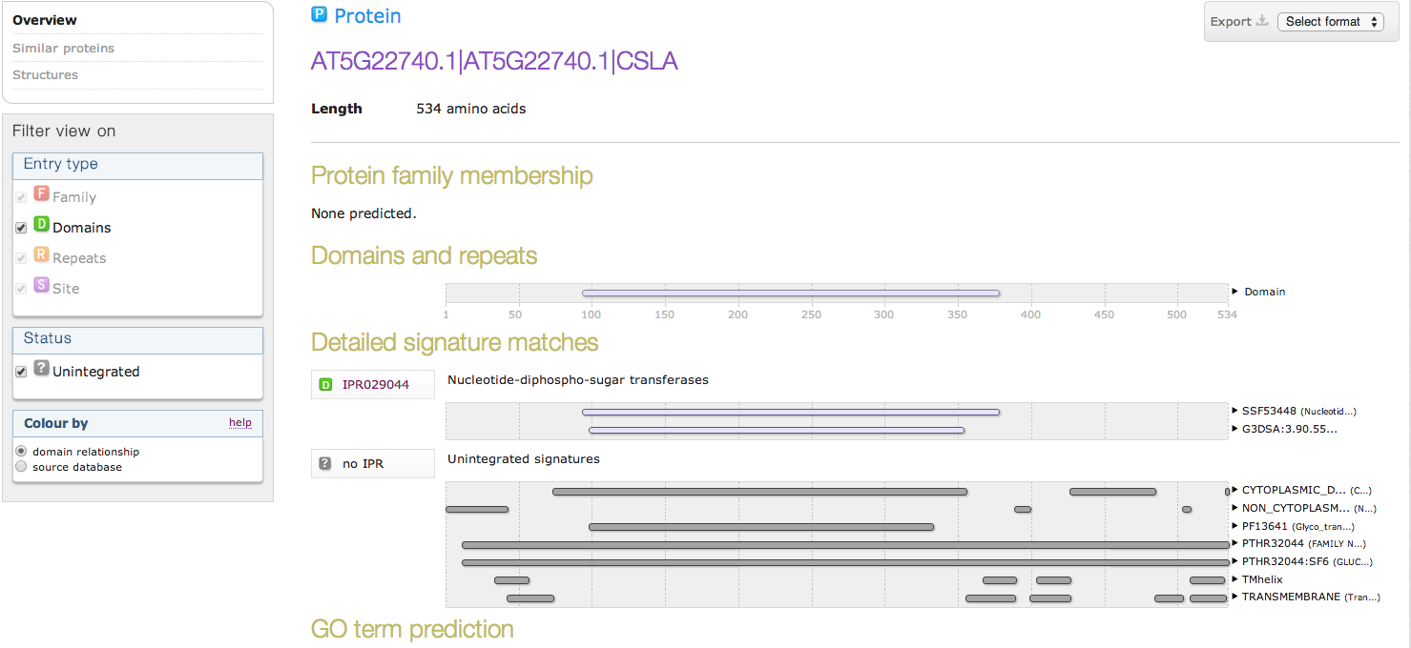
Click to link to InterPro page of this domain
Click to link to individual database website
These are individual family/domain matches not integrated in InterPro

Slide 20
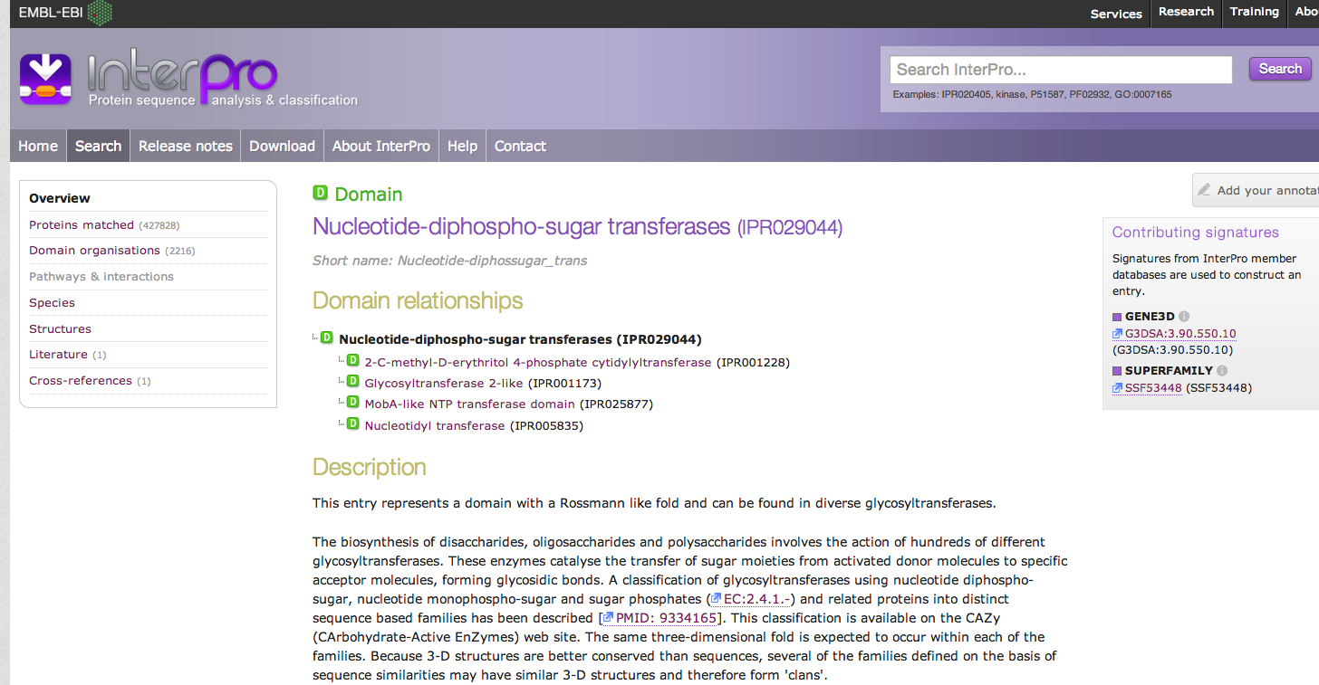
This is linked from the previous page: the InterPro page to describe IPR029044
Scientific literature for this IPR family

Slide 21
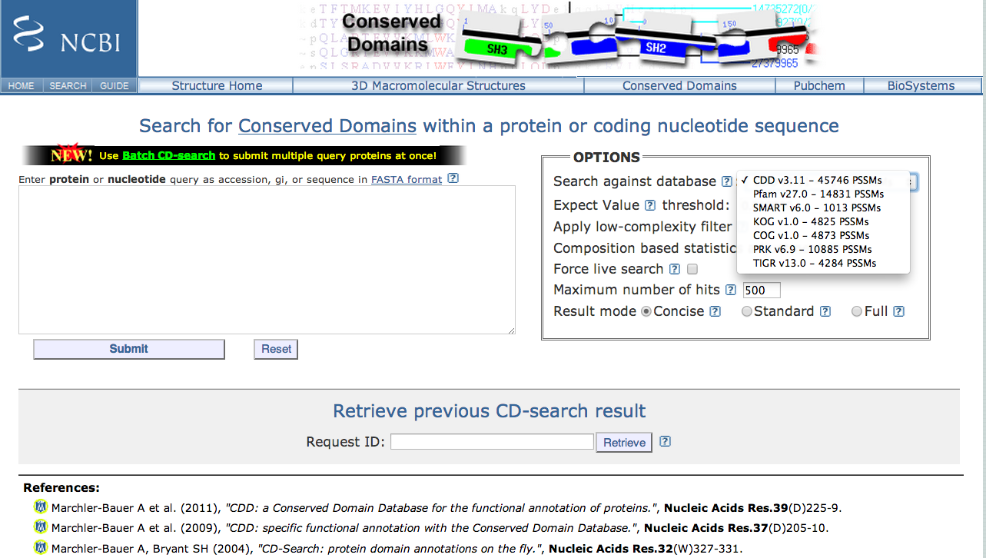
http://www.ncbi.nlm.nih.gov/Structure/cdd/wrpsb.cgi
NCBI’s Conserved Domain Database (CDD): equivalent to InterPro of EBI, much faster, but integrate less member databases

Slide 22
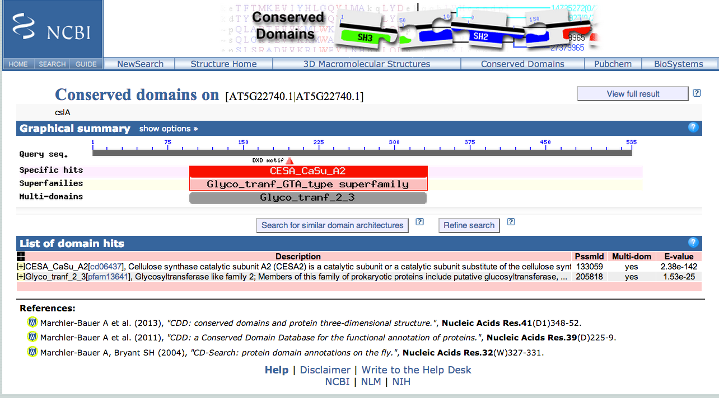

Slide 23
Genome browser: ENSEMBL

Slide 24
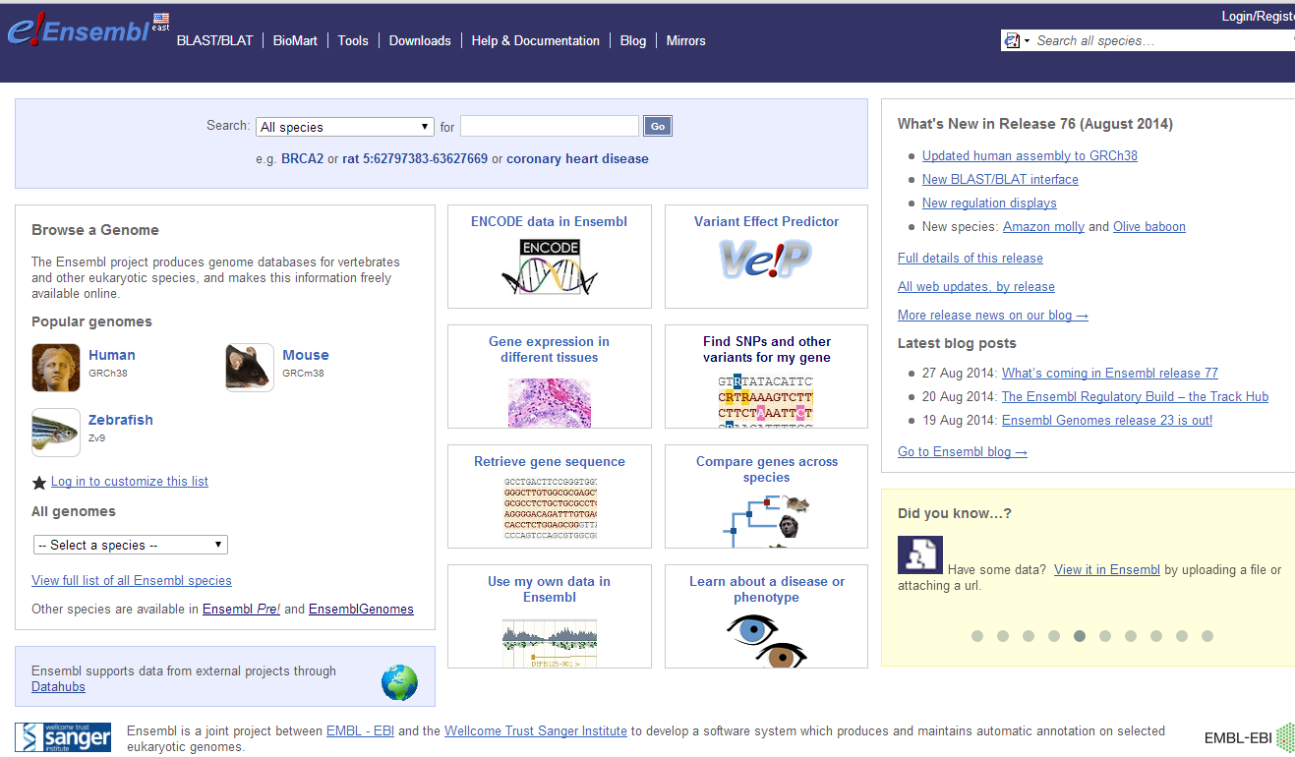
http://www.ensembl.org/
The Ensembl project aims to automatically annotate genome sequences, integrate these data with other biological information and to make the results freely available to geneticists, molecular biologists, bioinformaticians and the wider research community. Ensembl is jointly headed by Dr Stephen Searle at the Wellcome Trust Sanger Institute and Dr Paul Flicek at the European Bioinformatics Institute (EBI).

Slide 25
What do we need in genome browsers?
To make the bare DNA sequence, its properties, and the associated annotations more accessible through graphical interface.
Genome browsers provide access to large amounts of sequence data via a graphical user interface. They use a visual, high-level overview of complex data in a form that can be grasped at a glance and provide the means to explore the data in increasing resolution from megabase scales down to the level of individual elements of the DNA sequence.

Slide 26
Short tutorial videos introducing ENSEMBL
http://useast.ensembl.org/info/website/tutorials/index.html

Slide 27
http://useast.ensembl.org/info/website/tutorials/index.html

Slide 28
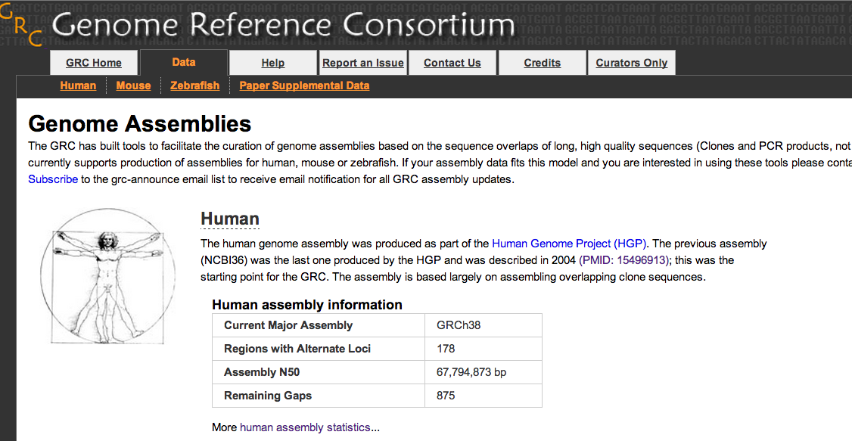
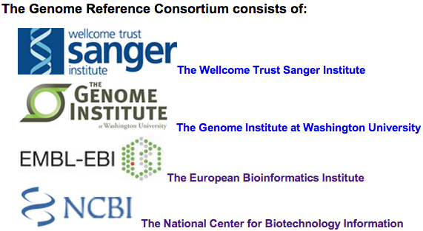
http://www.ncbi.nlm.nih.gov/projects/genome/assembly/grc/data.shtml

Slide 29
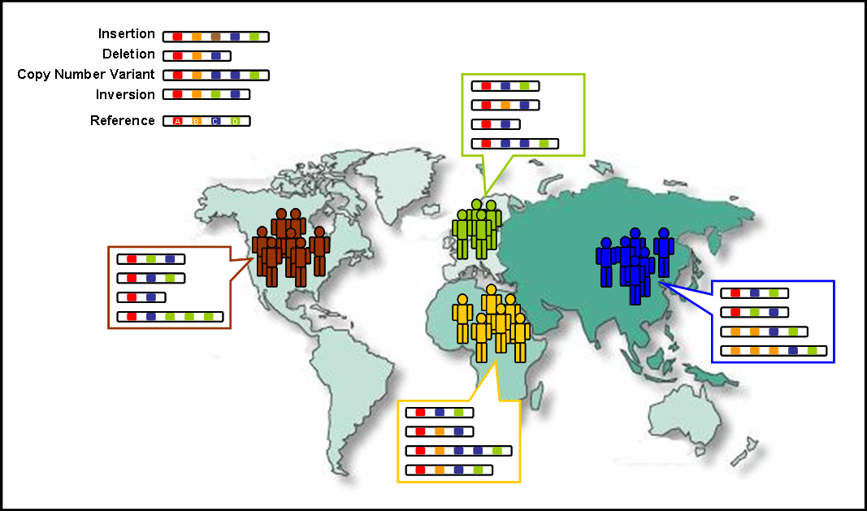
Nature 491, 56-65 ( 01 November 2012 )

Slide 30
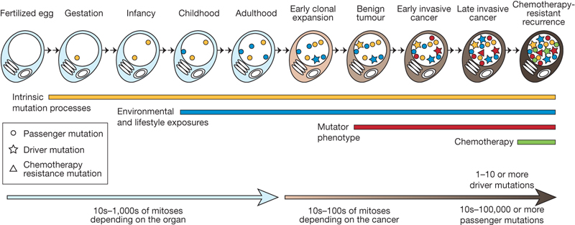
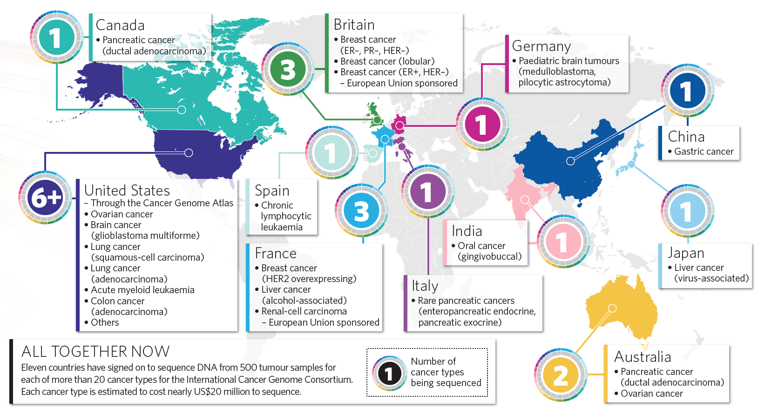
Nature 458, 719-724(9 April 2009)
NATURE|Vol 464|15 April 2010

Slide 31
While a user may start browsing for a particular gene, the user interface will display the area of the genome containing the gene, along with a broader context of other information available in the region of the chromosome occupied by the gene.
This information is shown in “tracks,” with each track showing either the genomic sequence from a particular species or a particular kind of annotation on the gene. The tracks are aligned so that the information about a particular base in the sequence is lined up and can be viewed easily.
In modern browsers, the abundance of contextual information linked to a genomic region not only helps to satisfy the most directed search, but also makes available a depth of content that facilitates integration of knowledge about genes, gene expression, regulatory sequences, sequence conservation between species, and many other classes of data.

Slide 32
• Ensembl Genome Browsers: http://www.ensemblgenomes.org
• NCBI Map Viewer: http://www.ncbi.nlm.nih.gov/mapview/
• UCSC Genome Browser: http://genome.ucsc.edu
Each uses a centralized model, where the web site provides access to a large public database of genome data for many species and also integrates specialized tools, such as BLAST at NCBI and Ensembl and BLAT at UCSC.
The public browsers provide a valuable service to the research community by providing tools for free access to whole genome data and by supporting the complex and robust informatics infrastructure required to make the data accessible

Slide 33
Hands on exercise 2: Ensembl gene search

Slide 34
http://www.ensembl.org/
Click to link to human page

Slide 35
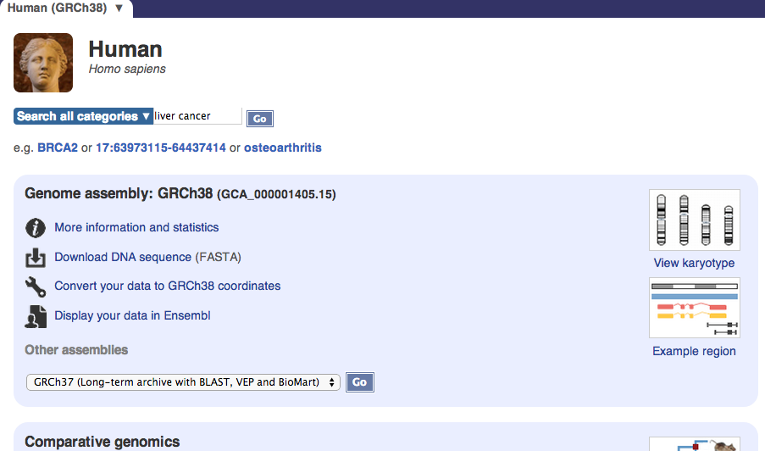
Put “liver cancer” in the search box and Go

Slide 36
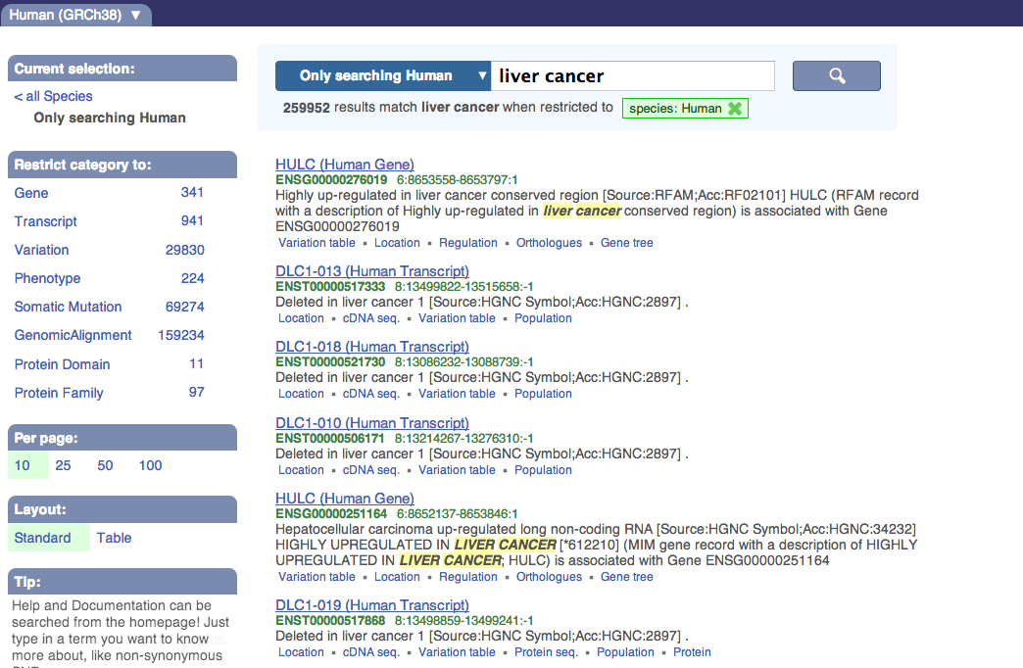
This keyword search gives everything that contains “liver cancer”
Click on Table to have a table view

Slide 37
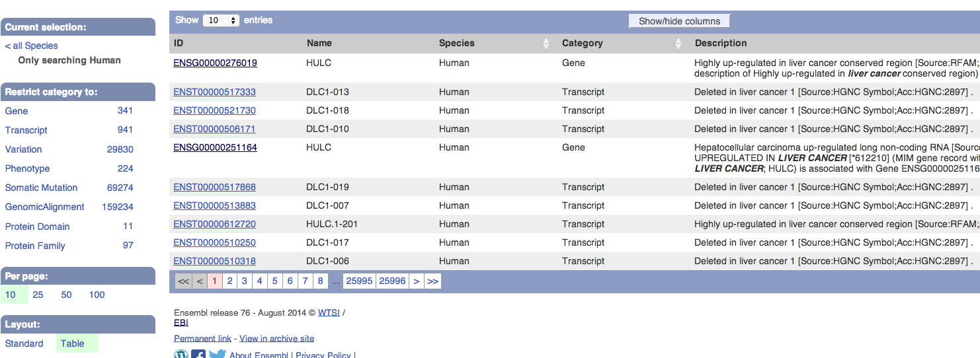
This col tells the category of the entry
Click on the numbers to only show gene entries

Slide 38
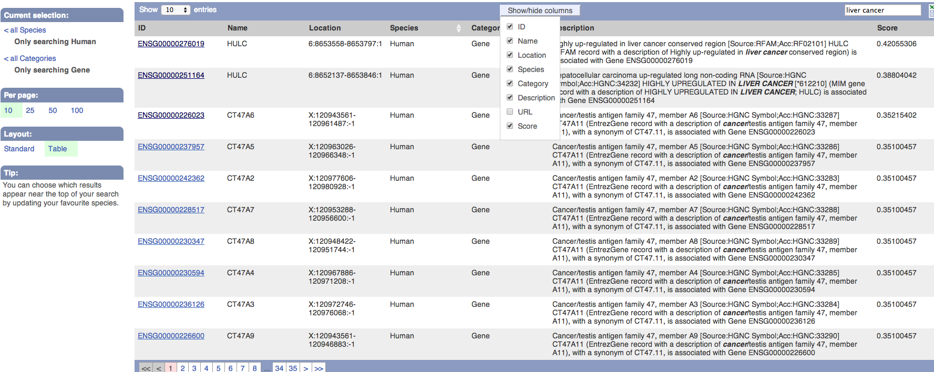
Click here to show the list and select Location and Score to show chromosome location info and score respectively
This is the list of genes
Score is calculated based on the query: how much the annotation description is similar to the searching keyword (liver cancer)
The first two entries in this page are ncRNA genes. Let’s try the 2nd one

Slide 39
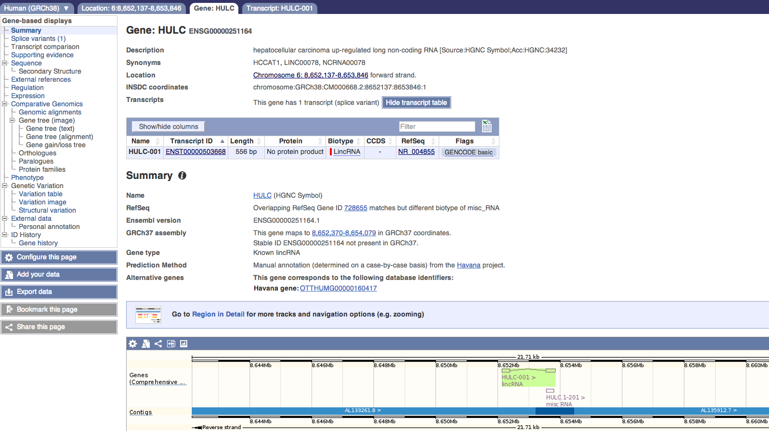
Now it’s showing the Gene; there are also other tabs
Many things can be explored
This is ENSEMBL Gene ID
Link to NCBI
This is ENSEMBL Transcript ID
This is is a long intergenic non-coding RNA gene
Here is the graphical representation of the gene

Slide 40
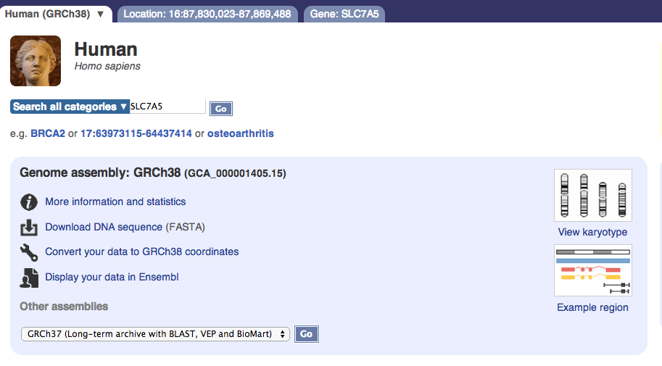
Let’s try a protein-coding gene: LAT1, also known as SLC7A5

Slide 41
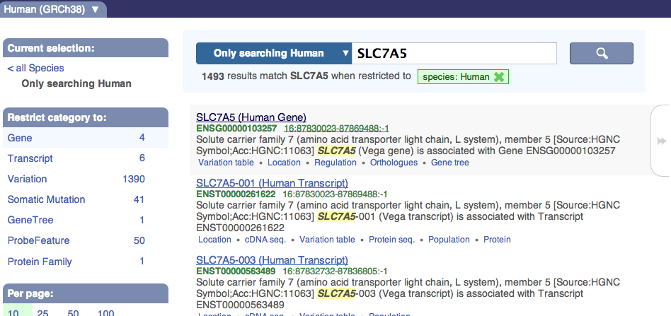
Click here

Slide 42
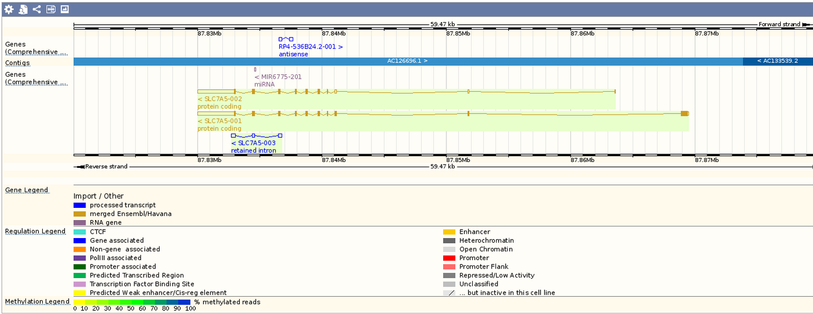
Click to view the sequence page
Different names of the gene
The three transcripts

Slide 43
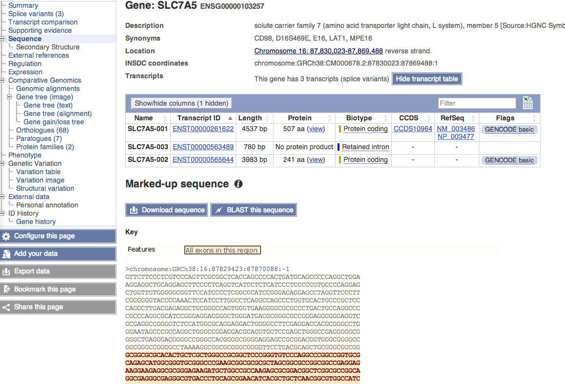
Now check the expression
Click to open a help page to explain what these highlights mean

Slide 44
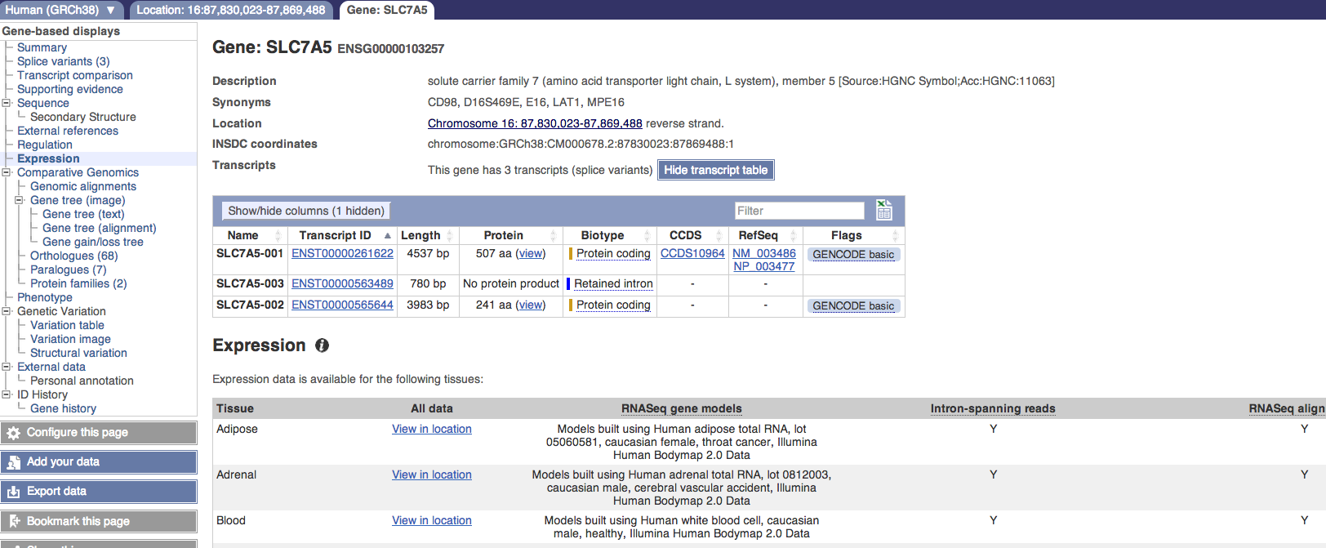
A long list, go further down to find liver and click “View in location”

Slide 45
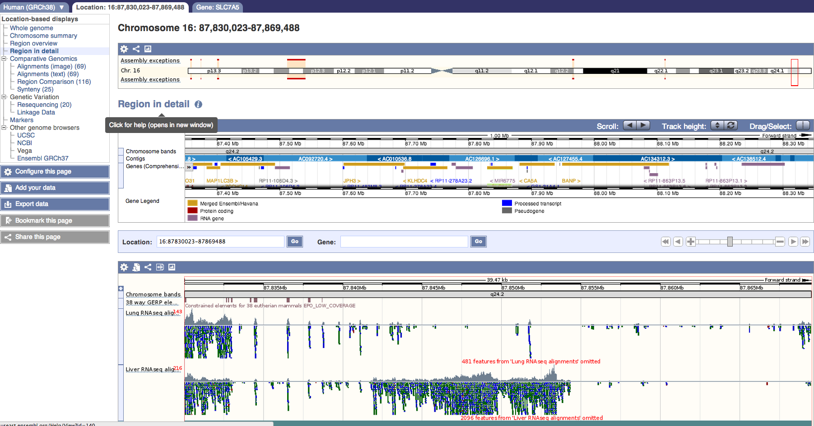
Links to other genome browsers
Zoomed in view
This is where the gene is located in the whole chromosome view
Further zoomed in view
A long page below
The RNA-seq read stack corresponding to exons

Slide 46
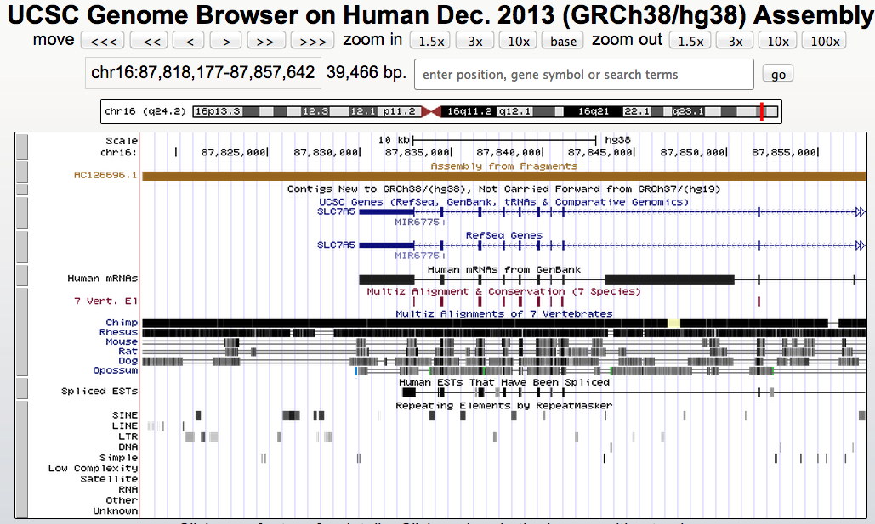
This is the same region in the UCSC browser
PS: much faster and easier to use/understand than ENSEMBL (richer info?)

Slide 47
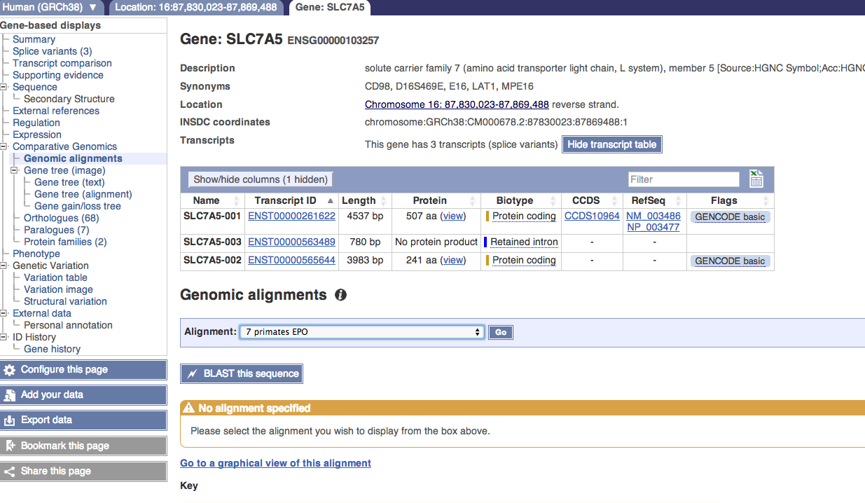
From the Gene tab click on Genome alignment will get you this page
Select 7 primates EPO and hit Go to see the whole genome alignment of 7 primates at this gene region

Slide 48
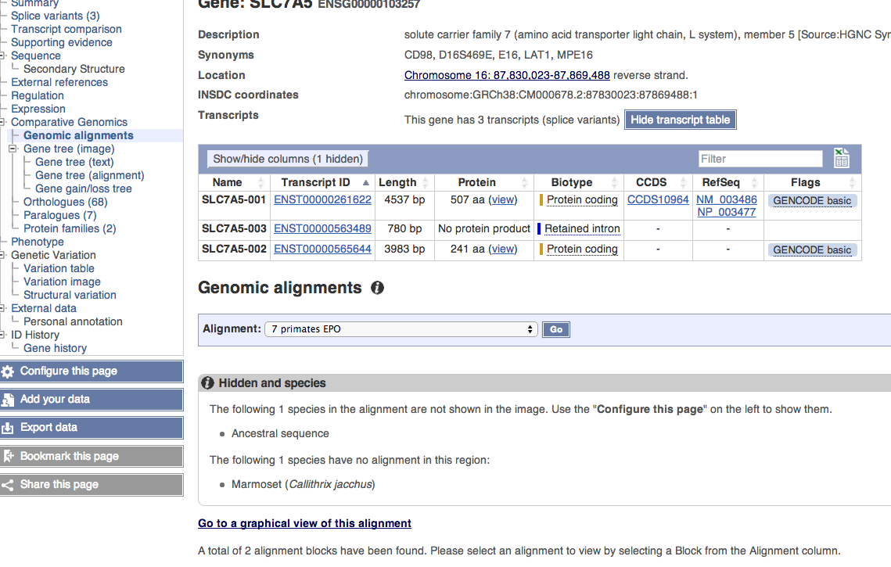
Hit here

Slide 49
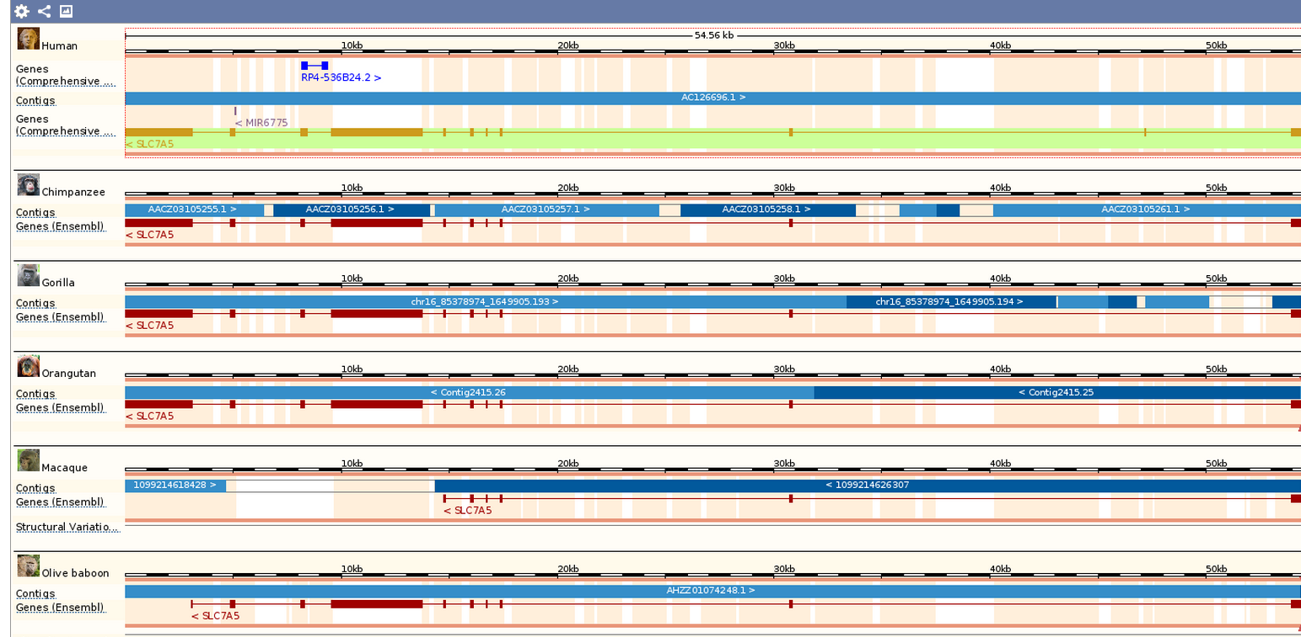
See how conserved this gene is across different primates
Some exons are missing in early primates

Slide 50
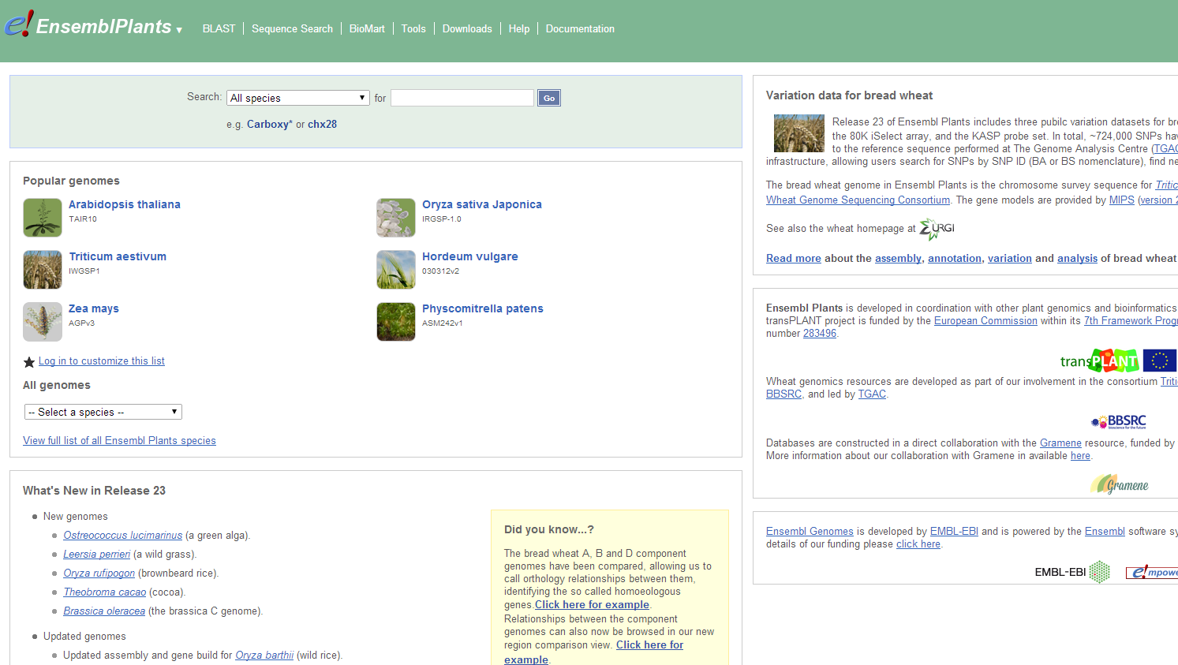
http://plants.ensembl.org/

Slide 51
Next lecture: ExPASy and DTU tools

