Slide 1
EBI web resources III: Web-based tools in Europe (EBI, ExPASy, EMBOSS, DTU)
Yanbin Yin
Fall 2014

Slide 2
Homework assignment 4
Download http://cys.bios.niu.edu/yyin/teach/PBB/purdue.cellwall.list.lignin.fa to your computer
Select a C3H protein and a F5H protein from the above file and calculate the sequence identity between them using the Water server at EBI.
Perform a multiple sequence alignment using MAFFT with all FASTA sequences in the file
Built a phylogeny with the alignment using the "A la Carte" mode at http://www.phylogeny.fr/
Build another phylogeny starting from the unaligned sequences using the “one-click” mode at http://www.phylogeny.fr/; if you encounter any error reports, try to figure out why and how to solve it (hint: skip the Gblocks step).
Write a report (in word or ppt) to include all the operations, screen shots and the final phylogenies from step 3 and 4.
Due on 10/13 (send by email)
Office hour:
Tue, Thu and Fri 2-4pm, MO325A
Or email: yyin@niu.edu

Slide 3
Outline
Hands on exercises!

Slide 4
Pairwise alignment (including database search) tools
Slower
SSEARCH
FASTA
BLAST
BWA
Faster
More matches
PSI-BLAST
PSI-Search
HMMER3
RPS-BLAST
BLAT
Bowtie
Less matches

Slide 5
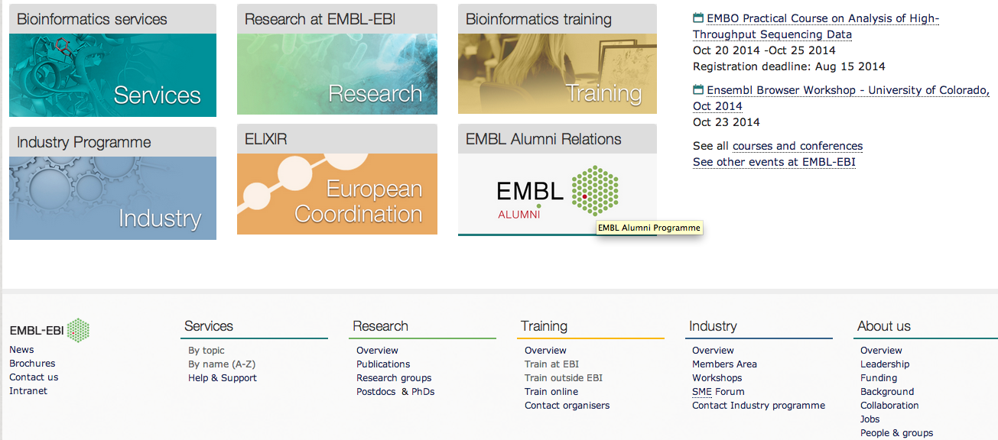
http://www.ebi.ac.uk/
To the bottom of the page
Click by names (A-Z)

Slide 6
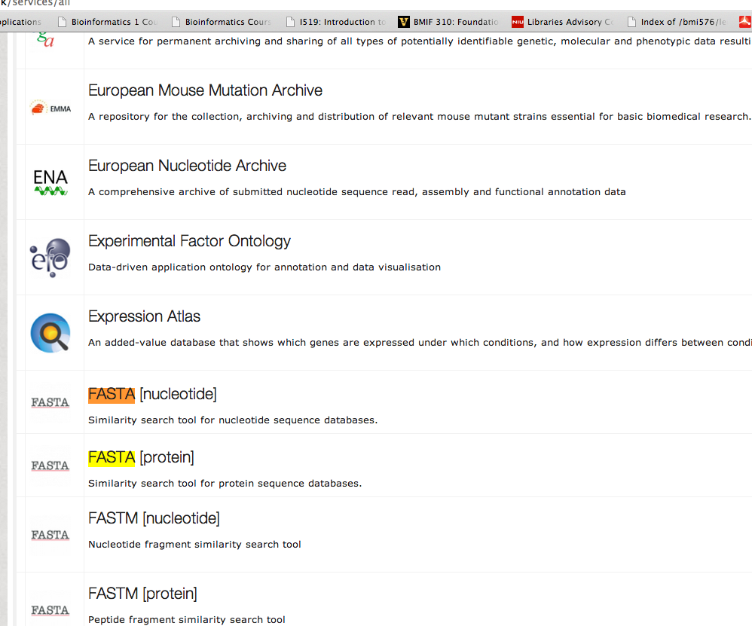
We are gonna try FASTA tool
This is a very long list of tools
Scroll down to find FASTA
Or Ctrl+F and type fasta
Click on FASTA [nucleotide]

Slide 7
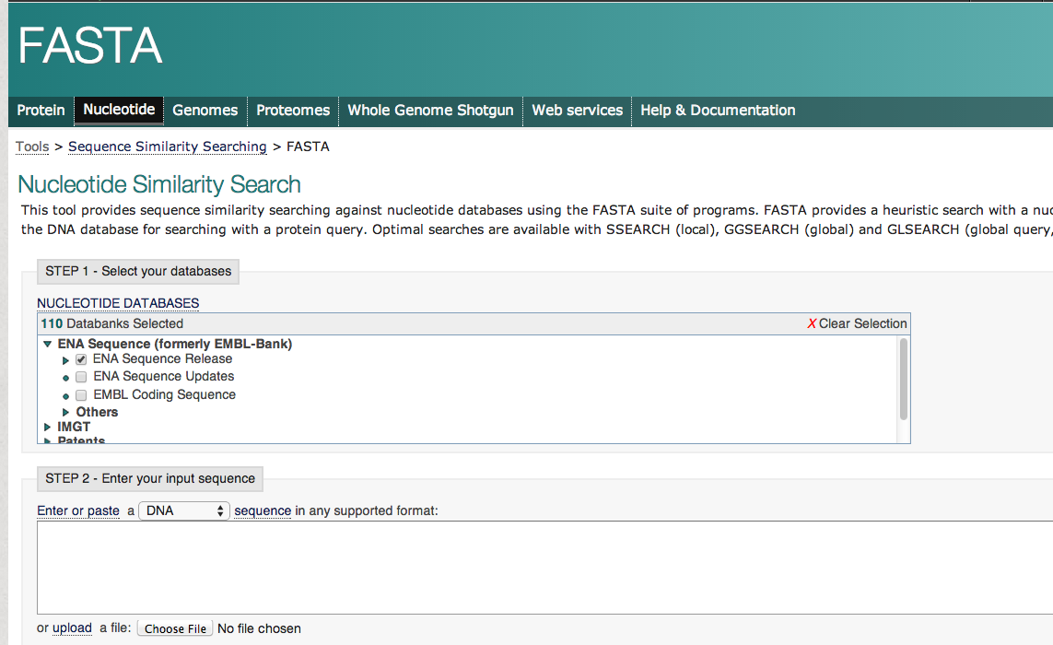
Click Genomes
We’re gonna search Arabidopsis genome

Slide 8
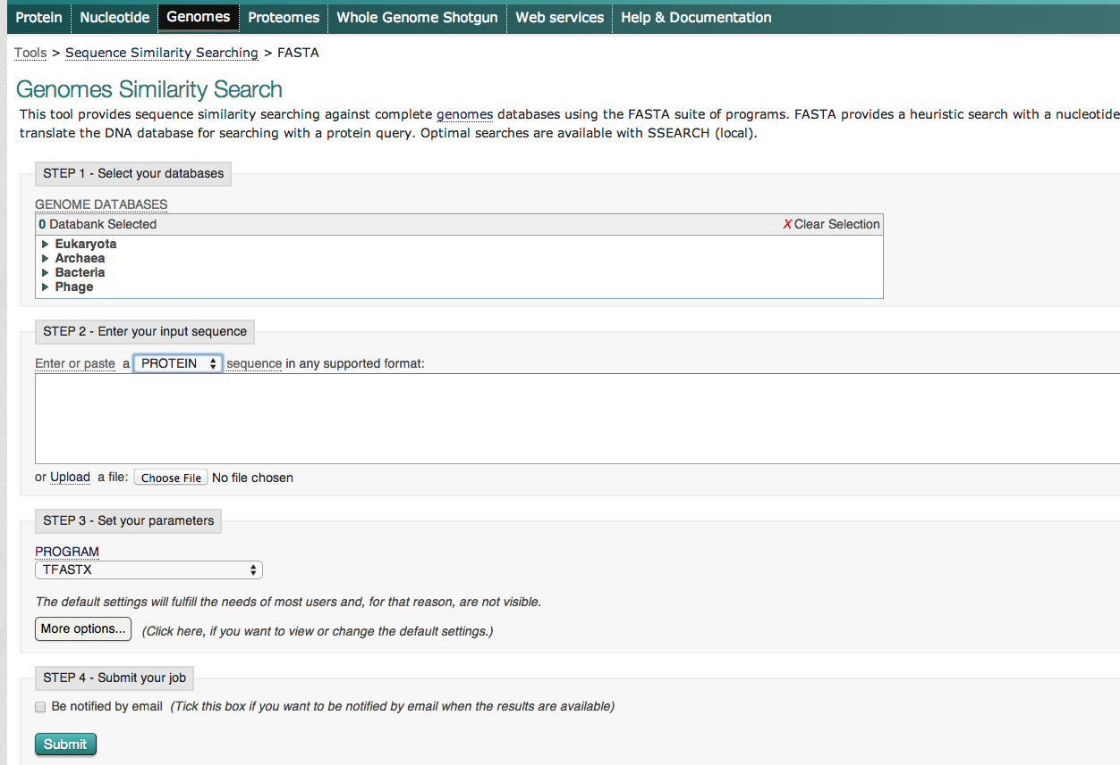
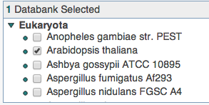
Click on this little arrow
Choose Arabidopsis
Change here to protein
Go to http://cys.bios.niu.edu/yyin/teach/PBB/cesa-pr.fa and copy the first seq (CesA) and paste here

Slide 9
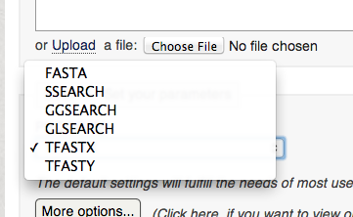
http://www.ebi.ac.uk/Tools/sss/fasta/help/index-genomes.html
Tfastx: allow frame shift between codons
Tfasty: also allow frame shift within codons
Tolerate sequence errors
Good for finding pseudogenes

Slide 10
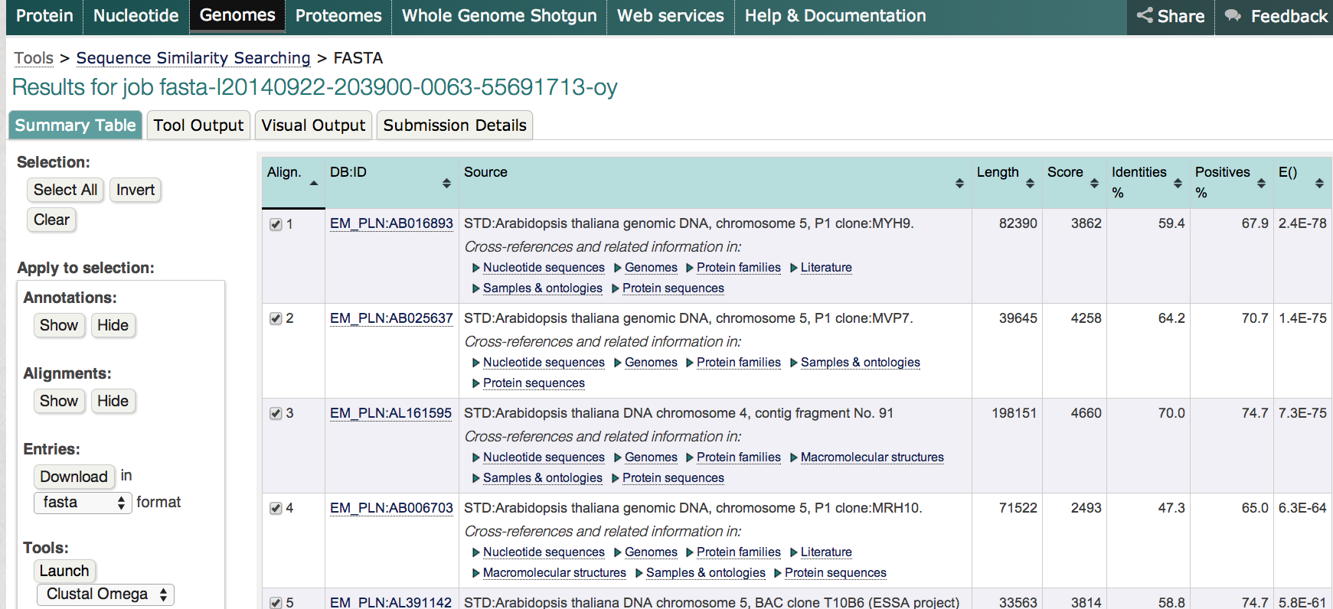
Should be finished very quickly
Graphical presentation of the output
Raw output (plain text)
Show alignment
Show EMBL format of the subject (hit)

Slide 11
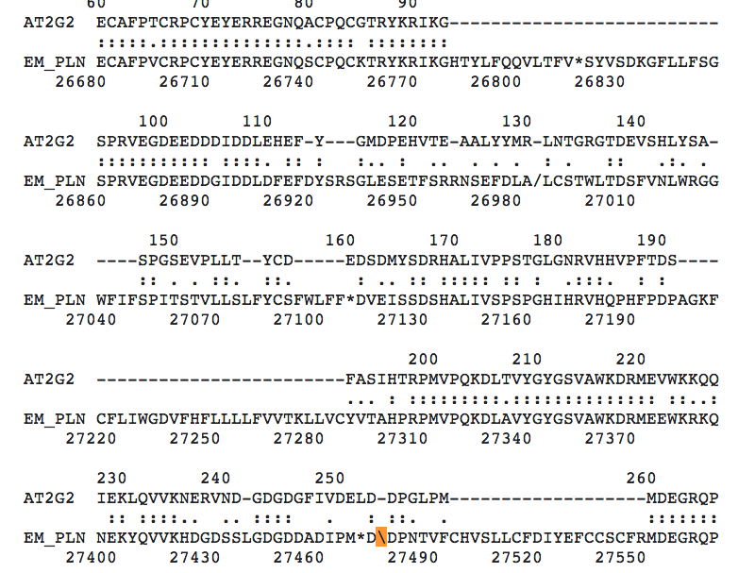
We are at the raw output view
In the alignment, look for
/ frame shift
\ frame shift
* stop codon
In order to align the query protein to the subject genomic DNA, reading frames have to move 1 or 2 base ahead (1 base insertion or 2 base insertion)

Slide 12
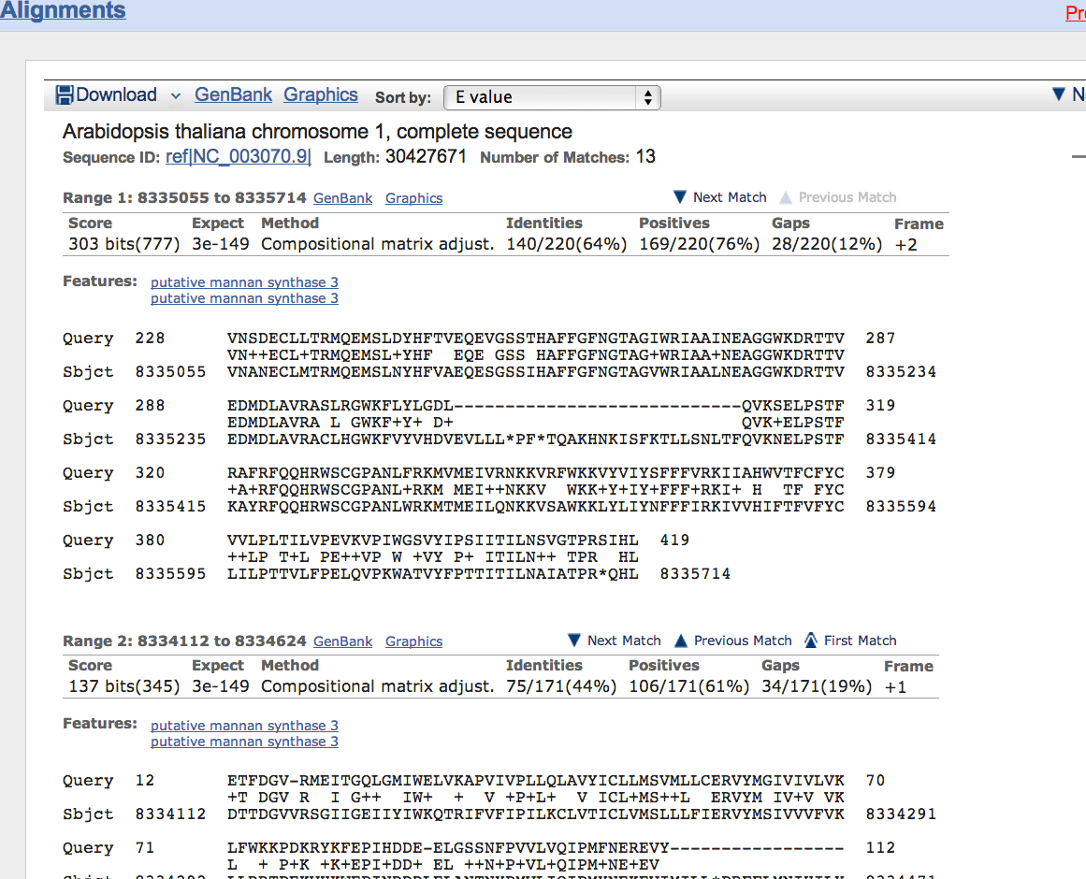
BLAST gives shorter alignment because its alignment breaks where it sees frame shifts

Slide 13
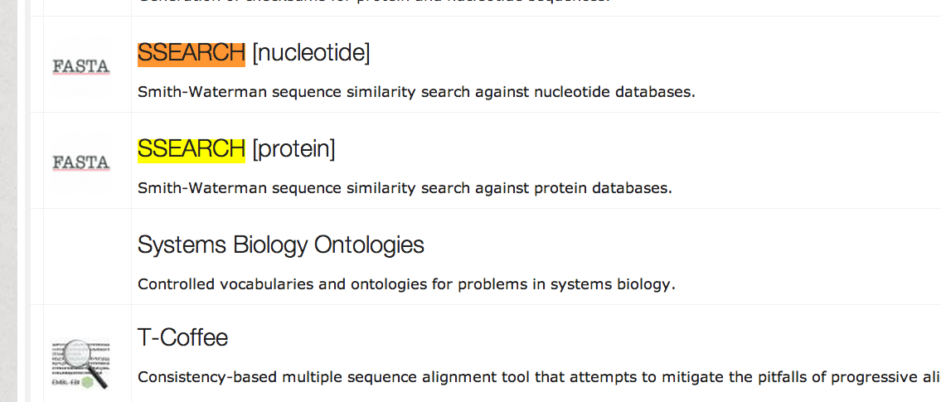
SSEARCH is a command in the FASTA package implementing Smith-Waterman algorithm
Go back to the tool A-Z page: http://www.ebi.ac.uk/services/all
Ctrl+F and type ssearch
Can only do pr-pr or nt-nt search
Ssearch can only do protein-protein or nucleotide-nucleotide searches
Slower but most accurate

Slide 14
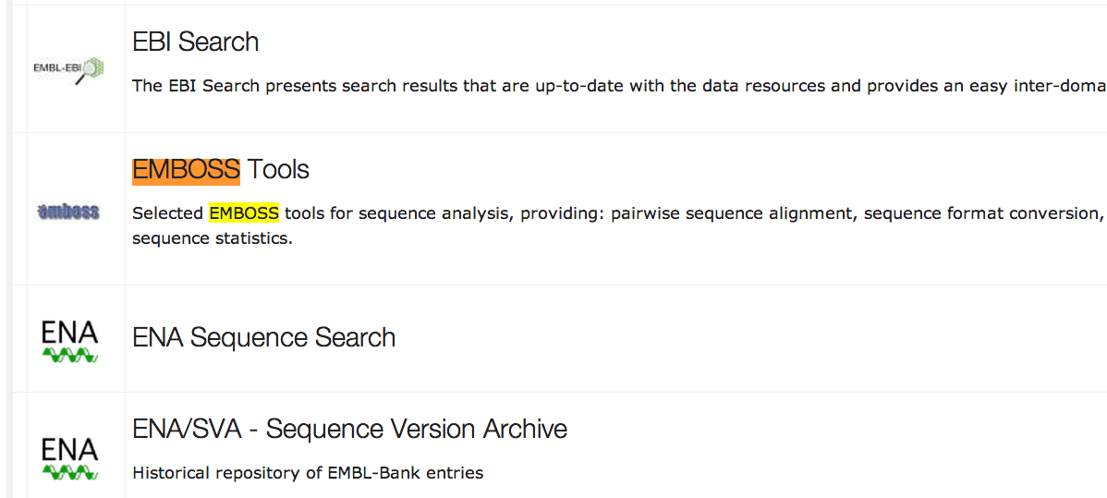
Go back to the tool A-Z page: http://www.ebi.ac.uk/services/all
Ctrl+F and type emboss
EMBOSS contain hundreds of computer programs for sequence analysis
EMBOSS: European Molecular Biology Open Software Suite
EMBOSS: The European Molecular Biology Open Software Suite (2000)
Rice,P. Longden,I. and Bleasby,A.
Trends in Genetics 16, (6) pp276--277

Slide 15
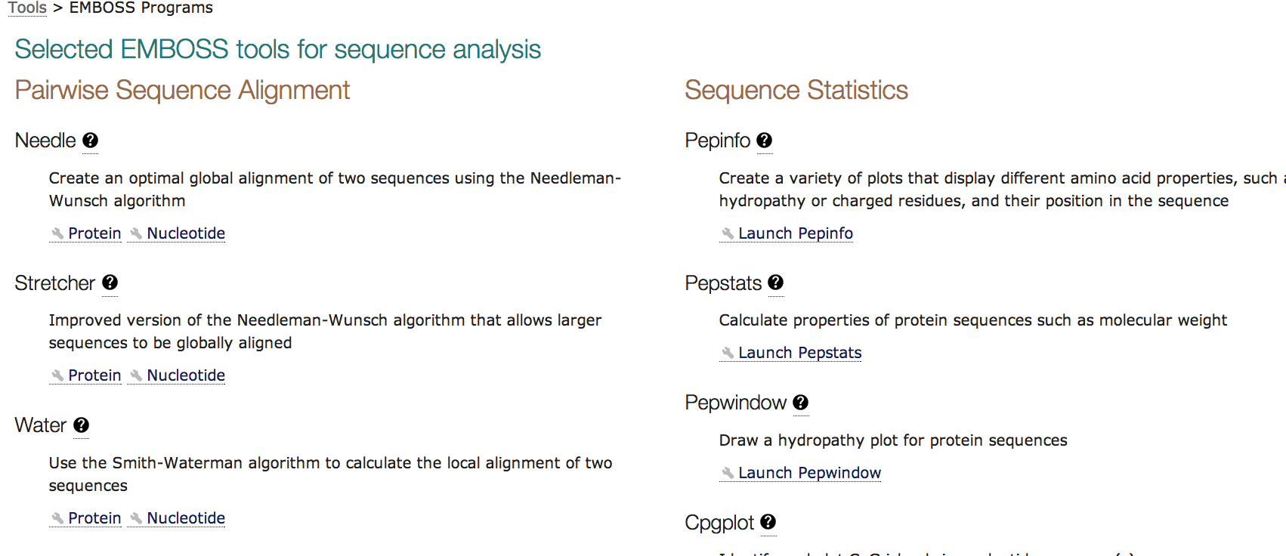
Needleman-wunsch algorithm
Smith-Waterman algorithm
Let’s try needle first
Equivalent to the bl2seq command of the BLAST package

Slide 16
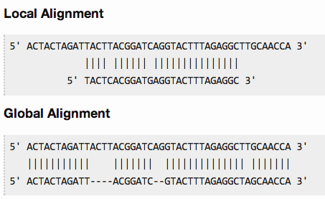
Global vs local alignment:
in a local alignment, you try to match your query with a substring (a portion) of your subject (reference)
in a global alignment you perform an end to end alignment with the subject

Slide 17
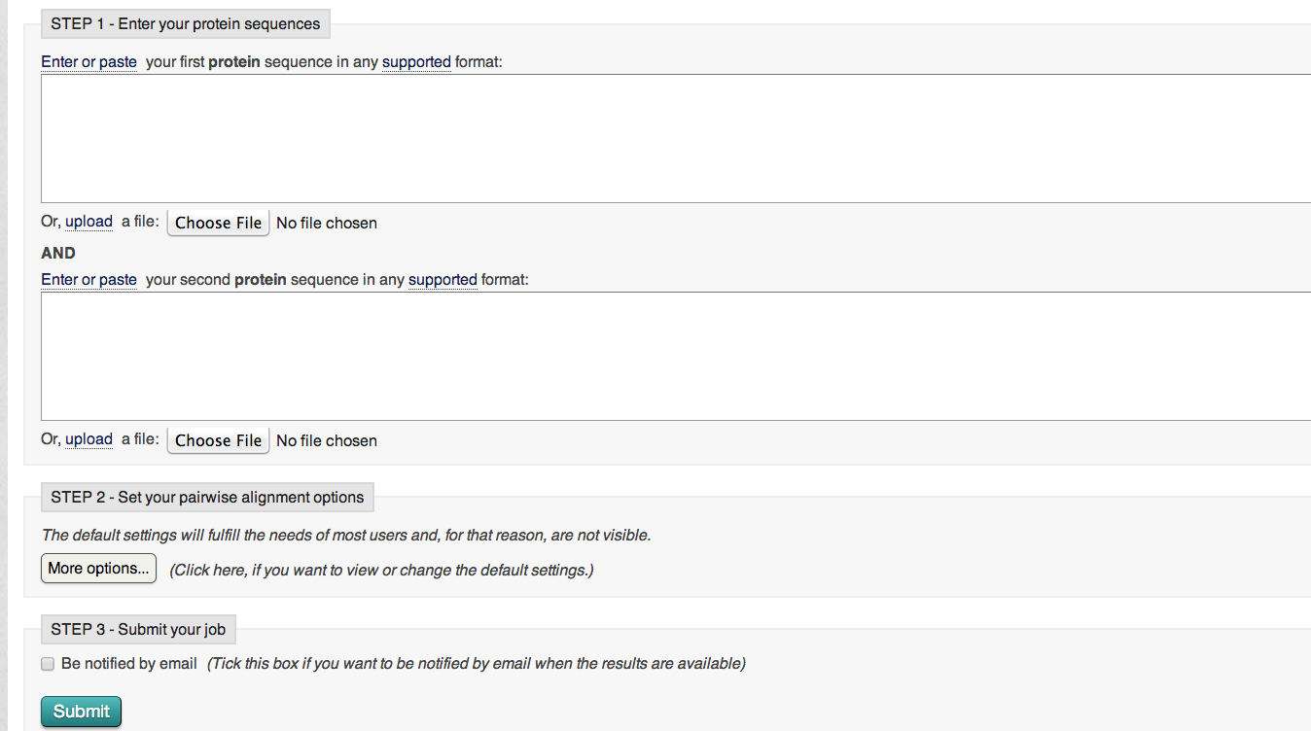
Go to http://cys.bios.niu.edu/yyin/teach/PBB/cesa-pr.fa
Copy & paste CesA
Copy & paste CslA
CslA: 539 aa
CesA: 1089 aa

Slide 18
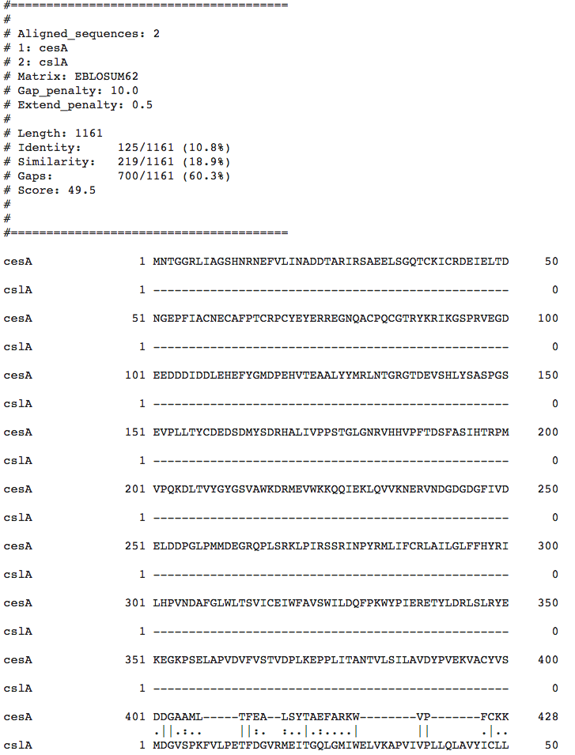
This is needle output
Not a database search, so no E-value is reported
- gap
. Negative score
: positive score
| identical
This is different from what BLAST shows the alignment

Slide 19
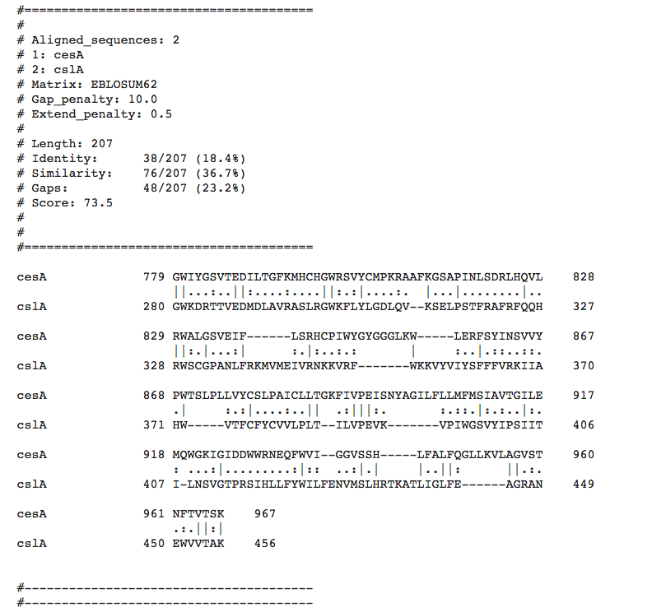
This is water output
The best way to find the optimally aligned regions and
calculate the similarity between two sequences

Slide 20
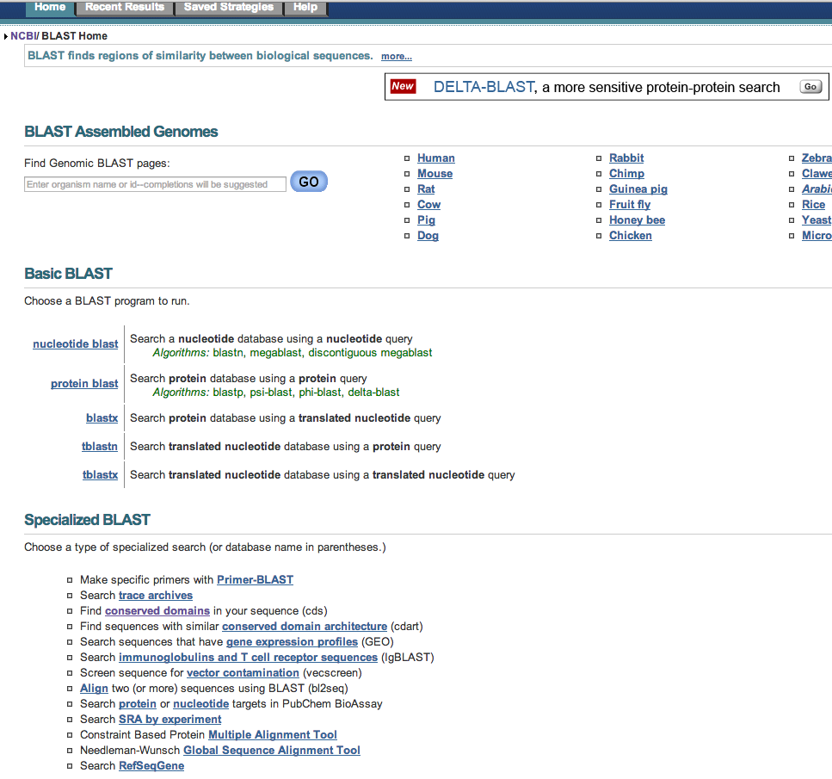
Now try blast 2 seq

Slide 21
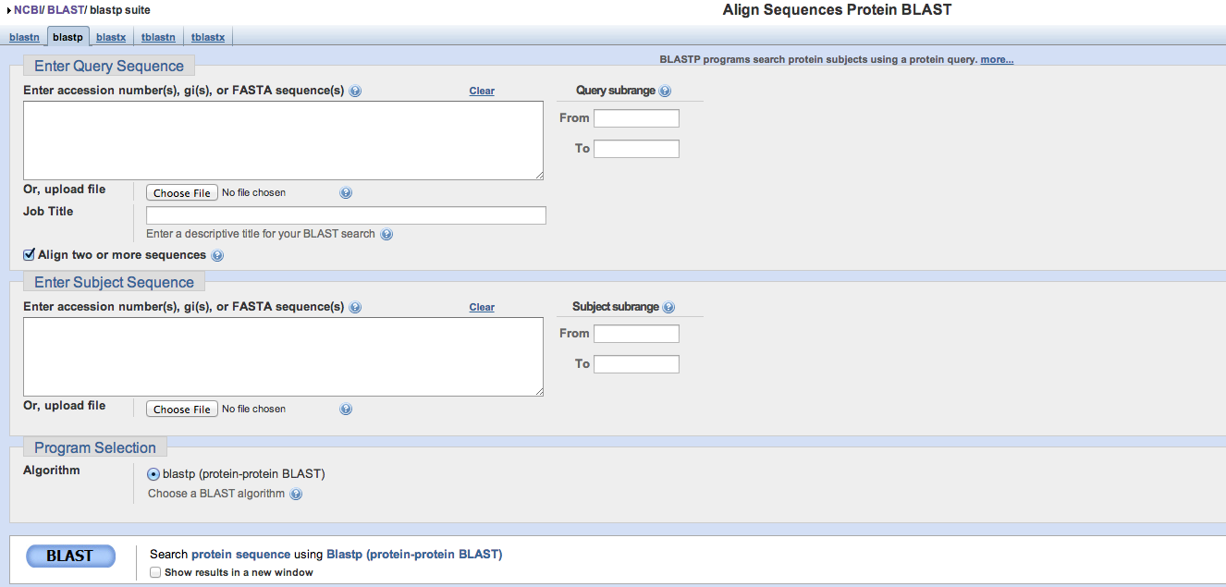
Choose blastp
Go to http://cys.bios.niu.edu/yyin/teach/PBB/cesa-pr.fa
Copy & paste CesA
Copy & paste CslA

Slide 22
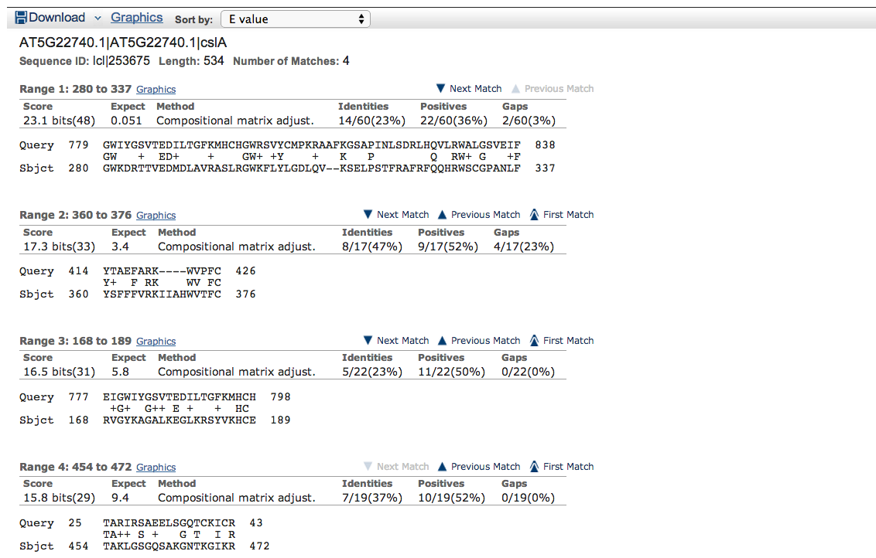
This blast2seq output
Fragmented alignments

Slide 23
Multiple sequence alignment tools
Foundation for many other further analyses: phylogeny, evolution, motif, protein family etc.

Slide 24
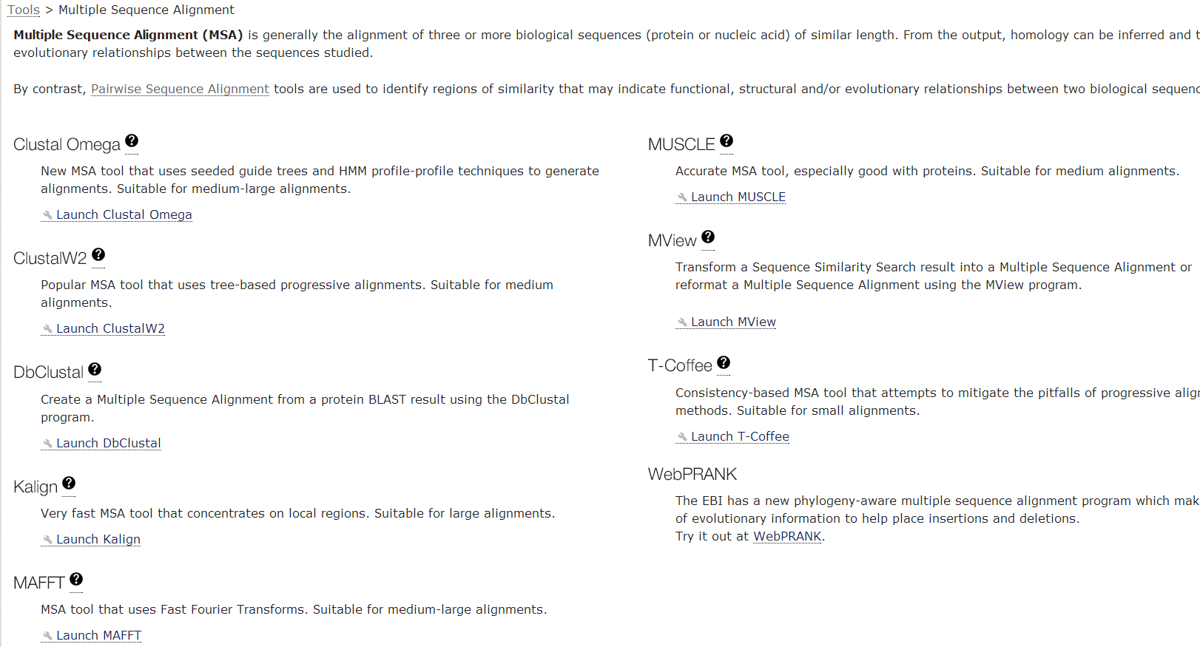
The MSA page shows nine tools and we’re gonna try Clustal Omega, MAFFT and MUSCLE
http://www.ebi.ac.uk/Tools/msa/

Slide 25
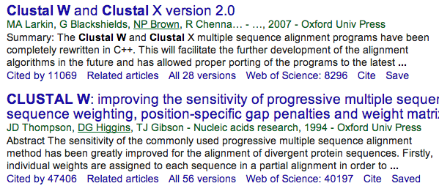
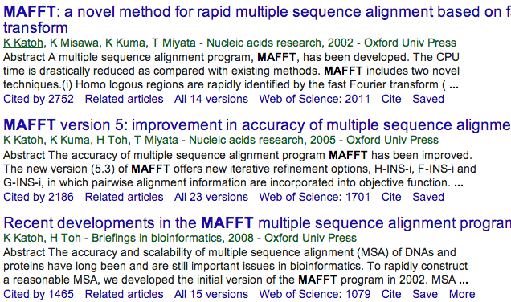

Slide 26
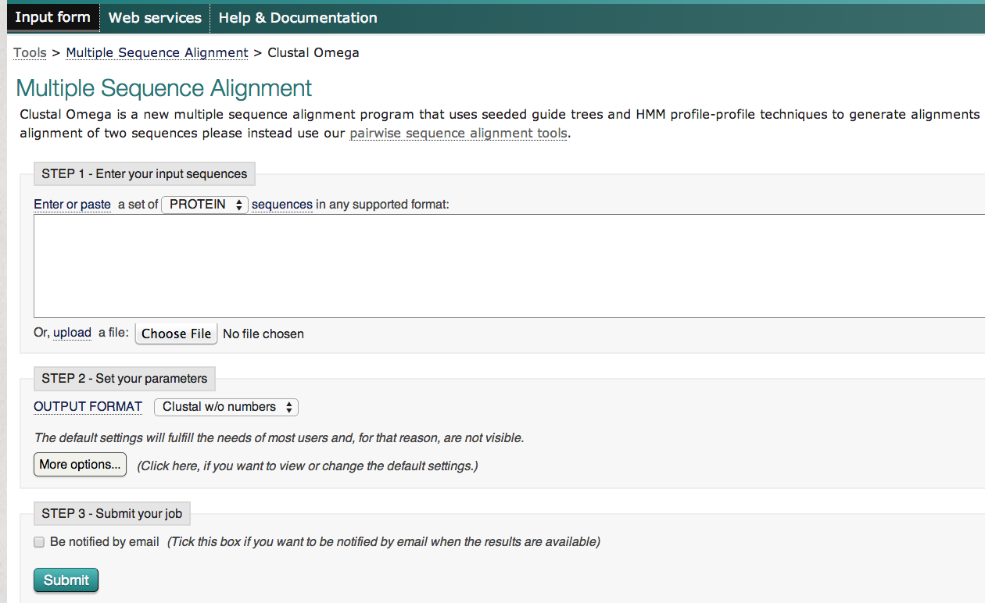
You can always check the help page
This is Clustal Omega page
Go http://cys.bios.niu.edu/yyin/teach/PBB/cesa-pr.fa and copy paste all the 9 protein seq here
Then submit

Slide 27
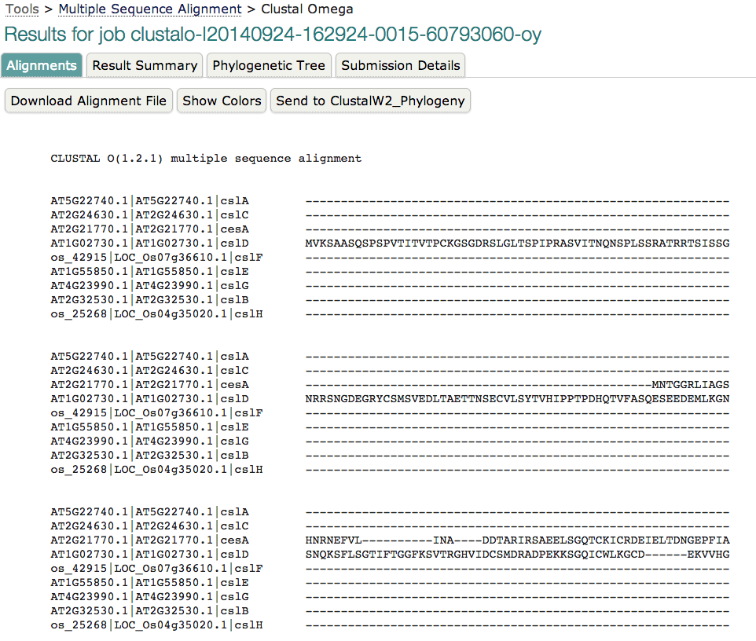
This is called clustal format of MSA
Color AA based on chemical properties, e.g. acidic AA in blue
Check the evolutionary relatedness
Get text format summary of the results

Slide 28
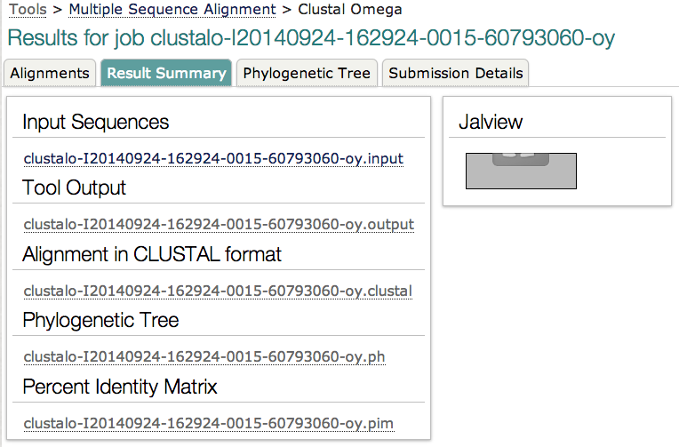
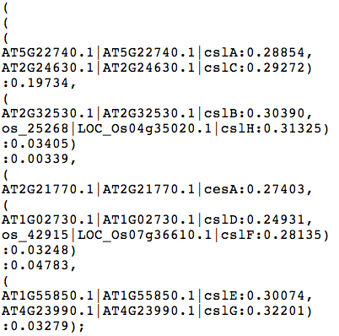
Txt format to describe relatedness and can be visualized graphically as a tree graph
Both can be copy paste to notepad and save as plain text file
Matrix tells how similar each pair of seqs is

Slide 30
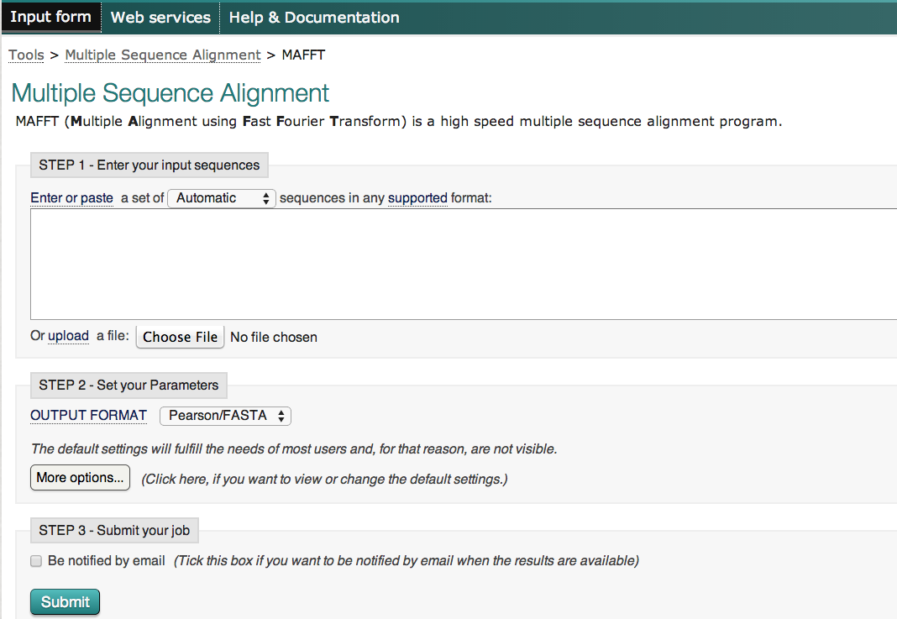
You can always check the help page
This is MAFFT page
Go http://cys.bios.niu.edu/yyin/teach/PBB/cesa-pr.fa and copy paste all the 9 protein seq here
Change here to ClustalW

Slide 31
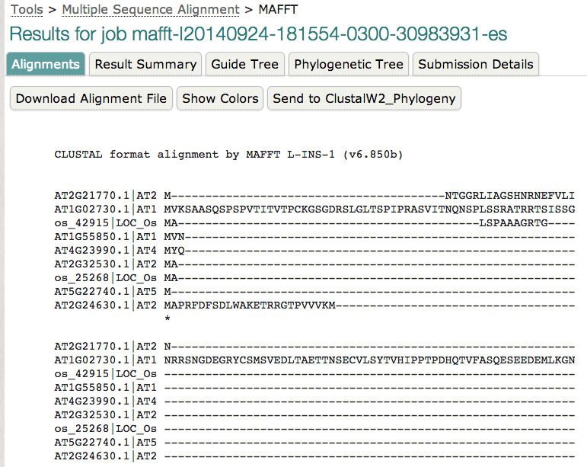
Force the first M residue aligned
IDs were truncated

Slide 32
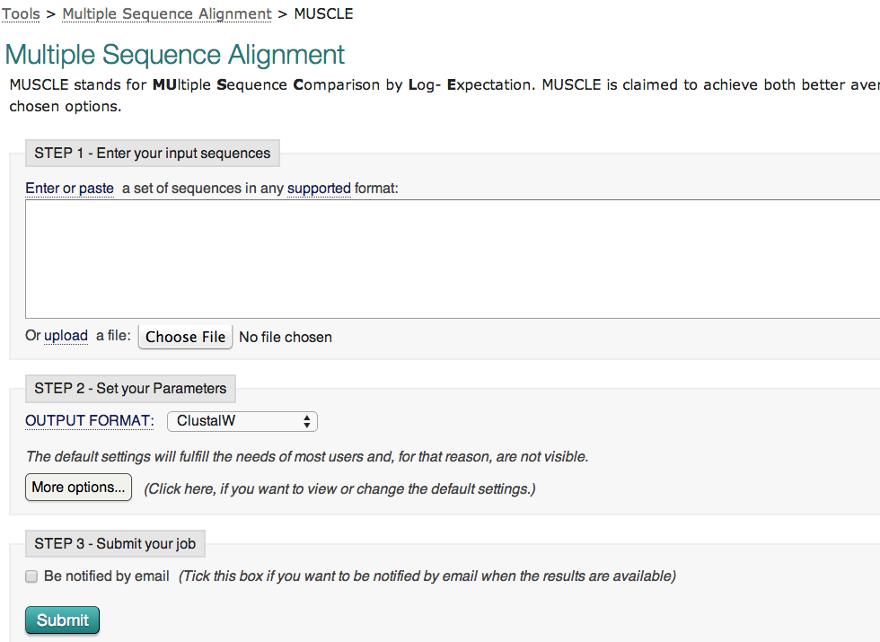
This is MUSCLE page
Go http://cys.bios.niu.edu/yyin/teach/PBB/cesa-pr.fa and copy paste all the 9 protein seq here
Change here to ClustalW

Slide 33
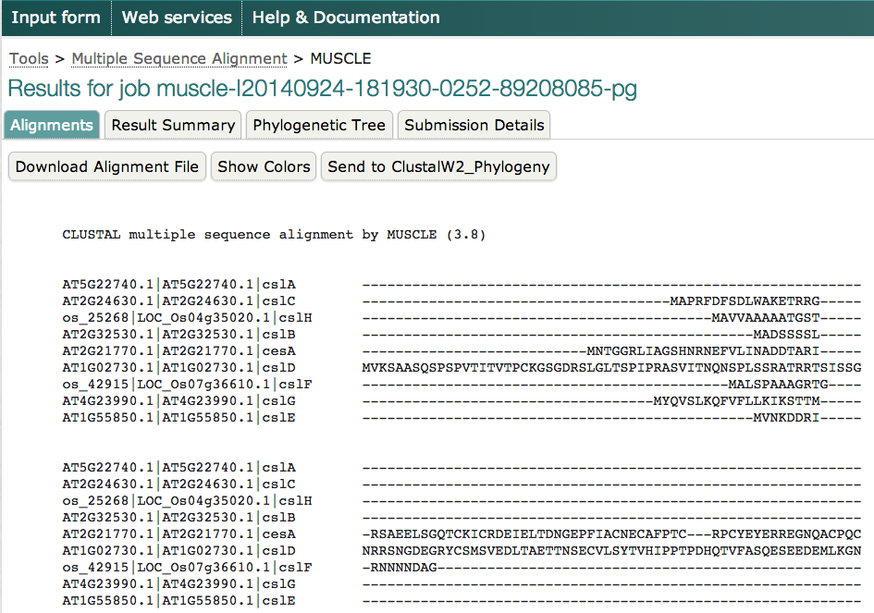

Slide 34
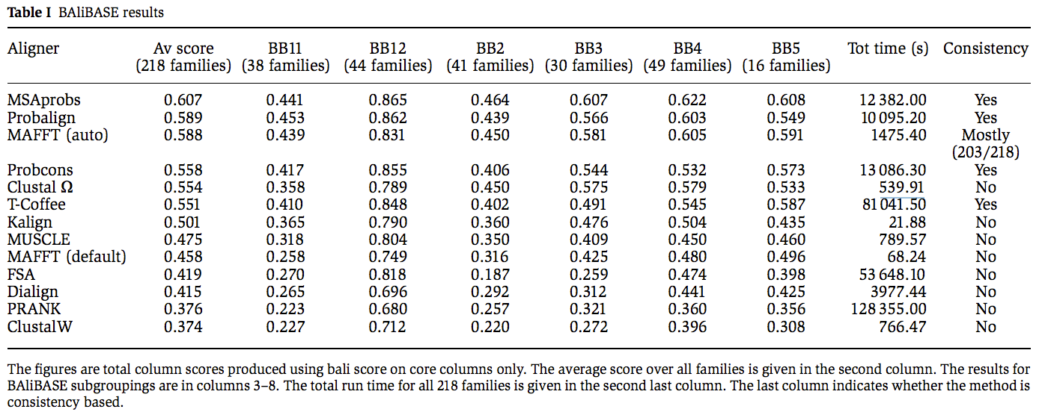
So which MSA tool should I use?
accuracy
MAFFT > Clustal Omega > MUSCLE >> ClustalW
speed
Molecular Systems Biology 7:539, 2011
http://mafft.cbrc.jp/alignment/software/about.html

Slide 35
http://www.ebi.ac.uk/Tools/msa/
Visualize alignment

Slide 36
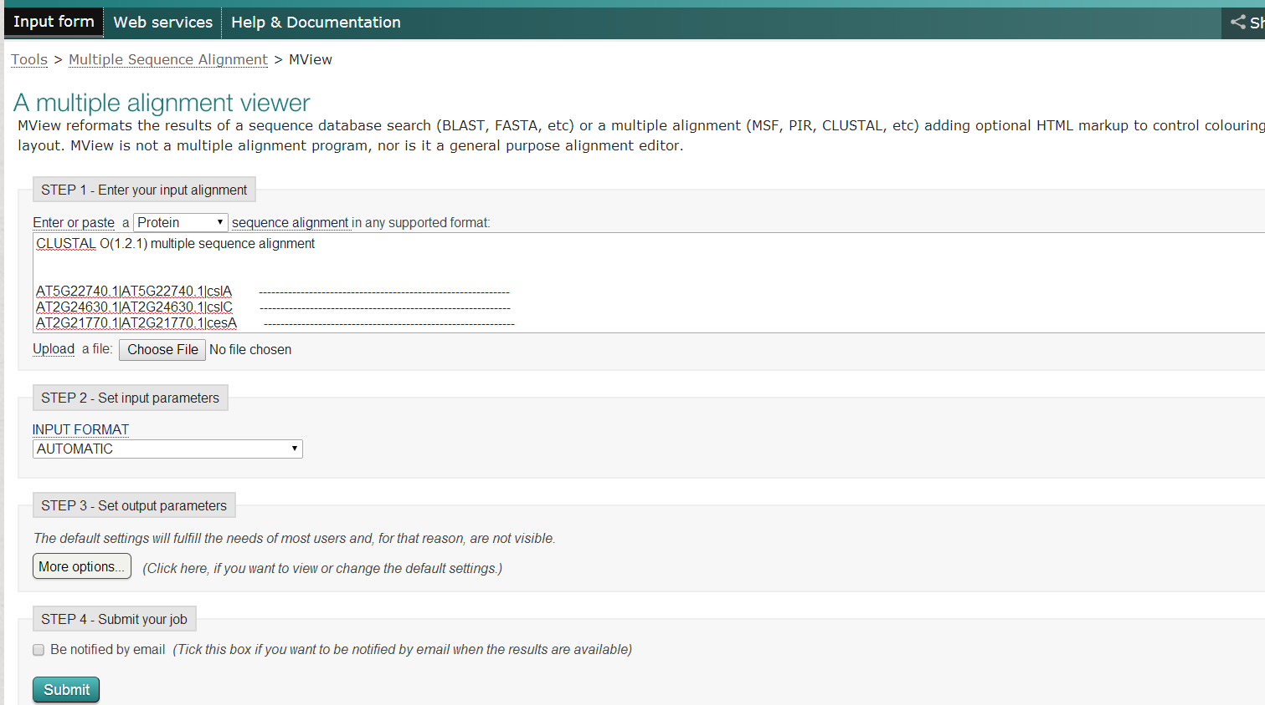
You can always check the help page
This is Mview page
Go http://cys.bios.niu.edu/yyin/teach/PBB/cesa-pr.fa.aln and copy paste the MSA built above
MView reformats the results of a sequence database search (BLAST, FASTA, etc) or a multiple alignment (MSF, PIR, CLUSTAL, etc) adding optional HTML mark-up to control colouring and web page layout. MView is not a multiple alignment program, nor is it a general purpose alignment editor

Slide 37
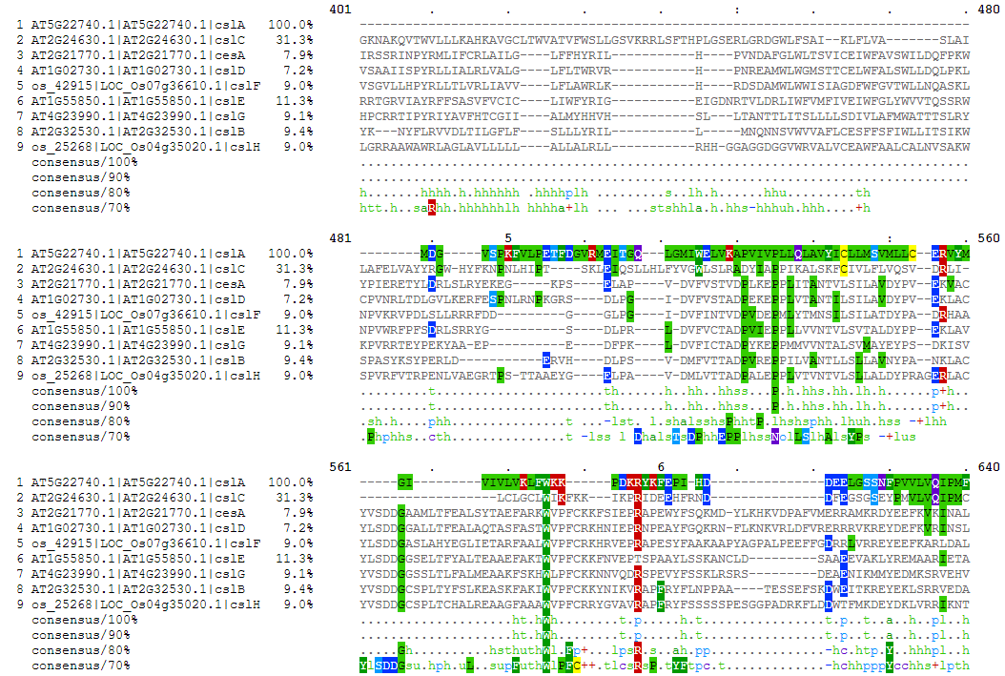
Consensus letters explained at
http://bio-mview.sourceforge.net/manual/manual.html#ref-output-formats

Slide 38
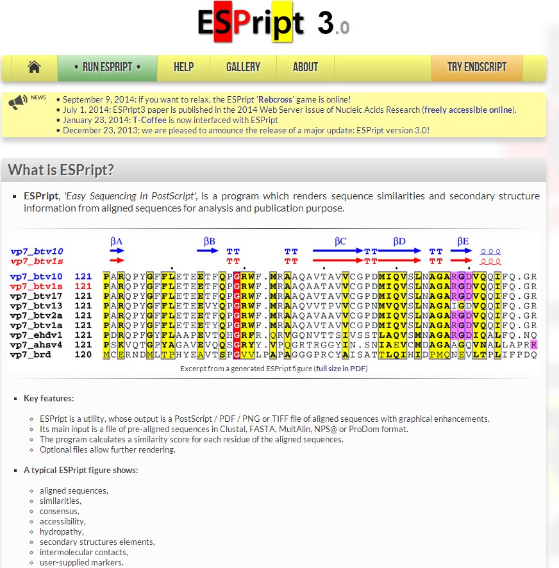
Another MSA visualization tool: ESPript http://espript.ibcp.fr/ESPript/ESPript/
Click here to start

Slide 39
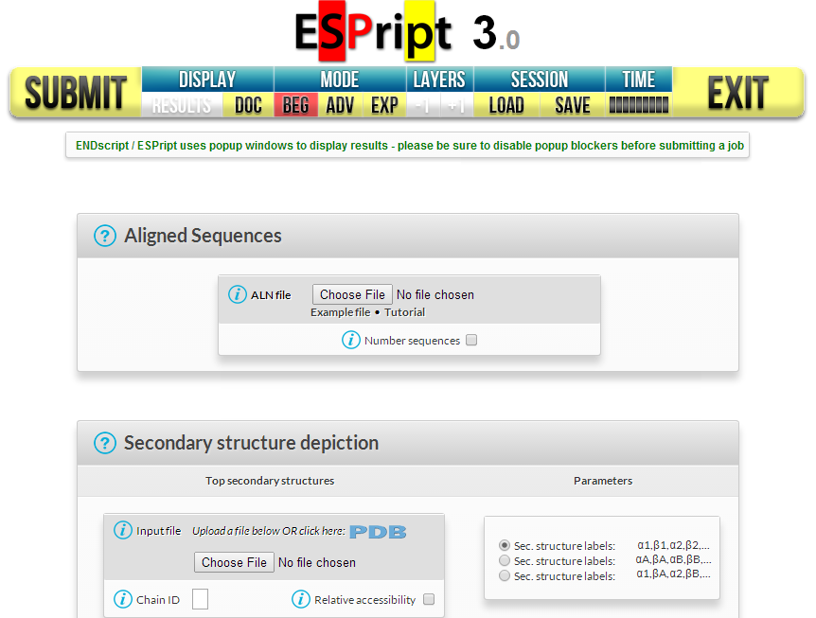
Copy http://cys.bios.niu.edu/yyin/teach/PBB/cesa-pr.fa.aln and paste to a txt file and save it on your desktop, and upload to
After the file is uploaded

Slide 40
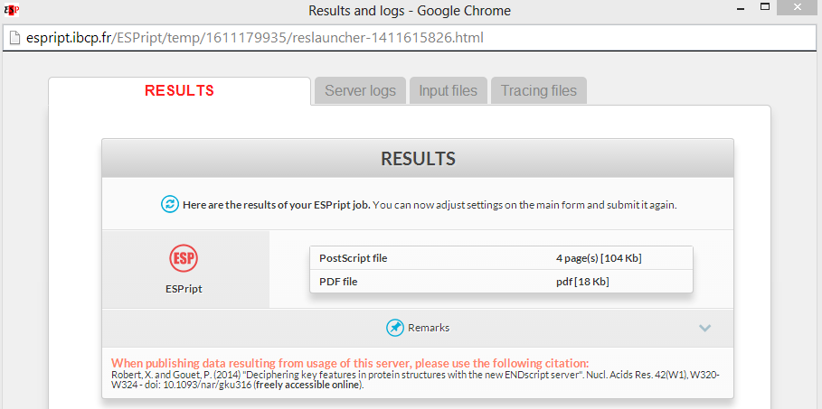
A new window popped out, view in PDF

Slide 41
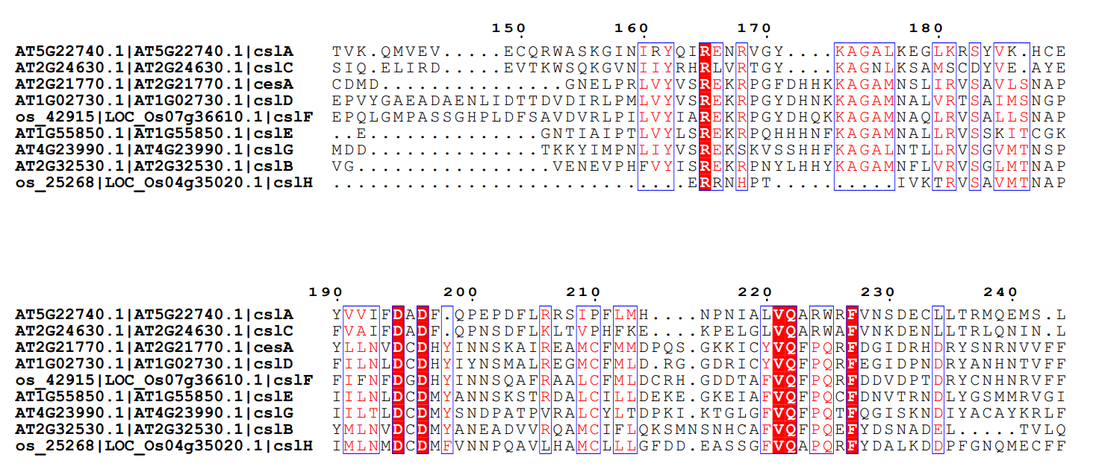
We just tried the very basic function. This web server has many more useful functions such as displaying secondary structures along with MSA. To learn more: http://espript.ibcp.fr/ESPript/ESPript/esp_tutorial.php

Slide 42
ExPASy: Expert Protein Analysis System at SIB
Collection of external/internal tools

Slide 43
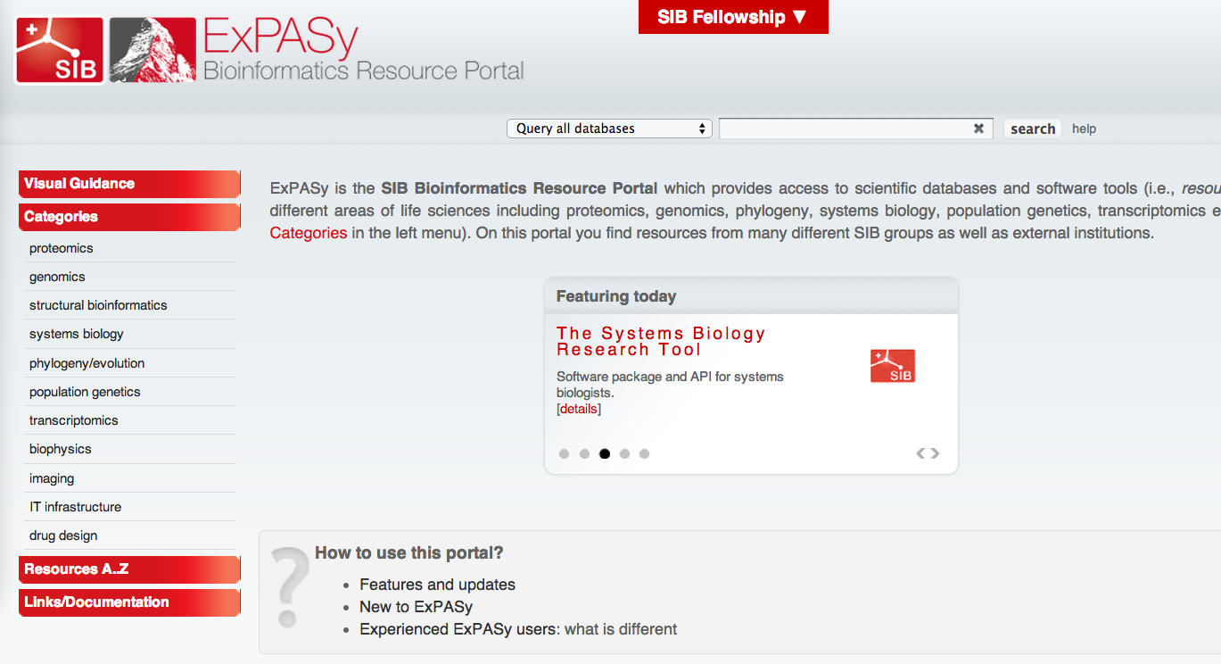
http://expasy.org/
This website collect and classify web links to hundreds of bioinfo tools
Click on genomics, then sequence alignment

Slide 44
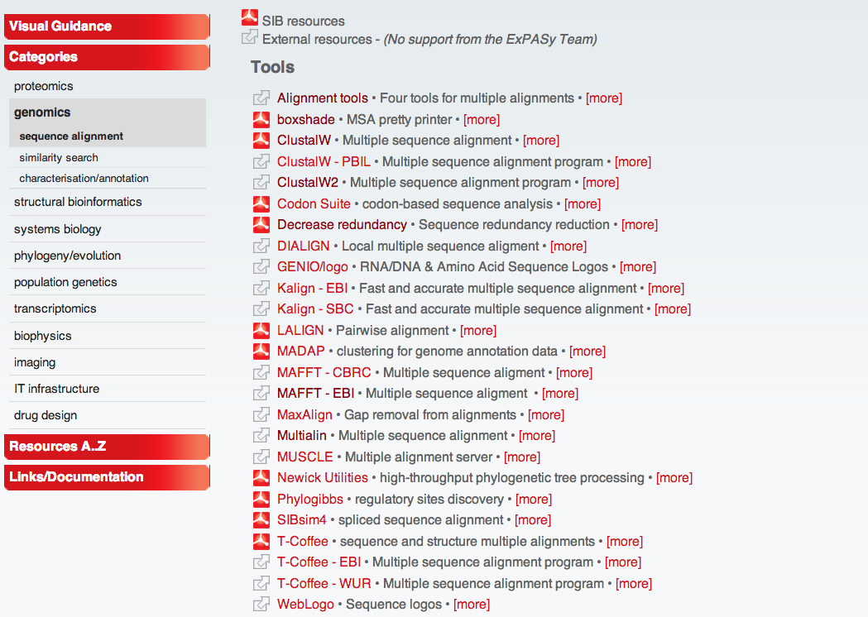
This page lists tools for sequence alignment
We’re gonna try

Slide 45
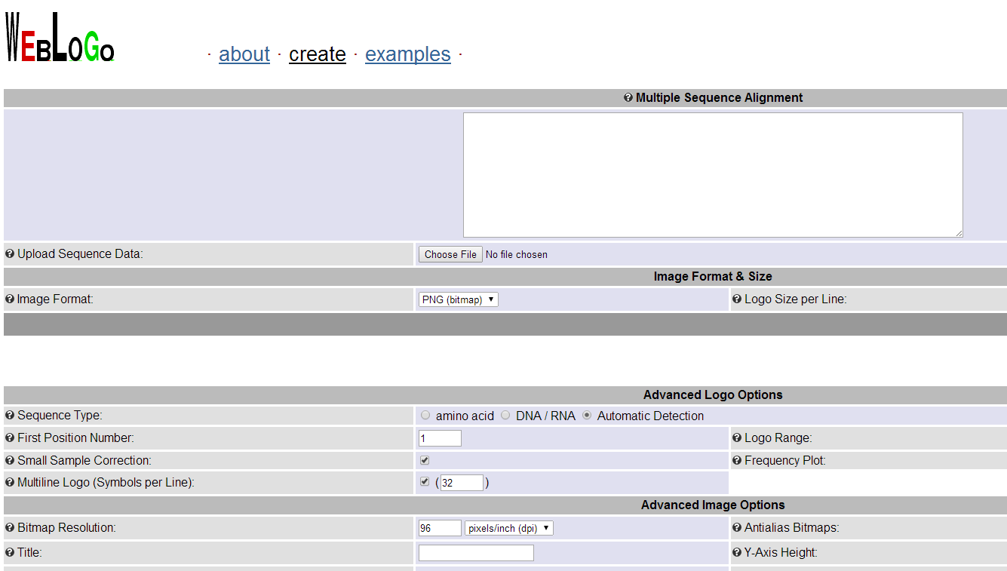
http://weblogo.berkeley.edu/logo.cgi
Upload the file that we downloaded from http://cys.bios.niu.edu/yyin/teach/PBB/cesa-pr.fa.aln
Toggle this to allow logo shown in multiline

Slide 46
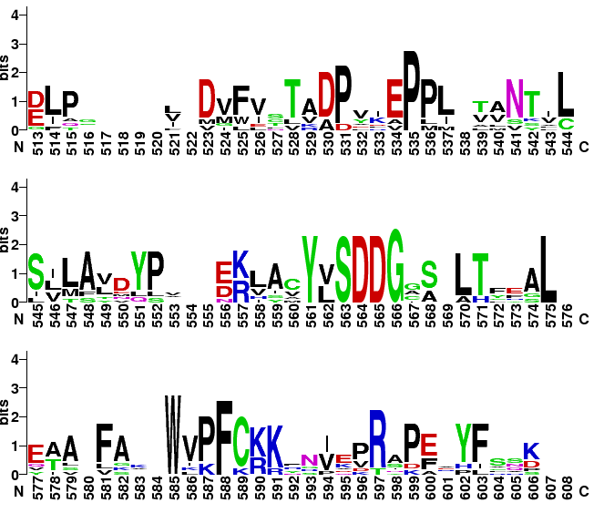
Click to increase

Slide 47
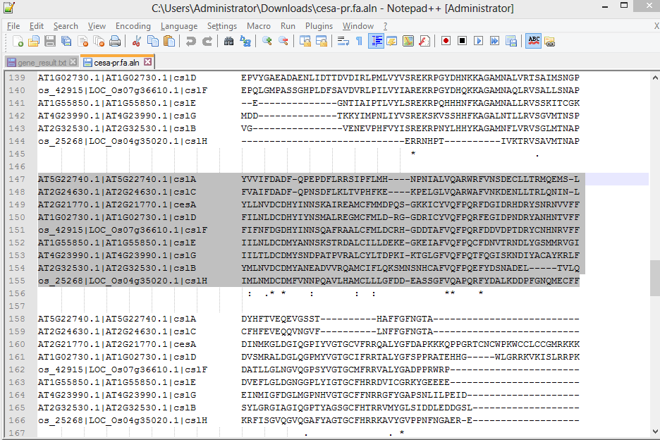
No need to use the entire alignment
You can also copy paste a segment of the alignment to weblogo

Slide 48
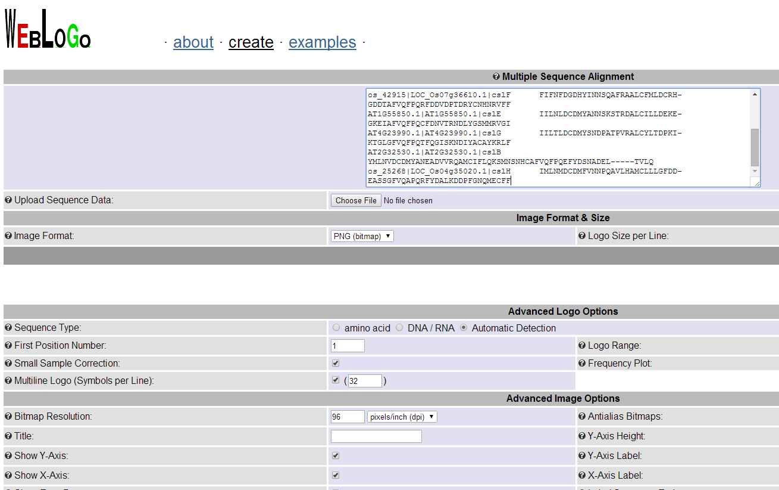
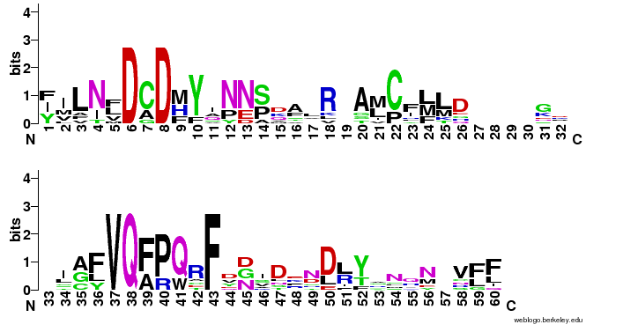
Paste the copied segment here

Slide 49
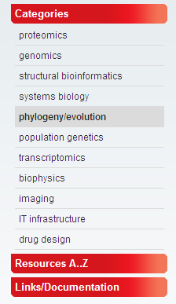
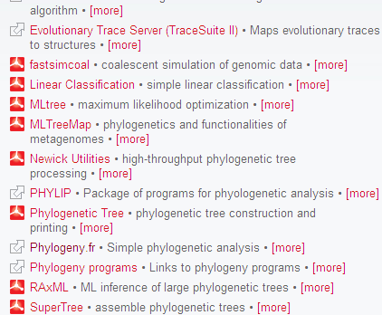
With MSA you can build a phylogeny to describe the relatedness of seqs
Seqs
MSA
Phylogeny
Graph
We are gonna try this website

Slide 50
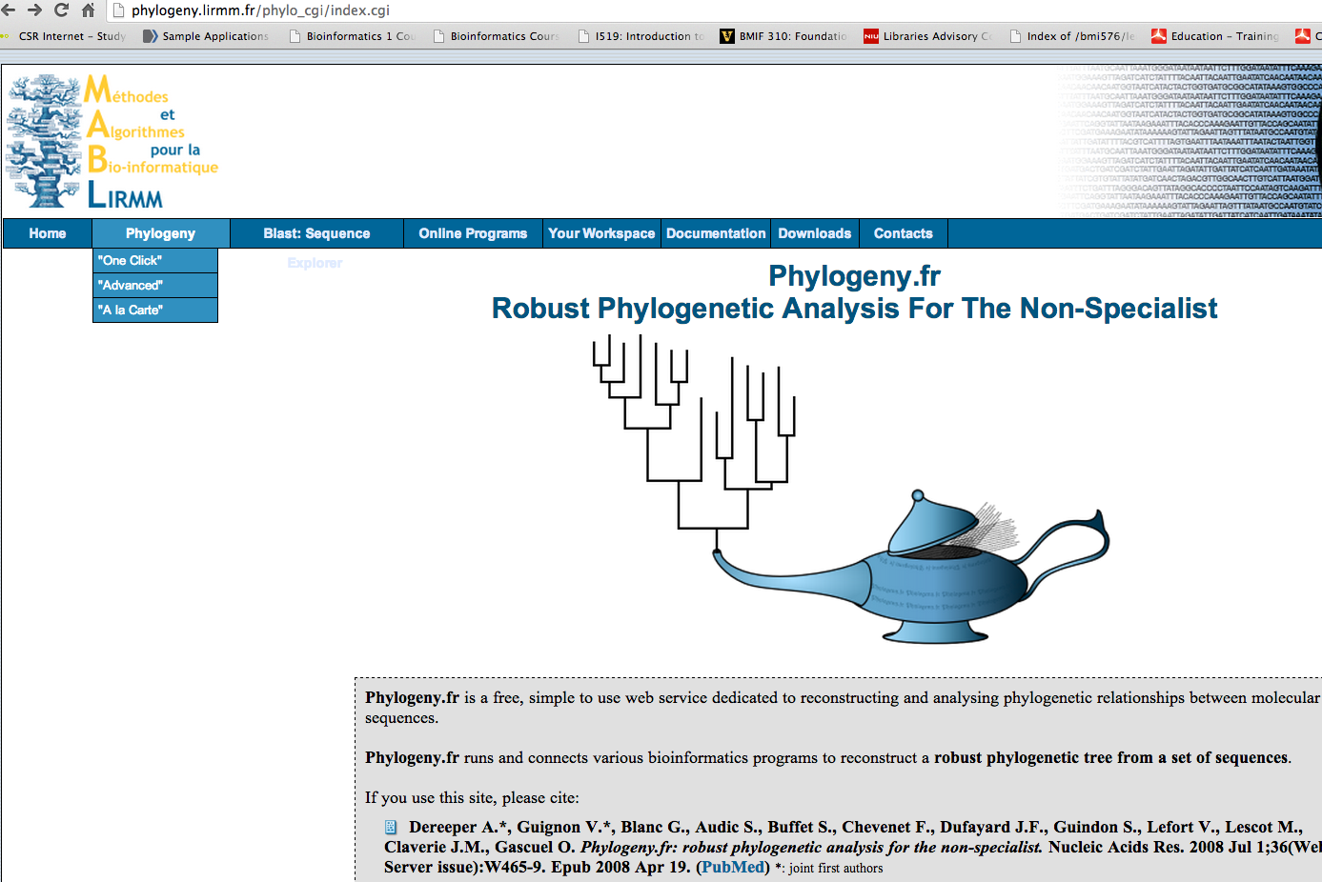
http://phylogeny.lirmm.fr/phylo_cgi/index.cgi
Three modes of phylogeny reconstruction
Try the one click mode

Slide 51
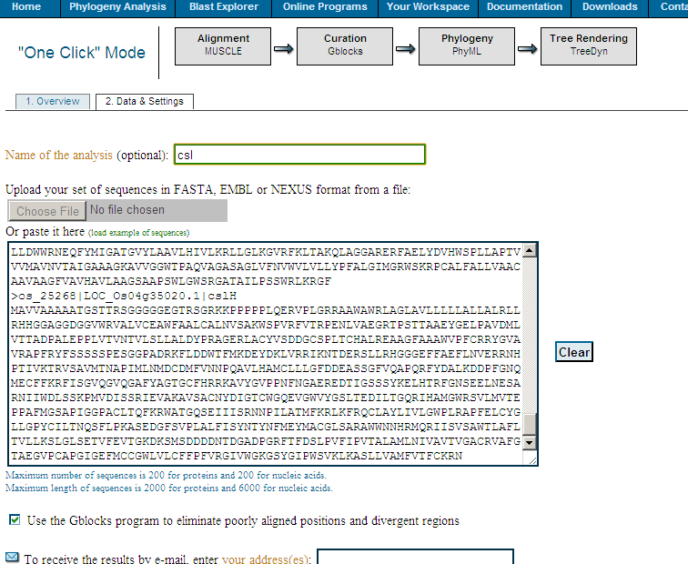
http://cys.bios.niu.edu/yyin/teach/PBB/cesa-pr.fa
One click mode uses these tools
Give this job a name
Gblocks is a program automatically edit the alignment

Slide 52
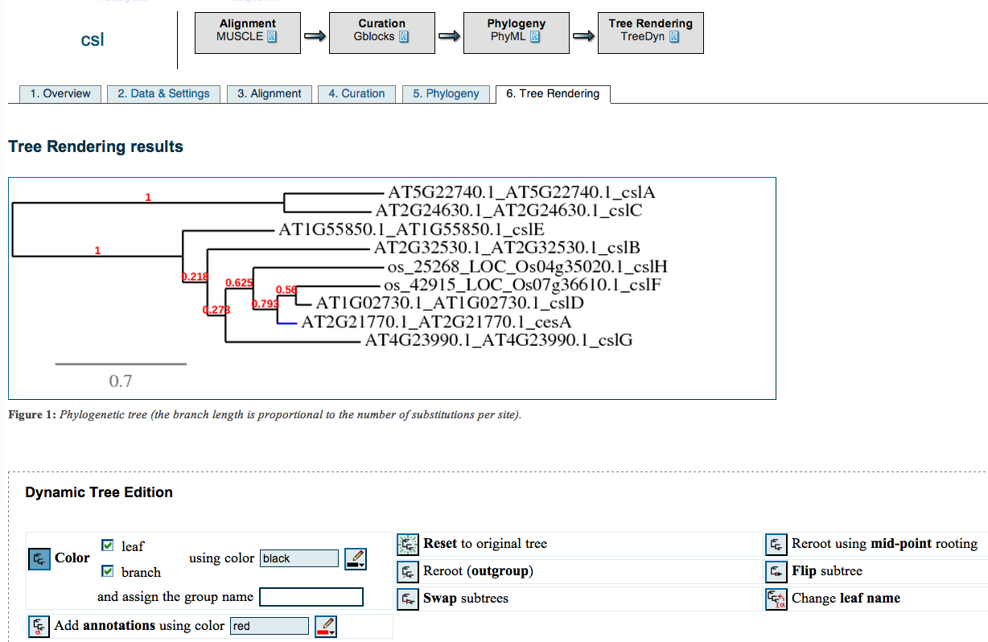

Slide 53
EMBOSS: European Molecular Biology Open Software Suite
EMBOSS: The European Molecular Biology Open Software Suite (2000)
Rice,P. Longden,I. and Bleasby,A.
Trends in Genetics 16, (6) pp276--277

Slide 54
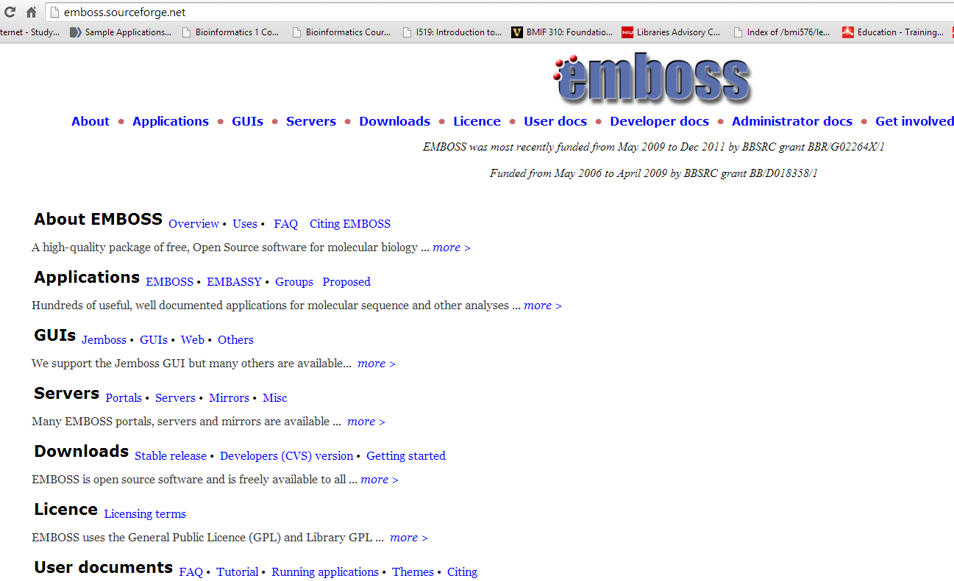
http://emboss.sourceforge.net/
EMBOSS contain hundreds of computer programs written in C language for sequence analysis
The best way to use is to install it on a Linux computer
Here we’re gonna try some public web servers that have EMBOSS package installed

Slide 55
Many others are not accessible, but this one is

Slide 56
350+ programs put into different groups
This is called EMBOSS explorer, which is a web interface to support running EMBOSS programs through web
We will try a few programs in this package

Slide 57
The most basic one: translate a nucleotide seq to an amino acid seq (related to finding the open reading frames)
Find the program transeq in the nucleic translation group

Slide 58
Copy and paste the seq in http://cys.bios.niu.edu/yyin/teach/PBB/nt-example.fa
It’s an assembled transcript from EST data of some algal species
We do not know if it indeed encode a protein and if yes where is the ORF
Remember mRNA contains untranslated region (UTR)
Choose all six frames

Slide 59
This is likely the right frame

Slide 60
If this is a correct result? You can take the nt seq to do blast at NCBI
Put the seq ID here because it is in GenBank already
Choose swiss-prot because it is smaller and high quality

Slide 61
Click formatting options
Choose plain text view
Click reformat

Slide 62
This is the alignment of our query with the best hit, the frame is +2, same as the transeq result

Slide 64
This is the longest ORF

Slide 65
http://cys.bios.niu.edu/yyin/teach/PBB/nt-example.fa
ATGCGCTA
TACGCGAT
TAGCGCAT
Complement
Reverse

Slide 67
http://cys.bios.niu.edu/yyin/teach/PBB/nt-example.fa
ATGCGCTA
TGCGCT
Region 2-7
Region 57-400

Slide 69
ATGCGCTA
GC%=50%
Calculate GC content
Change to yes to get a pic

Slide 71
ATGCGCTA
16 possible dinuc
64 possible trinuc
256 possible tetranuc
Default is dinuc

Slide 72
Application: scan genome to look for regions with abnormal compositions
Equal occurrence: 1/16

Slide 73
http://cys.bios.niu.edu/yyin/teach/PBB/cesa-pr.fa, copy paste the 1st seq

Slide 75
Popular tools developed at Technical University of Denmark

Slide 76
Google: cbs dtu

Slide 77
http://cys.bios.niu.edu/yyin/teach/PBB/nt-example.fa

Slide 78
This lists all the ATG in the seq, each was scored to indicate its likelihood to be a start codon

Slide 80
http://cys.bios.niu.edu/yyin/teach/PBB/cesa-pr.fa, copy paste the 1st seq

Slide 83
Next class: ClustalX and MEGA

