Slide 1
Linux command line basics I: files and folders
Yanbin Yin
Fall 2014
http://cys.bios.niu.edu/yyin/teach/PBB/Yin-chapter1.pdf
http://korflab.ucdavis.edu/Unix_and_Perl/current.html

Slide 2
Access server from outside of NIU:
https://securenet.niu.edu/ssl_general.shtml

Slide 3
Understand Linux/Unix and shell
File system
Basic shell commands
Commands for text processing
Pipe: chain multiple commands to get text processing pipeline
Shell one-liner
There's always more than one way to do it

Slide 4
Putty, ssh secure shell client, both are installed on computers of MO444

Slide 5
What is ssh?
Secure Shell (SSH) is a cryptographic network protocol for secure data communication, remote command-line login, remote command execution, and other secure network services between two networked computers

Slide 6
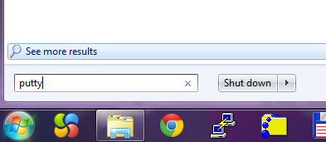
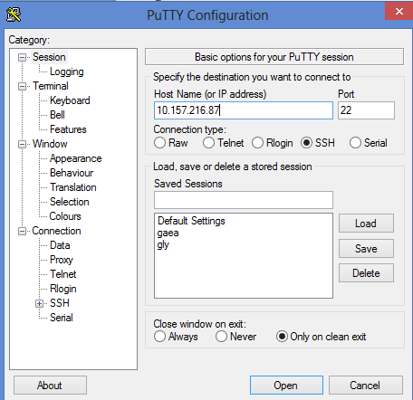
go to the left bottom, search “putty”
Put the IP address:
10.157.217.87
Hit Open

Slide 7
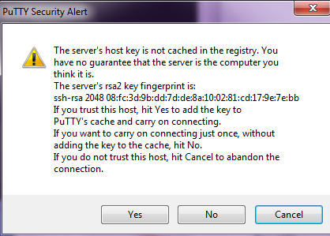
Hit Yes
Put your student ID here and hit enter
Wait until you see the following, then put your password (the same as your student ID)
Your password will be invisible while you are typing it in. Hit enter after you are done
Your user name and password are both your student ID

Slide 8
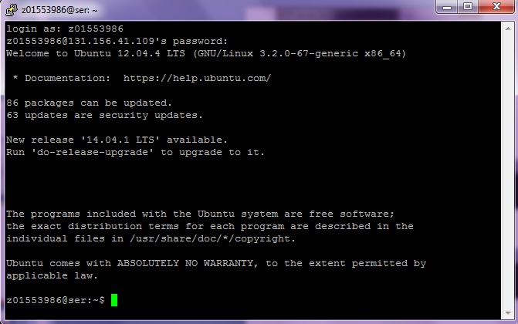
If you have put your password correctly, you will see this, meaning you are logged in now:
A plain text world
Everything is text, no images
Good:
lowest consumption from graphics, all resources (CPU, RAM, hard drive) saved for computation
Bad:
User unfriendly
If you did NOT put your password correctly, you will see this:
Just do it again

Slide 9
What you see after you successfully logged in
z01553986@ser:~$
Prompt sign
Cursor sits right after prompt
User name
Machine name
Your home (colon, tilde)

Slide 10
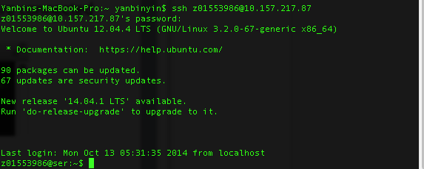
MAC has its built-in terminal. Search terminal application
Type in this part, hit enter and then yes, put password, and then you are connected

Slide 11
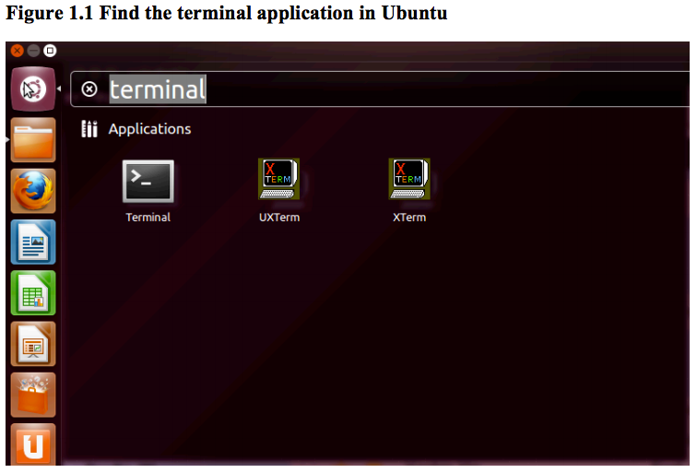
Ubuntu has its GUI and terminal and if you want to connect to another Linux server
After the terminal is opened, type:
ssh z01553986@10.157.217.87

Slide 12
To summarize: how to log in
WINDOWS
Terminal:
ssh yyin@10.157.217.87
putty
Linux
Ser server
MAC
Terminal:
ssh yyin@10.157.217.87
Terminal:
ssh yyin@gaea.niu.edu
ssh yinyb@zcluster.rcc.uga.edu
…
To logout, type
logout, exit or Ctrl+d

Slide 14
Interactive command line terminal
In the graphical interface of Windows, Linux and MAC, you click your mouse to make something happen.
However, under command line terminal (or console) interface, you always type in a command using the keyboard and hit Enter to let something happen.
The command you typed in is interpreted and executed by the Shell, the Linux software and interface to connect the users and the OS.
The output of the command is printed on the screen by default or written to a file. (together with error msg if any)

Slide 15
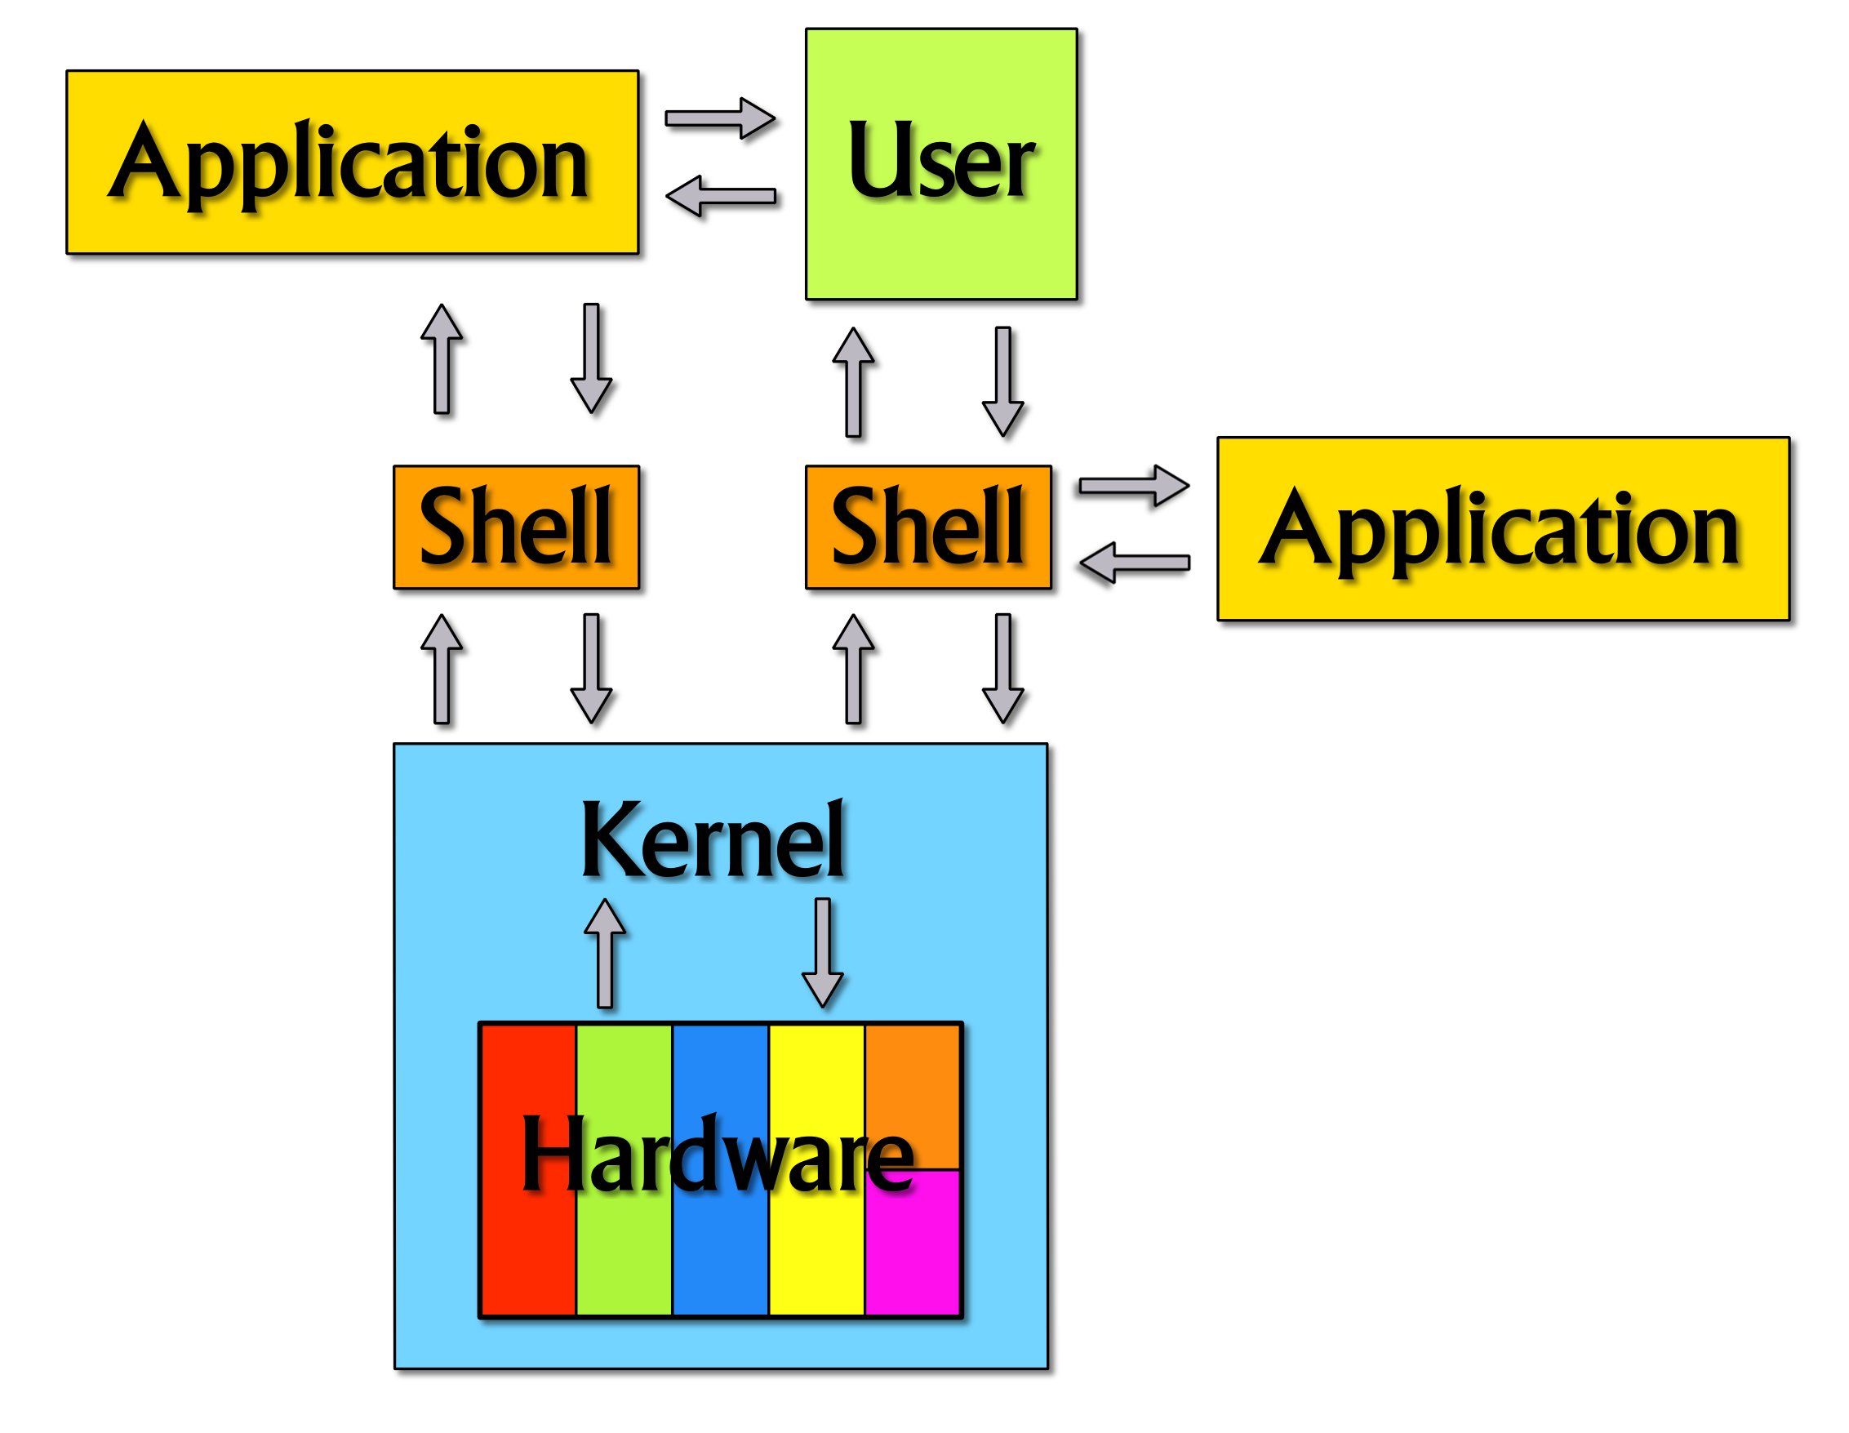
What is shell?
Terminal is the interface/Shell where user talks (by typing a command) to the kernel to operate hardware
The operating system

Slide 16
Commands
Commands can be a single word/letter or a few words separated by space; always hit Enter after you finished typing
The first word/letter is often a Shell command or an external program or your own script name
Other words can be command options, files, folders etc.
Examples:
yyin@ser:~$ pwd
/home/yyin
yyin@ser:~$ ls /disk4/z01553986
examples.desktop
For all of you, your home is at /disk?/yourid
? could be 1, 2, 3, 4
e.g. /disk4/z01553986

Slide 17
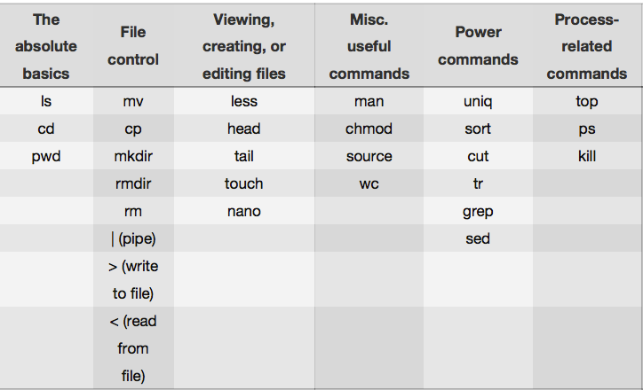
Commands you must learn
http://korflab.ucdavis.edu/Unix_and_Perl/unix_and_perl_v3.1.1.pdf

Slide 18
For people who have no experience in terminal: you are like in a dark room alone.
Where am I, what is that sound, what did I just bump into?
You can’t see, you have to get used to using your other senses …
No shortcuts, just learn by using
yyin@ser:~$ s
s: command not found
yyin@ser:~$ '
>
>
> ^C
If you type some not-existing command
If you mistakenly type in a quote and hit enter, you get stucked
Ctrl+c will get you out of there
Ctrl+d will log you out

Slide 19
Everything is a file or a folder/directory in Linux
A folder contains files or/and other folders (subdirectories)
A subdirectory can contain other files or folders
So the file system is a tree-like structure (multi-furcation)
root
/
2nd level
/media
/home
/bin
/usr
/etc
…
/media/DATAPART1
/home/nmcginn
/media/DATAPART2
/home/hscao
…
3rd level
/media/DATAPART3
…
/home/yyin
…
/home/yyin/book
…
4th level

Slide 20
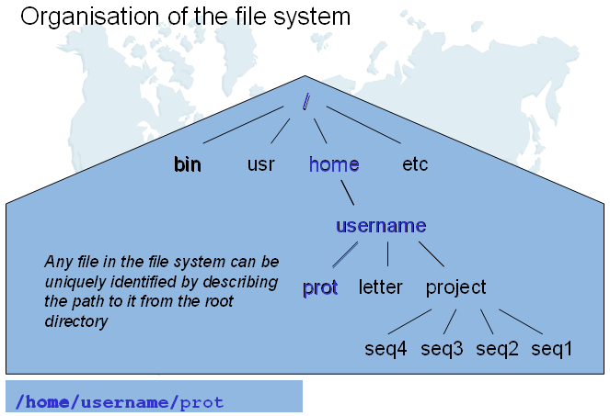
http://edu.isb-sib.ch/mod/resource/view.php?id=306

Slide 21
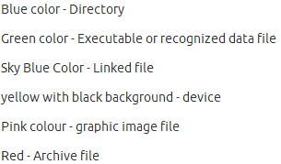
Since you are in a file system, knowing where you are is very important
Remember pwd is the command to find where you are (working directory)
If you issue a command which expect a file/folder name, you need to tell Shell the location of the file/folder, which is called path
Without specifying the path, Shell will think the file/folder is in the current folder. If it can’t find the file, it reports an error
yyin@ser:~$ pwd
/home/yyin
yyin@ser:~$ ls /disk4/z01553986
examples.desktop
http://askubuntu.com/questions/17299/what-do-the-different-colors-mean-in-the-terminal

Slide 22
File/folder/program names
Case sensitive!!!
File and file are two different files
Allow to contain letters, numbers, underscore (_), dot (.), dash (-), plus (+) but not to use other special characters and spaces
Example:
[yyin@gaea fungal]$ ls
all.hmmlib_1.75.fungal-dockerin.domain.fa.nobac.n2+.fa.id.source.nrgi.ps.col.lab
For programs, better use the correct file extension (.sh, .pl, .c, .py), e.g. run-blast.sh

Slide 23
Home folder (dir)
After you login a remote Linux machine or you opened a terminal in your Ubuntu or MAC computer, you are at your home
You can create or download folders, files, bioinformatics softwares
Make it organized and clean by creating folders that have meaningful names, such as tools, data, work, project, scripts etc.
You can also create subfolders, e.g. blast under tools, or project1 under project
Don’t put everything in your home directory; you will easily accumulate too many files/folders/programs/scripts that you will have a headache to find or remember

Slide 24
Directory (folder) commands
pwd find out where you are (your current directory or working directory)
cd change directory
Remember? Save you from some typing
Don’ need to type everything in
Always use TAB key to auto-complete a word!!!!!!!!!!
Up arrow key to bring your previous commands

Slide 25
Relative path and absolute path
Find out where you are:
yyin@ser:~$ cd /home/yyin
yyin@ser:~$ pwd
/home/yyin
If I want to change directory to /home/
yyin@ser:~$ cd ..
yyin@ser:/home$
If I want to go back to my home
yyin@ser:/home$ cd yyin
yyin@ser:~$
I can also use the absolute path to go back
yyin@ser:/home$ cd /home/yyin
yyin@ser:~$
Absolute path or full path
Relative path, relative to your current dir: /home

Slide 26
Special denotations:
~ or ~/ your home
. or ./ your current directory
.. or ../ the dir one level above
../.. ?
tilde
Try:
cd ~
cd ..
pwd
cd ../..
pwd
If you think you are lost in the file system and don’t know where you are, always run
pwd
From anywhere to go back to you home
cd
cd ~

Slide 27
More directory commands
mkdir create a directory
rmdir delete an empty directory (have no subdirectories or files)
At your home, try
mkdir bioinfo
Remember case sensitive and no special characters and space!!!

Slide 28
List command
ls list what files and directories are there in a folder
Try
ls
ls –l list in long listing format
ls –la list all including hidden files/folders
ls –lt list according to modification time
ls –ltr list according to time in reverse order
ls .. list one level up
ls –l /home/yyin list things under a given folder
ls –l | less if there are too many files to display in one page, use pipe and less to show page by page (will explain shortly)
have to type q to exit less
These are options, used to enrich the functionalities of a command

Slide 29
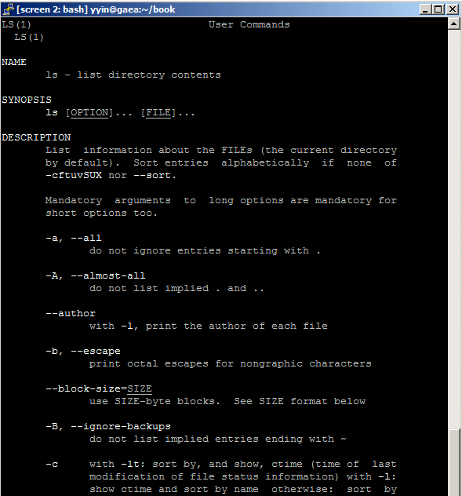
The manual command
man ls
If the manual is more than one page, hit space or PgDn key to page down, PgUp key or u to page up
To exit the man page, hit q
Man followed by any Linux command to display the manual of that command
man pwd
man cd
…

Slide 30
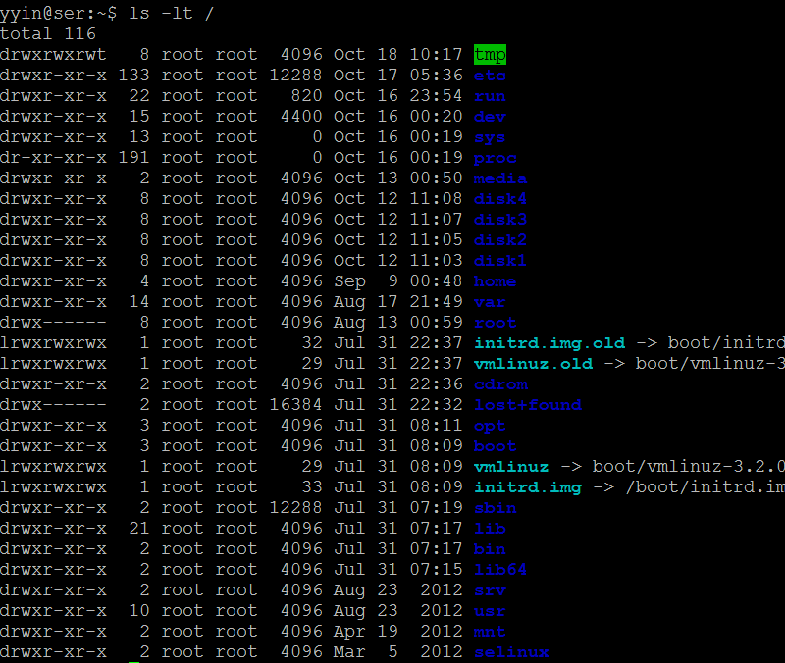
ls –lt /
d means folder
size
Permission
User and Group
Modification time

Slide 31
File and folder permission can be changed
Let’s look at one of the files under my home:
-rw-r--r--
The first one “-“ means it is a file; it will be “d” if it is a folder (directory).
The following nine columns indicate the permission of read (r), write (w) and execute (x) granted for the user (first three columns), the group (middle three) and others (last three). “-“ means no permission
-rwxrwxrwx the file could be read, write, and execute by anybody
-r-------- can only be read by the owner
yyin@ser:~$ chmod go-r /home/yyin/Unix_and_Perl_course/Data/GenBank/E.coli.genbank
yyin@ser:~$ ls -l /home/yyin/Unix_and_Perl_course/Data/GenBank/E.coli.genbank
-rw-r--r-- 1 yyin yanbin 10602328 Oct 9 2008 /home/yyin/Unix_and_Perl_course/Data/GenBank/E.coli.genbank
Now you can not read that file in my home

Slide 32
How to view files
In order for you to read my file:
yyin@ser:~$ chmod go+r /home/yyin/Unix_and_Perl_course/Data/GenBank/E.coli.genbank
yyin@ser:~$ ls -l /home/yyin/Unix_and_Perl_course/Data/GenBank/E.coli.genbank
-rw-r--r-- 1 yyin yanbin 10602328 Oct 9 2008 /home/yyin/Unix_and_Perl_course/Data/GenBank/E.coli.genbank
At your home, try
head /home/yyin/Unix_and_Perl_course/Data/GenBank/E.coli.genbank
Similar commands:
more
less
tail
cat
Unlike in Windows,
text files of any size
can be viewed
Only text files can be viewed
There are also binary files, zipped files and tarred files that can not be viewed. For example,
- Executables (e.g., blast, samtools, bwa, bowtie)
- Data in binary format (e.g, BAM files, index files for BWA or Bowtie, formatted BLAST databases)
- Compressed files (usually *.gz, *.zip, *.bz2,…, but extensions not necessary)

Slide 33
How to copy and move files/folders
At you home, try
cp /home/yyin/Unix_and_Perl_course/Data/GenBank/E.coli.genbank .
Remember what dot (.) means?
Now try,
ls
mv E.coli.genbank bioinfo
ls
mv bioinfo/E.coli.genbank .
ls
What about?
mv E.coli.genbank bioinf
What if you want to copy a folder?
cp –r bioinfo bioinfo2
You created this folder in your home moments ago
Difference?
mv file folder
mv file file

Slide 34
How to delete files/folders?
rm file remove file
rm folder remove empty folder
rm –rf folder remove not empty folder
For example,
rm –rf bioinfo2
WARNING: deleted things can not be recovered in Linux!!!
To be asked before deletion,
yyin@ser:~$ rm -i bioinf
rm: remove regular file `bioinf'? y

Slide 35
Homework #6
Create a folder under your home called hw6; pwd to find out where you are
Change directory to hw6; pwd to find out where you are
Copy the entire folder Unix_and_Perl_course from my home to your working folder (the folder where you currently are)
Change directory back to your home
Use ls to explore the folder Unix_and_Perl_course and the sub-folders in there to locate the At_genes.gff file and the unix_and_perl_v3.1.1.pdf file. Tell me what is the size and creation date of these files.
Change the permission of the At_genes.gff file so that every user can edit this file.
Write a report (in word or ppt) to include all the operations/commands and screen shots.
Due on 10/30 (send by email)
Office hour:
Tue, Thu and Fri 2-4pm, MO325A
Or email: yyin@niu.edu

Slide 36
Next class: commands for controlling files

