Slide 1
Linux command line basics II: downloading data and controlling files
Yanbin Yin
Fall 2014

Slide 2
Things you should know about programming
Learning programming has to go through the hands-on practice, a lot of practice
Hearing what I describe about a command or a program helps, but you will not be able to do it unless you type in the codes and run it to see what happens
Reading others’ codes helps but often is harder than writing it by yourself from scratch
Although painful and frustrating, trouble-shooting is normal and part of the learning experience (ask experienced people or google)
To avoid errors, you have to follow rules; most errors occurred in programming are because of not knowing rules or forgetting rules
Use comments in case you forget what you’ve written means
write-> run -> errors -> edit-> errors -> ………………………………….. -> run -> success
Good news: finished scripts could be reused or edited for later use

Slide 3
Homework #7
Create a folder under your home called hw7
Change directory to hw7
Go to NCBI ftp site, find the genome, bacteria, ecoli MG1655 folder, and download the ptt file and the faa file in there
Create a copy of the ppt file, if the original file is called A.ptt, name the copied file A.ptt.bak
Do the same thing for the faa file
For the ppt file, use vi to replace .. in the location column with a tab space
For the faa file, use vi to delete anything after a space in the description line
Write a report (in word or ppt) to include all the operations/commands and screen shots.
Due on Nov 11 (send by email)
Office hour:
Tue, Thu and Fri 2-4pm, MO325A
Or email: yyin@niu.edu

Slide 4
What we learned last class:
file system,
relative/absolute paths,
working folder, home folder
ssh, pwd, ls
cd, mkdir, rmdir, rm, man
cp, mv
If things go wrong, try:
Ctrl+c (sometimes multiple times)
q to exit from man page

Slide 5
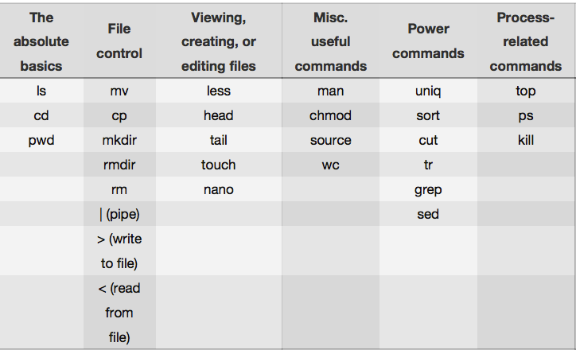
http://korflab.ucdavis.edu/Unix_and_Perl/unix_and_perl_v3.1.1.pdf

Slide 6
View files: more, less, head, tail
How you use Tab key to autocomplete
less /home/ then hit tab twice, you will see all files/folders under /home/
less /home/yyin/ then hit tab twice, you will see …
less /home/yyin/U then hit tab once, Unix_and_Perl_course will be autocompleted
less /home/yyin/Unix_and_Perl_course/ keep doing this until you get
less /home/yyin/Unix_and_Perl_course/Data/Arabidopsis/At_proteins.fasta
You can also try:
ls /home/yyin/Unix_and_Perl_course/Data/Arabidopsis/
q: quit viewing ↑ or ↓: move up or down a line
space: next page />: search for text ‘>’
B or PgUp: back a page F or PgDn: forward a page
n: find next occurrence of ‘abc’
G: go to the end ?: find previous occuence of ‘abc’

Slide 7
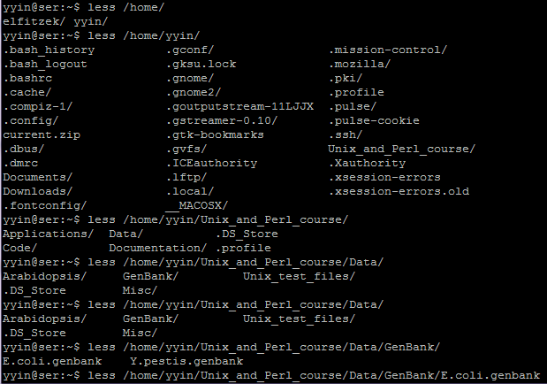
How you use Tab key to autocomplete

Slide 8
more is similar to less, but can do less than less
more /home/yyin/Unix_and_Perl_course/Data/Arabidopsis/At_genes.gff
head to dump the top few lines to the screen
head /home/yyin/Unix_and_Perl_course/Data/Arabidopsis/chr1.fasta
head -20 /home/yyin/Unix_and_Perl_course/Data/Arabidopsis/chr1.fasta
tail to dump the last few lines to the screen
tail /home/yyin/Unix_and_Perl_course/Data/Arabidopsis/intron_IME_data.fasta
tail -20 /home/yyin/Unix_and_Perl_course/Data/Arabidopsis/intron_IME_data.fasta
more, less, head, tail do not load all file content to the memory
You can edit the file content either, they are just viewers

Slide 9
Create or edit files
Text editors:
nano
pico
vi
Suppose you are at your home:
Write the top part of the intAt_genes.gff file to a new file
head -20 /home/yyin/Unix_and_Perl_course/Data/Arabidopsis/At_genes.gff > head
Try nano (Intuitive user interface)
nano head
Try vi (command-driven interface, but much more power)
vi head
Create a file from scratch using vi.
you type vi filename and hit enter
after you are in vi, type i to get into edit mode and copy & paste content in vi
hit Esc to exit edit mode and then :x to save the file and exit vi.

Slide 10
Input and output redirection: the greater-than sign
Unix has a special way to direct input and output from commands or programs.
By default, the input is from keyboard (called standard input, stdin): you type in a command and Shell takes the command and executes it.
The standard output by default is to the terminal screen (stdout);
if the command or program failed, you will also have standard errors dumped to the terminal screen (stderr).
However, if you do not want the output dumped to the screen, you can use “>” to redirect/write the output into a file. For example, try
ls /home/yyin
ls /home/yyin > list
ls /home/yyim
ls /home/yyim 2> err
“2>” to dump the error message
No space here!

Slide 11
vi basics
i
command mode
edit mode
Esc
The following commands operate in command mode (hit Esc before using them)
x delete one character at cursor position
u undo
dd delete the current line
G go to end of file
1G go to beginning of file
10G go to line 10
$ go to end of line
1 go to beginning of line
:q! exit without saving
:w save (but not exit)
:wq or :x save and exit
Arrow keys: move cursor around (in both modes)
http://cbsu.tc.cornell.edu/ww/1/Default.aspx?wid=36

Slide 12
Search and substitution in vi
In command mode, you can do a number of fancy things. The most useful are:
- Search: hit slash (“/”) to get the cursor to the left-bottom corner; you can type any word or letter to search it; type n to go to the next instance
- Replace: hit Esc (at any time, hitting Esc to get back to the default status is the safest thing to do) and type “:1,$s/+/pos/g” and then enter will replace all “+” to “pos”.
Try this in
vi head
From the first line to the last
all instances in a row
The first field: to be replaced
:1,$s/+/pos/g
hit Esc to exit edit mode and then :q! to NOT save the file and exit vi.
Substitution
The second field: to replace with
Ready to type in command

Slide 13
Wild cards and regular expression
Regular expression (regex or regexp) is a very powerful tool for text processing and widely used in text editors (e.g. vi) and programming languages (e.g. Shell commands: sed, awk, grep and perl, python, PHP) to automatically edit (match and replace strings) texts.
Finding and replacing exact words or characters are simple, e.g. the vi example shown above
However, if you want to match multiple words or characters, you will need wildcards or patterns.

Slide 14
a list of commonly used wildcards and patterns:
* any numbers of letters, numbers and characters except for spaces and special
characters, e.g. ()[]+\/$@#%;,?
. any single letter, number and character including special characters
^ start of a line
$ end of a line
^$ an empty line, i.e. nothing between ^ and $
[] create your own pattern, e.g. [ATGC] matches one of the four letters only,
[ATGC]{2} matches two such letters; [0-9]: any numbers
\w any letter (a-z and A-Z)
\d any number (0-9)
+ previous items at least one times, e.g. \w+ matches words of any sizes
{n} previous items n times, e.g. \w{5} matches words with exactly five letters
\s space
\t tabular space
\n new line
caret
Curly brackets
http://www.bsd.org/regexintro.html

Slide 15
Use regex inside vi
This overwrite the head file:
head -20 /home/yyin/Unix_and_Perl_course/Data/Arabidopsis/At_proteins.fasta > head
vi head
Inside vi, try
:1,$s/ *//g
Hit u to undo
What about
:1,$s/ .*//g
hit Esc to exit edit mode and then :x to save the file and exit vi.

Slide 16
Get data from remote ftp/http website
ftp
lftp
sftp
ncftp
lftp addr command to connect to a remote ftp server
cd dir change to the directory
cd .. change to the upper folder (..)
ls list files and folders in the current directory at once
ls dir list files and folders in dir at once
ls | less list page by page (good if the list is too long)
get file get a file
mirror dir get a folder
zless file view the file content
by or bye exit lftp

Slide 17
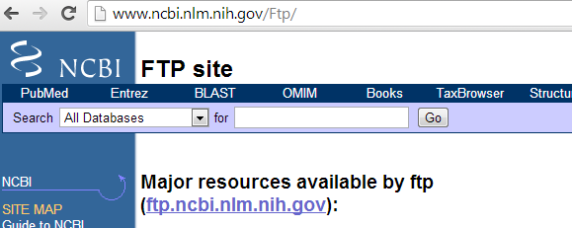
NCBI ftp site :
Connect to NCBI ftp site:
lftp ftp.ncbi.nih.gov
The prompt will change to:
lftp ftp.ncbi.nih.gov:/>
After ‘>’ you can type in command and hit enter:
lftp ftp.ncbi.nih.gov:/>ls
The ftp site can also be accessed through a web browser

Slide 18
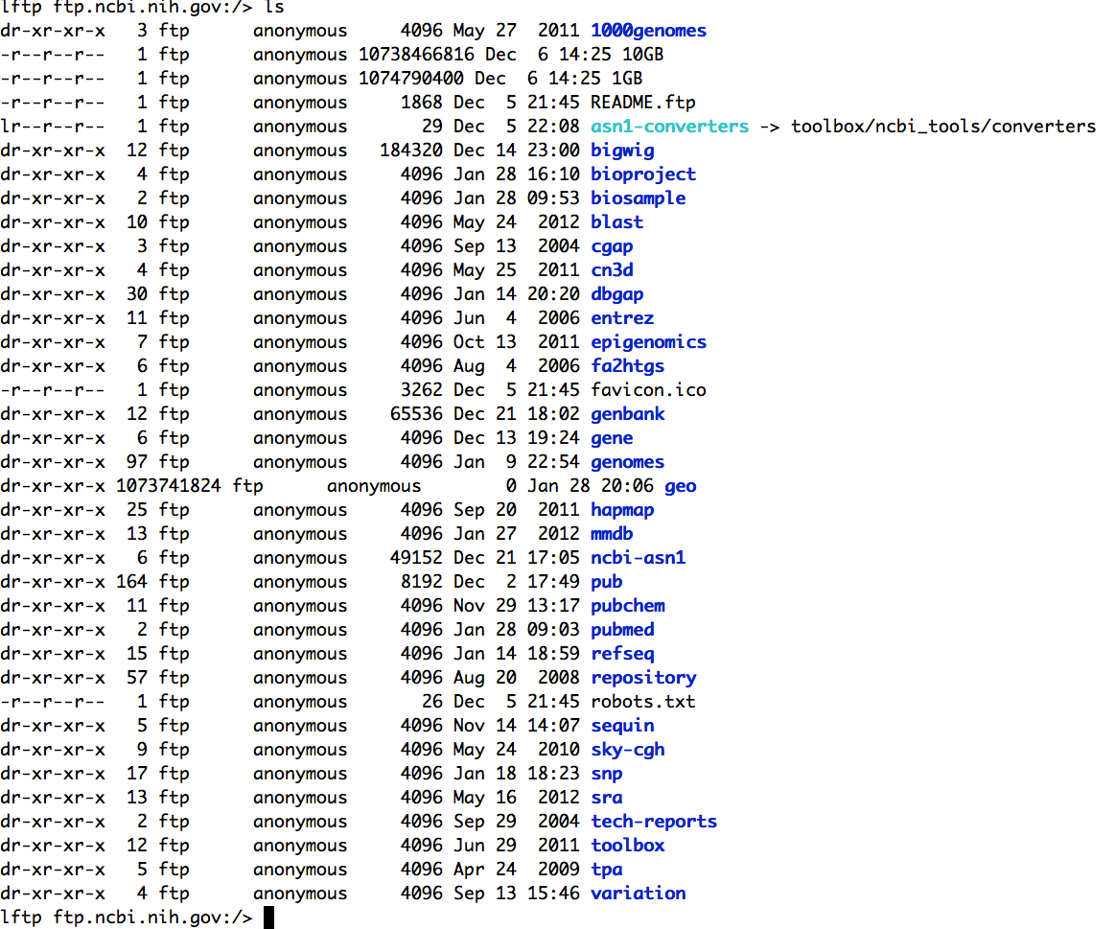
ls command:
list files and folders

Slide 19
Where bacterial genomes are in the ftp site?

Slide 20
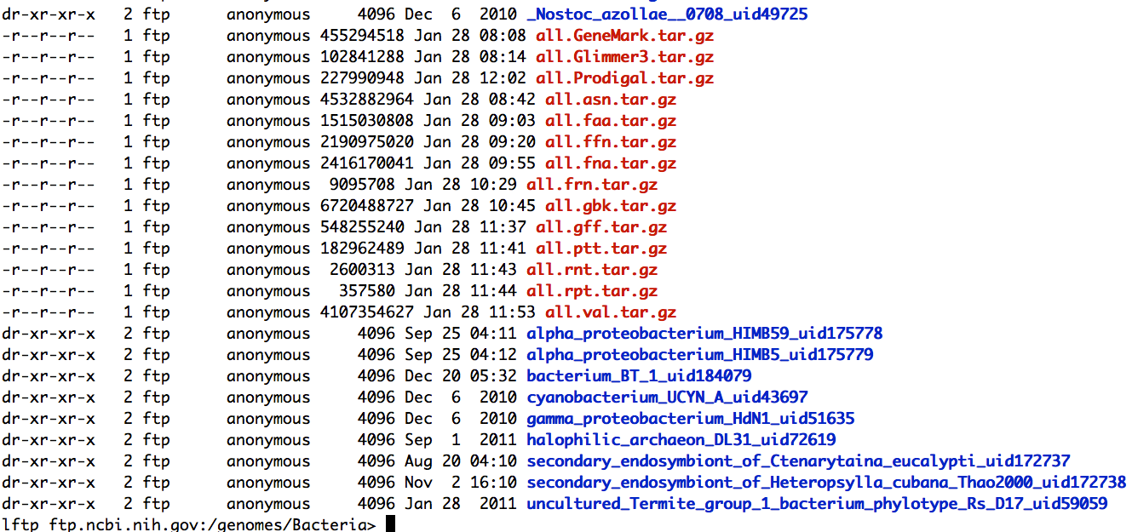
The end of the page after ls

Slide 21
cd ne
Then press tab key to auto-complete or list

Slide 22
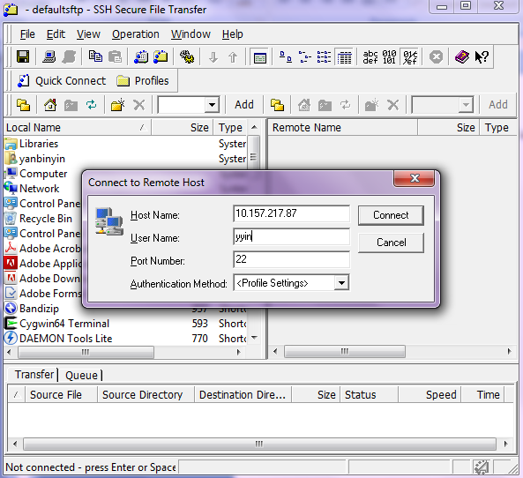
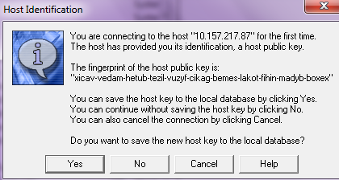
How to transfer file between a linux and a windows machine?
Use SSH secure file transfer client
Open the software
Hit enter
Put IP address
Put user name
Hit connect
Choose yes
Put password
Hit ok

Slide 23
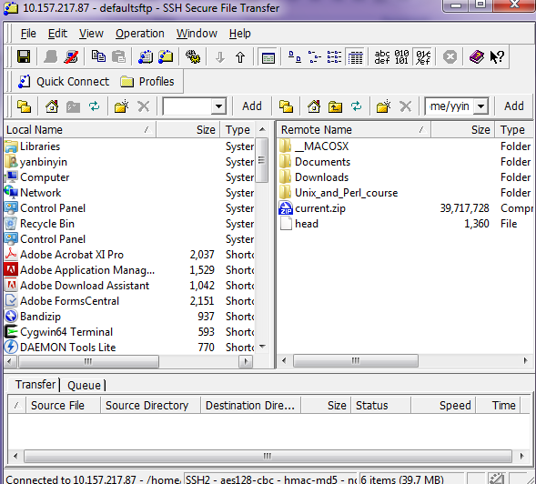
If transfer from local to remote: locate your file and drag to the right
If transfer from remote to local: locate your file and drag to the left

Slide 24
Transfer files between two Linux machines (or mac and linux)
scp: secure copy files/folders between hosts on a network
You are at a Linux or Mac machine, e.g. your laptop with Ubuntu installed and you want to copy some file from ser
Open a terminal in your machine
scp yyin@10.157.217.87:/home/yyin/Unix_and_Perl_course/Data/Arabidopsis/At_genes.gff .
scp username@IP:/path .
You will be asked for password on ser

Slide 25
wget
wget is a program useful for downloading files from both FTP and HTTP sites.
wget is non-interactive: you simply enter the necessary options and arguments on the command line and the file is downloaded for you.
You must identify the links first: browse a http webpage or a ftp site and locate the remote files/folders you want to download and then go to the terminal and type
wget http://cys.bios.niu.edu/yyin/teach/PBB/cesa-pr.fa
wget -q ftp.ncbi.nih.gov/blast/db/FASTA/yeast.aa.gz
wget -r -q ftp://ftp.ncbi.nih.gov/genomes/Bacteria/Escherichia_coli_K_12_substr__MG1655_uid57779
wget –q ftp.ncbi.nih.gov:/blast/executables/LATEST/ncbi-blast-2.2.27+-x64-linux.tar.gz
wget ftp://emboss.open-bio.org/pub/EMBOSS/emboss-latest.tar.gz
It take time to download
Put & at the end of command line to put the job to the background
-q quiet
-r recursive (for folders)

Slide 26
Archive and compress files/folders
To save disk space, we can compress large files if we do not intend to use them for a
while. A lot of files downloaded from the web are compressed and need to be
uncompressed before any processing can take place.
Common compressed formats:
• gzip (gz)
gzip my_file (compresses file my_file, producing its compressed version,
my_file.gz)
gzip –d my_file.gz (decompress my_file.gz, producing its original version
my_file)
• bzip2
bzip2 my_file (compresses file my_file, producing its compressed version,
my_file.bz2)
bunzip2 my_file.bz2 (decompress my_file.bz2, producing its original
version my_file)
zless to view zipped files

Slide 27
Common compressed formats (continued):
• zip
zip my_file.zip my_file1 my_file2 my_file3 (create a compressed archive
called my_files.zip, containing three files: my_file1, my_file2, my_file3)
zip ‐r my_file.zip my_file1 my_dir (if my_dir is a directory, create an
archive my_file.zip containing the file my_file1 and the directory my_dir
with all its content)
zip –l my_file.zip (list contents of the zip archive my_file.zip)
unzip my_files.zip (decompress the archive into the constituent files and
directories
• tar
tar ‐cvf my_file.tar my_file1 my_file2 my_dir (create a compressed
archive called my_files.tar, containing files my_file1, my_file2 and the
directory my_dir with all its content)
tar –tvf my_file.tar (list contents of the tar archive my_file.tar)
tar ‐ xvf my_files.tar (decompress the archive into the constituent files
and directories)
Use man tar to learn more

Slide 28
Common compressed formats (continued):
• tgz (also, tar.gz – essentially a combo of “tar” and “gzip”)
tar ‐czvf my_file.tgz my_file1 my_file2 my_dir (create a compressed
archive called my_files.tgz, containing files my_file1, my_file2 and the
directory my_dir with all its content)
tar –tzvf my_file.tgz (list contents of the tar archive my_file.tar)
tar ‐xzvf my_files.tgz (decompress the archive into the constituent files
and directories)

Slide 29
Wget the book materials of Unix and Perl Primer for Biologists
http://korflab.ucdavis.edu/Unix_and_Perl/
mkdir book
cd book
wget http://korflab.ucdavis.edu/Unix_and_Perl/current.zip
unzip current.zip
Unpackage the emboss package
cd
mkdir tools
cd tools
mv ../emboss-latest.tar.gz tools
tar –zxf emboss-latest.tar.gz &

Slide 30
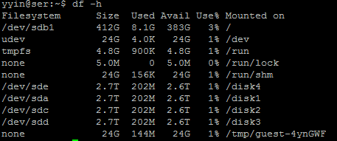
Check disk usage
Disk space is a limited resource, and you want to frequently monitor how much disk space you have used. To check the disk space usage for a folder, use the du (disk usage) command
yyin@ser:~$ du -hs .
318M .
yyin@ser:~$ du -hs Unix_and_Perl_course/
131M Unix_and_Perl_course/
To check how much space left on the entire storage file system, use the df command

Slide 31
- Save history of your commands:
history > hist1
less hist1
- Send message to other online users
write username (ctrl+c to exit)
- Change your password
passwd
Ctrl+c to tell Shell to stop current process
Ctrl+z to suspend
bg to send to background
Ctrl+d to exit the terminal (logout)

