Slide 1
Intro to Unix and Linux
Yanbin Yin
Fall 2014

Slide 2
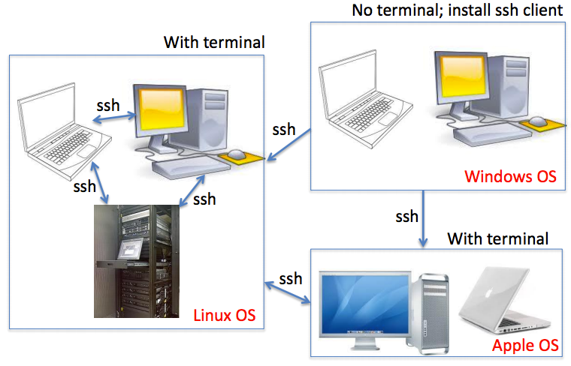

Slide 3
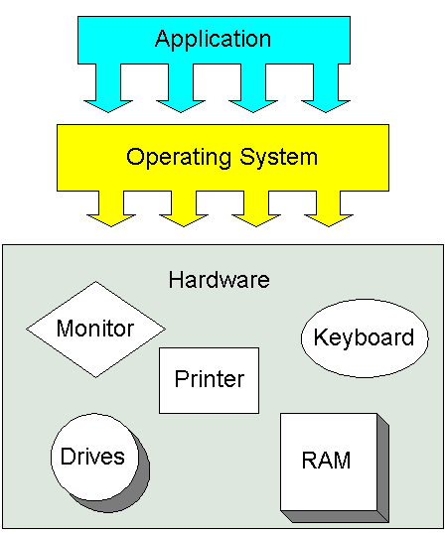
Operating Systems
Operating systems (OSs)
Windows
MAC OS
UNIX
http://www.karbosguide.com/hardware/module6c1.htm

Slide 4
Why do bioinformaticians NOT like Windows?
OS is NOT free
Applications are NOT free
The OS uses too much CPU and RAM resource
Command-line is too simple to support automated data processing

Slide 5
Why do Bioinformaticians prefer Mac or UNIX over Windows?
Better development environment
Software availability
Powerful command-line interface (terminal)
To really learn bioinformatics (regardless of whether you’re a “biology student”), you need to become familiar with a “*nix” environment and the tools that it provides
http://network.nature.com/groups/bioinformatics/forum/topics/8100

Slide 6
UNIX & Linux
There are many different versions of UNIX, although they share common similarities. The most popular varieties of UNIX are Sun Solaris, GNU/Linux, and MacOS X
Linux is a Unix-like computer operating system assembled under the model of free and open source software development and distribution. The Linux kernel was written in 1991 by Linus Torvalds

Slide 7
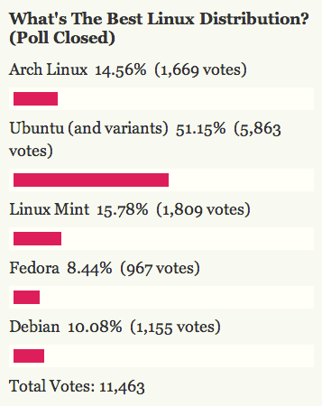
Linux distributions take the Linux kernel and combine it with other free software to create complete packages
Ubuntu: one of the most
popular desktop Linux Distro
http://lifehacker.com/5904069/five-best-linux-distributions

Slide 8
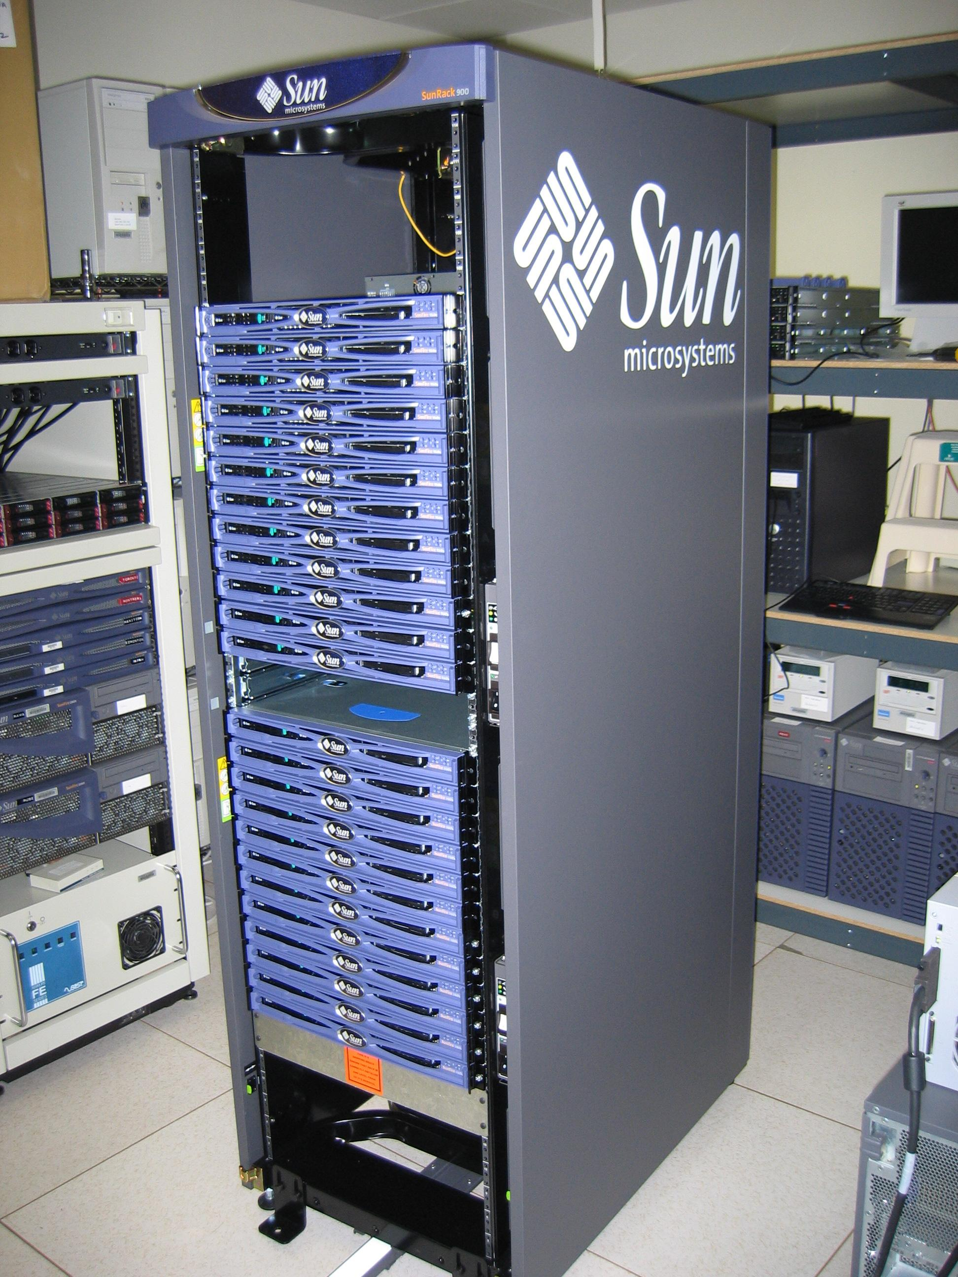
Two distinct UNIX environments
Large/super computer cluster
Individual Linux desktop/workstation

Slide 9
MAC users
MAC OS is essentially Unix based and has built-in terminal.
http://tech-devnet.blogspot.de/2012/05/running-ubuntu-1204-on-mac.html

Slide 10
Multiple ways to install ubuntu
http://www.youtube.com/watch?v=ba9Wv-XU_4M
Make sure you are connected to the internet!
WINDOWS 8 can NOT run Ubuntu alongside

Slide 11
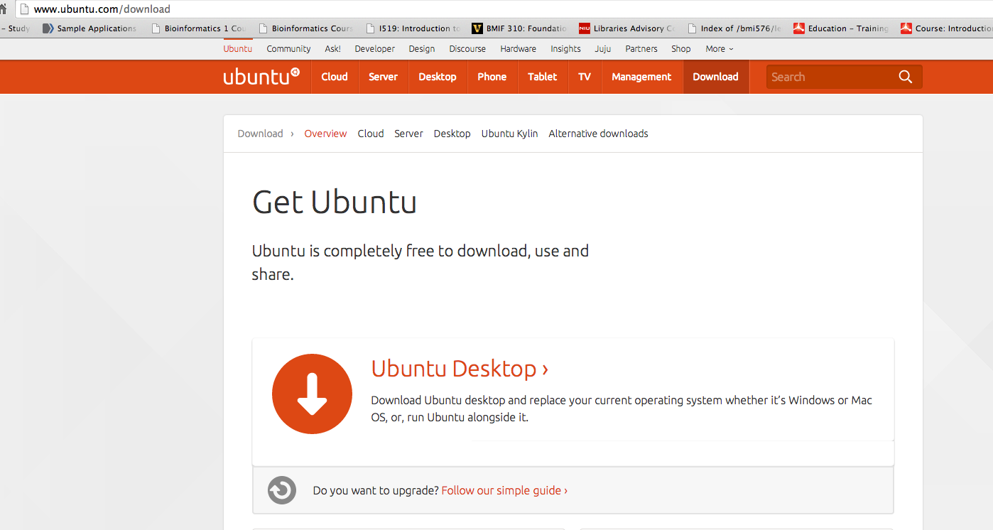
www.ubuntu.com/download
Download -> burn CD -> install

Slide 12
A different/easy way to install
Use Wubi to install unbuntu
https://wiki.ubuntu.com/WubiGuide

Slide 13
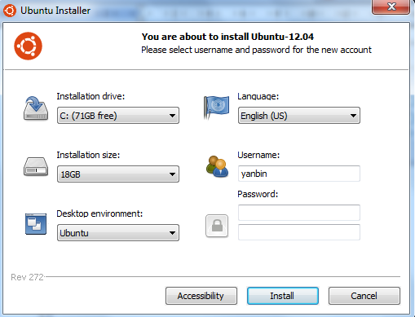

Slide 14
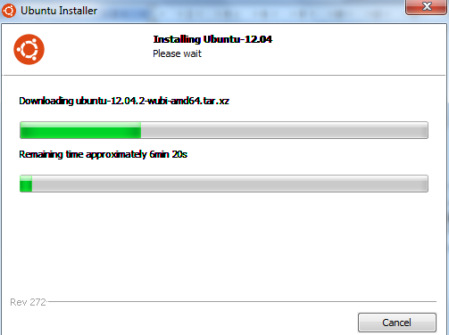
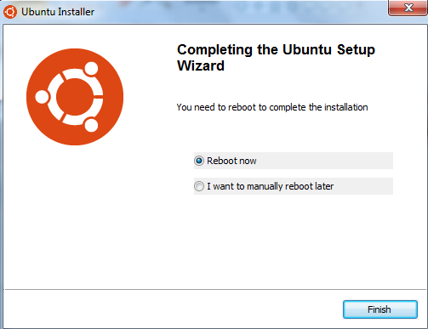
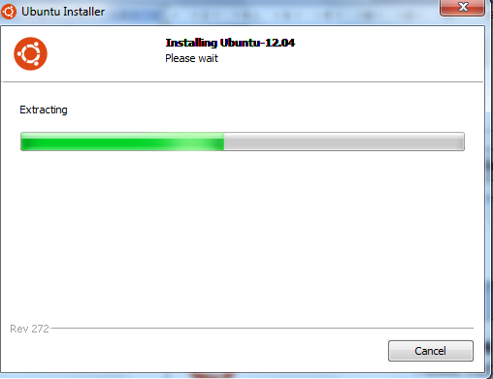
Takes at least 20 minutes to finish
depending on how fast your computer and internet are

Slide 15
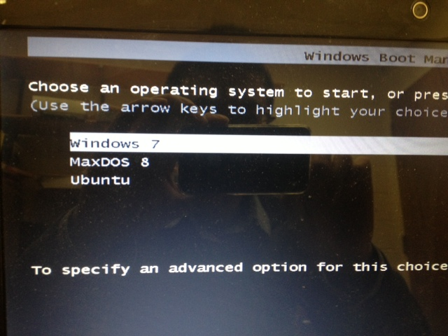

Slide 16
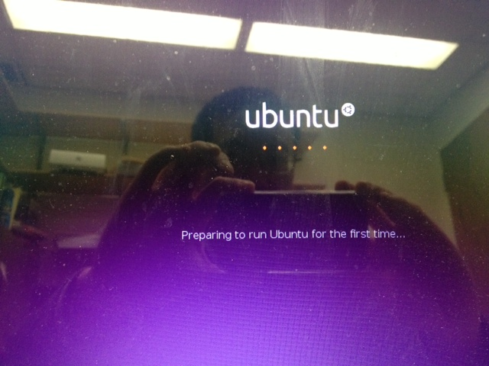

Slide 18
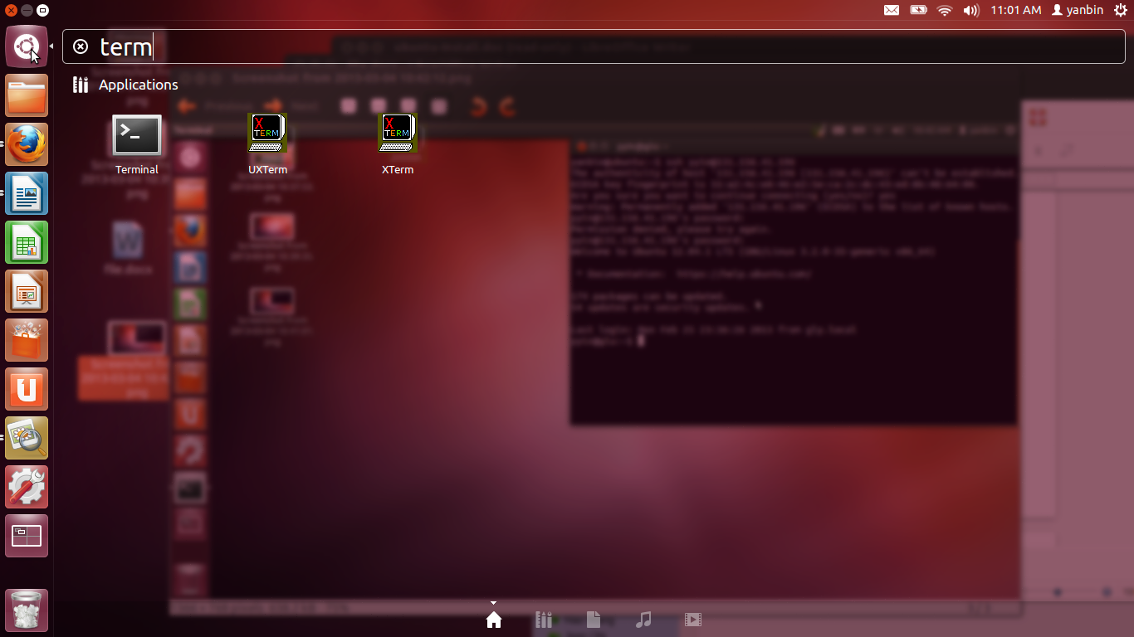
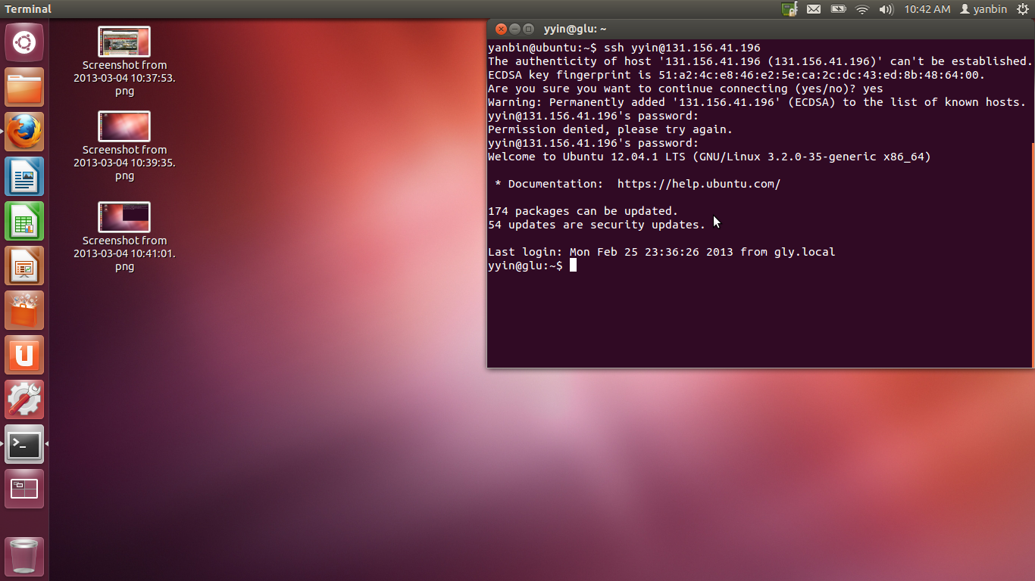
Ctrl+Alt+t

Slide 19
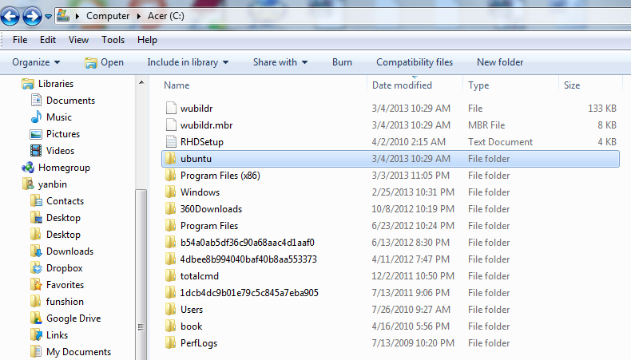
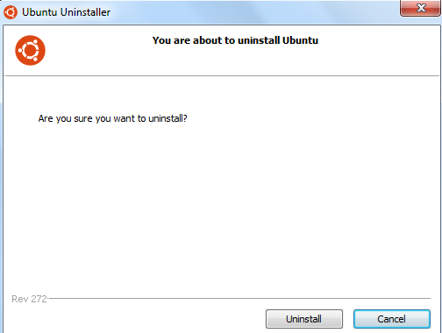
Want to delete ubuntu?
Get back to windows

Slide 20
Next class: Linux command line basics

