Slide 1
Basic molecular biology and overview of major bioinformatics web resources
Yanbin Yin
Fall 2014

Slide 2
Outline
Basic molecular biology
Web Databases
Web Servers

Slide 3
References
NAR database and web server annual special issues
http://pbil.univ-lyon1.fr/bookmarks.html
http://www.ebi.ac.uk/2can/resources/index.html
http://www.ebi.ac.uk/training/online/
http://www.ncbi.nlm.nih.gov/Class/FieldGuide/
http://www.csd.hku.hk/bruhk/resources.html
http://anil.cchmc.org/BioInfoRes.html
http://www.ncbi.nlm.nih.gov/Class/NAWBIS/

Slide 4
How to run bioinformatics applications
• Most naive: use web-based tools [e.g. NCBI blast server]
– Primarily need biology
• More professional: Use stand-alone tools
1. tools with GUI (graphical user interface: click buttons)
2. tools without GUI (terminal-based: type commands)
– Need biology plus ability to use Unix, write wrappers in Perl/Python, write shell scripts
– Sometimes need an understanding of data storage and scalability
• Most advanced: Algorithm development
– Computer-science focus, usually partner with a biologist
• Making data/methods public
– Creating databases/web pages
http://chagall.med.cornell.edu/BioinfoCourse/presentations2012/Lecture1_Intro_2012.pdf

Slide 5
Proteins: the building blocks of life
Proteins are the main building blocks and functional molecules of the cell, taking up almost 20% of a eukaryotic cell’s weight, the largest contribution after water (70%).
Proteins are made from small molecules called amino acids. There are many types of proteins some of which are:
Structural proteins which can be thought of as the organism's basic building blocks.
Enzymes which perform (catalyse) a multitude of biochemical reactions, such as altering, joining together or chopping up other molecules. Together these reactions and the pathways they make up is called metabolism.
Regulatory proteins: transcription factors
Transmembrane proteins are key in the maintenance of the cellular environment, regulating cell volume, extraction and concentration of small molceules from the extracellular environment and generation of ionic gradients essential for muscle and nerve cell function

Slide 6
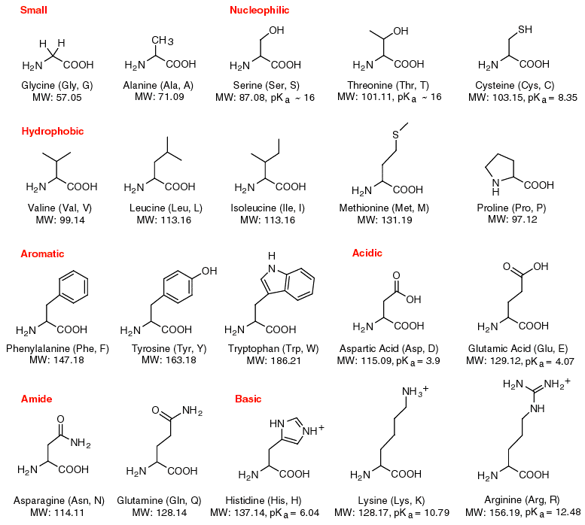
Proteins are chains of 20 different types of amino acids. This sequence of amino acids is known as the primary structure, and it can be represented as a string of 20 different symbols (i.e., a word over the common alphabet of 20 letters).

Slide 7
Protein primary sequence
>gi|170083040|ref|YP_001732360.1| cellulose synthase subunit BcsC [Escherichia coli str. K-12 substr. DH10B]
MRKFTLNIFTLSLGLAVMPMVEAAPTAQQQLLEQVRLGEATHREDLVQQSLYRLELIDPNNPDVVAARFR SLLRQGDIDGAQKQLDRLSQLAPSSNAYKSSRTTMLLSTPDGRQALQQARLQATTGHAEEAVASYNKLFN GAPPEGDIAVEYWSTVAKIPARRGEAINQLKRINADAPGNTGLQNNLALLLFSSDRRDEGFAVLEQMAKS NAGREGASKIWYGQIKDMPVSDASVSALKKYLSIFSDGDSVAAAQSQLAEQQKQLADPAFRARAQGLAAV DSGMAGKAIPELQQAVRANPKDSEALGALGQAYSQKGDRANAVANLEKALALDPHSSNNDKWNSLLKVNR YWLAIQQGDAALKANNPDRAERLFQQARNVDNTDSYAVLGLGDVAMARKDYPAAERYYQQTLRMDSGNTN AVRGLANIYRQQSPEKAEAFIASLSASQRRSIDDIERSLQNDRLAQQAEALENQGKWAQAAALQRQRLAL DPGSVWITYRLSQDLWQAGQRSQADTLMRNLAQQKSNDPEQVYAYGLYLSGHDQDRAALAHINSLPRAQW NSNIQELVNRLQSDQVLETANRLRESGKEAEAEAMLRQQPPSTRIDLTLADWAQQRRDYTAARAAYQNVL TREPANADAILGLTEVDIAAGDKAAARSQLAKLPATDNASLNTQRRVALAQAQLGDTAAAQRTFNKLIPQ AKSQPPSMESAMVLRDGAKFEAQAGDPTQALETYKDAMVASGVTTTRPQDNDTFTRLTRNDEKDDWLKRG VRSDAADLYRQQDLNVTLEHDYWGSSGTGGYSDLKAHTTMLQVDAPYSDGRMFFRSDFVNMNVGSFSTNA DGKWDDNWGTCTLQDCSGNRSQSDSGASVAVGWRNDVWSWDIGTTPMGFNVVDVVGGISYSDDIGPLGYT VNAHRRPISSSLLAFGGQKDSPSNTGKKWGGVRADGVGLSLSYDKGEANGVWASLSGDQLTGKNVEDNWR VRWMTGYYYKVINQNNRRVTIGLNNMIWHYDKDLSGYSLGQGGYYSPQEYLSFAIPVMWRERTENWSWEL GASGSWSHSRTKTMPRYPLMNLIPTDWQEEAARQSNDGGSSQGFGYTARALLERRVTSNWFVGTAIDIQQ AKDYAPSHFLLYVRYSAAGWQGDMDLPPQPLIPYADW

Slide 8
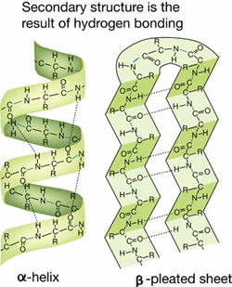
Protein secondary structure
Although the primary structure of a protein is linear, the molecule is not straight, and the sequence of the amino acids affects the folding
These three are called secondary structure elements:
alpha-helices, beta-strands, loops

Slide 9
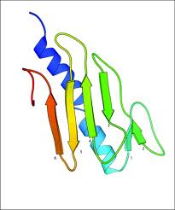
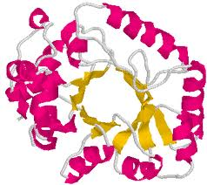
3D structure
As the result of the folding, parts of a protein molecule chain come into contact with each other and various attractive or repulsive forces (hydrogen bonds, disulfide bridges, attractions between positive and negative charges, and hydrophobic and hydrophilic forces) between such parts cause the molecule to adopt a fixed relatively stable 3D structure. This is called tertiary structure. In many cases the 3D structure is quite compact

Slide 10
DNA: genetic information carrier
DNA may be single or double stranded. A single stranded DNA molecule, also called a polynucleotide, is a chain of small molecules, called nucleotides. There are four different nucleotides grouped into two types, purines: adenine and guanine and pyrimidines: cytosine and thymine. They are usually referred to as bases and denoted by their initial letters, A, C, G and T (not to be confused with amino acids!)

Slide 11
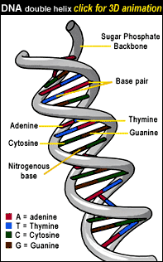
DNA Double Helix
Two complementary polynucleotide chains form a stable structure, which resembles a helix and is known as a the DNA double helix. About 10 bp in this structure takes a full turn, which is about 3.4 nm long. This structure was first figured out in 1953 in Cambridge by Watson and Crick (with the help of others). Later they got the Nobel Prize for this discovery, The DNA Double Helix.

Slide 12
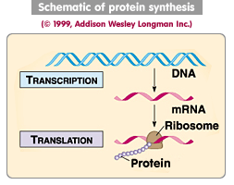
RNA: genetic information messenger and much more unknown roles
RNA has various functions in a cell, e.g., mRNA and tRNA are functionally different types of RNA which are required for the two main steps in protein synthesis, transcription and translation.
C-G-A-T-T-G-C-A-A-C-G-A-T-G-C DNA
| | | | | | | | | | | | | | |
G-C-U-A-A-C-G-U-U-G-C-U-A-C-G RNA

Slide 13
DNA sequence
>gi|49175990|ref|NC_000913.2| Escherichia coli str. K-12 substr. MG1655 chromosome, complete genome AGCTTTTCATTCTGACTGCAACGGGCAATATGTCTCTGTGTGGATTAAAAAAAGAGTGTCTGATAGCAGC TTCTGAACTGGTTACCTGCCGTGAGTAAATTAAAATTTTATTGACTTAGGTCACTAAATACTTTAACCAA TATAGGCATAGCGCACAGACAGATAAAAATTACAGAGTACACAACATCCATGAAACGCATTAGCACCACC ATTACCACCACCATCACCATTACCACAGGTAACGGTGCGGGCTGACGCGTACAGGAAACACAGAAAAAAG CCCGCACCTGACAGTGCGGGCTTTTTTTTTCGACCAAAGGTAACGAGGTAACAACCATGCGAGTGTTGAA GTTCGGCGGTACATCAGTGGCAAATGCAGAACGTTTTCTGCGTGTTGCCGATATTCTGGAAAGCAATGCC AGGCAGGGGCAGGTGGCCACCGTCCTCTCTGCCCCCGCCAAAATCACCAACCACCTGGTGGCGATGATTG AAAAAACCATTAGCGGCCAGGATGCTTTACCCAATATCAGCGATGCCGAACGTATTTTTGCCGAACTTTT GACGGGACTCGCCGCCGCCCAGCCGGGGTTCCCGCTGGCGCAATTGAAAACTTTCGTCGATCAGGAATTT GCCCAAATAAAACATGTCCTGCATGGCATTAGTTTGTTGGGGCAGTGCCCGGATAGCATCAACGCTGCGC TGATTTGCCGTGGCGAGAAAATGTCGATCGCCATTATGGCCGGCGTATTAGAAGCGCGCGGTCACAACGT TACTGTTATCGATCCGGTCGAAAAACTGCTGGCAGTGGGGCATTACCTCGAATCTACCGTCGATATTGCT GAGTCCACCCGCCGTATTGCGGCAAGCCGCATTCCGGCTGATCACATGGTGCTGATGGCAGGTTTCACCG CCGGTAATGAAAAAGGCGAACTGGTGGTGCTTGGACGCAACGGTTCCGACTACTCTGCTGCGGTGCTGGC TGCCTGTTTACGCGCCGATTGTTGCGAGATTTGGACGGACGTTGACGGGGTCTATACCTGCGACCCGCGT
…
4,639,675 bp circular DNA

Slide 14
Working with text files
Always use plain text editors: notepad etc.
ALL bioinformatics applications do NOT take sequence files saved in word or excel formats
Try notepad++

Slide 15
Web resource types
Databases
Web servers
Genome browsers

Slide 16
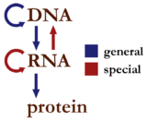
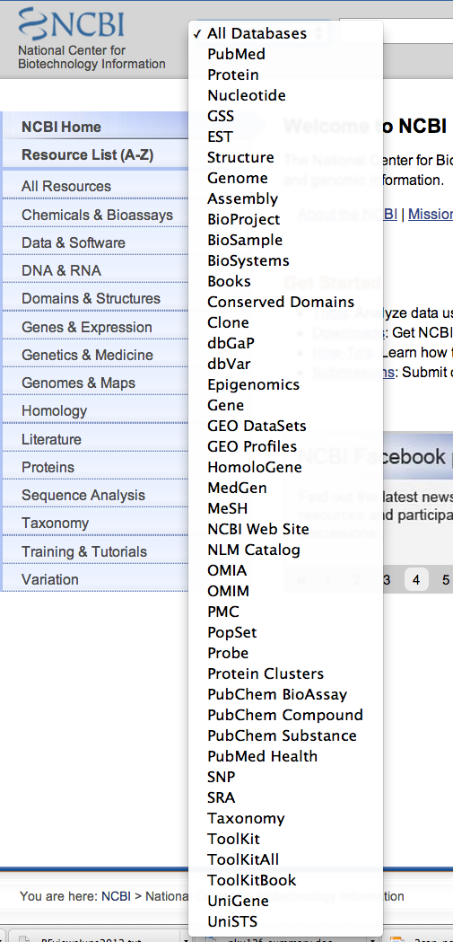
Databases
Sequence databases
Nucleotide Databases
Protein Databases
Function databases
Protein domain/family
Function classification
Pathway
Protein structure database PDB
Gene expression databases
Literature databases
Taxonomic databases
Other databases

Slide 17
Nucleotide Databases
Genomic DNAs
mRNAs or full length cDNAs
EST (expressed sequence tags)
SRA (short read archive)
Where the data come from:
Large genome sequencing centers
Individual research labs
GenBank
EMBL
DDBJ

Slide 18
The first genome sequenced ever
Haemophilus influenzae Rd KW20
Frequency and distribution of DNA uptake signal sequences in the Haemophilus influenzae Rd genome. Smith HO, et al. Science 1995 Jul 28
http://www.ncbi.nlm.nih.gov/genome/165/?project_id=57771

Slide 19
All published sequences will go to GenBank eventually
Most journals require an accession number of sequence data for submitted papers
http://genome.cshlp.org/site/misc/ifora_weblinks.xhtml
After published, the paper is linked to data
http://www.ncbi.nlm.nih.gov/pubmed?term=21303537

Slide 20
Protein Databases
Experimentally characterized proteins
Computational predicted proteins (e.g. automatically predicted by gene finding programs)
Where the data come from:
Genome annotation efforts from large genome sequencing centers
Individual research labs
Swiss-Prot
TrEMBL
PIR
PDB
GenPept
RefSeq
PRF

Slide 21
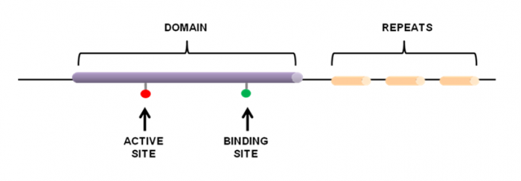
Protein function databases
All databases are built upon existing knowledge
Start from function known proteins and literatures
Retrieve functional domains/motifs/sites
Retrieve homologs to form family
Use statistical models to represent family
Assign functions to family and link family to literatures

Slide 22
How protein family databases are built
http://www.ebi.ac.uk/training/online/course/introduction-protein-classification-ebi

Slide 23
One example: PROSITE
[Ala or Cys]-any-Val-any-any-any-any-{any but Glu or Asp}
http://prosite.expasy.org/scanprosite/scanprosite_doc.html

Slide 25
Over 1000 bioinformatics databases
Nucleic Acids Research’s annual database special issue (20 years already)
http://www.oxfordjournals.org/nar/database/c

Slide 26
Sequence formats (all plain text)
FASTA
GenBank
EMBL
PDB
Alignment format
http://emboss.sourceforge.net/docs/themes/SequenceFormats.html

Slide 27
FASTA format
A sequence in FASTA format begins with a single-line description, followed by lines of sequence data. The description line (defline) is distinguished from the sequence data by a greater-than (">") symbol at the beginning. An example sequence in FASTA format is:
>gi|129295|sp|P01013|OVAX_CHICK GENE X PROTEIN (OVALBUMIN-RELATED) QIKDLLVSSSTDLDTTLVLVNAIYFKGMWKTAFNAEDTREMPFHVTKQESKPVQMMCMNNSFNVATLPAE KMKILELPFASGDLSMLVLLPDEVSDLERIEKTINFEKLTEWTNPNTMEKRRVKVYLPQMKIEEKYNLTS VLMALGMTDLFIPSANLTGISSAESLKISQAVHGAFMELSEDGIEMAGSTGVIEDIKHSPESEQFRADHP FLFLIKHNPTNTIVYFGRYWSP
gi number
Swissprot id
Swissprot AC
Source db: swissprot
Notes:
Fasta is actually a software package

Slide 28
FastQ format
Four lines:
Sequence id
Sequence
+
Quality score as ASCII characters
Nucleic Acids Res. 2010 April; 38(6): 1767–1771

Slide 29
GenBank and EMBL formats
Much richer info: many different fields for annotation of the protein/DNA
http://www.ncbi.nlm.nih.gov/protein/129295
http://www.uniprot.org/uniprot/P01013

Slide 30
PDB format
PDB: Protein Data Bank, a protein 3D structure database
http://www.rcsb.org/pdb/explore/explore.do?structureId=1GOT

Slide 31
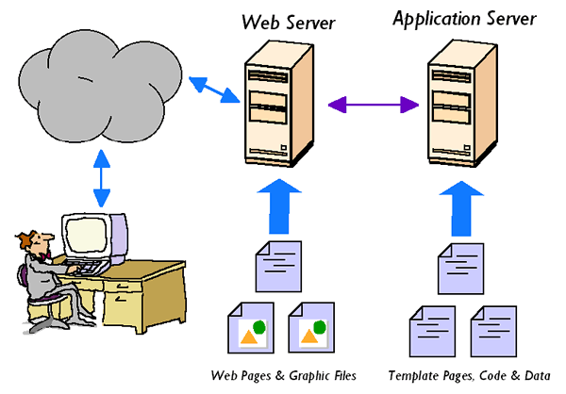
Web servers
Remote servers that allow users to upload data, invoke bioinfo softwares running on the remote server and return the results to the user with a graphical web interface

Slide 32
Over 1000 bioinformatics web servers
Nucleic Acids Research’s annual Web Server special issue (10 years already)
http://nar.oxfordjournals.org/content/40/W1/W3
This one might be better:
http://www.hsls.pitt.edu/obrc/

Slide 33
Genome browsers
Integrated graphical presentation of genomes to allow visualize and browse entire genomes with annotated data including gene prediction and structure, proteins, expression, regulation, variation, comparative analysis, etc
Examples: NCBI MapViewer, UCSC Genome Browser, ENSEMBL Genome Browser
http://en.wikipedia.org/wiki/Genome_browser

Slide 34
Genomic databases
Microbial genomes:
NCBI, JGI IMG
Plant genomes: JGI phytozome
Animal genomes: EBI ensembl, UCSC genome browser
Fungal genomes: JGI and Broad Institute

Slide 35
Next lecture: NCBI resources I

