Slide 1
NCBI resources II: web-based tools and ftp resources
Yanbin Yin
Fall 2014
Most materials are downloaded from ftp://ftp.ncbi.nih.gov/pub/education/

Slide 2
Outline
Tools
BLAST
Specialized BLAST
GEO
ftp download
Hands on exercise

Slide 3
References
NCBI discovery workshops ftp://ftp.ncbi.nih.gov/pub/education/discovery_workshops/NLM/2012/Sept2012/
http://homepages.ulb.ac.be/~dgonze/TEACHING/stat_scores.pdf
http://www.bioinformatics.wsu.edu/bioinfo_course/notes/lecture6.pdf

Slide 4
Evolution of pairwise alignment tools
1990
BLAST
1985
FASTA
Faster but less accurate
1981
Smith-Waterman algorithm
1970
Needleman-Wunsch algorithm

Slide 5
Basic Local Alignment Search Tool
Widely used similarity search tool
Heuristic approach based on Smith Waterman algorithm
Finds best local alignments
Provides statistical significance
All combinations (DNA/Protein) query and database
DNA vs DNA
DNA translation vs Protein
Protein vs Protein
Protein vs DNA translation
DNA translation vs DNA translation
www, standalone, and network client

Slide 6
http://www.bioinformatics.wsu.edu/bioinfo_course/notes/lecture6.pdf

Slide 7
http://homepages.ulb.ac.be/~dgonze/TEACHING/stat_scores.pdf

Slide 8
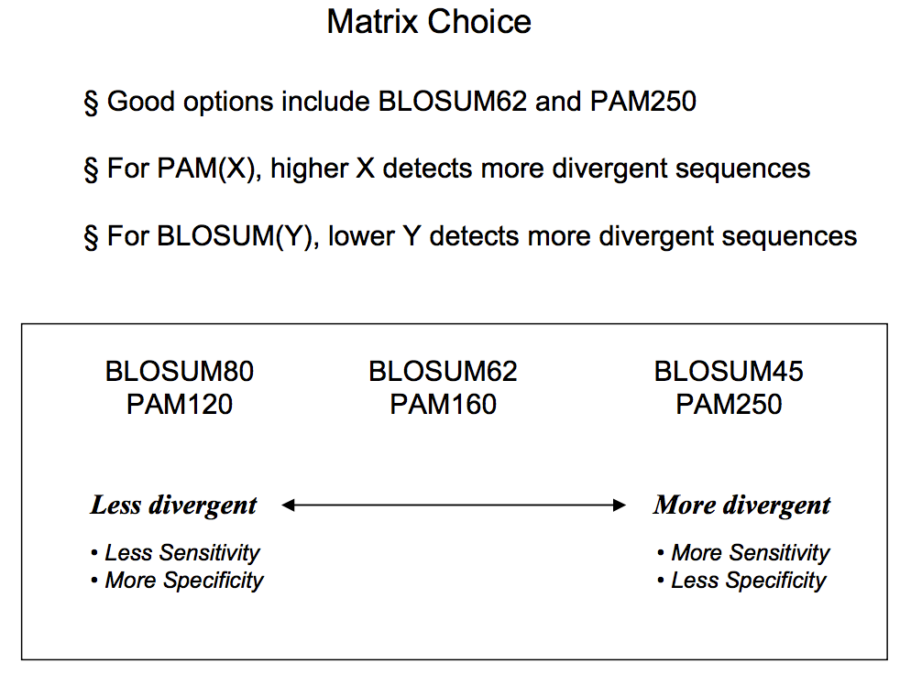
http://www.bioinformatics.wsu.edu/bioinfo_course/notes/lecture6.pdf

Slide 9
http://www.bioinformatics.wsu.edu/bioinfo_course/notes/lecture6.pdf

Slide 10
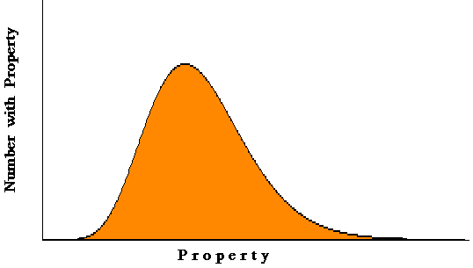
Local Alignment Statistics
High scores of local alignments between two random sequences
follow the Extreme Value Distribution
Expect Value
E = number of database hits you expect to find by chance
size of database
your score
E = Kmne^{-λS} or E = mn2^{-S’}
K = scale for search space
λ = scale for scoring system
S’ = bitscore = (λS - lnK)/ln2
Alignments
expected number of random hits
Score
(applies to ungapped alignments)
http://www.youtube.com/ncbinlm

Slide 11
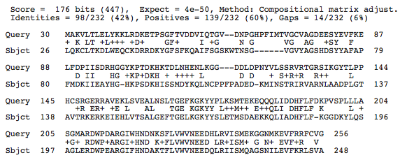
Local Alignment Scoring: Protein
Number of Chance Alignments = 4 X 10⁻⁵⁰
K
K +5
K
E +1
Q
F -3
Gap
-(11 + 4(1))= -14
Scores from BLOSUM62, a position independent matrix

Slide 12
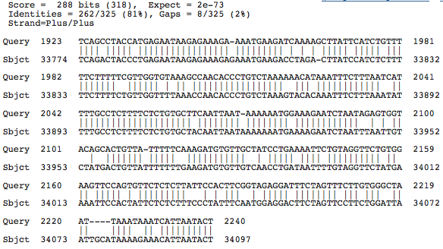
Local Alignment Scoring: Nucleotide
Number of Chance Alignments = 2 X 10⁻⁷³
Match=+2
Mismatch=-3
Gap
-(5 + 4(2))= -13

Slide 13
BLAST and BLAST-like programs
Traditional BLAST (formerly blastall) nucleotide, protein, translations
blastn nucleotide query vs. nucleotide database
blastp protein query vs. protein database
blastx nucleotide query vs. protein database
tblastn protein query vs. translated nucleotide database
tblastx translated query vs. translated database
Megablast nucleotide only
Contiguous megablast
Nearly identical sequences
Discontiguous megablast
Cross-species comparison

Slide 14
Position-specific BLAST Programs (protein only)
Position Specific Iterative BLAST (PSI-BLAST)
Automatically generates a position specific score matrix (PSSM)
Position-Hit Initiated BLAST (PHI-BLAST)
Focuses search around pattern (motif)
Domain Enhanced Lookup Time Accelerated (DELTA) BLAST
Uses domain PSSM in first round of search
Reverse PSI-BLAST (RPS-BLAST)
Searches a database of PSI-BLAST PSSMs
Conserved Domain Database Search

Slide 15
http://www.ch.embnet.org/CourseAthens/slides/intro_hmm_profile.pdf

Slide 16
Non-redundant protein
nr (non-redundant protein sequences)
GenBank CDS translations
NP_, XP_ refseq_protein
Outside Protein
PIR, Swiss-Prot, PRF
PDB (sequences from structures)
pat protein patents
env_nr metagenomes (environmental samples)
Services
blastp
blastx

Slide 17
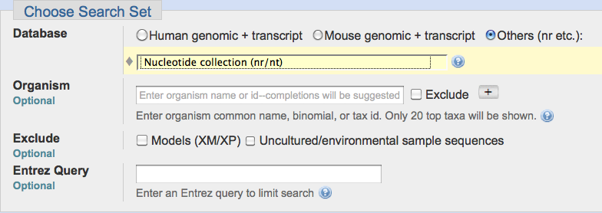
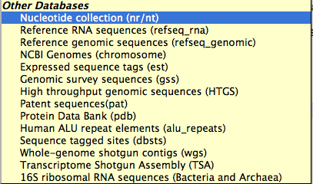
Nucleotide Databases: Traditional
Services
blastn
tblastn
tblastx

Slide 18
Nucleotide Databases: Traditional
Databases are mostly non-overlapping
nr (nt)
Traditional GenBank
NM_ and XM_ RefSeqs
refseq_rna
NCBI Genomes
NC_ RefSeqs
GenBank Chromosomes
dbest
EST Division
non-human, non-mouse ests
htgs
HTG division
gss
GSS division
wgs
whole genome shotgun contigs
tsa
transcriptome shotgun assembly
16S microbial
Selected 16S sequences (targeted loci)

Slide 19
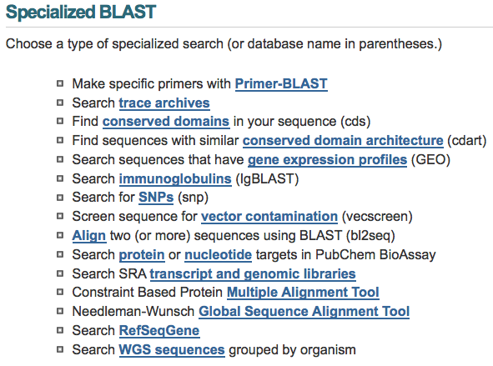
Specialized BLAST Pages

Slide 20
Hands on exercise 1
blastn and megablast

Slide 22
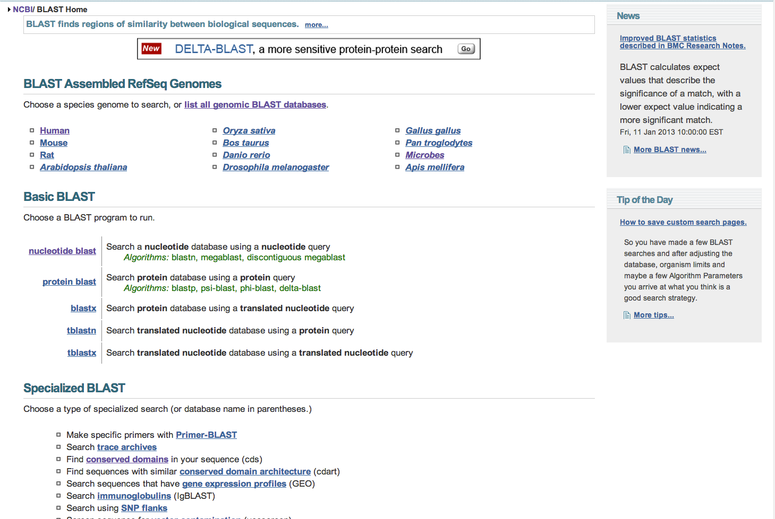
Search against human database

Slide 23
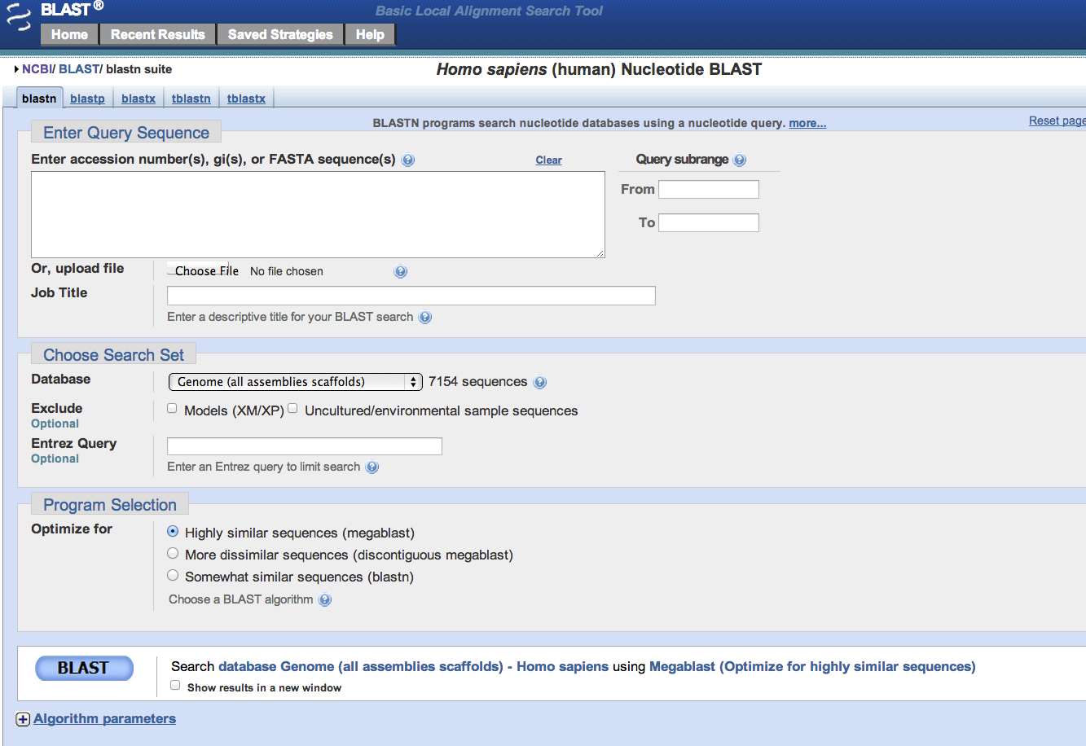
A lot of things you may explore

Slide 24
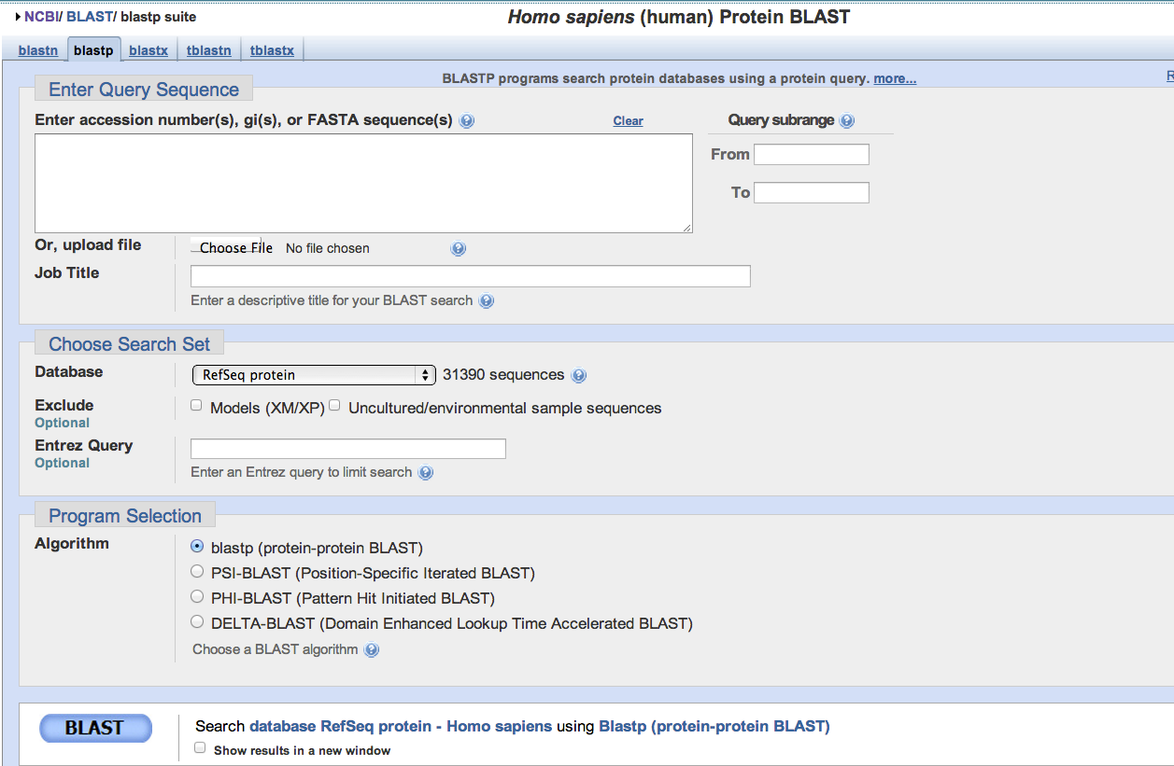
Protein db search has different programs

Slide 25
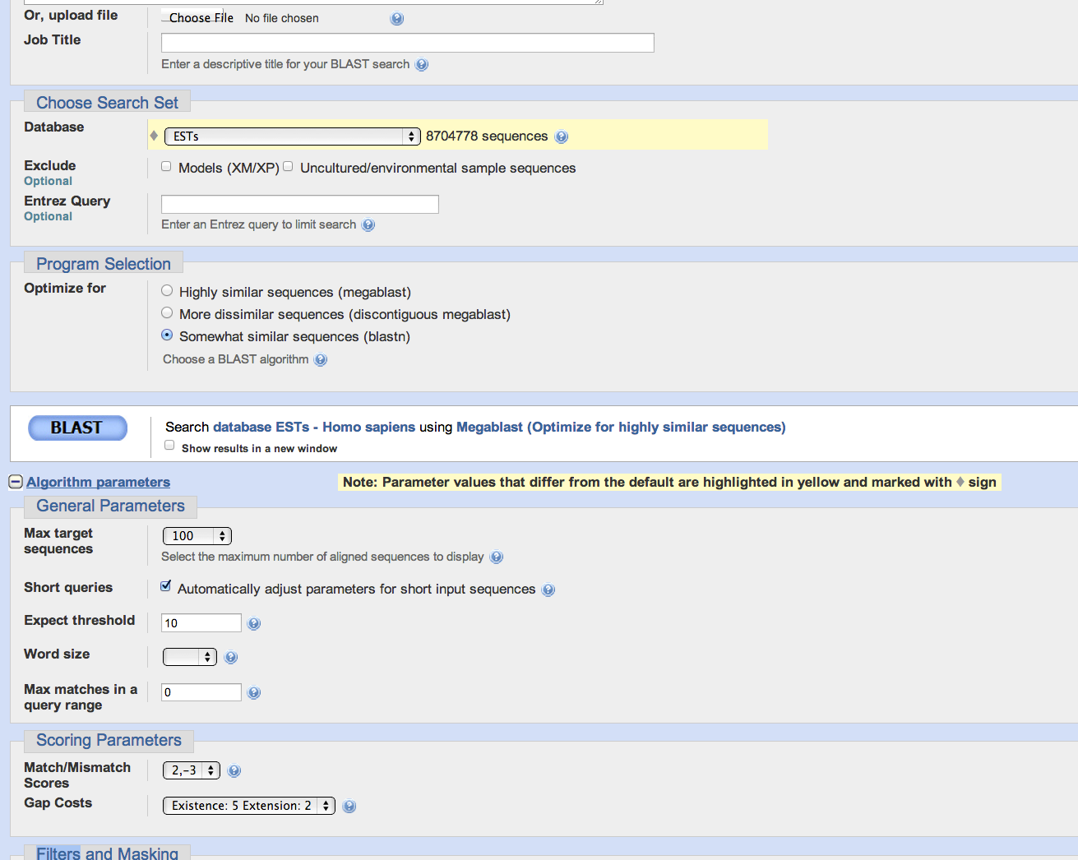
Upload a text file with human tp53 mRNA fasta sequence
Download from course webpage
Go back to blastn page
Question: how many ESTs match tp53 genes?
Change here to 1000

Slide 26
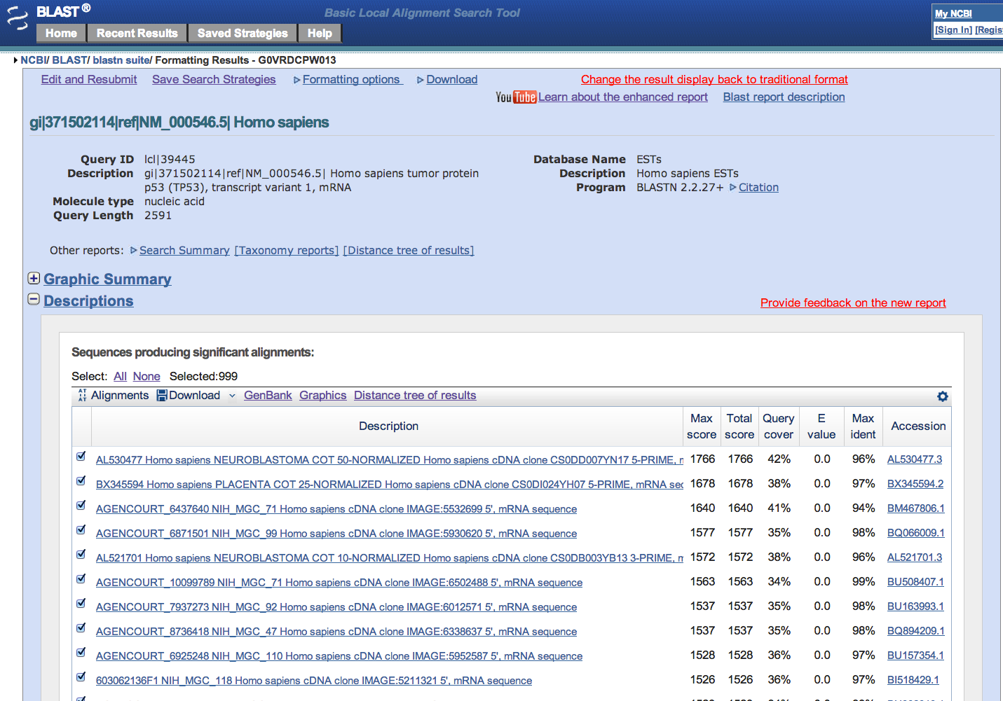
It took ~1 minute to finish
A lot of things you may explore!!!

Slide 27
Search against other refseq databases

Slide 28
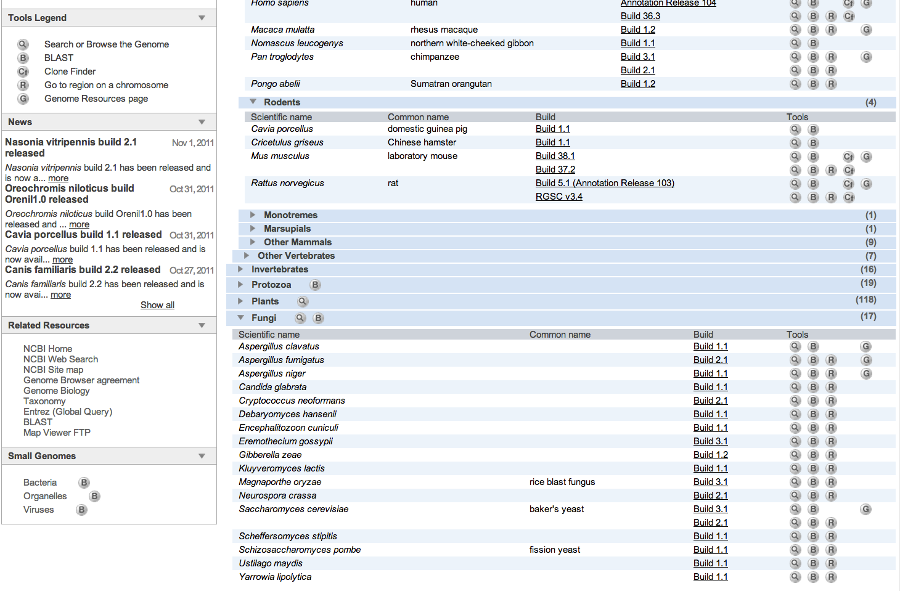

Slide 29
Hands on exercise 2
Protein blast (blastp and tblastn)

Slide 30
If not select organisms …

Slide 31
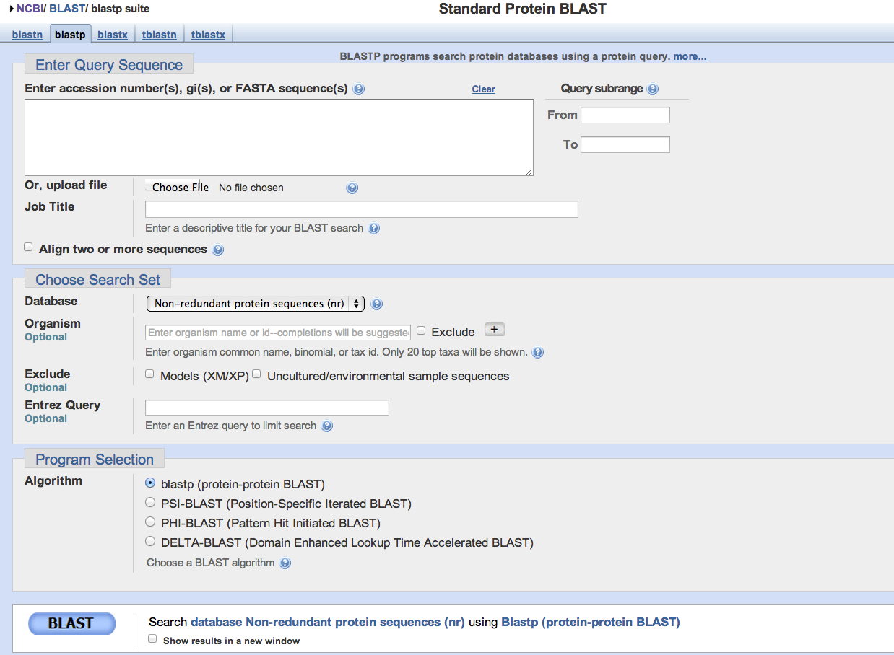
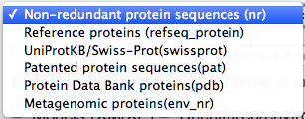
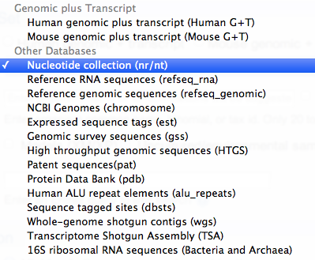
You can still specify organisms …

Slide 32
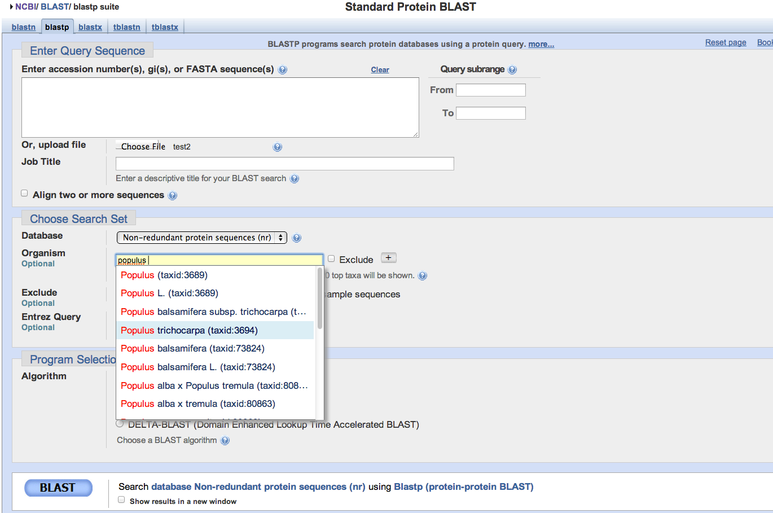
Upload a text file with two arabidopsis protein fasta sequence
Download from course webpage
Type in populus to choose populus trichocarpa
Question: what are the homologs in poplar tree?
You may submit many sequences, but expect it takes time

Slide 33
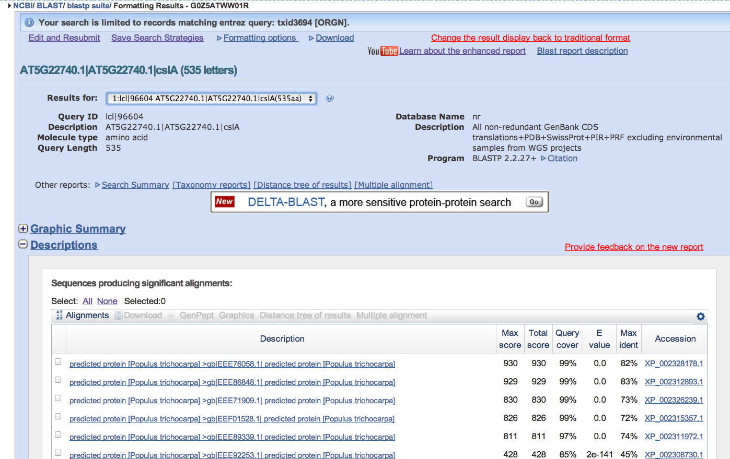
It took ~1 minute (smaller database)
Click here to choose to view which query protein

Slide 34
How to determine what is a good e-value cutoff to select homologs?
http://www.youtube.com/watch?v=nO0wJgZRZJs&list=PL8FD4CC12DABD6B39&index=6

Slide 35
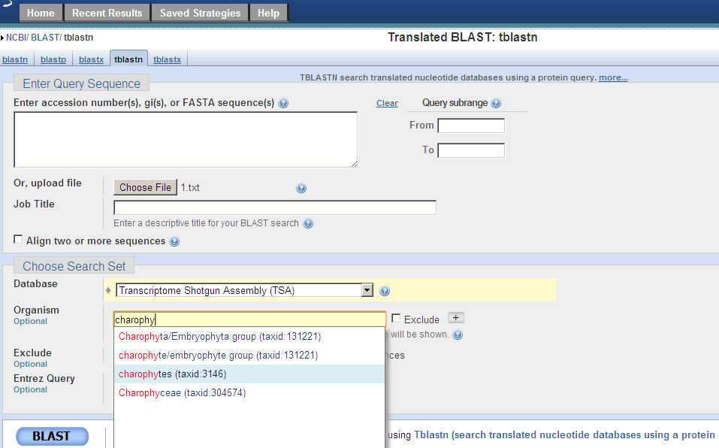
Type in charoph to choose charophytes
Question: what are the EST homologs in charophytic algae?

Slide 36
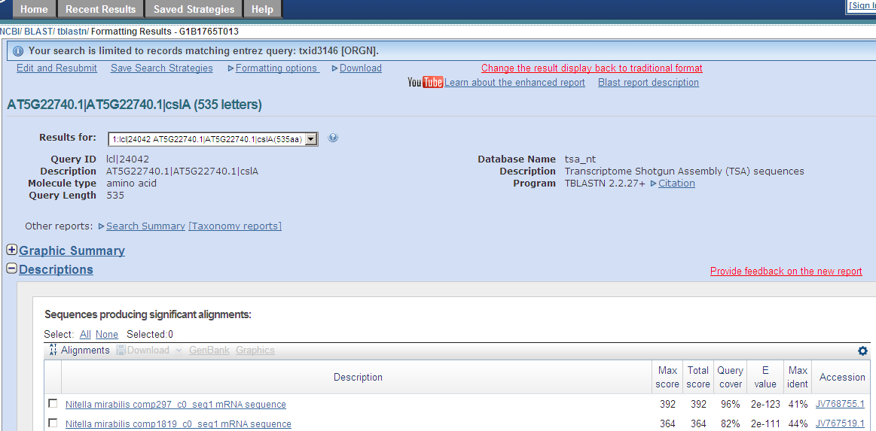

Slide 37
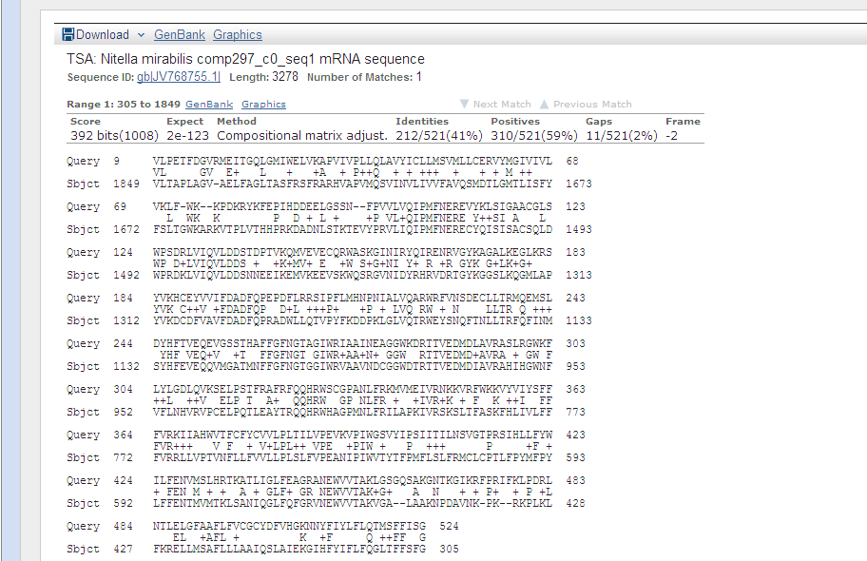

Slide 38
Hands on exercise 3
PHI-BLAST
Query protein + short motif/pattern
&
PSI-BLAST (iterated BLAST)
Multi-round BLASTP

Slide 39
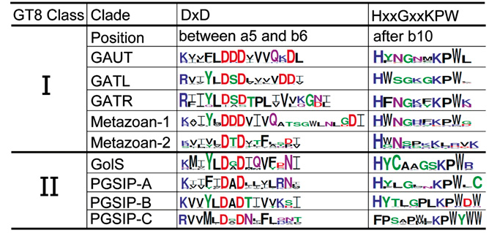
Example: plant glycosyltransferase family 8 (GT8) has signature motif
We want to search Arabidopsis GAUT1 protein (gi #: 86611465) and the HXXGXXKPW motif
ProSite style pattern: H-x(2)-G-x(2)-K-P-W

Slide 40
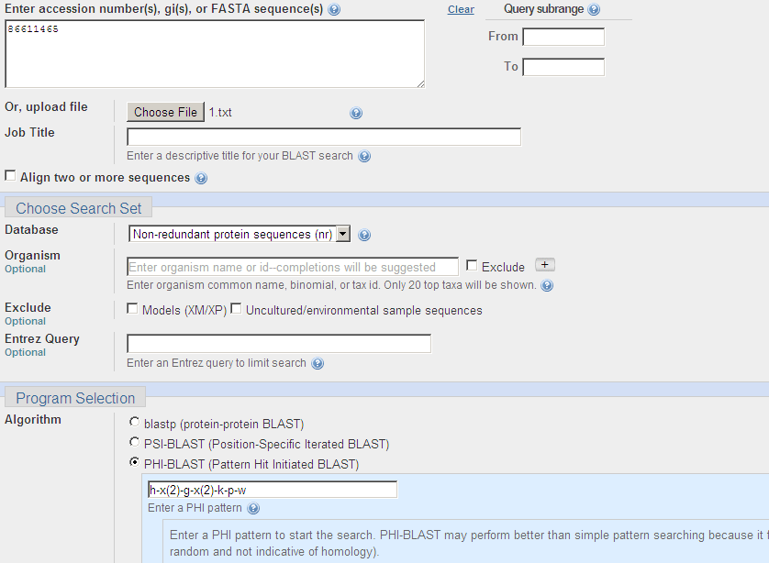

Slide 41
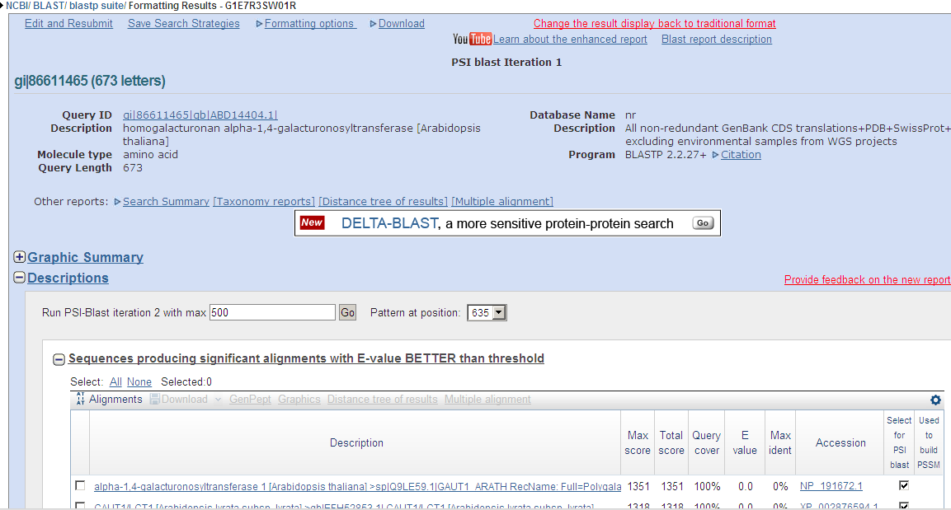

Slide 42
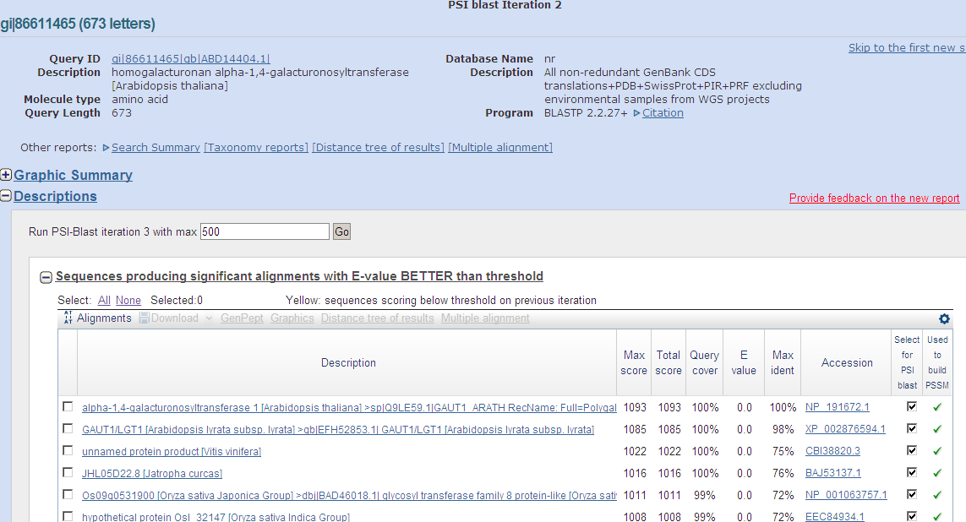

Slide 43
Hands on exercise 4
RPS-BLAST
Given protein sequences, find conserved functional domains

Slide 44
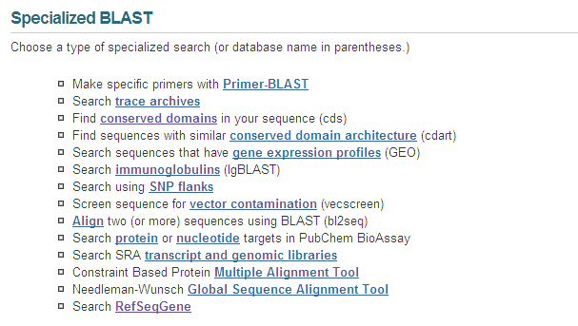

Slide 45
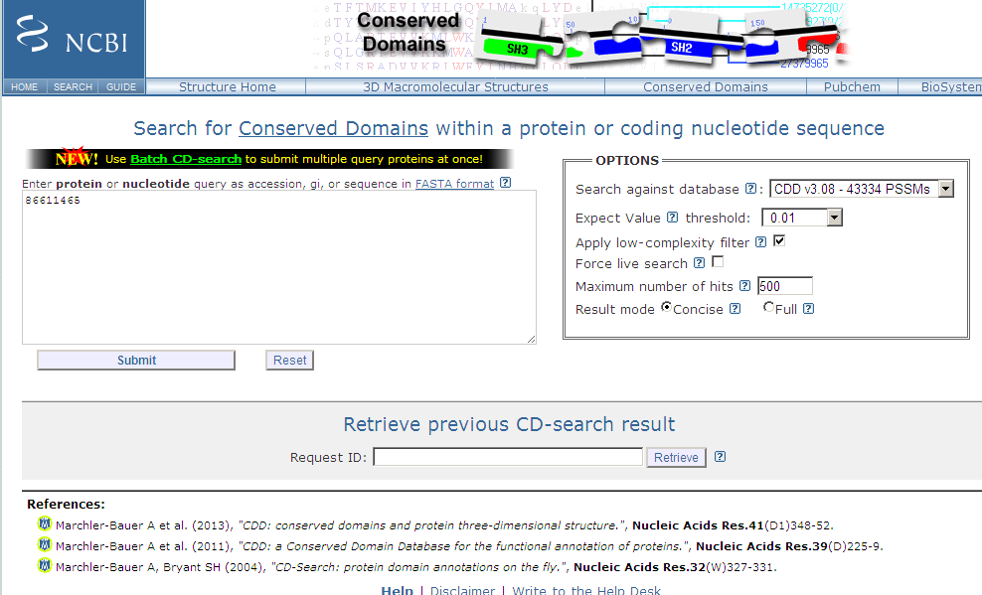

Slide 46
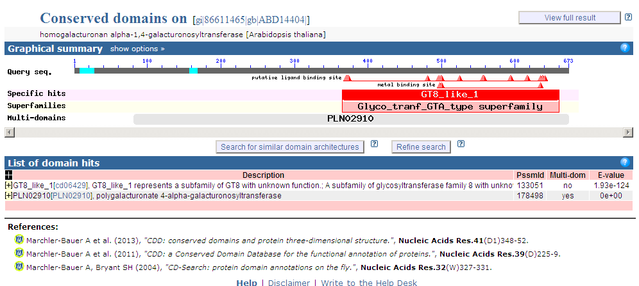

Slide 47
Next class: NCBI GEO and ftp resource (with a little bit intro to Linux skills) and practice

