Slide 1
Practical Bioinformatics for Biologists (BIOS 441/641) - Course overview
Yanbin Yin
Fall 2014
MO444
Notes:
Introduce each other, 4 under and 5 grad

Slide 2
BIOS 643 and 646
Minimum theoretical intro
A LOT of practical applications
Goal: enhance the use of computational tools in molecular biology research
Half day on the web can save you half month in the lab

Slide 3
Questions
How many have experience in Linux/Unix
How many working in a research lab
How many have programming experience of any kind language
How many have used BLAST
What bioinfo softwares you have ever used
What softwares you will be using
Notes:
Get an idea of background and level of bioinf

Slide 4
Tools
Two parts
Web-based resources
Stand-alone tools
Windows-based (have a GUI)
Linux-based (no GUI, command line)
Notes:
syllabus

Slide 5
Class rules:
Attendance: students are required to attend all classes. Absences without notifying the instructor in advance will result in 5% reduction in final grade.
Plagiarism: copying materials (figures, tables, sentences) directly from other people, literatures or internet without proper reference are considered as plagiarism and will lead to a fail of this course.
Notes:
Homework

Slide 6
Grading:
Attendance: 5%
Home work: 40%
Final report: 30%
-Project 1: 15%
-Project 2: 15%
Final exam: 25%

Slide 7
Books:
Mainly uses slide notes, but may refer to:
Practical Bioinformatics by Agostino, 2013 Garland Science
Practical Computing for Biologists by Haddock and Dunn, 2011 Sinauer
Developing Bioinformatics Computer Skills by Gibas and Jambeck, 2001 O’reilly

Slide 8
Class website
http://cys.bios.niu.edu/yyin/teach/PBB/
Slides, homeworks, reading materials, notes, handouts

Slide 9
Expectations
Be focused inside class
Spend at least 5 hours outside class per week
Turn in homework on time
Use what you learned in your research
Notes:
No checking emails

Slide 10
What you can expect from this course
How to find a particular gene in NCBI?
How to find the homologs for that gene?
How to get 100 protein sequences at a time?
How to predict functions for an uncharacterized gene?
How to perform a sequence alignment of 100 proteins?
How to perform expression analysis?
…
Notes:
On web or windows

Slide 11
What you can expect from this course
How to install Ubuntu Linux on a laptop/desktop?
How to access a remote Linux machine from Windows?
How to work with Linux terminals?
How to install bioinformatics softwares using terminals?
How to run bioinfo tools e.g. BLAST in the Linux terminal?
How to do basic sequence analysis using bioinfo tools such as EMBOSS commands?
How to extract 100 protein sequences from a large protein database, given the IDs of the proteins, using a combination of Linux commands and perl one-liner script?
and many more ...
Notes:
On linux

Slide 12
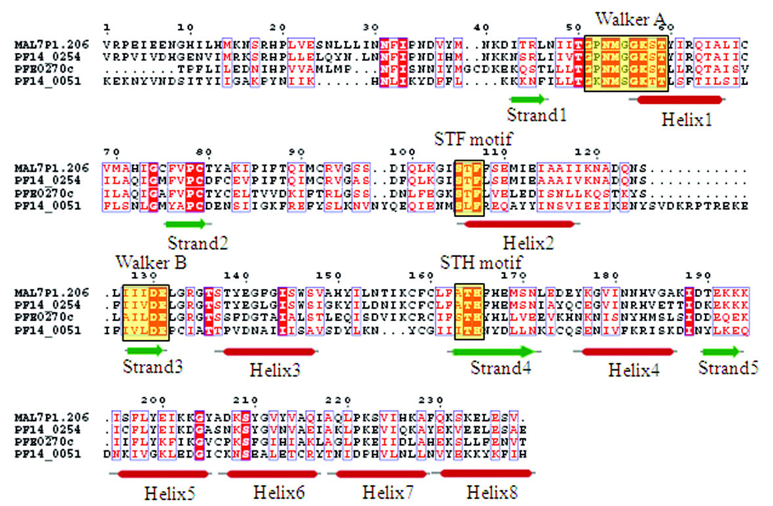
Multiple sequence alignment
Notes:
Very common computational tasks done with bioinfo tools

Slide 13
Sequence logo

Slide 14
Phylogenetic tree
Notes:
Automated color branches not manually

Slide 15
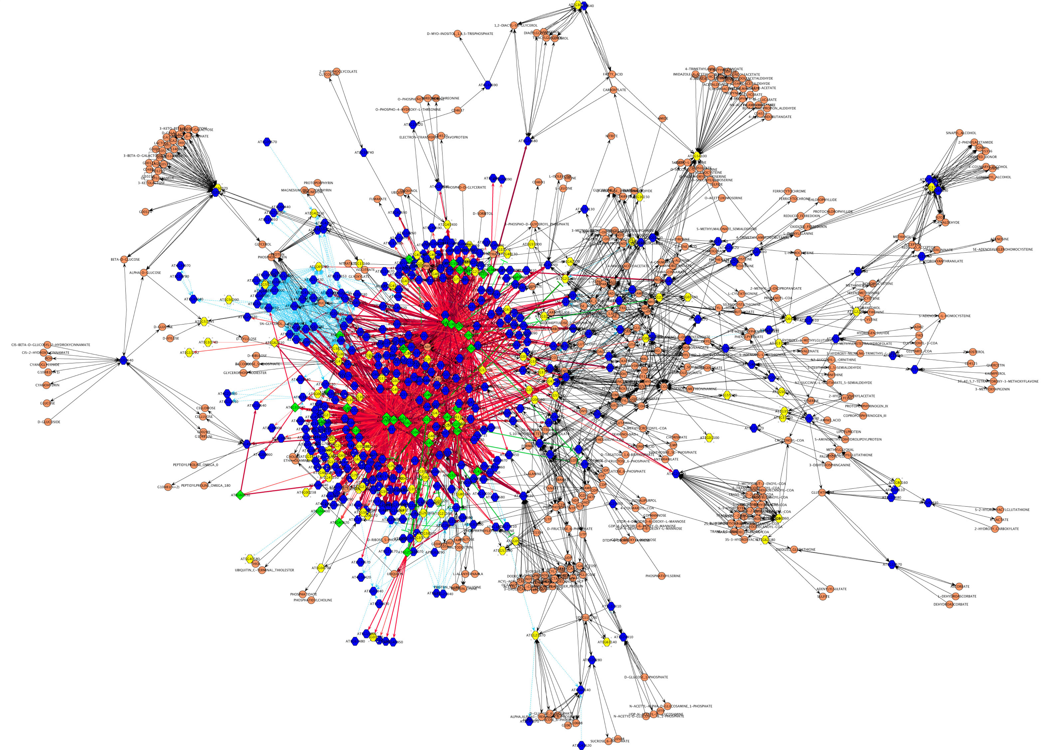
Gene Network
Notes:
Tools to process large interaction data and visualize

Slide 16
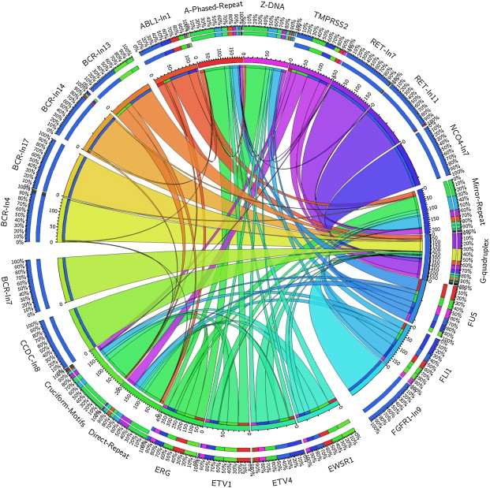
Circos plot
Notes:
Generate good looking pictures

Slide 17
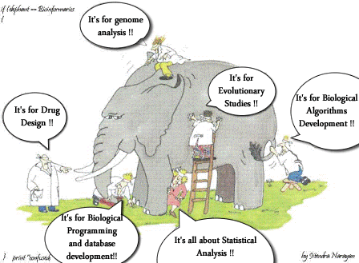
What is bioinformatics?
Develop computational tools
Use computational tools

Slide 18
Three themes in molecular biology
DNA sequence determines protein sequence
Protein sequence determines protein structure
Protein structure determines protein function
The study of how to represent, store, search, retrieve and analyze DNA/RNA/protein data

Slide 19
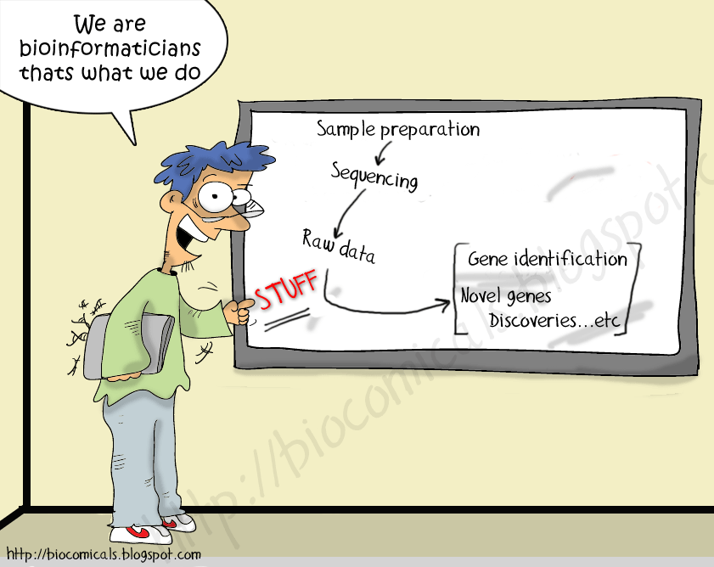
What are most bioinformaticians doing?

Slide 20
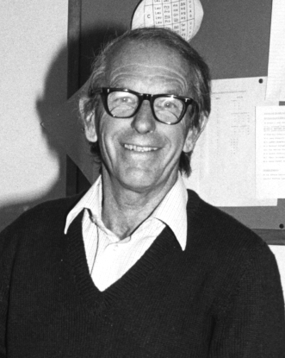
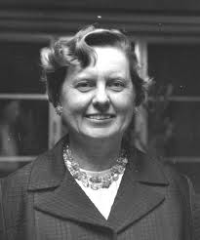
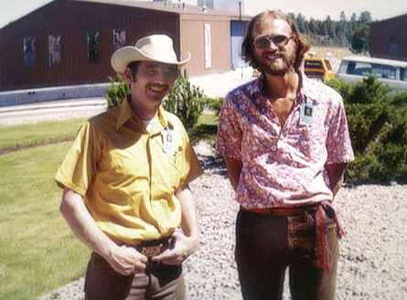
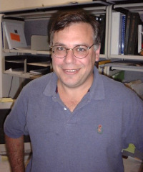
Bioinformatics pioneers
The study of how to represent, store, search, retrieve and analyze biological data
Sanger
50’
Bioinformatics
Dayhoff
60’
Computational Biology
80’
Smith and Waterman
90’
Altschul
Lipman

Slide 21
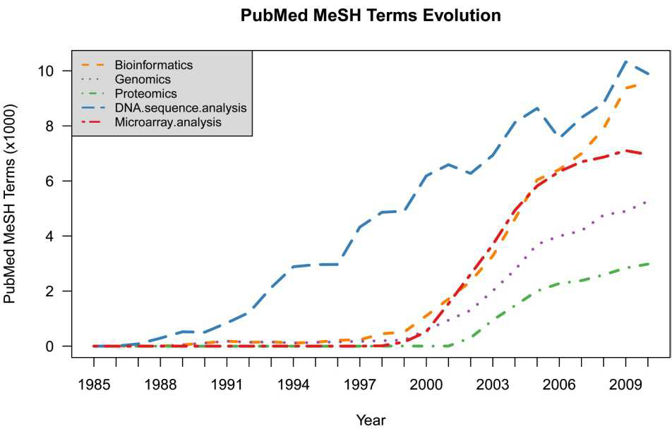

Slide 22
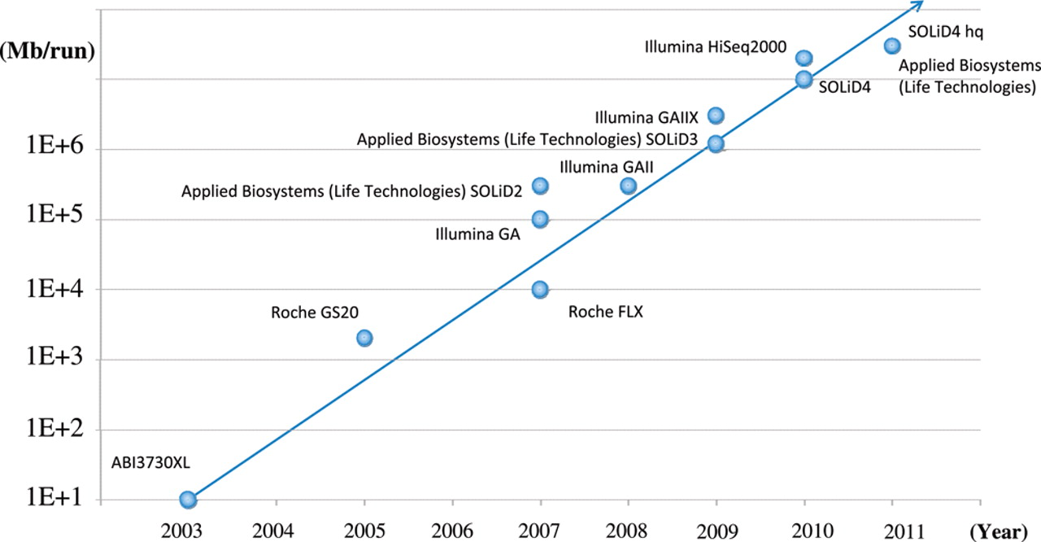
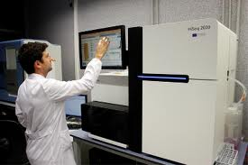
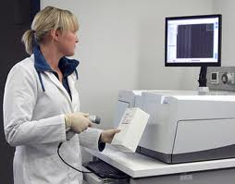
Driven by big (sequence) data
Tsuji S, 2010, Hum. Mol. Genet

Slide 23
Cost decreases
http://arep.med.harvard.edu/pdf/Lunshof_10b.pdf
http://www.genome.gov/images/content/cost_per_genome.jpg

Slide 24
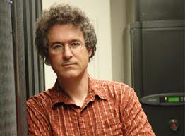
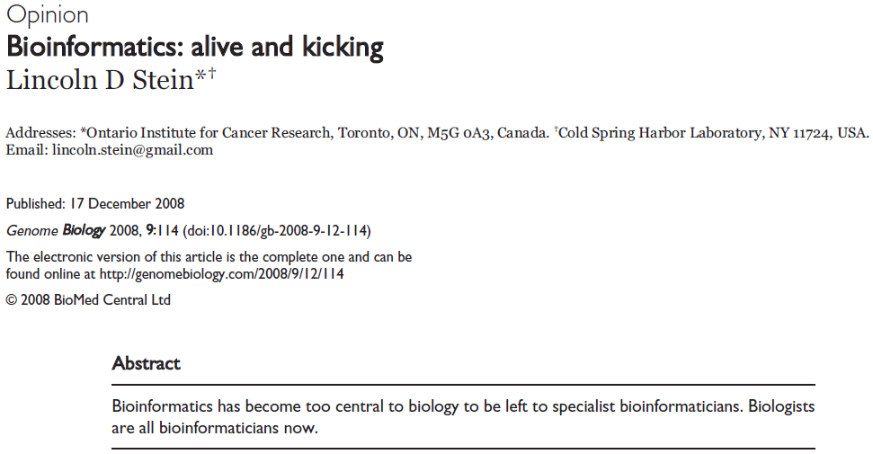

Slide 25
Bioinformaticians: gone by 2012. Bioinformatics: stronger than ever.
In February 2003 I gave a keynote address for the second annual O’Reilly Bioinformatics Technology Conference called ‘Bioinformatics: Gone in 2012’ in which I predicted that bioinformatics as a discipline separate from mainstream biology would be gone in ten years.
In 2008 as it happens, my predictions were quite wrong.
My prediction was that bioinformatics would become one of a series of core courses taught in undergraduate and graduate biology programs, and that there would be a vanishing market for researchers who focus solely on biological data management.

Slide 26
Example
http://www.iscb.org/iscb-degree-certificate-programs
The graduate programs in bioinformatics are within the Institute of Bioinformatics at University of Georgia, which offer two different focuses of study:
Bioinformatics applications designed for students with background and strengths in the biological sciences; and
Bioinformatics Methods Development is designed for students with background and strengths in the computer science, mathematics, and statistics.

Slide 27
Bioinformaticians: gone by 2012. Bioinformatics: stronger than ever.
So bioinformatics isn’t disappearing. But who is giving these bioinformatics talks, and making and analyzing these large databases? By and large these are not people who call themselves bioinformaticians. Instead, we are witnessing the rise of a new generation of computational biologists who spend part of their time at the bench and part of their time at the computer.

Slide 28
Next lecture: basic molecular biology and introduction to bioinformatics web resources

