Slide 1
Bioinformatics tools for phylogeny and visualization
Yanbin Yin
Spring 2013

Slide 2
Homework assignment 5
Take the MAFFT alignment http://cys.bios.niu.edu/yyin/teach/PBB/purdue.cellwall.list.lignin.fa.aln as input and use MEGA5 to build a phylogenetic tree
Try maximum likelihood (ML), neighbor-joining (NJ) and maximum parsimony (MP) algorithms with 100 bootstrap replications and compare the running time and the topology of the resulting trees. If encounter errors, try to use the HELP link to find out and solve it
Color the branches and leafs in the resulting ML tree graph using different colors for different gene subfamilies

Slide 3
Homework assignment 5 Cont.
Export the tree as a newick format file
Prepare a color definition file for different gene subfamilies (see step 3); upload the newick tree file and the color definition file to iTOL to display the tree
Write a report (in word or ppt) to include all the operations and screen shots.
Due on Oct 21 (send by email)
Office hour:
Tue, Thu and Fri 2-4pm, MO325A
Or email: yyin@niu.edu

Slide 4
Outline
Introduction to phylogenetic analysis
Hands on practice of MEGA 5 and iTOL

Slide 5
Phylogenetics is the science of estimating the evolutionary past, in the case of molecular phylogeny, based on the comparison of DNA or protein sequences:
Study the evolution of genomes and gene families (duplication and transfer)
Study the diversity of genes or fragments
Cluster homologous sequences into subfamilies based on evolutionary history
Infer functions for unknown genes

Slide 6
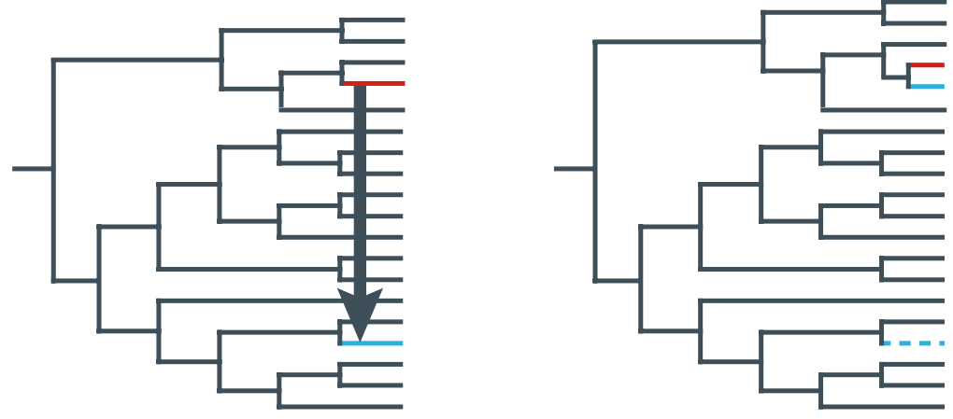
A simple case of horizontal gene transfer

Slide 7
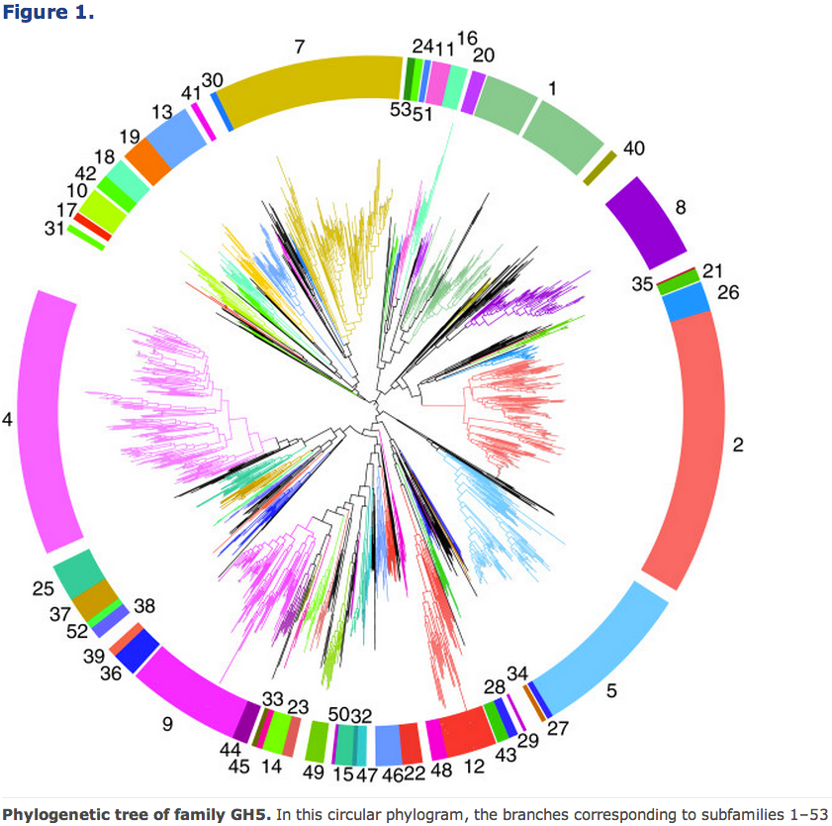
http://www.biomedcentral.com/1471-2148/12/186

Slide 8
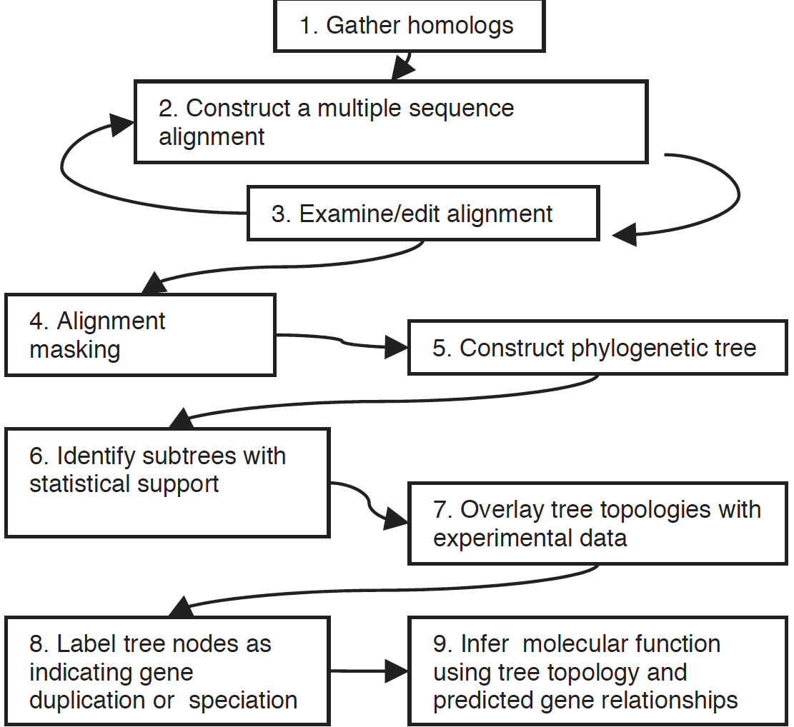
Bioinformatics
Vol. 20 no. 2 2004, pages 170–179

Slide 9
Step 1. Assembling a dataset
BLAST, FASTA, domain/family based (HMMER)
Step 2. Multiple sequence alignment
MAFFT, MUSCLE, Clustal Omega
Step 3. Phylogeny reconstruction
MEGA5, PHYML, RAxML, GARLI, MrBayes, FastTree
Step 4. Tree visualization
TreeView, TreeDyn, MEGA5, iTOL

Slide 10
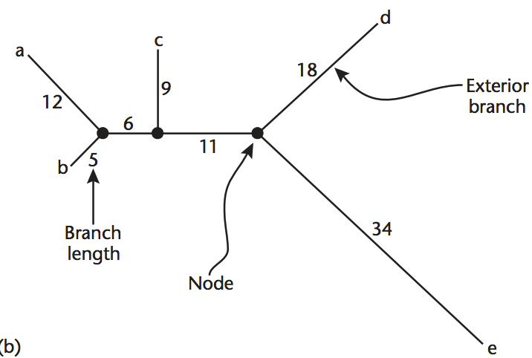
Unrooted tree
Internal node (inferred)
Terminal node (actual seq)
Leaf node
Operational taxonomic unit (OTU)

Slide 11
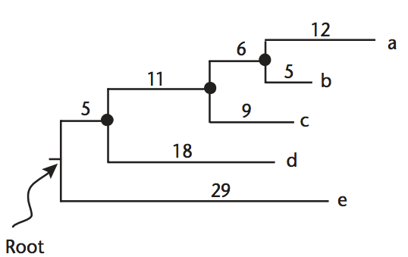
Rooted tree
Root is often selected based on prior knowledge
Branches are drawn with lengths proportional to the divergence (difference) between two nodes

Slide 12
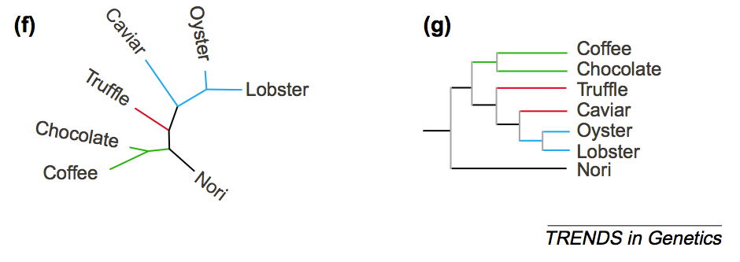
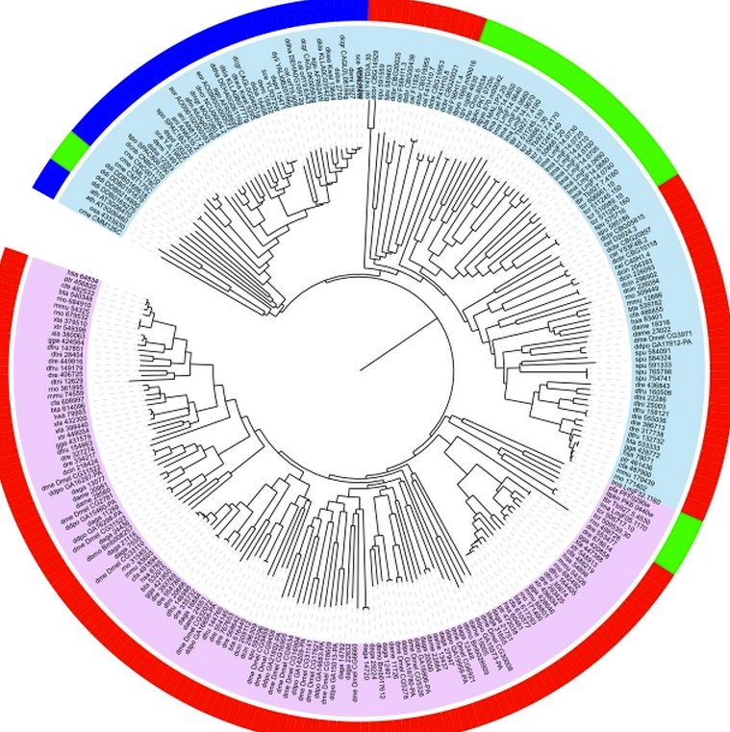
Radial view
Rectangular view
Circular view

Slide 13
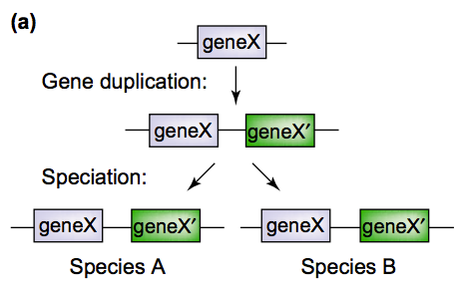
Paralog: X and X’
Ortholog:
X in A and X in B
X’ in A and X’ in B
What about X in A and X’ in B?
They are called out-paralog (not often used)
All the four genes together are called an orthologous group

Slide 14
MEGA: Molecular Evolutionary Genetics Analysis
MEGA is an integrated tool for conducting sequence alignment, inferring phylogenetic trees, mining web-based databases, estimating rates of molecular evolution, inferring ancestral sequences, and testing evolutionary hypotheses. MEGA is used by biologists in a large number of laboratories for reconstructing the evolutionary histories of species and inferring the extent and nature of selective forces shaping the evolution of genes and species
Mega was developed as a software with GUI

Slide 15
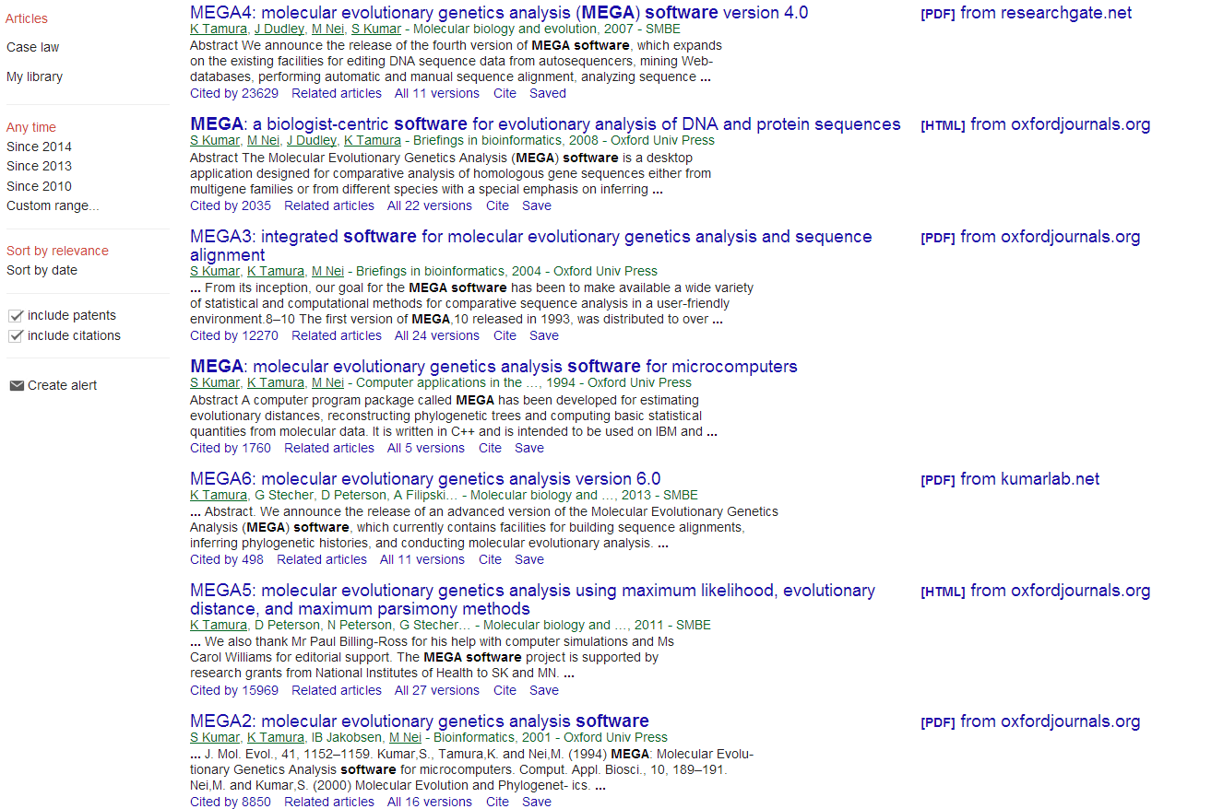
The most cited phylogenetics analysis software package

Slide 16
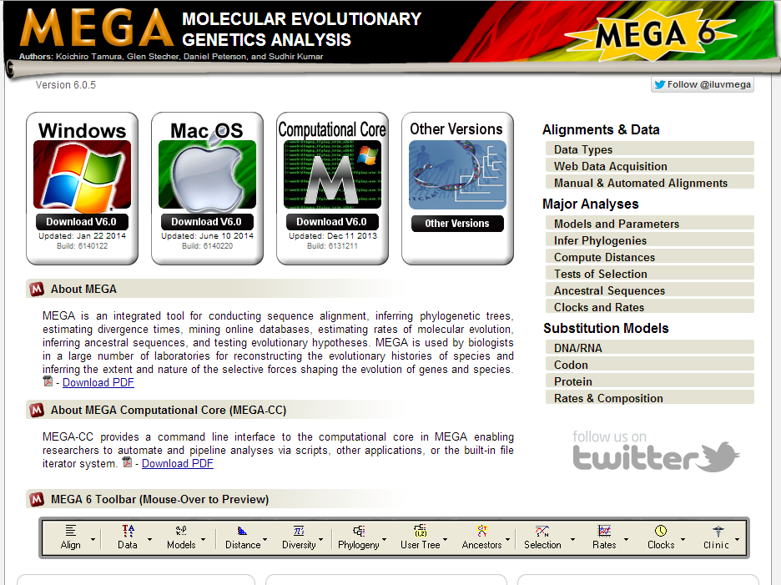
http://www.megasoftware.net/
Free download for different Oss, e.g. WINDOWS

Slide 17
it's free, but you need to fill out an on-line form to download
MEGA5 is already installed on MO444 computers
find MEGA5 in the start->program->MEGA

Slide 18
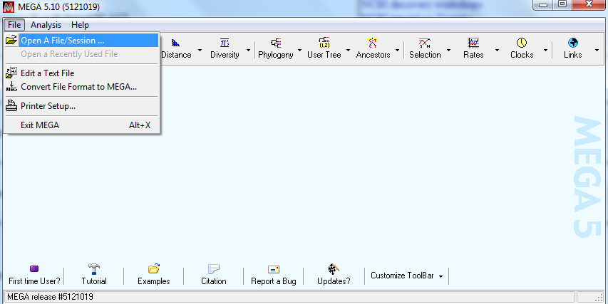
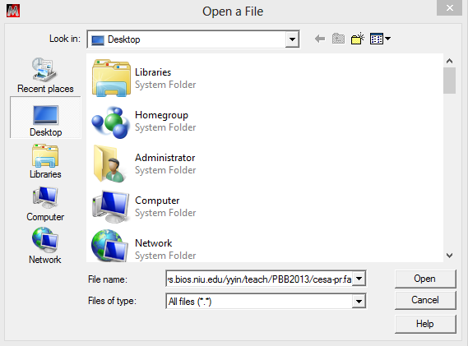
We’re gonna use MEGA to do the alignment first, then build the phylogeny
Click on Open a File, then copy paste the URL
http://cys.bios.niu.edu/yyin/teach/PBB2013/cesa-pr.fa

Slide 19
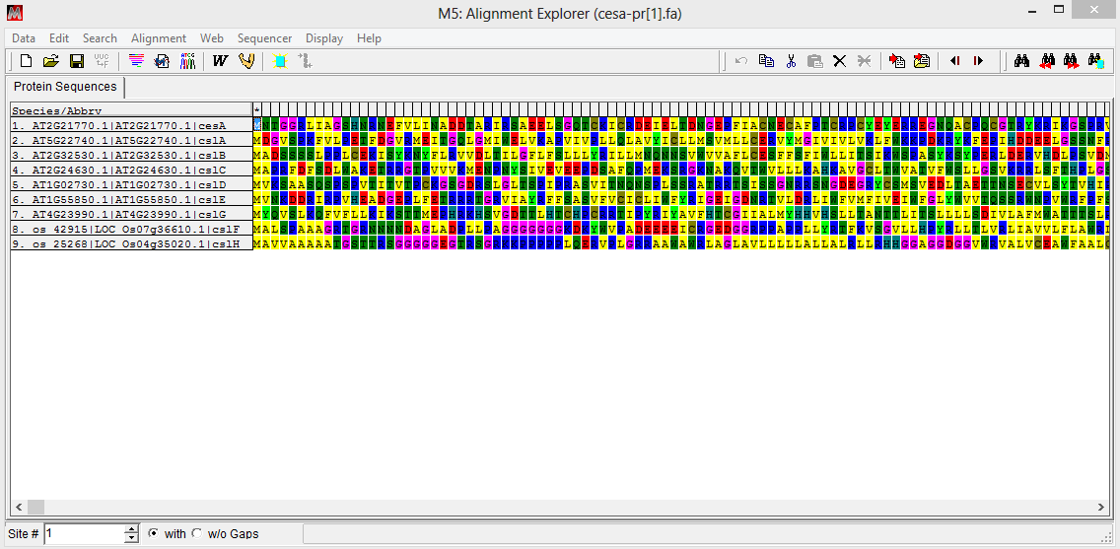
Align the seq first
Click on alignment then choose align by muscle
The alignment explorer popped out
Select yes

Slide 20
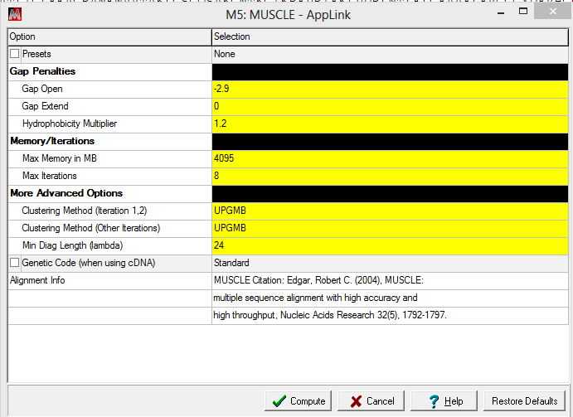
Popped out window to allow option change
let’s just hit compute
Now the alignment explorer shows the aligned seqs
Next hit the save icon to save the alignment as a MEGA format

Slide 21
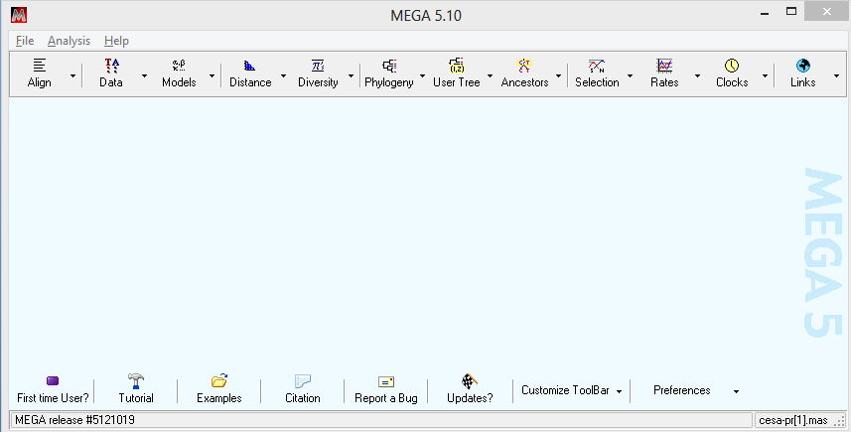
Now I saved it in the desktop folder
Now go back to the main window, click on File to open the saved mas file

Slide 22
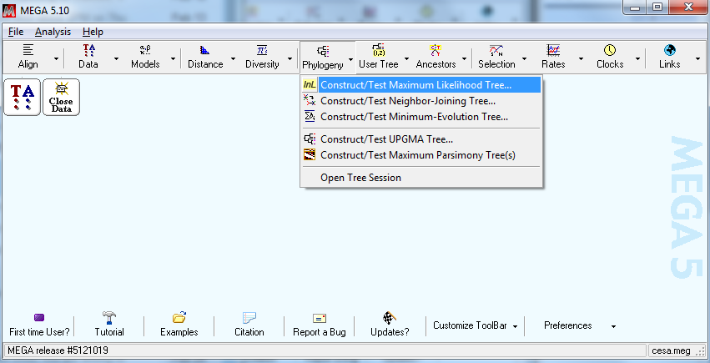
This time choose analyze as it’s an aligned file
This window changed, meaning the data is loaded; we can build the tree now
You may choose from a list of different building algorithms
basically, maximum likelihood is the most accurate but also the slowest
neighbor-joining and maximum parsimony are also very popular and faster if you have over 50 sequences or longer sequences

Slide 23
Phylogenetic trees are calculated by applying mathematical models to infer evolutionary relationships between molecules or organisms (here sequences), based on a set of characters that describe their differences.
Four main categories of phylogenetic reconstruction methods:
Maximum parsimony approaches create trees using the minimum number of ancestors needed to explain the observed characters
Distance matrix methods, such as neighbor joining, allow more sophisticated evolutionary models than parsimony
Maximum likelihood methods search a set of tree and evolutionary models to find the ones most likely to generate the observed characters
Bayesian approaches offer more flexibility, as they allow optimization of all aspects of a tree (model, topology, branch length)

Slide 24
Syst. Biol. 55(2):314–328, 2006
Maximum likelihood and Bayesian, in general, outperformed neighbor joining and maximum parsimony in terms of tree reconstruction accuracy.
In general, our results indicate that as alignment error increases, topological accuracy decreases.
Results also indicated that as the length of the branch and of the neighboring branches increase, alignment accuracy decreases, and the length of the neighboring branches is the major factor in topological accuracy.
Mol Biol Evol (2005) 22 (3): 792-802.
Over the variety of conditions tested, Bayesian trees estimated from DNA sequences that had been aligned according to the alignment of the corresponding protein sequences were the most accurate, followed by Maximum Likelihood trees estimated from DNA sequences and Parsimony trees estimated from protein sequences

Slide 25
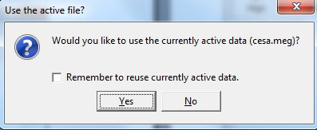
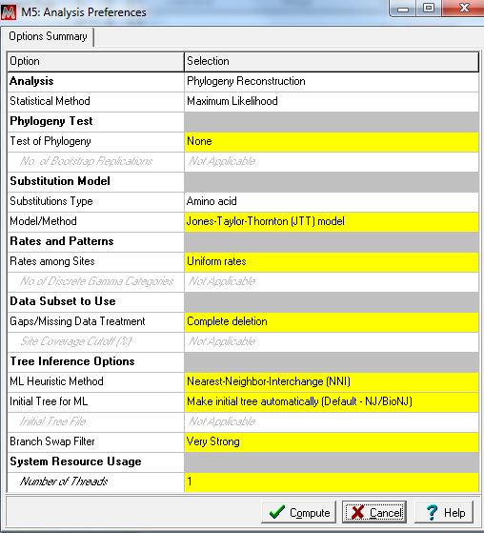
Choose yes
You may choose parameters for tree building
Let’s just hit compute

Slide 26
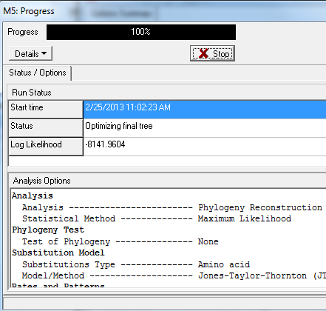
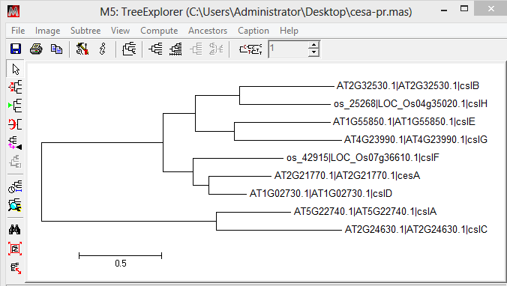
the tree graph is shown after it’s done

Slide 27
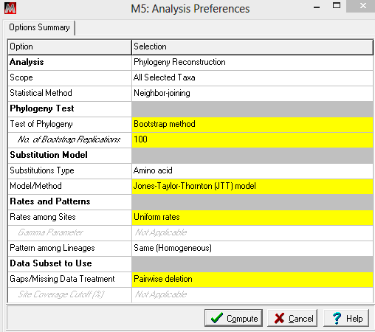
if we want to have statistical values on the clustering
this time we want to choose neighbor-joining algorithm because it is much faster than maximum likelihood. Here we also want to choose bootstrap method to test the phylogeny then we will have statistical values for each node.
Now change here
Yellow are where you can change
To learn what do these options mean
Click on help

Slide 28
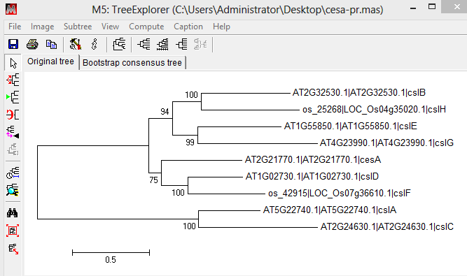
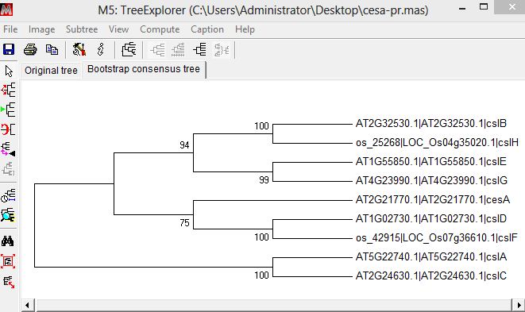
This is the original tree with bootstrap support values at each internal node
Consensus tree from bootstrap test

Slide 29
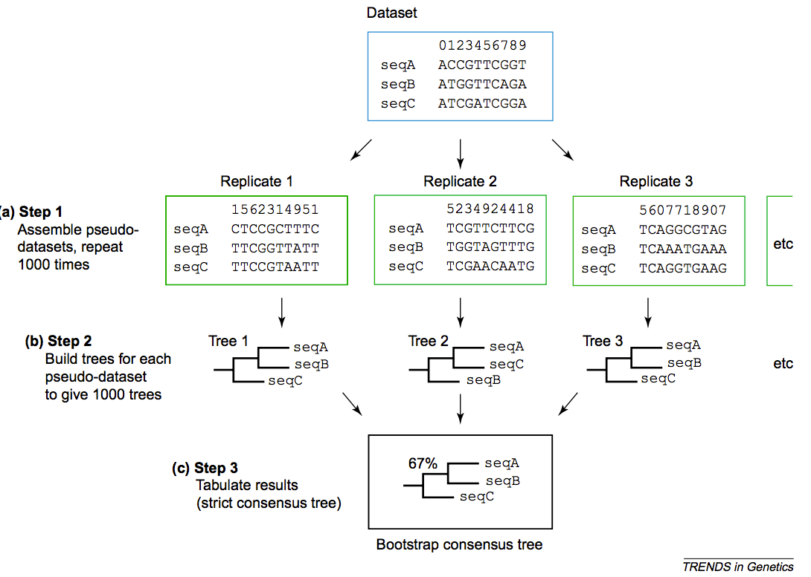
Bootstrap test

Slide 30
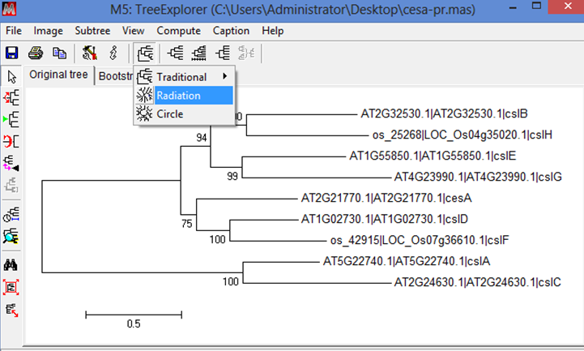
Different presentation views of phylograms

Slide 31
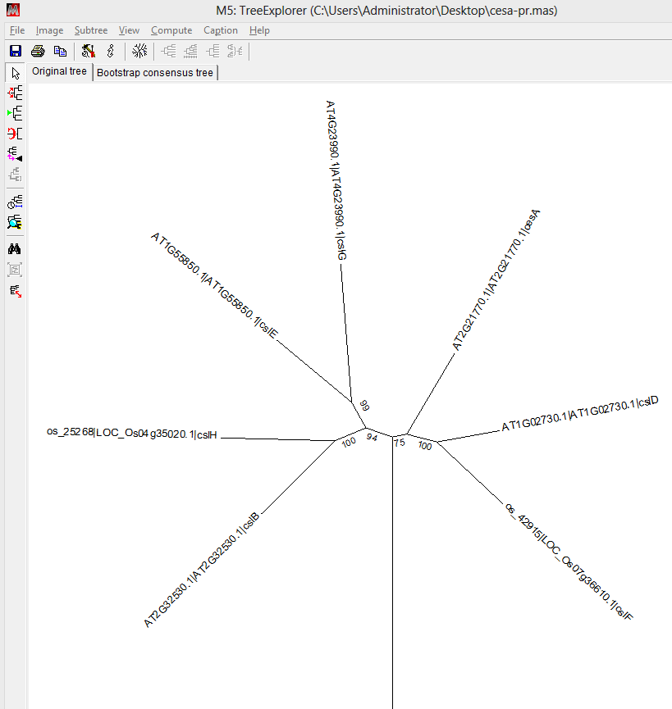
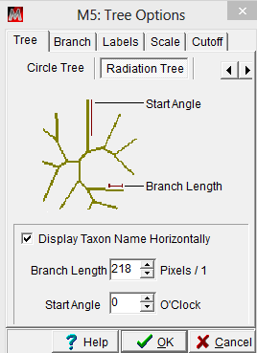
The option window

Slide 32
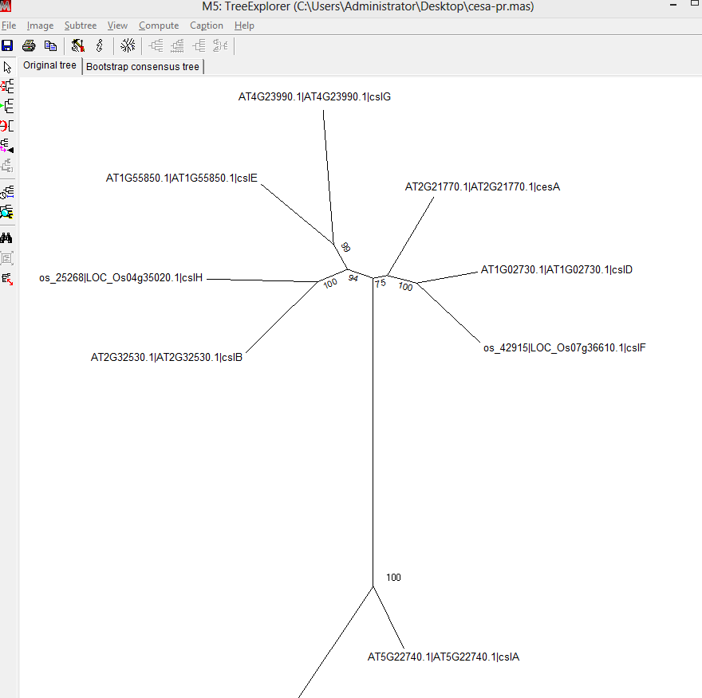
Now the IDs (leaf names) are arranged horizontally

Slide 33
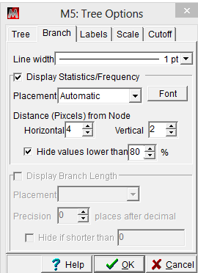
To only show good bootstrap values higher than certain values

Slide 34
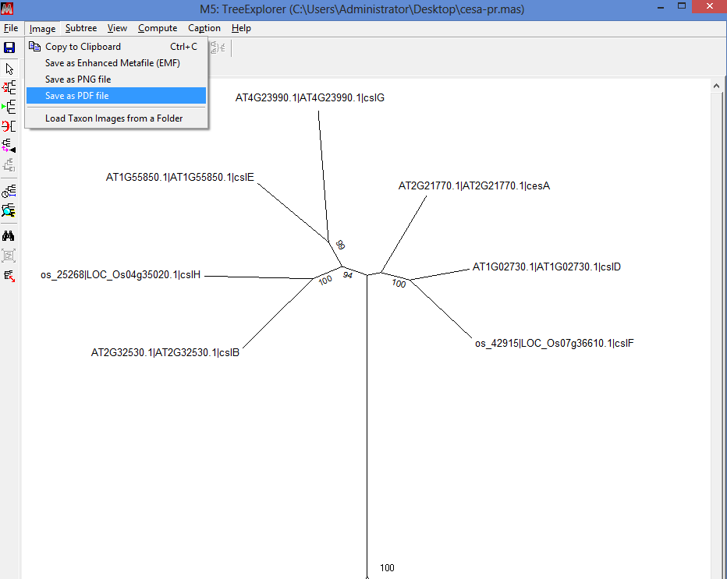
Export phylogram as image file,
Click Image then save as

Slide 35
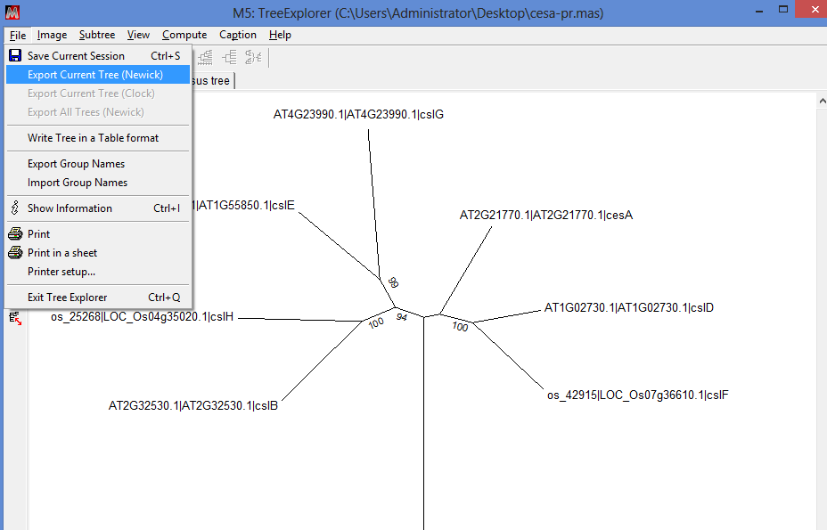
Export the text format file that defines phylogeny topology
File then Export Newick file

Slide 36
Open the saved newick format file in notepad
((((AT2G32530.1|AT2G32530.1|cslB:0.57646262,'os_25268|LOC_Os04g35020.1|cslH':0.63658065)1.0000:0.18712502,(AT1G55850.1|AT1G55850.1|cslE:0.54168375,AT4G23990.1|AT4G23990.1|cslG:0.77646829)0.9900:0.16421052)0.9400:0.15649299,(AT2G21770.1|AT2G21770.1|cesA:0.52631255,(AT1G02730.1|AT1G02730.1|cslD:0.35504124,'os_42915|LOC_Os07g36610.1|cslF':0.50349483)1.0000:0.17352695)0.7500:0.08201111)1.0000:0.72454177,(AT5G22740.1|AT5G22740.1|cslA:0.39871493,AT2G24630.1|AT2G24630.1|cslC:0.77203016)1.0000:1.04968340);
Not for human read!!!
Newick format uses parenthesis to group two nodes at a time to describe the groupings

Slide 37
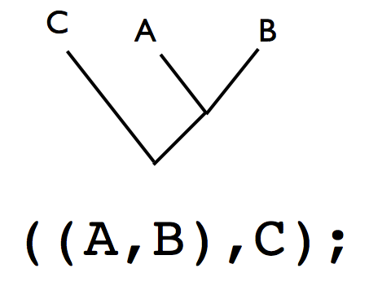
A most simplified example
http://www.embl.de/~seqanal/courses/molEvolSofiaMar2012/newickPhylipTreeFormat.pdf

Slide 38
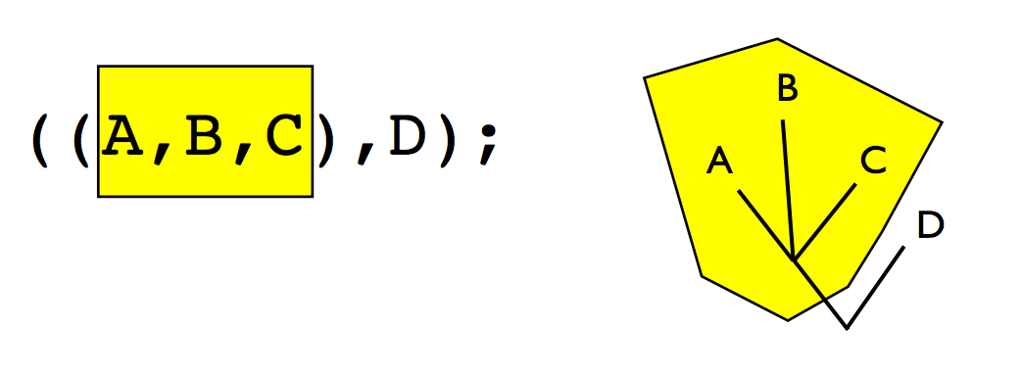
polytomy/multifurcation

Slide 39
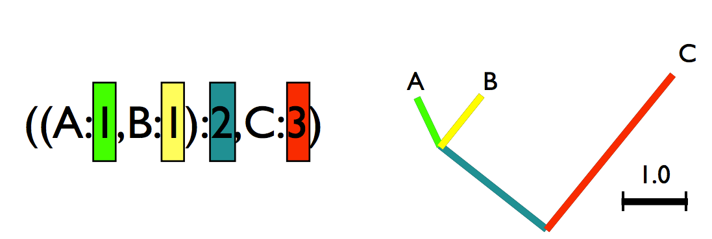
Add the branch length

Slide 40
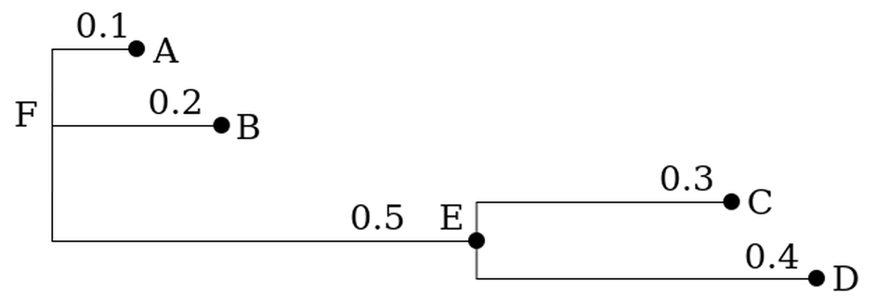
Add the internal node name
(A:0.1,B:0.2,(C:0.3,D:0.4)E:0.5)F;
E and F and inferred nodes, not from the input

Slide 41
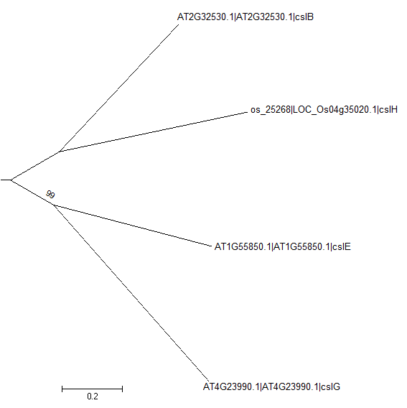
More often, do not add internal nodes but add bootstrap values
100
((cslB:0.57078988,cslH:0.55075714)1.000:0.26338963,(cslE:0.57830980,cslG:0.64691609)0.9900:0.23352951);

Slide 42
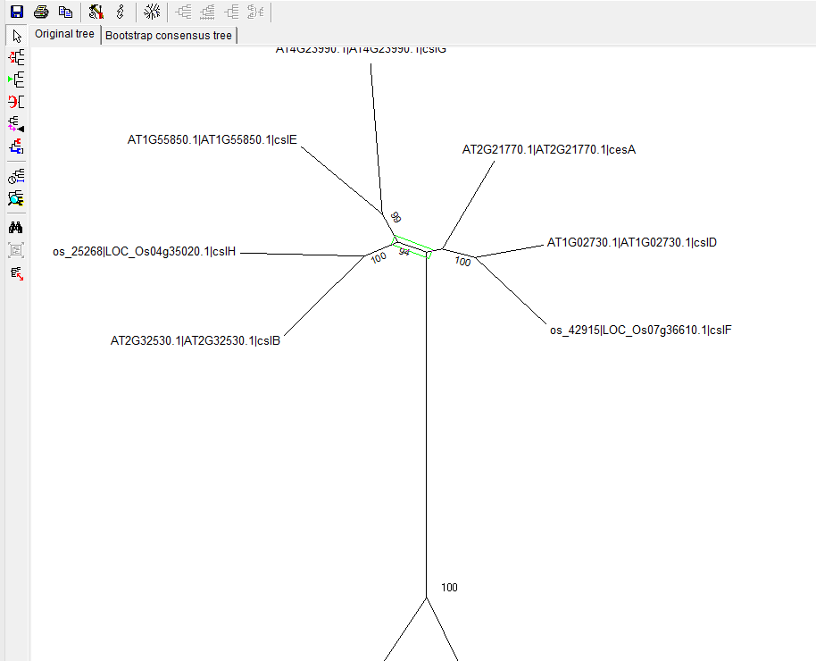
Click on this internal branch to select it
Then click
To excise a selected subtree (clade)

Slide 43
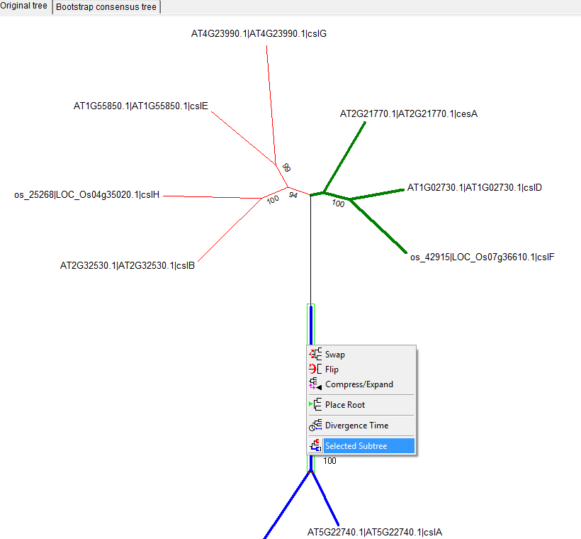
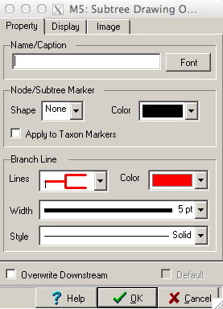
To color branches
Right click on the internal branch

Slide 44
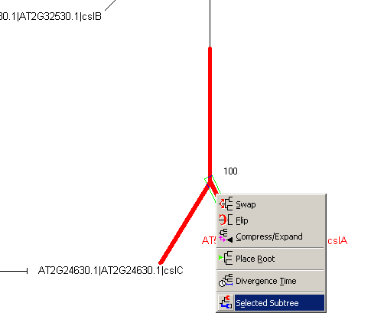
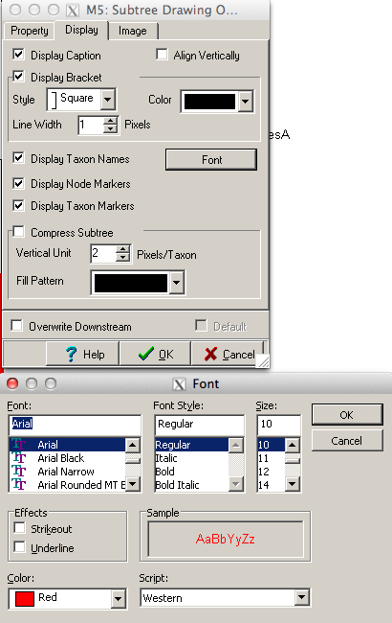
Change the fonts of leaf names

Slide 45
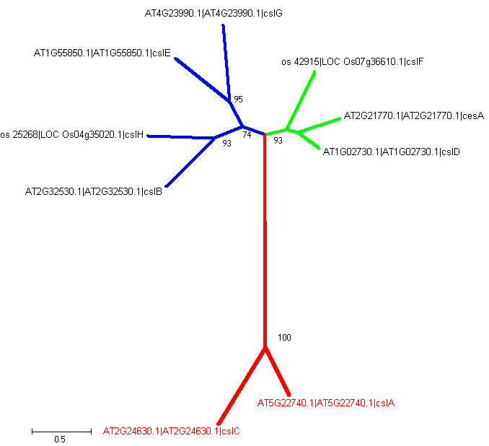
Manually color all branches/fonts

Slide 46
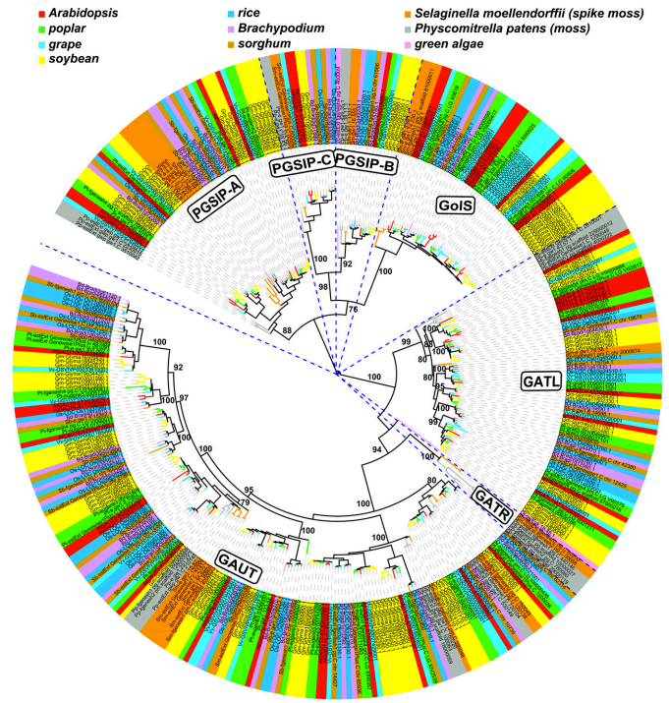
What if we have hundreds of genes?

Slide 47
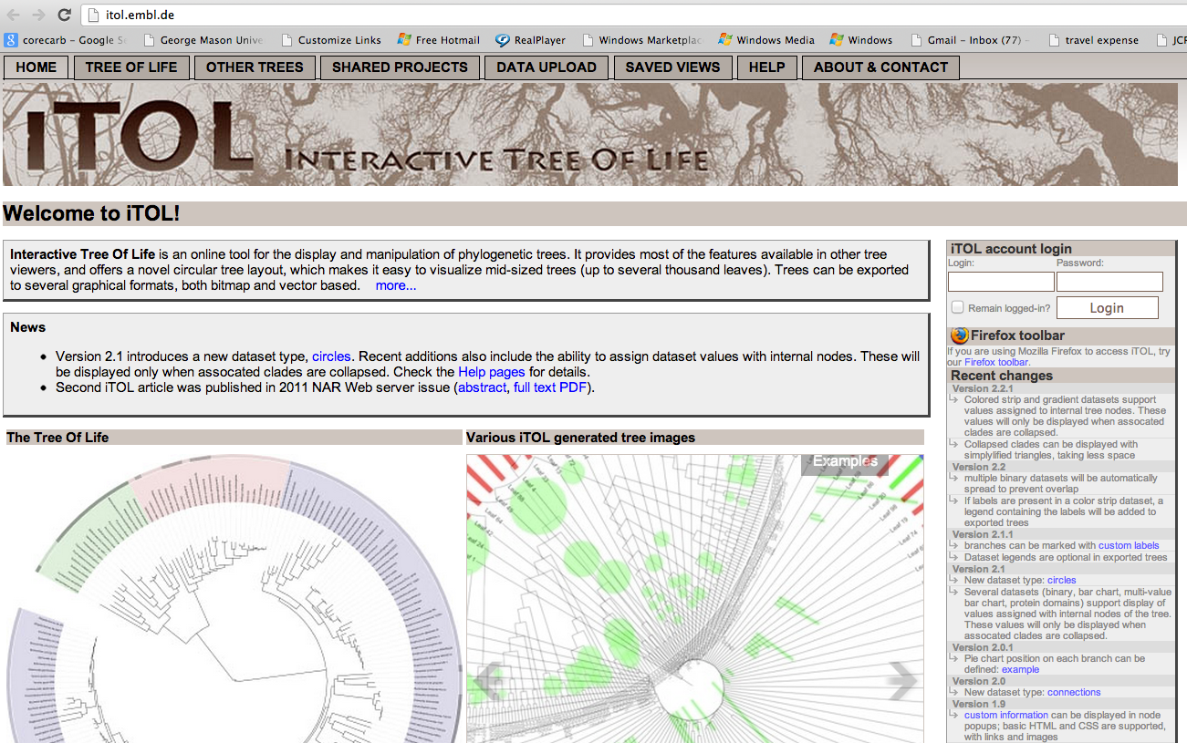
http://itol.embl.de/

Slide 48
Automatically define branch colors by uploading a color definition file
You can define your own colors for each branch/leaf separately. Use standard hexadecimal color notation (for example, #ff0000 for red)
http://www.w3schools.com/html/html_colors.asp
http://itol.embl.de/help/help.shtml

Slide 49
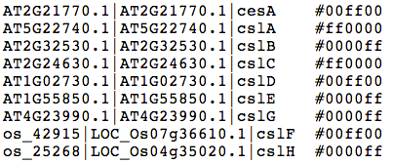
http://cys.bios.niu.edu/yyin/teach/PBB/cesa-pr.fa.col
((((AT2G32530.1|AT2G32530.1|cslB:0.57078988,os_25268|LOC_Os04g35020.1|cslH:0.55075714)0.9300:0.26338963,(AT1G55850.1|AT1G55850.1|cslE:0.57830980,AT4G23990.1|AT4G23990.1|cslG:0.64691609)0.9500:0.23352951)0.7400:0.19857786,(os_42915|LOC_Os07g36610.1|cslF:0.54191868,(AT2G21770.1|AT2G21770.1|cesA:0.37516472,AT1G02730.1|AT1G02730.1|cslD:0.22502015)0.6600:0.09521396)0.9300:0.18369951)1.0000:0.73286595,(AT5G22740.1|AT5G22740.1|cslA:0.44848889,AT2G24630.1|AT2G24630.1|cslC:0.75671710)1.0000:1.05517231);

Slide 50
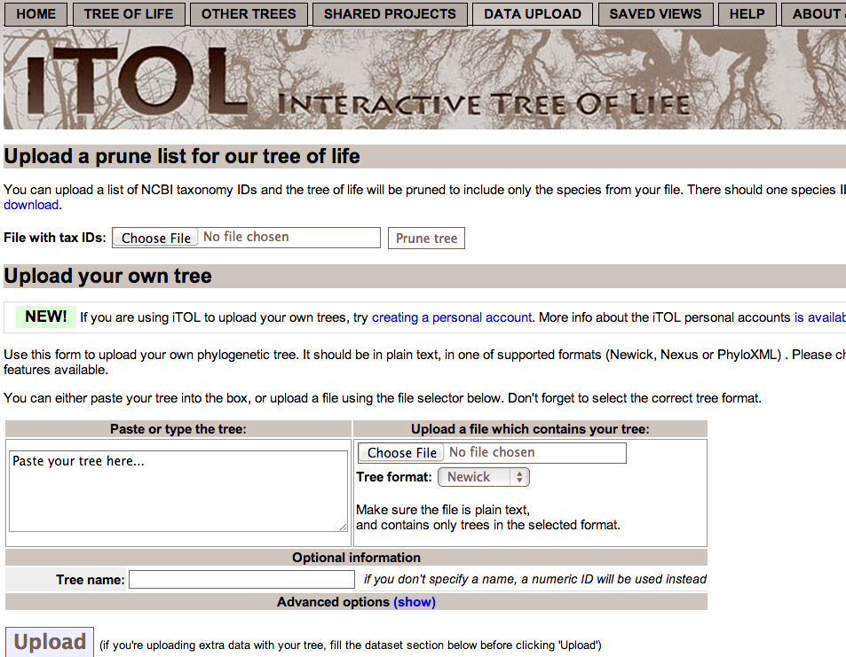

Slide 51
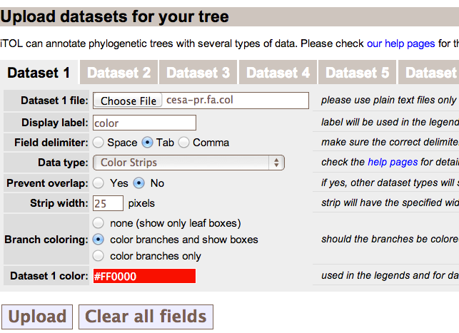
Upload color definition file

Slide 52
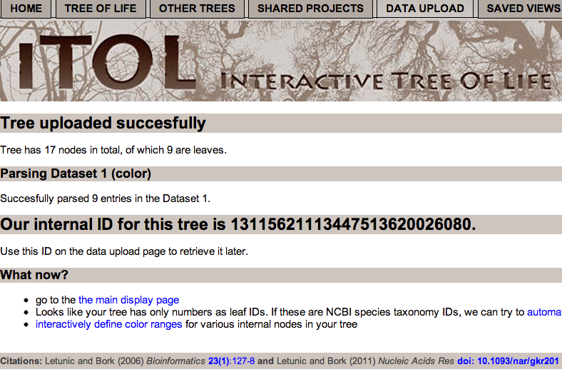

Slide 53
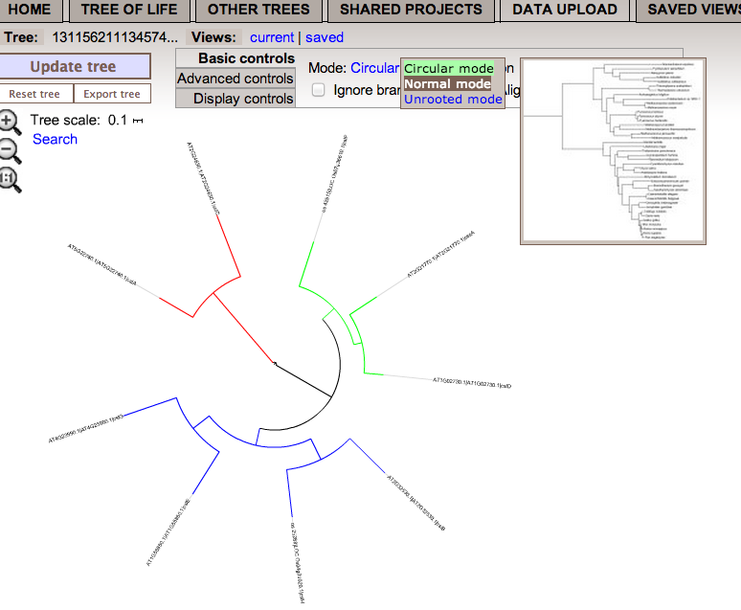

Slide 54
More options to display the phylogram

Slide 55
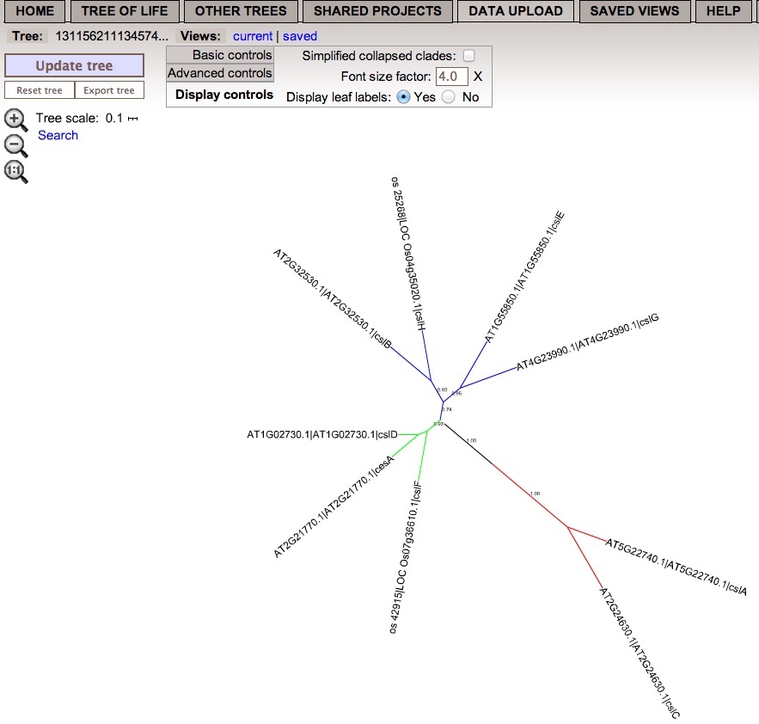
Export the tree

Slide 57
Excise a subtree

